Slide 1
Core HTML Tags
Text Formatting
  Headings (<h1> to <h6>), paragraphs (<p>), and line breaks (<br>).
  Bold (<b>), italic (<i>), and underline (<u>).
Lists
  Ordered (<ol>) and unordered (<ul>) lists.
  Adding list items (<li>).
Links and Anchors
  Creating links using <a href="URL">Text</a>.
Images
  Embedding images with <img src="URL" alt="description">.

Slide 2
Core HTML Tags
By default, links will appear as follows in all browsers:
An unvisited link is underlined and blue
A visited link is underlined and purple
An active link is underlined and red

Slide 3
Core HTML Tags
<b> - Bold text
<strong> - Important text
<i> - Italic text
<em> - Emphasized text
<mark> - Marked text
<small> - Smaller text
<del> - Deleted text
<ins> - Inserted text
<sub> - Subscript text
<sup> - Superscript text
<!-- This is a comment -->
<p>This is a paragraph.</p>

Slide 4
Core HTML Deep Dive: Forms, Tables, and Semantic Elements Tags

Slide 5
Tables — displaying structured data
When to use: Tabular data (schedules, price lists, exam marks). Not for layout.
Basic table tags:
<table> — container
<thead>, <tbody>, <tfoot> — optional sections
<tr> — table row
<th> — header cell (usually bold & centered)
<td> — data cell
scope attribute on <th> for accessibility (scope="col" or scope="row")

Slide 6
<table>
<caption>Semester 1 — Marks</caption>
<thead>
<tr>
<th scope="col">Roll No</th>
<th scope="col">Name</th>
<th scope="col">Math</th>
<th scope="col">Physics</th>
</tr>
</thead>
<tbody>
<tr>
<td>101</td>
<td>Asha</td>
<td>85</td>
<td>78</td>
</tr>
<tr>
<td>102</td>
<td>Rahul</td>
<td>90</td>
<td>82</td>
</tr>
</tbody>
</table>

Slide 7
Exercise: Build a timetable table for a 5-day week with 5 periods each day.
<!DOCTYPE html>
<html lang="en">
<head>
<meta charset="UTF-8">
<meta name="viewport" content="width=device-width, initial-scale=1.0">
<title>Weekly Timetable</title>
</head>
<body>
<h1>Weekly Timetable</h1>
<table border="1" cellspacing="0" cellpadding="8">
<caption><b>Class Timetable — Monday to Friday</b></caption>
<thead>
<tr>
<th>Day</th>
<th>Period 1<br>9:00–9:50</th>
<th>Period 2<br>10:00–10:50</th>
<th>Period 3<br>11:00–11:50</th>
<th>Period 4<br>12:00–12:50</th>
<th>Period 5<br>2:00–2:50</th>
</tr>
</thead>

Slide 8
<tr>
<th>Wednesday</th>
<td>CSS</td>
<td>Math</td>
<td>Break</td>
<td>Python</td>
<td>Workshop</td>
</tr>
<tr>
<th>Thursday</th>
<td>DBMS</td>
<td>HTML</td>
<td>Break</td>
<td>Project</td>
<td>Lab</td>
</tr>
<tr>
<th>Friday</th>
<td>English</td>
<td>Python</td>
<td>Break</td>
<td>CSS</td>
<td>Games</td>
</tr>
</tbody>
</table>
</body>
</html>
<tbody>
<tr>
<th>Monday</th>
<td>HTML</td>
<td>Math</td>
<td>Break</td>
<td>CSS</td>
<td>Lab</td>
</tr>
<tr>
<th>Tuesday</th>
<td>Python</td>
<td>DBMS</td>
<td>Break</td>
<td>Project</td>
<td>English</td>
</tr>

Slide 9
What Are Semantic Tags?
Semantic tags are special HTML elements that tell both the browser and humans what kind of content is inside them.
In simple words:
A semantic tag gives meaning to the content inside it.
Example:
<header>Welcome to My Website</header>
Why Were Semantic Tags Introduced?
Before semantic tags, developers used <div> and <span> for almost everything.
That made HTML code look messy and hard to understand — something like this
<div id="top"></div>
<div id="main"></div>
<div id="bottom"></div>
You can’t easily guess what’s inside each section.
So HTML5 introduced semantic tags to make code more meaningful and organized.

Slide 10
Why Use Semantic Tags?
Clarity: Makes the HTML code easier to read and understand.
SEO Benefits: Helps search engines understand webpage structure.
Accessibility: Improves compatibility with screen readers for visually impaired users.
Future-Proofing: Aligns with modern web development standards.

Slide 11
List of Common Semantic Tags
Semantic Tag | Meaning / Use | Example
<header> | Top section of a page or article | Logo, title, navigation links
<nav> | Navigation area | Menus or links to other pages
<main> | Main content area | Central part of your webpage
<section> | A logical section of content | “About Us”, “Courses”, etc.
<article> | Independent piece of content | Blog post, news article
<aside> | Side content | Sidebar, ads, tips
<footer> | Bottom section | Copyright, contact info
<figure> and <figcaption> | Image with caption | Picture with a short description

Slide 12
Why Are Semantic Tags Important?
Makes code easier to read and maintain
  Anyone (even beginners) can look at the HTML and understand the structure quickly.
Improves SEO (Search Engine Optimization)
Search engines (like Google) can understand your content better, which helps your site appear higher in search results.
Better structure and browser performance
Browsers can render (display) your page more efficiently when structure is clear.

Slide 13
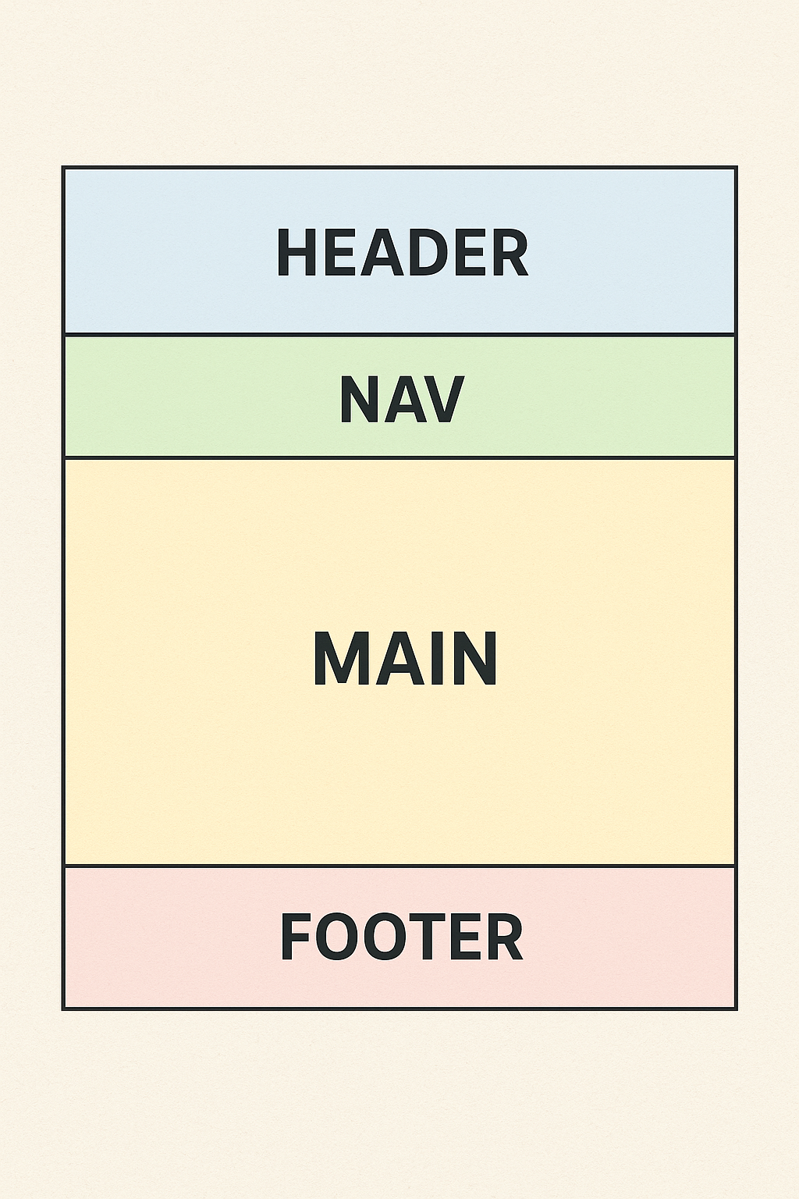

Slide 14
Detailed Explanation with Examples
1. <header>
Purpose: Represents the header of a page or section.Typical Use: Contains a logo, title, or navigation menu.
<header>
<h1>Welcome to My Website</h1>
<nav>
<a href="#home">Home</a>
<a href="#about">About</a>
<a href="#contact">Contact</a>
</nav>
</header>

Slide 15
2. <nav>
Purpose: Holds navigation links.Typical
Use: Menus or site navigation.
<nav>
<ul>
<li><a href="index.html">Home</a></li>
<li><a href="about.html">About</a></li>
<li><a href="services.html">Services</a></li>
</ul>
</nav>

Slide 16
3. <main>
Purpose: Contains the main content of the webpage.
Typical Use: Focuses on the unique content of the page.E
<main>
<h2>About Us</h2>
<p>Our mission is to make learning simple and accessible.</p>
</main>

Slide 17
4. <section>
Purpose: Groups related content.
Typical Use: Dividing content into logical chunks.
<section>
<h2>Our Services</h2>
<p>We offer web development, training, and more.</p>
</section>
5. <article>
Purpose: Contains self-contained, reusable content.
Typical Use: Blog posts or articles.
<article>
<h2>Top 10 Programming Languages</h2>
<p>Discover the best programming languages in 2025.</p>
</article>

Slide 18
6. <aside>
Purpose: Holds content indirectly related to the main content.
Typical Use: Sidebars, ads, or additional info.
<aside>
<h3>Did You Know?</h3>
<p>HTML was created in 1993!</p>
</aside>
7. <footer>
Purpose: Represents the footer of a page or section.
Typical Use: Contains copyright, privacy policy, or contact details.
<footer>
<p>&copy; 2025 My Website. All rights reserved.</p>
</footer>

Slide 19
8. <figure> and <figcaption>
Purpose: Displays media content with captions.
Typical Use: Adding images or diagrams with descriptions.
<figure>
<img src="landscape.jpg" alt="Beautiful Landscape">
<figcaption>A breathtaking view of the mountains.</figcaption>
</figure>
9. <mark>
Purpose: Highlights important text.
Typical Use: Emphasizing keywords or terms.
<p>The <mark>deadline</mark> for the project is next Friday.</p>

Slide 20
<!DOCTYPE html>
<html lang="en">
<head>
<meta charset="UTF-8">
<meta name="viewport" content="width=device-width, initial-scale=1.0">
<title>Semantic Tags Example</title>
</head>
<body>
<header>
<h1>Welcome to My Website</h1>
<nav>
<a href="#home">Home</a>
<a href="#about">About</a>
<a href="#contact">Contact</a>
</nav>
</header>
<main>
<section>
<h2>About Us</h2>
<p>We are dedicated to making learning simple and fun.</p>
</section>
<article>
<h2>Blog Post</h2>
<p>This is an example of a blog post using semantic tags.</p>
</article>
</main>
<aside>
<h3>Sidebar</h3>
<p>Additional information goes here.</p>
</aside>
<footer>
<p>&copy; 2025 My Website. All rights reserved.</p>
</footer>
</body>
</html>

Slide 21
Benefits of Semantic Tags
Easier to Understand: Semantic tags make it clear what each section of the webpage does.
Better Accessibility: Helps screen readers navigate the page effectively.
Improved SEO: Search engines can easily identify key parts of your content.
Standardized Structure: Aligns with HTML5 best practices.

Slide 22
Forms and Inputs
Creating a Simple Form
    Form structure: <form>, <input>, and <button>.
Input Types
    Text, email, password, date, and more.
Labels and Placeholders
    Adding labels with <label> and placeholders with placeholder attribute.
Form Validation
    Basic HTML5 validation attributes (required, maxlength, pattern).

Slide 23
Basic Form Structure
<form>: This tag wraps all the elements of the form and specifies where the data is sent (via the action attribute).
<input>: Used to collect various types of user input (text, email, passwords, etc.).
<button>: Used to submit the form or trigger any custom action.

Slide 24
<!DOCTYPE html>
<html lang="en">
<head>
<meta charset="UTF-8">
<meta name="viewport" content="width=device-width, initial-scale=1.0">
<title>Simple Form</title>
</head>
<body>
<h1>User Registration Form</h1>
<form action="/submit" method="post">
<!-- Text Input -->
<label for="name">Name:</label>
<input type="text" id="name" name="name" placeholder="Enter your name" required>
<br><br>
<!-- Email Input -->
<label for="email">Email:</label>
<input type="email" id="email" name="email" placeholder="Enter your email" required>
<br><br>
<!-- Password Input -->
<label for="password">Password:</label>
<input type="password" id="password" name="password" placeholder="Enter your password" required>
<br><br>
<!-- Submit Button -->
<button type="submit">Register</button>
</form>
</body>
</html>

Slide 25
Breaking Down the Example
<form action="/submit" method="post">
  action: Specifies where the form data will be sent.
  method: Defines how the data is sent (GET or POST).
<input type="text">
  Used for plain text input, like names or addresses.
  placeholder: Provides a hint about what to input.
<input type="email">
  Ensures the user enters a valid email address.
<input type="password">
  Masks the characters entered for security.
<button type="submit">
  Triggers the form submission.

Slide 26
MINI PROJECT
Create a “Workshop Signup” page that contains:
A semantic header with page title and nav.
A registration <form> with:
Full name (required)
Email (required)
Course preference (radio buttons)
Skills (checkboxes)
Short bio (textarea)
Submit button
A sample <table> below showing “Last 3 participants” with Name, Course, Status.
Footer with contact email.

