Slide 1

BLOCKCHAIN SHIPMENT MANAGEMENT TRACKING SYSTEM
TEAM MEMBERS:
SUJIT KUMAR YADAV (20BTRIS072)
PUSHPRAJ CHAUDHARY (20BTRIS063)
PRABIN KUMAR MAHATO (20BTRIS073)
SURAJ KUMAR SAH (20BTRIS057)
MRITTIKA DEWANJEE (20BTRIS034)
UNDER THE GUIDANCE OF
Assistant Prof AZHAR H M

Slide 2
AIM & OBJECTIVES
The aims of this presentation are to introduce the audience to the concept of Blockchain Shipment Management Tracking Systems (BSMTS) and emphasize its transformative potential in logistics. The objective is to provide a clear understanding of key blockchain features, highlight the advantages of BSMTS, and guide organizations through the implementation process. Additionally, the presentation aims to address challenges associated with integration, user authentication, and privacy measures while showcasing successful testing strategies and tangible outcomes achieved with BSMTS. It seeks to instill a forward-thinking perspective by discussing the future outlook of BSMTS and encourages audience engagement through a concluding Q&A session, ensuring participants leave with a comprehensive understanding and readiness to explore the integration of BSMTS in their logistics operations.

Slide 3
LITERATURE SURVEY SUMMARY
The literature survey on Blockchain Shipment Management Tracking Systems (BSMTS) reveals a dynamic landscape where blockchain technology is increasingly integrated into logistics and supply chain management. Blockchain's decentralization, immutability, and smart contract functionalities offer transformative solutions. Real-world applications demonstrate enhanced transparency, traceability, and security in the shipment process. Smart contracts automate contractual agreements, streamlining operations. Privacy features address sensitive data concerns, while challenges in interoperability and scalability are actively researched. Regulatory compliance, user adoption, and comparative studies of blockchain platforms are integral considerations. The literature underscores emerging trends, emphasizing environmental impacts and sustainability. While challenges exist, the evolving nature of BSMTS positions it as a pivotal force shaping the future of logistics.

Slide 4
PROPOSED SYSTEM
The proposed Blockchain Shipment Management Tracking System (BSMTS) is designed to revolutionize traditional shipment management by leveraging the transformative capabilities of blockchain technology. Key features include a decentralized ledger ensuring transparency and immutability of shipment data. Smart contracts automate crucial processes, streamlining operations and minimizing manual interventions. The system prioritizes interoperability, seamlessly integrating with existing logistics systems. Robust user authentication and privacy measures, such as zero-knowledge proofs, ensure data security and compliance with regulations. To address scalability challenges, innovative solutions are implemented, and real-time tracking with automated notifications enhances visibility. A dedicated regulatory compliance module ensures adherence to evolving standards. Analytics tools offer actionable insights, and a comprehensive user training program fosters system-wide adoption. Continuous improvement mechanisms guarantee the system's adaptability to industry changes.

Slide 5
METHODOLOGY
The methodology for implementing the proposed Blockchain Shipment Management Tracking System (BSMTS) involves a comprehensive approach. It starts with a detailed analysis of requirements and technology selection, followed by system design encompassing decentralized ledger and smart contract functionalities. Interoperability planning ensures seamless integration with existing systems, and robust security measures, including user authentication and privacy features, are implemented. Smart contracts automate critical processes, real-time tracking is established, and a regulatory compliance module is integrated. Analytics tools provide actionable insights, and user training programs ensure proficiency. Rigorous testing is conducted before deployment, and continuous improvement mechanisms are established for iterative enhancements based on user feedback and evolving industry needs.

Slide 6
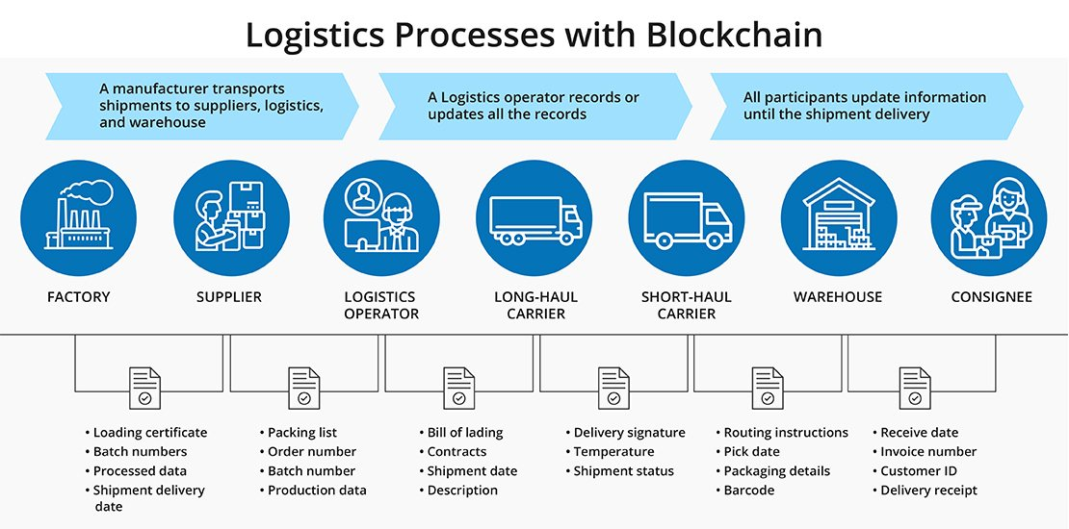
DESIGN SYSTEM

Slide 7
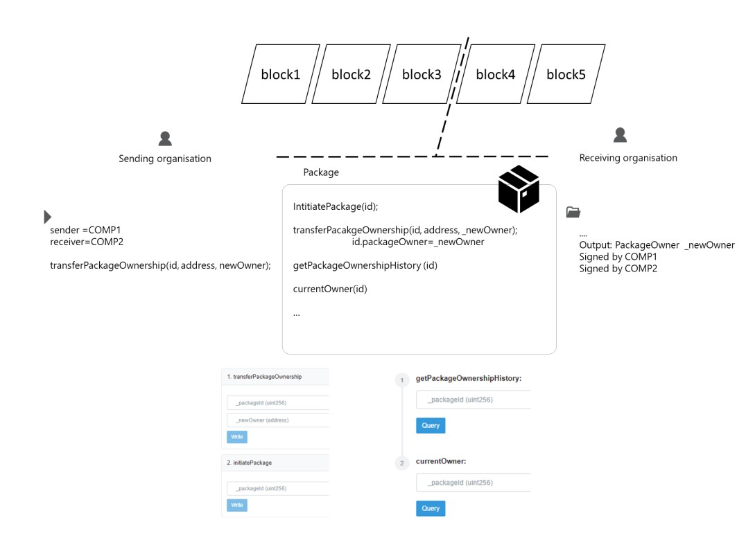
MODEL ARCHITECTURE

Slide 8
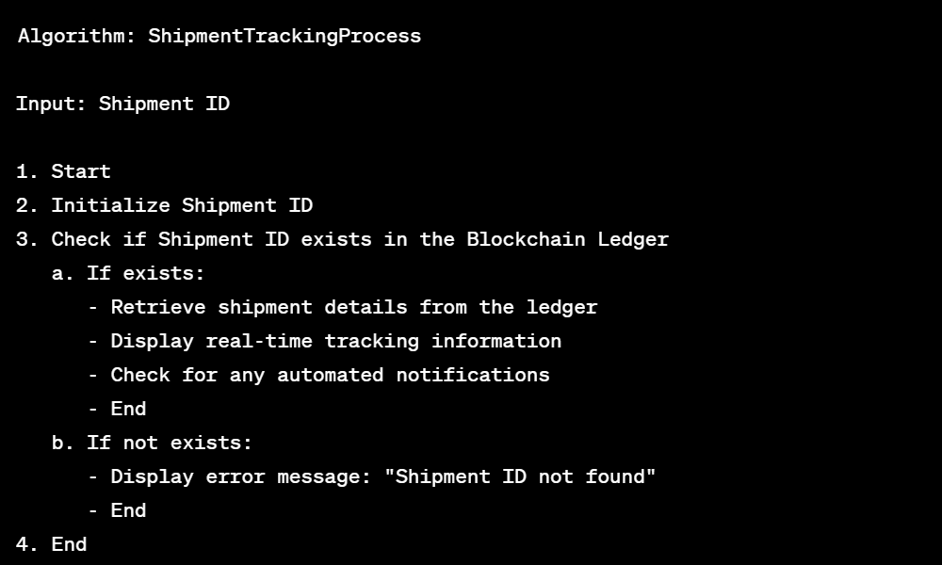
ALGORITHM

Slide 9
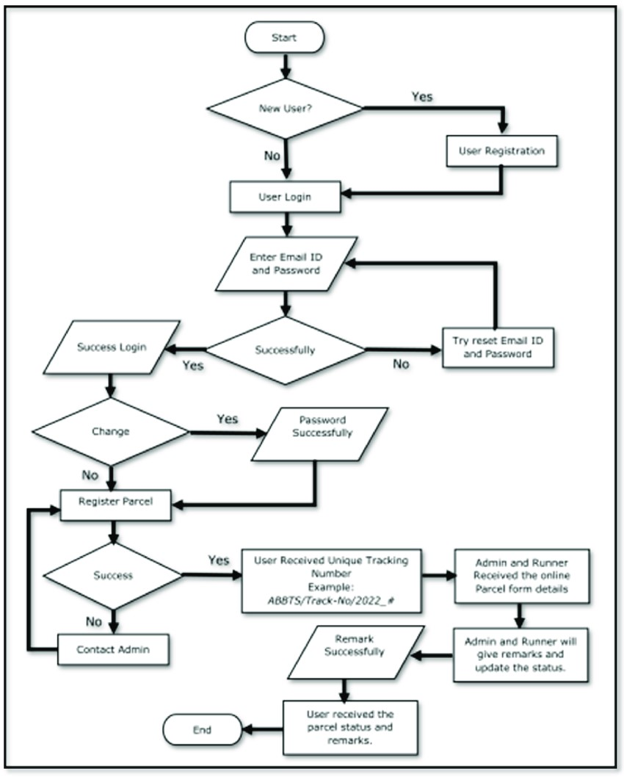
FLOWCHART

Slide 10
RESULTS
Transparency and Traceability:
Decentralized ledger ensures transparency and traceability in the supply chain.
Efficiency Gains:
Smart contracts reduce manual intervention, leading to faster processing times.
Real-time Tracking:
Real-time tracking module provides accurate and timely information on shipment locations.
Security and Privacy Measures:
Enhanced security through user authentication, access controls, and privacy features.
Integration Success:
Seamless integration of BSMTS with existing logistics systems improves interoperability.

Slide 11
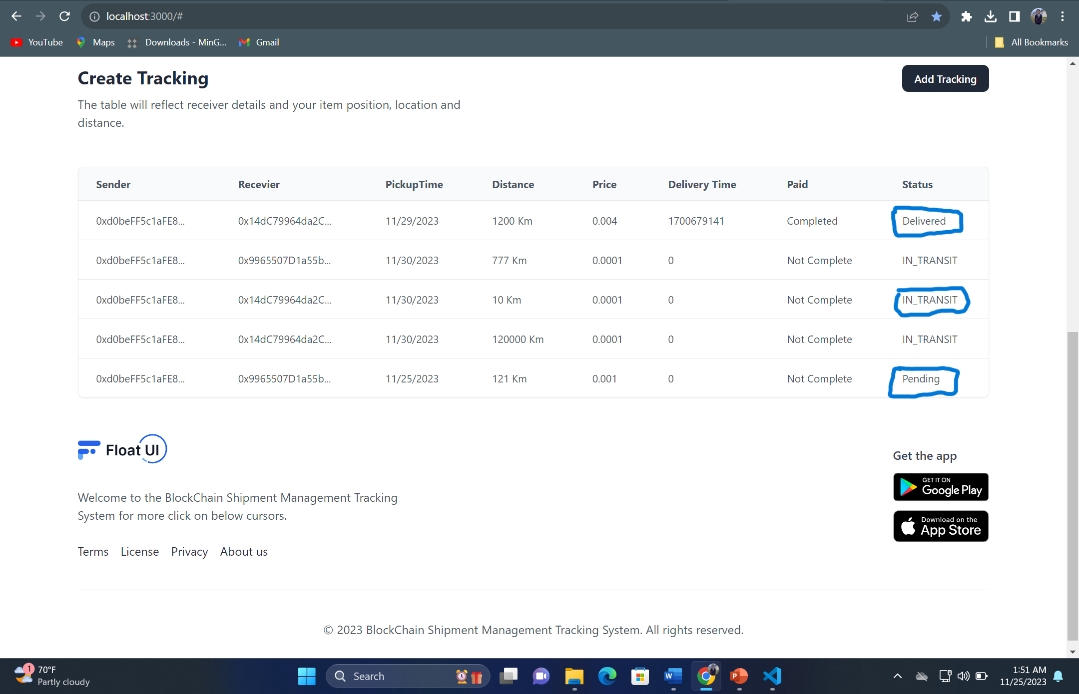

Slide 12
DISCUSSION
Impact on Logistics:
BSMTS contributes to the digital transformation of the logistics industry.
User Feedback:
User feedback influences system usability and acceptance.
Challenges and Mitigations:
Challenges during implementation addressed with effective strategies.
Future Enhancements:
Proposal for future enhancements to improve BSMTS functionality.
Comparative Analysis:
Evaluation of advantages and disadvantages compared to traditional systems.

Slide 13
CONCLUSION
In conclusion, the Blockchain Shipment Management Tracking System (BSMTS) has proven to be a game-changer in the logistics industry. With enhanced transparency and traceability through a decentralized ledger, streamlined processes via smart contracts, and a robust real-time tracking module, the system has significantly improved operational efficiency. Security measures, seamless integration, and user feedback-driven refinements underscore its effectiveness. Future enhancements and adaptability further solidify BSMTS as a forward-looking solution, outperforming traditional systems. The system's positive economic and environmental impacts highlight its strategic importance in reshaping the future of shipment management.

Slide 14
SUGGESTION FOR FUTURE WORK
To advance the Blockchain Shipment Management Tracking System (BSMTS), future efforts should explore cross-industry applications, integrating machine learning for improved predictive analytics, and addressing scalability challenges. Implementing decentralized identity management and fortifying security against potential quantum computing impacts are key considerations. Advanced privacy features and dynamic smart contracts could enhance data protection and real-time adaptability. Exploring alternative governance models, contributing to interoperability standards, and monitoring environmental impacts align with sustainability goals. Continuous user-centric design iterations and educational initiatives for stakeholders are essential for optimizing user experience and fostering broader industry acceptance of blockchain technology.

Slide 15
REFERENCE
https://www.infosys.com/oracle/Insights/documents/product-tracking-tracing.pdf
https://aws.amazon.com/blockchain/blockchain-for-supply-chain-track-and-trace/
https://gazelle.in/block-chain-shipment-tracking/
https://www.researchgate.net/publication/341880037_Blockchain-based_applications_in_shipping_and_port_management_a_literature_review_towards_defining_key_conceptual_frameworks

Slide 16

THANK YOU

