Slide 1
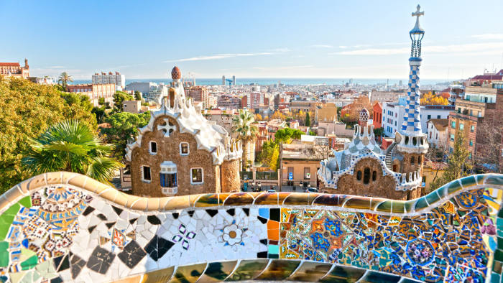
SPAIN
Presented By:
Pushpraj & Abhishek

Slide 2

SPAIN
Capital: Madrid
Official Language: Spanish
Religion:
Catholicism-67%
Other – 3.1%
No Religion-27.2%
Currency: Euro(€)
Area:550,990 sq.km
Population:46,733,038

Slide 3
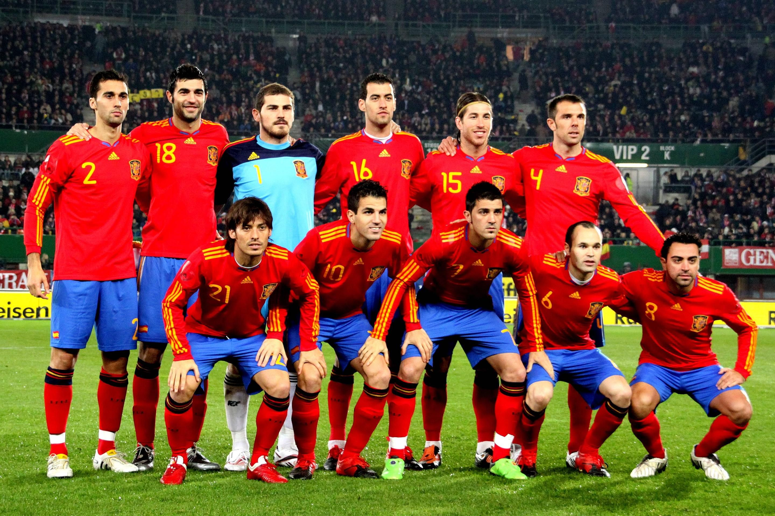
SPORTS
Sport in Spain in the second half of the 20th century has always been dominated by football.
Real Madrid and Barcelona are famous clubs of Spain.
Other popular sport activities include basketball, tennis, cycling, handball, motorcycling, Formula One, water sports, rhythmic gymnastics, golf, bullfighting and skiing.

Slide 4
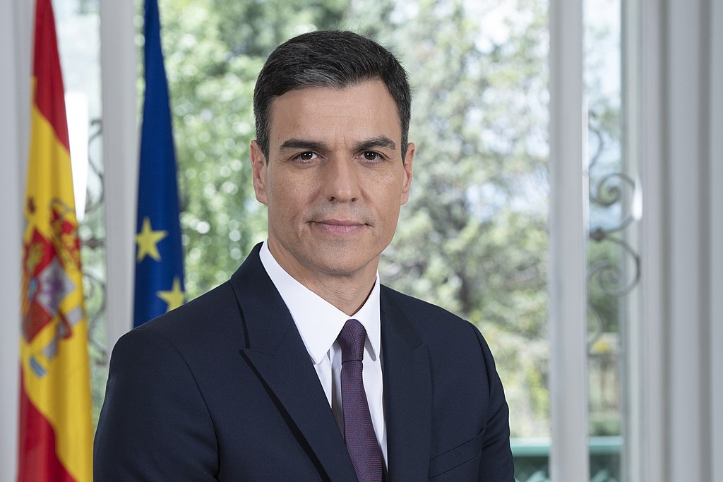
GOVERNMENT
Head of State
King Felipe VI since 19 June 2014
Head of Government
Prime Minister of Spain elected 1 June 2018.
Cabinet
Council of Minister designated by the Prime Minister
Pedro Sanchez

Slide 5


GREETINGS
Men who are friends will frequently hug, while women will give a slight embrace and kiss on each cheek.
Buenos dias – good morning
Adios-Goodbye

Slide 6
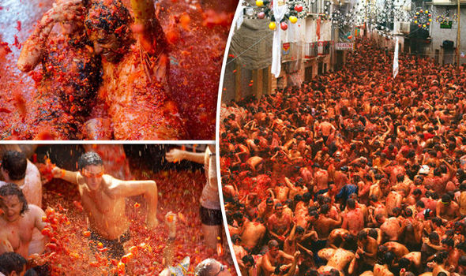
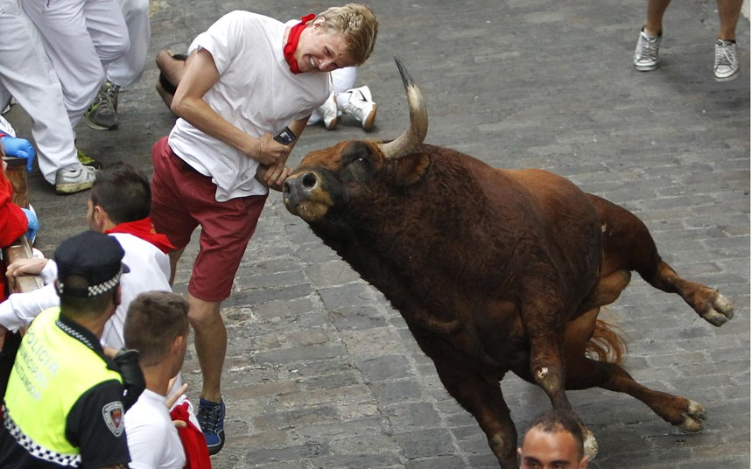
CELEBRATIONS AND FESTIVALS
TOMATINA
BULL RUN

Slide 7
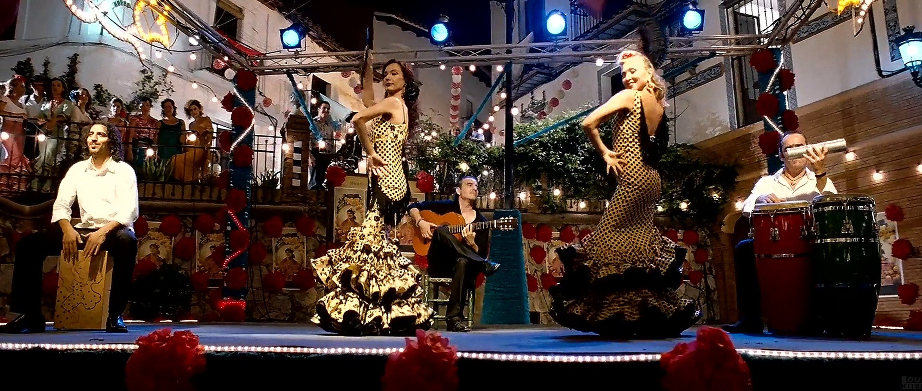
DANCE
Flamenco
Jota
Sardana
Flamenco performed by a mixture of singing, guitar playing, dancing, finger snapping and hand clapping.

Slide 8
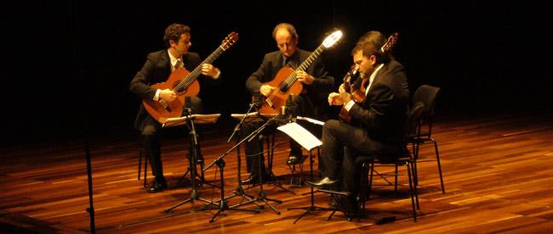
MUSIC
Music of all kinds, from flamenco to rock, jazz to classical, is extremely popular in Spain and an essential ingredient of any festival or fiesta.
Spain has a wealth of traditional folk music and dance, particularly flamenco and classical guitar, which are popular throughout the country.

Slide 9
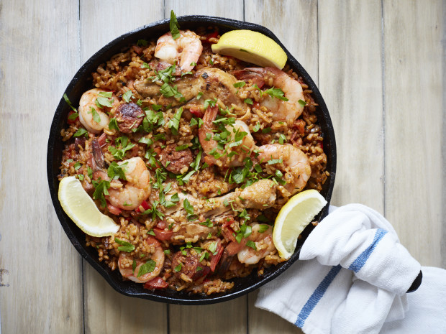
FOOD
Paella Valenciana originated in the fields of Valencia, where country folk mixed rice with rabbit, snails, and vegetables and cooked it over an open fire.
It has evolved into Spain's most well-known dish, in which fish, shellfish, meat, pork, and chicken might be variously used

Slide 10
FAMILY & ROLE TOWARDS FAMILY
The family is the centre of Spanish life
Strong ties with extended family
Christmas and birthdays are celebrated with large gatherings of family members

Slide 11
CHILD RAISING
The Spanish education system is compulsory and free for all children aged between 6 and 16 years.
It is supported by national government .
Children in spain have free healthcare coverage under their parent or guardian´s insurance till the age 15.

