Slide 1
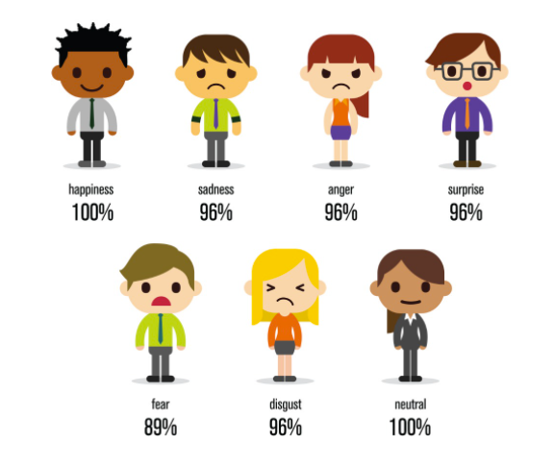
Facial Expression Recognition using CNN
Data 606 Capstone Project - Spring 2021

Slide 2
Introduction :
Importance of Facial expression recognition.
Emotions are a powerful tool in communication and one way that humans show their emotions is through their facial expressions.
Facial recognition, the challenge.
Uses of Facial Recognition.
Notes:
Facial expressions are an essential factor in understanding the emotion of a person. These days emotions are required to study many things, including anger, love, hatred, etc. Sometimes facial expressions are the key to communicate few things, including agreement and disagreement. In this project, I am trying to implement a model that would understand facial expressions. Emotions are a powerful tool in communication and one way that humans show their emotions is through their facial expressions. One of the challenging and powerful tasks in social communications is facial expression recognition, as in non-verbal communication, facial expressions are key.
The automated analysis of facial expressions has been widely used in different research areas, such as biometrics or emotional analysis. Special importance is attached to facial expressions in sign language, since they help to form the grammatical structure of the language and allow for the creation of language disambiguation, and thus are called Grammatical Facial Expressions.

Slide 3
Aim of the project :
Recognize the facial expressions of a human face
Model that would understand facial expressions
Convolutional Neural Network (CNN), is used to determine the output accurately
Translated into a set of features
The large volumes of data can be segregated into relevant groups.

Slide 4
Data Extraction:
The data is extracted from https://archive.ics.uci.edu/ml/datasets/Grammatical+Facial+Expressions https://www.kaggle.com/jonathanoheix/face-expression-recognition-dataset
These datasets consist of images with datapoint files and also the images with different facial expressions.
The data is divided into training and validation with 7 groups each with more than 3000 images in each group with less than 2KB of image size.

Slide 5
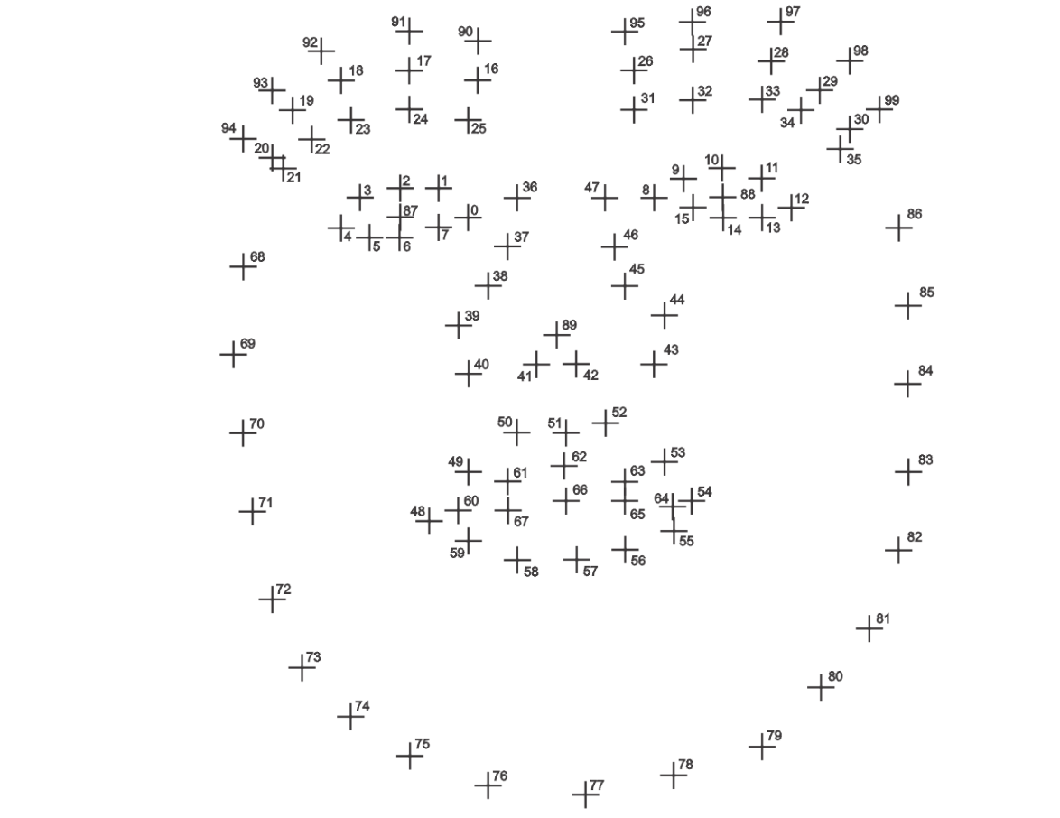

Slide 6
References:
Facial expression recognition with convolutional neural networks. (n.d.). Retrieved February 16, 2021, from https://ieeexplore.ieee.org/abstract/document/9031283
Dhami, D. (2018, December 21). Face Recognition/Special applications of CNN. Retrieved February 16, 2021, from https://medium.com/@dhartidhami/face-recognition-special-applications-of-cnn-51b928a3cd40
UCI machine Learning Repository: Grammatical facial Expressions data set. (n.d.). Retrieved February 18, 2021, from https://archive.ics.uci.edu/ml/datasets/Grammatical+Facial+Expressions
S. Peng, J., OS. Anies, M., Dean, D., A. Savran, B., Bookstein, F., A. Colombo, C., . . . LE. Peterson, M. (1970, January 01). 3-Dimensional facial expression recognition in human using multi-points warping. Retrieved February 18, 2021, from https://bmcbioinformatics.biomedcentral.com/articles/10.1186/s12859-019-3153-2

Slide 7


