Slide 1
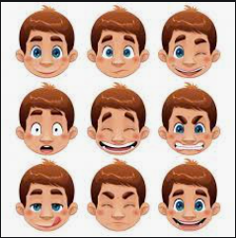
Facial Expression Recognition using CNN
Phase 2
Data 606 Capstone Project - Spring 2021

Slide 2
Data Loading and Preprocessing:
The images are being segregated based on different emotions.
Trained a convolutional neural network to classify the image with respect to the emotion.
Used a dataset containing different facial expressions of different human beings.
Initially downloaded the data and extracted the images, organize the images into different folders and train the model.
Make and evaluate the test predictions.
Created a bunch of destination folders according to the directory convention.
Outer folder (data) with subfolders: train, validation, and test. Within each of those folders, there is a folder named happy, neutral, sad, anger, etc.

Slide 3
Convolutional Neural Network:
A Convolutional Neural Network (ConvNet/CNN) is a Deep Learning algorithm that can take in an input image, assign importance (learnable weights and biases) to various aspects/objects in the image, and be able to differentiate one from the other.
The pre-processing required in a ConvNet is much lower as compared to other classification algorithms.
While in primitive methods filters are hand-engineered, with enough training,
ConvNets have the ability to learn these filters/characteristics.

Slide 4
Model Training :
Using the Keras framework, the model is created so as to get it trained using the segregated dataset, the evaluation metrics are calculated to find the accuracy of the model.
Ran the model for 20 epochs, the learning rate decreases with each epoch, allowing us to get closer and closer to the optimum.
ReLu speeds up training. There is evidence that having the “mean activation” be close to 0 makes training faster.

Slide 5
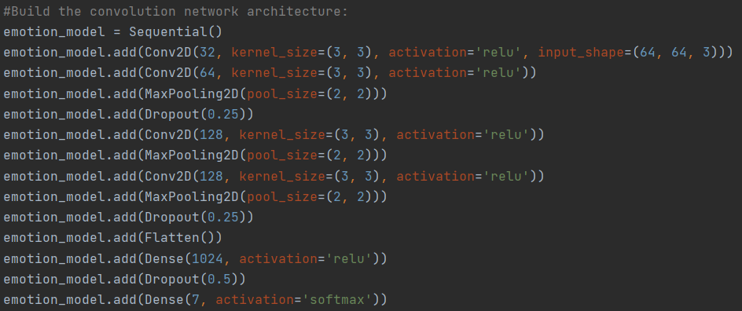
CNN Architecture :
The below is the model to identify the facial expressions of a person, here 4 CNN layers have been used with an activation function i.e., ReLu.

Slide 6
Predictions on Test data:
Testing the model by feeding the test data and evaluate the performance of the model based on the output predicted by the model.
Initially, the model was able to perform the correct output for only a few of the images, but later the weights and few activation functions have been adjusted.
After few trials, the model was able to provide 86% accuracy for the test data.

Slide 7
References:
Facial expression recognition with convolutional neural networks. (n.d.). Retrieved February 16, 2021, from https://ieeexplore.ieee.org/abstract/document/9031283
Dhami, D. (2018, December 21). Face Recognition/Special applications of CNN. Retrieved February 16, 2021, from https://medium.com/@dhartidhami/face-recognition-special-applications-of-cnn-51b928a3cd40
UCI machine Learning Repository: Grammatical facial Expressions data set. (n.d.). Retrieved February 18, 2021, from https://archive.ics.uci.edu/ml/datasets/Grammatical+Facial+Expressions
S. Peng, J., OS. Anies, M., Dean, D., A. Savran, B., Bookstein, F., A. Colombo, C., . . . LE. Peterson, M. (1970, January 01). 3-Dimensional facial expression recognition in human using multi-points warping. Retrieved February 18, 2021, from https://bmcbioinformatics.biomedcentral.com/articles/10.1186/s12859-019-3153-2
Ching, C. (2019, March 29). How to build an image classifier for waste sorting. Retrieved April 04, 2021, from https://towardsdatascience.com/how-to-build-an-image-classifier-for-waste-sorting-6d11d3c9c478
Saha, S. (2018, December 17). A comprehensive guide to convolutional neural networks - the eli5 way. Retrieved April 04, 2021, from https://towardsdatascience.com/a-comprehensive-guide-to-convolutional-neural-networks-the-eli5-way-3bd2b1164a53

