Slide 1
Facial Expression Recognition using CNN
(Capstone project 606)
Pushyami Reddy Ginnavaram
(HZ98176)

Slide 2
Build a CNN Architecture:
The initial step involved in setting up the model is to initialize the training and validation generators.
The generator used for this data is ImageDataGenerator, and then the images are rescaled to 1./255 is to transform every pixel value from range [0,255] -> [0,1]. Scaling every image to the same range [0,1] will make images contribute more evenly to the total loss.
Building a model (emotion model) using Convolutional Neural Networks, the architecture includes input and output layers with many hidden computational layers.
The 2D convolutional layer with kernel size (3,3), and an activation layer ReLU (Rectified Linear Unit) is added

Slide 3
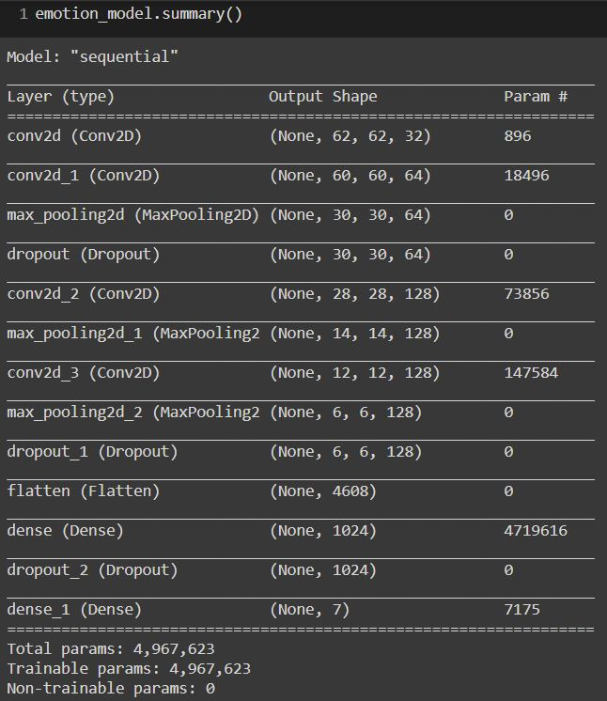
Model Summary:
The Model for the built CNN model is summarized
The total number of parameters is 4,967,623
Because every hidden unit I have 896 input weights
one weight is a bias with the connection
This means that every hidden unit gives back 896 parameters.
Hidden layers and bias important to produce significant results.

Slide 4
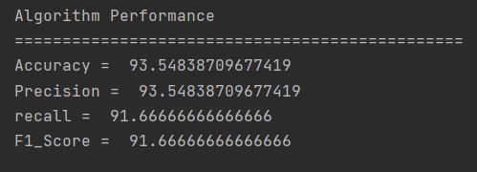
Model Performance:
Flatten performs the input role. Next is Dense — densely connected layer with the value of the output space (64) and ReLU activation function. It follows Dropout, which is preventing overfitting. Overfitting is the phenomenon when the constructed model recognizes the examples from the training sample, but works relatively poorly on the examples of the test sample. Dropout takes values between 0 and 1. Тhe last fully connected layer has 1 output and a Sigmoid activation function.

Slide 5
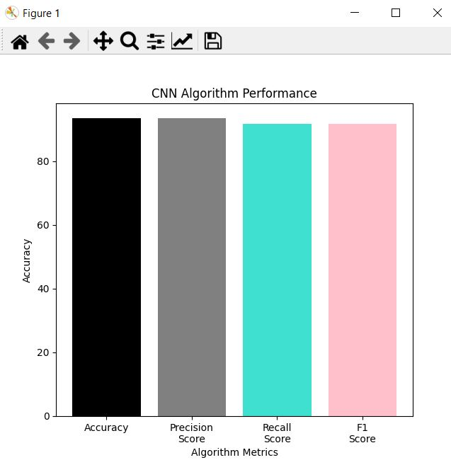
Visualization
The model is being trained with the given training dataset
Learning rate of 0.01 and the number of epochs given is 50.
Using Python GUI, the evaluation metrics are being visualized.
The accuracy, Precision score, Recall score, F1 score.
The model is performing with an accuracy of 93.5%

Slide 6
Graphical User Interface using Python
PyQt5 is a python library used for building the graphical user interface, it is a set of Python bindings for Qt v5, which is a set of C++ libraries to implement APIs at a high level for mobile and desktop applications.
PyQt5 is based on Qt v5 and includes classes that cover Graphical User Interfaces as well as XML handling, network communication, regular expressions, threads, SQL databases, multimedia, web browsing, and other technologies available in Qt. PyQt5 implements over one thousand of these Qt classes in a set of Python modules, all of which are contained within a top-level Python package called PyQt5.
PyQt5 is compatible with Windows, Unix, Linux, macOS, iOS, and Android. This can be an attractive feature if you’re looking for a library or framework to develop multi-platform applications with a native look and feel on each platform.

Slide 7
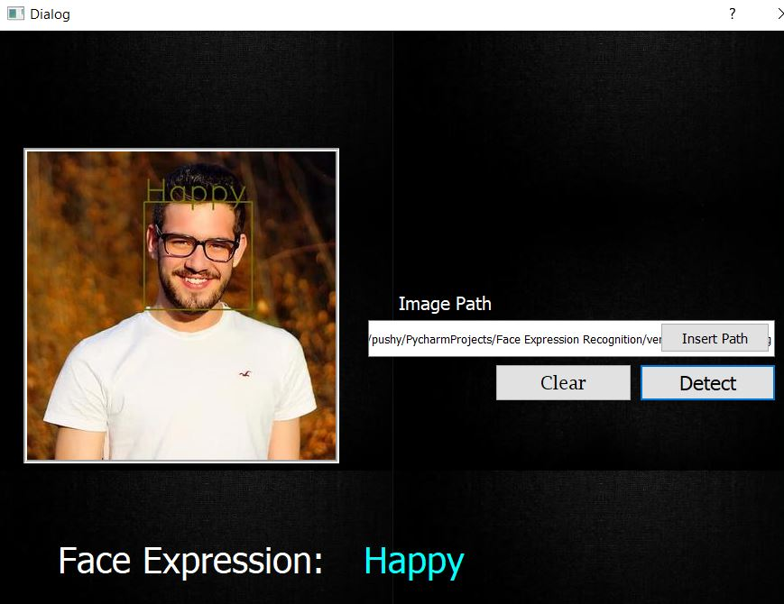
Results by uploading an image:

Slide 8
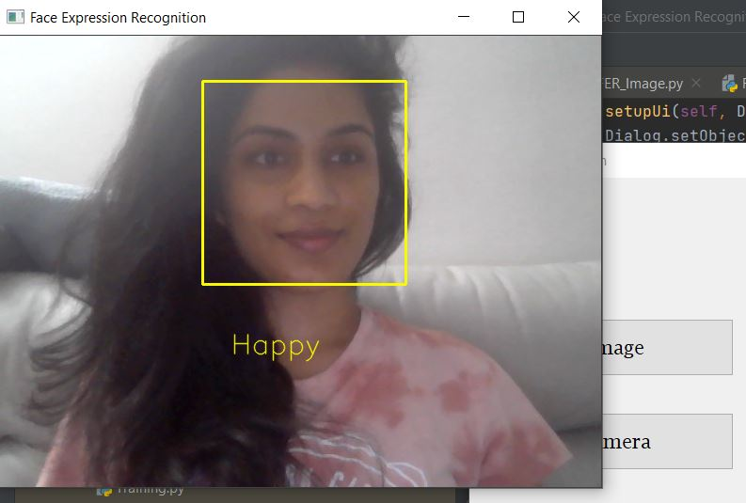
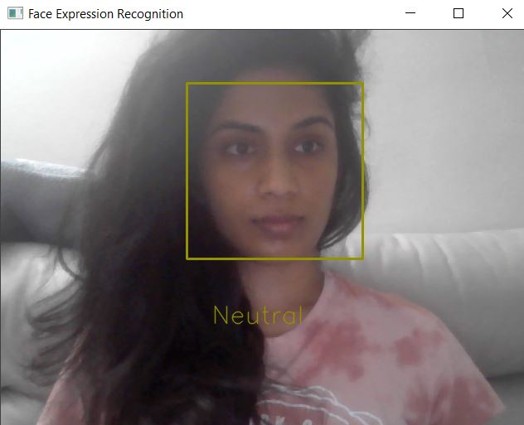
Results using webcam:

Slide 9
References:
https://medium.com/analytics-vidhya/facial-expression-detection-using-machine-learning-in-python-c6a188ac765f
https://towardsdatascience.com/building-a-convolutional-neural-network-male-vs-female-50347e2fa88b
https://medium.com/@ksusorokina/image-classification-with-convolutional-neural-networks-496815db12a8#:~:text=Convolutional%20neural%20networks%20(CNN)%20is,this%20architecture%20is%20image%20classification.&text=Instead%20of%20the%20image%2C%20the%20computer%20sees%20an%20array%20of%20pixels.
https://realpython.com/python-pyqt-gui-calculator/

