Slide 1

Note: The data and information in this document is reflective of a hypothetical situation and client. This document is to be used for KPMG Virtual Internship purposes only.
Sprocket Central Pty Ltd
Data analytics approach
Pushyami Keerthi Kolati

Slide 2
Note: The data and information in this document is reflective of a hypothetical situation and client. This document is to be used for KPMG Virtual Internship purposes only.
Agenda
Introduction
Data Exploration
Model Development
Interpretation

Slide 3
Note: The data and information in this document is reflective of a hypothetical situation and client. This document is to be used for KPMG Virtual Internship purposes only.
Introduction
Business Context :
Sprocket Central Pty Ltd has a new list of 1000 potential customers with their demographics and attributes. However, these customers do not have prior transaction history with the organization
Business Problem:
Analyze the existing customer dataset to determine customer trends and behavior. Thereafter recommend strategy for targeting new 1000 customers to drive the most value for the organization.
Data Introduction
Data used for Exploration
1) Customer Demographic
2) Customer Address
3) Transaction
Data Used Model Development and Interpretation.
1) NewCustomerList

Slide 4
Note: The data and information in this document is reflective of a hypothetical situation and client. This document is to be used for KPMG Virtual Internship purposes only.
Data Exploration
Scope of Data : Jan – Dec 2017
Data Summary :
1) Transaction details,
2) Customer demographic details and
3) New customers list which needs to be clustered.
Data Preparation :
1) Missing value imputations for columns -
2) Dropped columns with more than 5% of total data is missing:
default, deceased_indicator, Rank , Value
3) Created additional column using List Price and Standard Cost:
Profit
4) Created additional columns using DOB:
Age , Age group

Slide 5
Note: The data and information in this document is reflective of a hypothetical situation and client. This document is to be used for KPMG Virtual Internship purposes only.
Data Exploration
To reveal useful customer insights for targeting the new customers, the analysis is segmented into :
Brand based Analysis
Gender based Analysis
State Based Analysis
Age group-based Analysis
Seasonality in sales

Slide 6
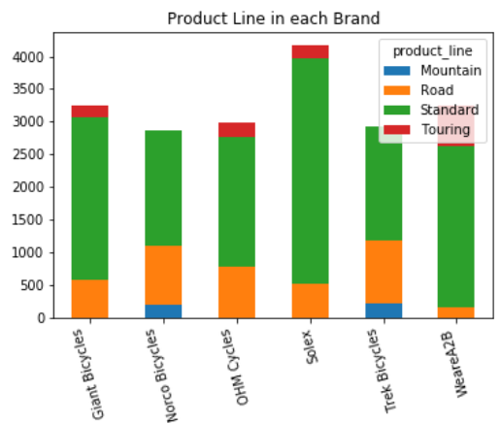
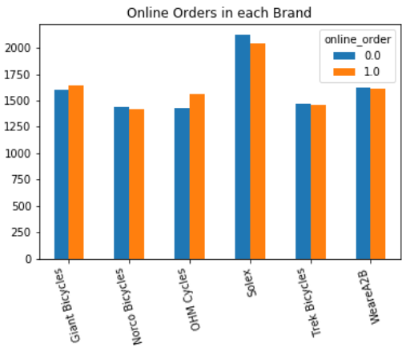
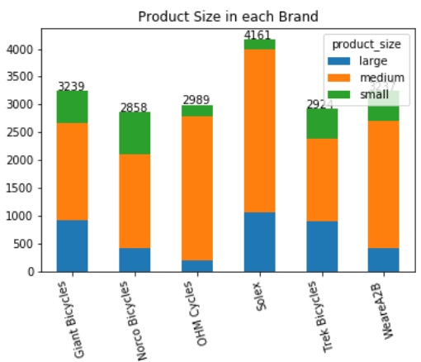
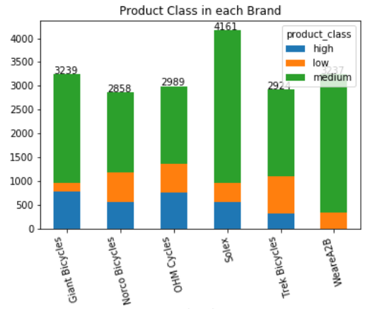
Note: The data and information in this document is reflective of a hypothetical situation and client. This document is to be used for KPMG Virtual Internship purposes only.
Model Development
Brand Based Analysis :
Observations:
Highest selling brand : Solex
Highest Selling Product line : Standard
Highest mode of selling : Offline
Highest Selling Product size : Medium
Highest Selling Product Class : Medium
So we need to focus more on Solex and promote more instore offers by maintain
-ing medium product size and medium product class.

Slide 7
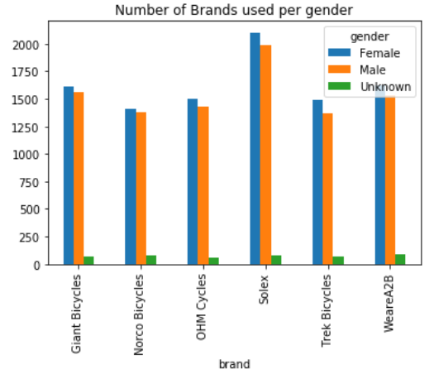
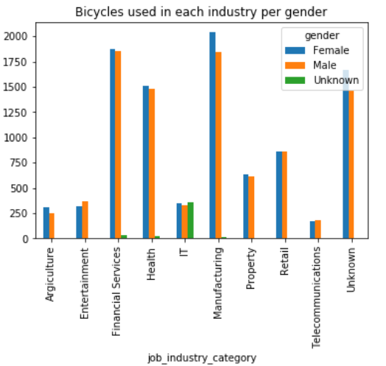
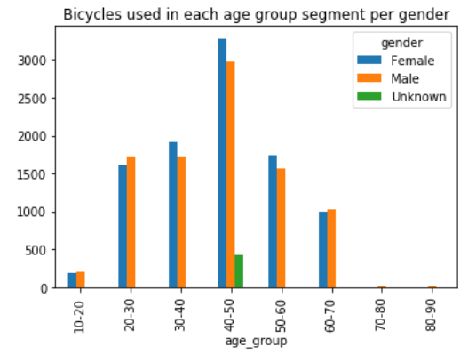
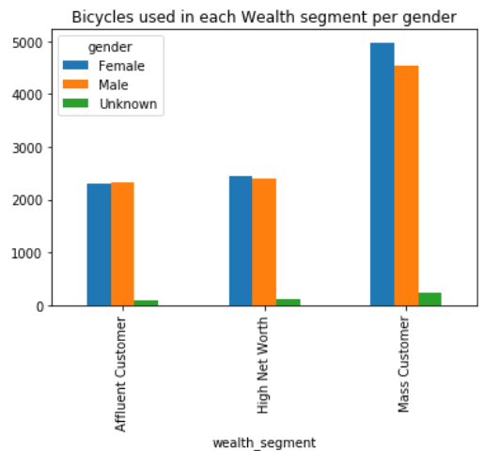
Note: The data and information in this document is reflective of a hypothetical situation and client. This document is to be used for KPMG Virtual Internship purposes only.
Model Development
Gender Based Analysis :
Observations:
Largest buyer : Female
Most chosen brand : Solex
Highest selling in Age group : 40-50
Highest sales by Industry : Manufacturing
Highest Sales in wealth segment :
Mass Customers
So we need to target more on Females who are working in Manufacturing industry from mass customers in the age group of 40-50 with Brand Solex.

Slide 8
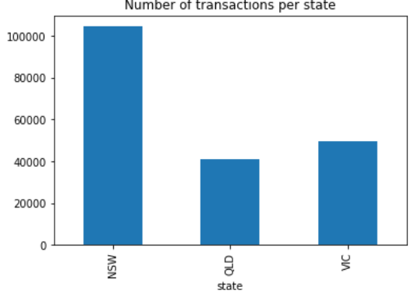
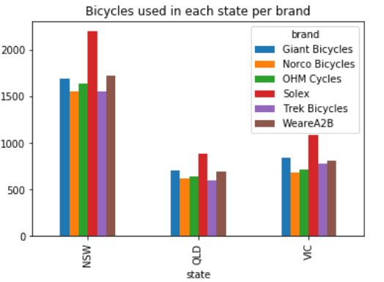
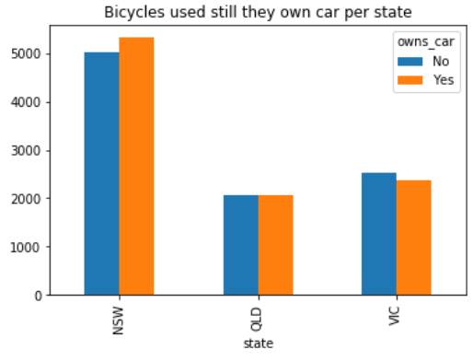
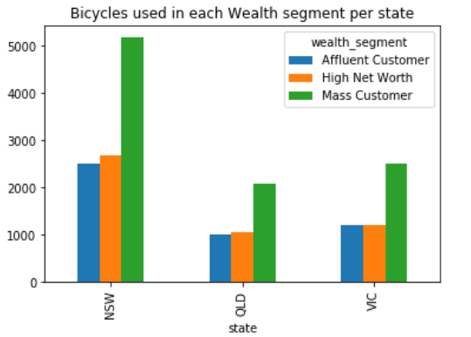
Note: The data and information in this document is reflective of a hypothetical situation and client. This document is to be used for KPMG Virtual Internship purposes only.
Model Development
States Based Analysis :
Observations:
Highest selling states : NSW
Gender contribution : Female
wealth segment contribution : Mass customers
Brand contribution :Solex
Car Owns highest : NWS
Even though NSW is having more Own cars , it is having the highest sales from Females Category in Mass customers in the Solex brand.

Slide 9
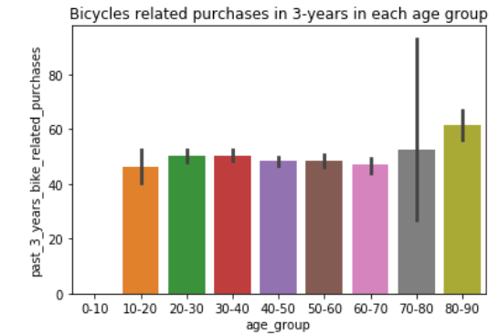
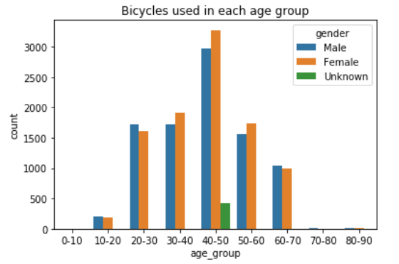
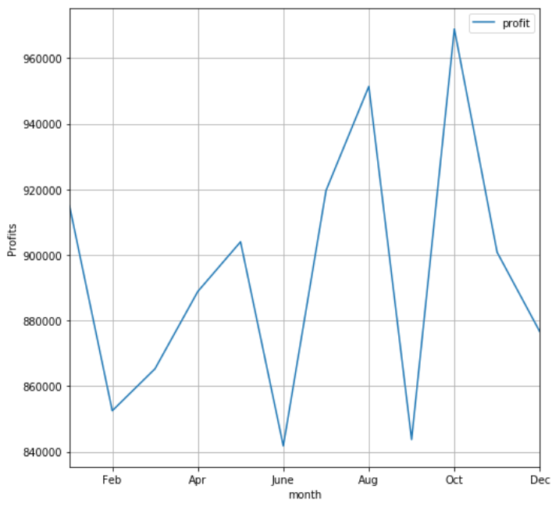
Note: The data and information in this document is reflective of a hypothetical situation and client. This document is to be used for KPMG Virtual Internship purposes only.
Model Development
Age Group Analysis :
Observations:
Highest Bicycle related Purchases : 80-90.
Highest sales contributed from age group 40-50 and more from females.
Seasonality in sales
We can see the sales are highest in
October and followed by August.

Slide 10
Note: The data and information in this document is reflective of a hypothetical situation and client. This document is to be used for KPMG Virtual Internship purposes only.
Interpretation
Recommendations :
We can clearly see that New South Wales state has highest sales. The marketing strategy of this state has to be applied to other states to boost sales based on the customer's wealth segment, work industry or gender.
Solex & Giant Bicycles Brand are on high demand.
Standard Product line have high transaction.
Product class Medium is having a very good demand.
we need to target more on Females who are working in Manufacturing industry from mass customers in the age group of 40-50 with Brand Solex.
we need to focus more on Solex and promote more instore offers by maintaining medium product size and medium product class.

Slide 11
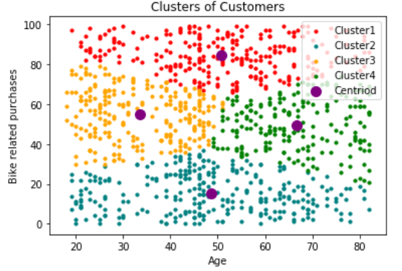
Note: The data and information in this document is reflective of a hypothetical situation and client. This document is to be used for KPMG Virtual Internship purposes only.
Interpretation
Clustering of New Customers based on Age :
Primary Target for sales will be the Cluster 1(Red) as they are making higher profits.
The secondary target will be cluster 2 ( Green) and cluster 3(Green) model since they make average number of purchases which could be increased by better marketing strategy.

Slide 12
Note: The data and information in this document is reflective of a hypothetical situation and client. This document is to be used for KPMG Virtual Internship purposes only.
Appendix

Slide 13
Note: The data and information in this document is reflective of a hypothetical situation and client. This document is to be used for KPMG Virtual Internship purposes only.
Appendix
Jupyter python note book :

Slide 14
Thank you

