Slide 1
India-Electricity
By Pushyami Keerthi

Slide 2
Contents
Business Objective
Reasons for increase of Energy needs & Proposed solution
Trend analysis –Region wise Consumption
Coal sector on industry
Recommendations and Conclusions

Slide 3
Business Objective
India’s energy needs are going to double in next 6-7 years at the present rate of growth of the economy.
Ratio of energy demand and GDP is useful indicator for economics growth i.e economic growth of country depend upon rate of improvement in per capita energy consumption.
Due to increasing import charges and problems associated with the development of energy from conventional sources like pollution and global warming a need to create sustainable, and potentially clean, source of energy for future growth is essential.
The main objective of this presentation is
To make aware of the present electricity scenario
To understand the proportion of energy use based on the industries
To make aware of electricity deficiency problem
Nuclear, Solar , Wind, Biomass are among potentially clean fuel and have a future

Slide 4
Reasons for increase of Energy needs & Proposed solution
For growing economy, the need for electricity is very crucial. Electricity plays very important role in growth of country.
Reason for increasing demand of energy :
Domestic demand is increasing more rapidly as the quality of life for Indians is improving
Increase in transportation
Increasing population
Increase in industrialisation
Solution Proposed:
For sustainable growth and pollution reduction ,developing countries like India require substantial investments in their power sector looking forward for new available form of energy resources for future survival (mainly Renewable resources)

Slide 5
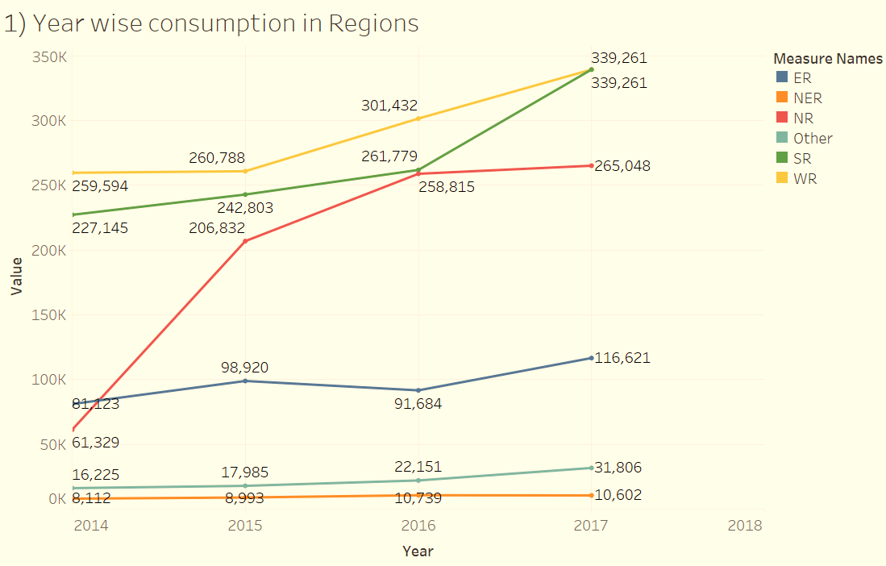
Trend analysis –Region wise Consumption
During the year 2014-2017, demand for electricity in India is out far stripped in all regions especially in Northern region .
Although the overall growth of the country and the need of electricity is linear, in eastern region for year 2016 there is a small decrease in consumption and North eastern regions having lower increasing trends .

Slide 6
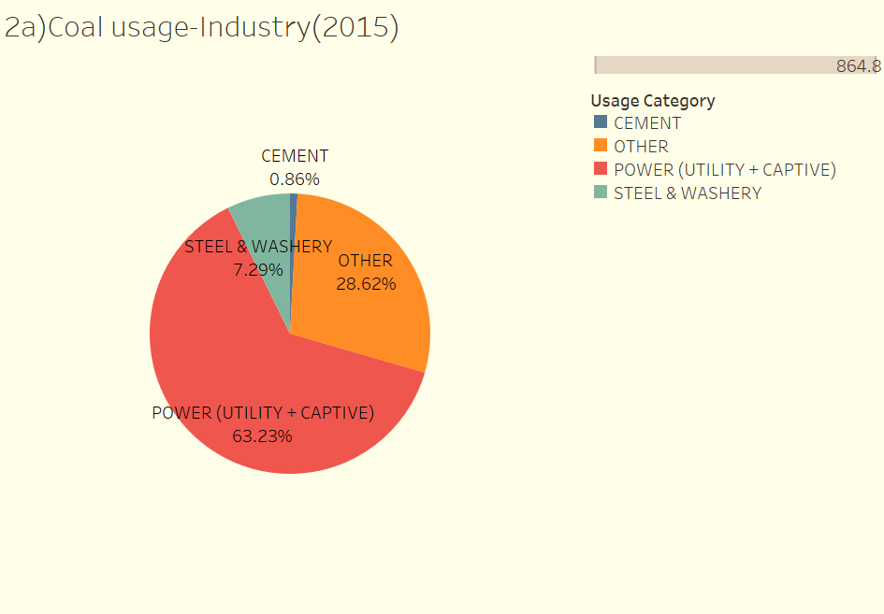
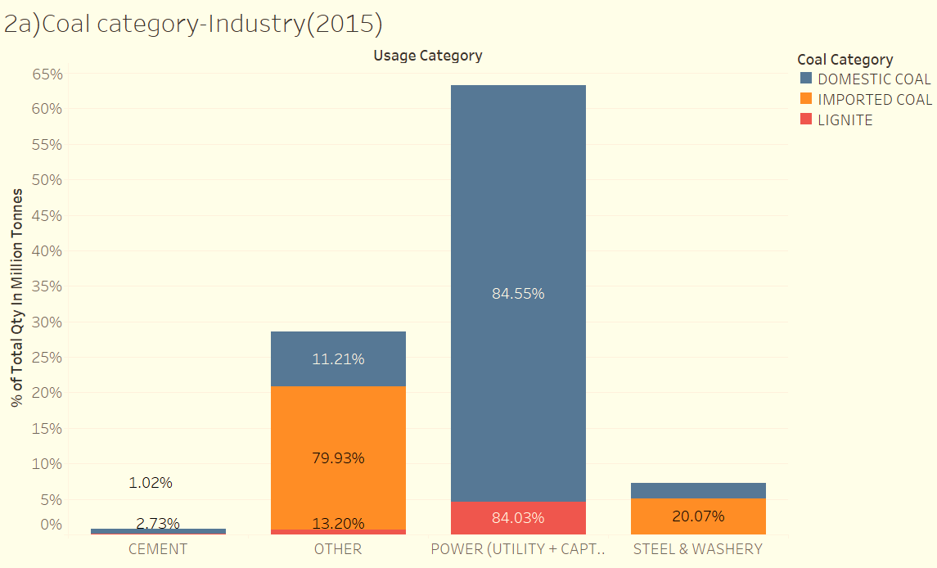
Coal sector on industry
Power Industry :
The Industry Power has major part of Coal consumption with 63.2% .
The Domestic Coal has most consumption in the Power industry with 84.5%.
Industry “Other” :
The Industry “Other” has next major part in Coal consumption with 28.6% .
Major portion of Imported Coal is used in “Other” Industry
In Industry Power, Lignite has most consumption with 84.03% compared to other industries.

Slide 7
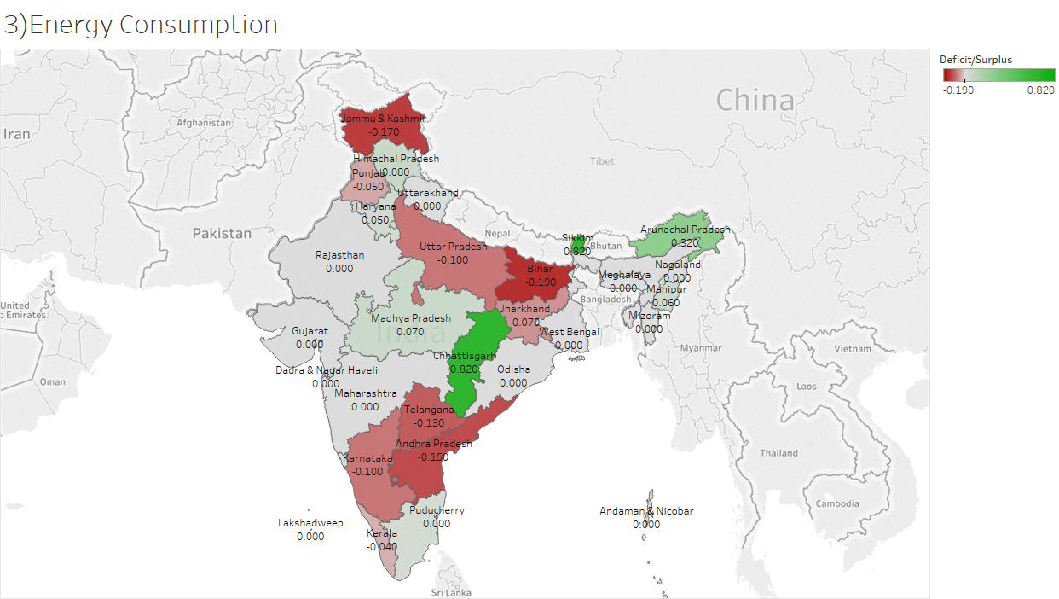
Energy consumption Scenario in India
Chhattisgarh and Sikkim has highest surplus of energy
Bihar and Jammu & Kashmir has highest deficit of Energy
Bihar has higher population hence energy demand is higher causing deficit of energy.

Slide 8
Recommendations and Conclusions
Conclusions:
India, one of the stable economic country depend upon thermal power plant to meet most of the demand about 63.2%.
Still the share of renewable energy is not significant.
Recommendations:
India has potential of renewable energy source in abundance ,which if developed properly can augment the growing demand of the energy .
To make future brighter India gear up to utilise renewable resources to reduce the global warming and pollution .

Slide 9
Thank You

