Slide 1
Lending Club Case Study
Group Members: Puspanjali Sarma & Harjaspreet Singh
Batch: ML- C43
Institute: Post Graduate Diploma in Machine Learning and AI - IIIT, Bangalore

Slide 2
Business Understanding
Lending club , a finance company is the largest online loan marketplace, facilitating personal loans, business loans, and financing of medical procedures. Borrowers can easily access lower interest rate loans through a fast online interface.
To be profitable in business, Lending Club needs to control credit loss which arises from lending loans to ‘risky’ applicants.
To mitigate risky lending , the company must be able to identify these risky loan applicants, then such loans can be reduced thereby cutting down the amount of credit loss.
In other words, the company wants to understand the driving factors (or driver variables) behind loan default, i.e. the variables which are strong indicators of default. The company can utilise this knowledge for its portfolio and risk assessment.

Slide 3
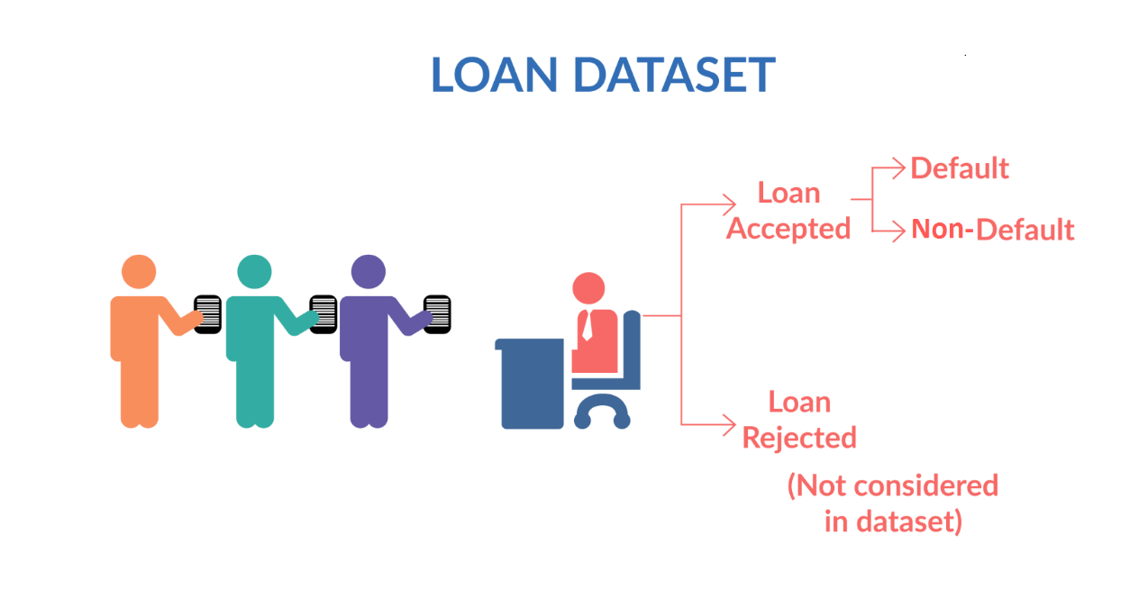
Problem Statement
Lending Club wants to understand the driving factors (or driver variables) behind loan default, i.e. the variables which are strong indicators of default. So that company can utilise this knowledge for its portfolio and risk assessment.
As per process, when the company receives a loan application, the company has to make a decision for loan approval based on the applicant’s profile.
Two types of risks are associated with the bank’s decision:
If the applicant is likely to repay the loan, then not approving the loan results in a loss of business to the company
If the applicant is not likely to repay the loan, i.e. he/she is likely to default, then approving the loan may lead to a financial loss for the company
We are given past data containing information about past loan applicants and whether they ‘defaulted’ or not.
The aim is to identify patterns which indicate if a person is likely to default, which may be used for taking actions such as denying the loan, reducing the amount of loan, lending (to risky applicants) at a higher interest rate, etc.
In this case study, you will use EDA to understand how consumer attributes and loan attributes influence the tendency of default.

Slide 4
Problem Solving Methodology
Data Cleaning
Removing the null valued columns, unnecessary variables and checking the null value percentage and removing the respective rows.
Data Understanding
Working with the Data Dictionary and getting knowledge of all the columns and their domain specific uses
Data Analysis
Univariate Analysis: Analysing each column, plotting the distributions of each column.
Segmented Univariate Analysis: Analysing the continuous data columns with respect to the categorical column.
Bivariate Analysis: Analysing the two variable behaviour like term and loan status with respect to loan amount.
Recommendations
Analysing all plots and recommendations for reducing the loss of business by detecting columns best which contribute to loan defaulters.

Slide 5
Data Understanding and Analysis
Loan dataset has total 111 variables and 39717 rows.
The variables are stored as integer, float and categorical datatypes.
We will perform data cleansing by applying:
Remove duplicates (if any)
Remove null values (if any)
Drop unwanted columns/values (if any)
Dimension Reduction
Exploratory Data Analysis will be performed by applying:
Univariate Analysis
Segmented Univariate Analysis
Bivariate Analysis
Recommendations will be given after analysing all plots and metrics.

Slide 6
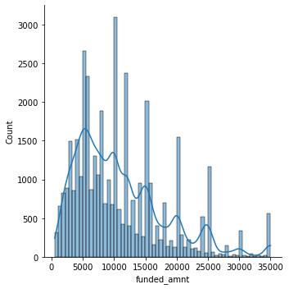
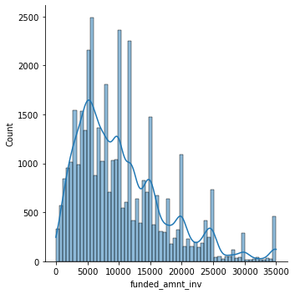
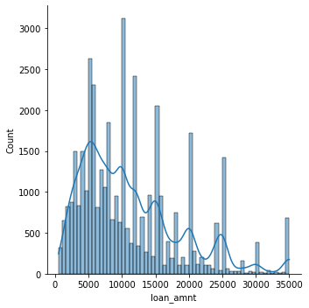
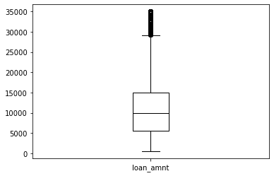
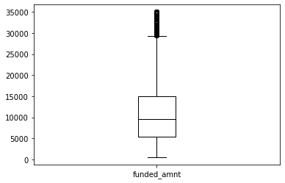
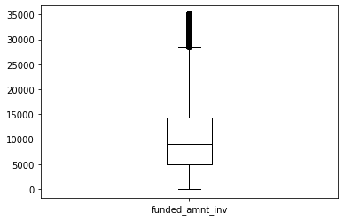
Univariate Analysis – Continuous Variables: Distribution Plots & Outlier Detection
Observation:
1. Distribution of amounts for all three looks very much similar.
2. Most of the Loan amounts are in range of 5000 - 15000

Slide 7
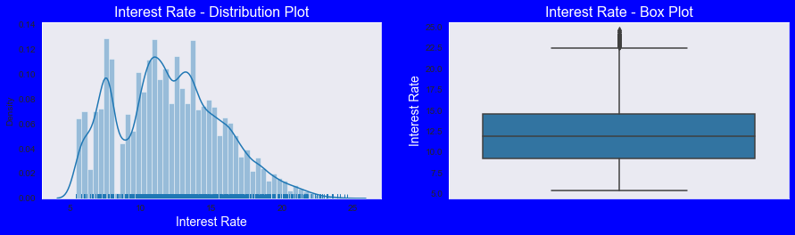
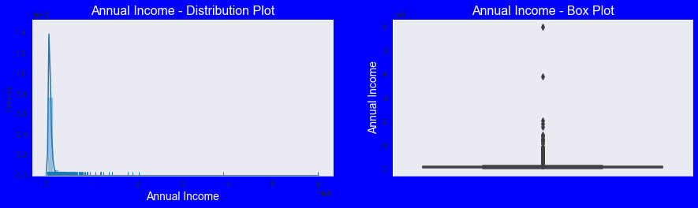
Univariate Analysis – Continuous Variables: Distribution Plots and Outlier Detection
Observations : Most of the Interest Rates on loans are in range of 10% - 15%
Observations: Most of the borrower's Annual incomes are in range of 40000- 80000

Slide 8
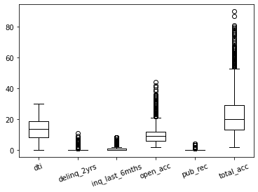
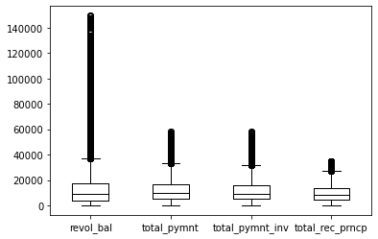
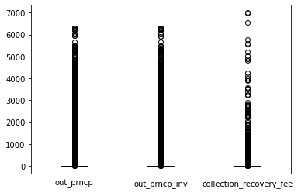
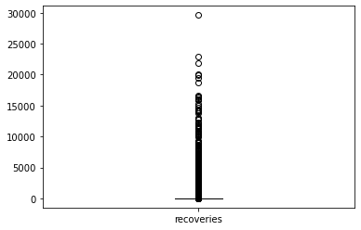
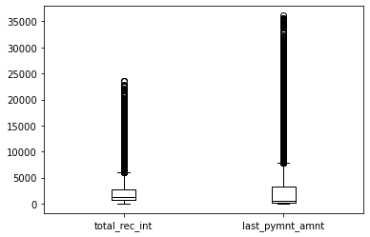
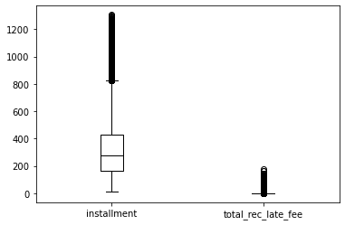
Univariate Analysis – Continuous Variables: Outlier Detection
Observation: We are seeing that Outliers exist in almost all the Continuous Variables

Slide 9
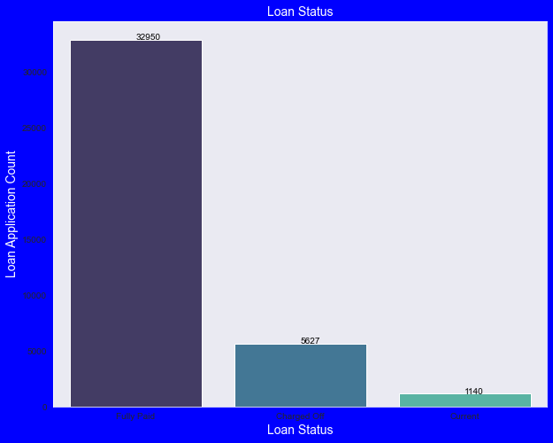
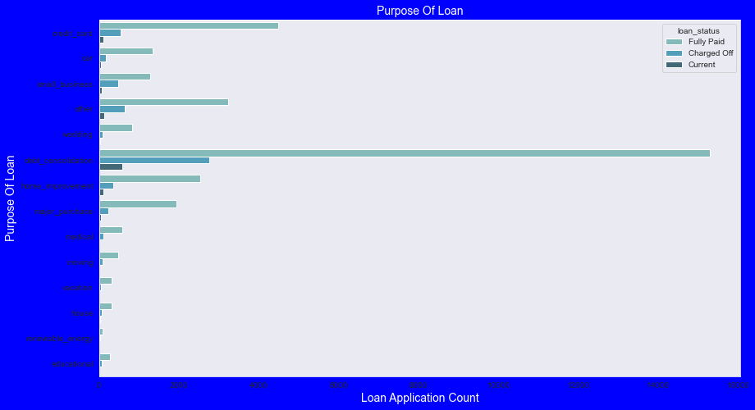
Univariate Analysis – Categorical Variables
Observations :
Approx. 14% loans were charged off out of total loan issued.
Observations:
Most of the loans were taken for the purpose of debt consolidation & paying credit card bill. And number of charged off count also high too for these loans.

Slide 10
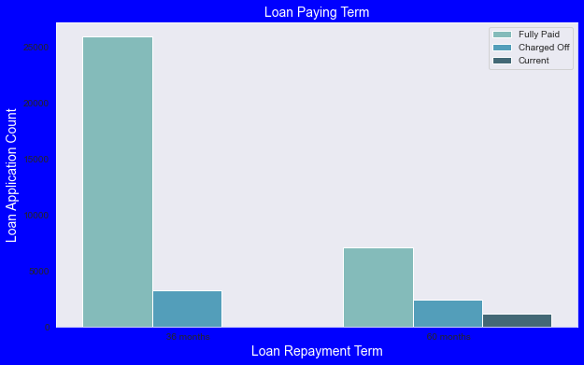
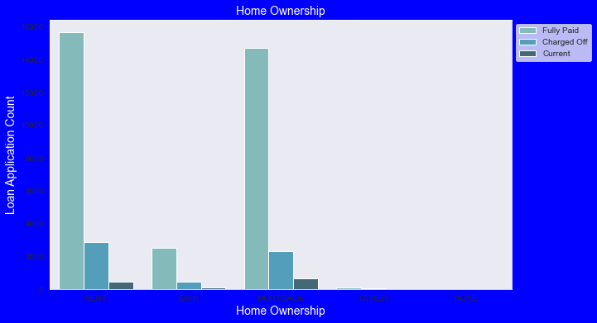
Univariate Analysis – Categorical Variables
Observation: Borrowers who had taken loan to repay in 60 months had more % of number of applicants getting charged off as compared to applicants who had taken loan for 36 months.
Observations : Most of them living in rented home or mortgaged their home. And number of applicants is high from these categories so charged off is high too.

Slide 11
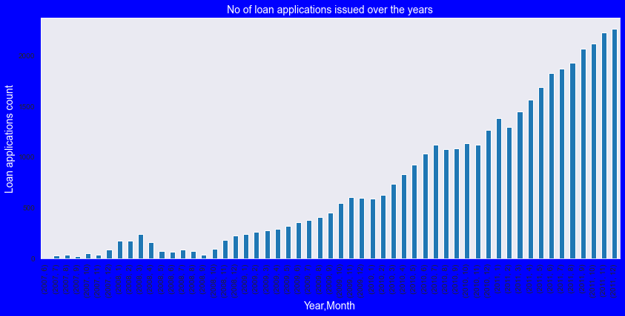
Univariate Analysis – Categorical Variables
Observation: Count of loan application is increasing every year which is adding more to number of charged off applications. It is also seen that number of loans issued in 2008( May-October) got dipped, may be due to Recession.

Slide 12
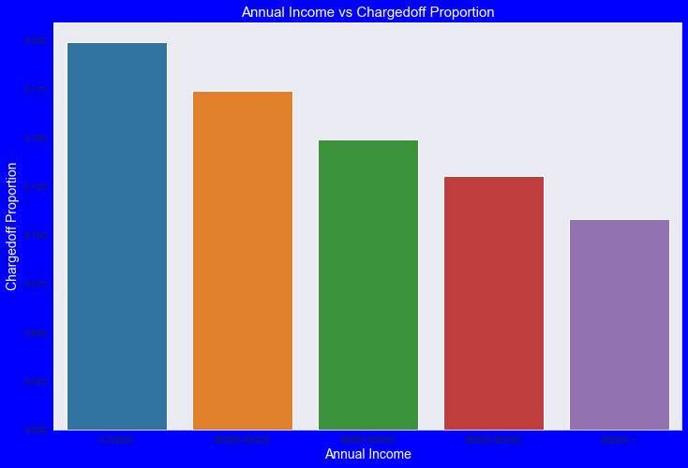
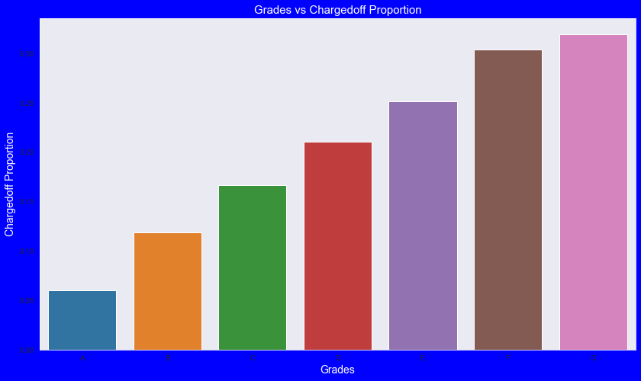
Bi-Variate Analysis
Observations:
Income range 80000+ has less chances of charged off.
Income range 0-20000 has high chances of charged off.
Notice that with increase in annual income charged off proportion got decreased.
Observations:
Grade "A" has very less chances of charged off.
Grade "F" and "G" have very high chances of charged off.
Chances of charged of is increasing with grade moving from "A" towards "G"

Slide 13
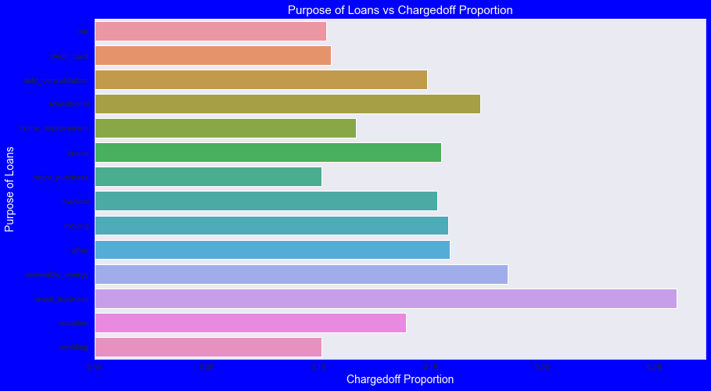
Bi-Variate Analysis
Observations:
Small Business applicants have high chances of getting charged off.
Wedding and major_purchase are purposes where charged off proportion is better as compare to other categories.

Slide 14
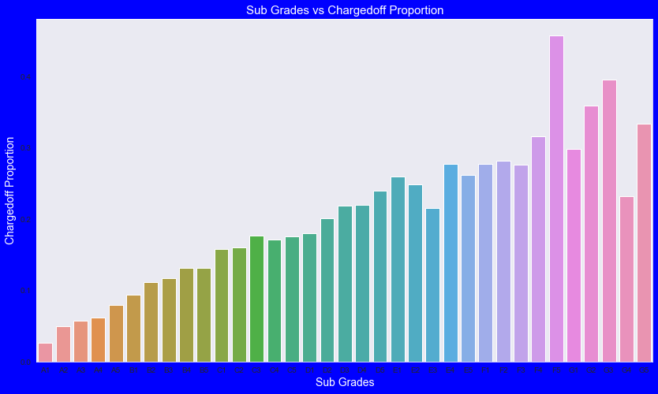
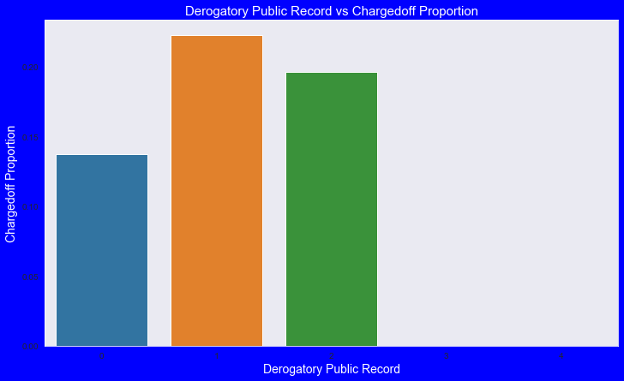
Bi-Variate Analysis
Observations:
sub Grades of "A" has very less chances of charged off.
sub Grades of "F" and "G" have very high chances of charged off.
proportion of charged off is increasing with sub grades moving from sub grades of "A" towards sub grades of "G"
Observations:
Those who already have pub_rec_bankruptcies value 1, have charged off proportion higher than who have no pub_rec_bankruptcies.
pub_rec_bankruptcies count 2 has even higher charged off proportion but those numbers are not significant to decide.
Not known is the column for which we don't have any information about borrower.
This also makes sense that who has defaulted before has more chances of defaulting in future as well.

Slide 15
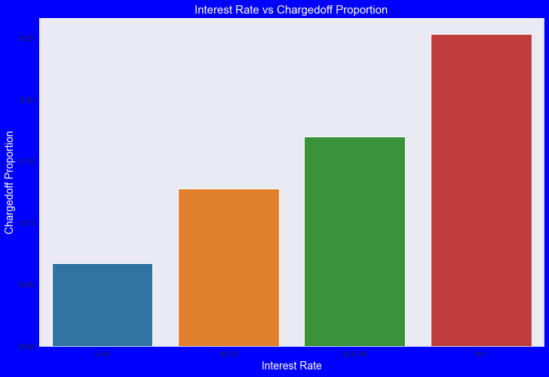
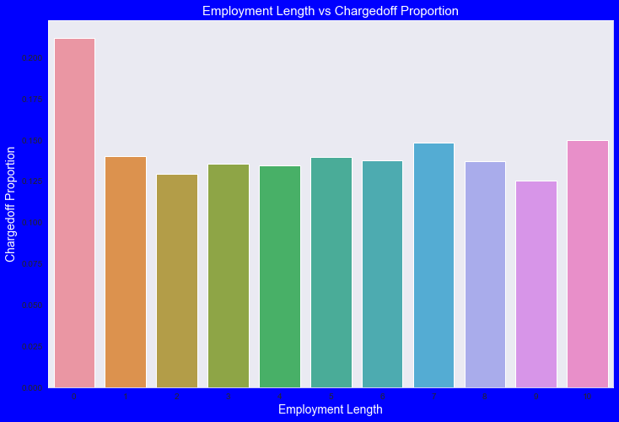
Bi-Variate Analysis
Observations:
The interest rate less than 10% has very less chances of charged off. Interest rates are starting from minim in 5 %.
interest rate more than 16% has good chances of charged off as compared to other category interest rates.
Charged off proportion is increasing with higher interest rates.
Observations:
Those who are not working or have less than 1 year of work experience have high chances of getting charged off.
It makes sense as with less or no experience they don't have source of income to repay loan.
Rest of the applicants have more or less same chances of getting charged off.

Slide 16
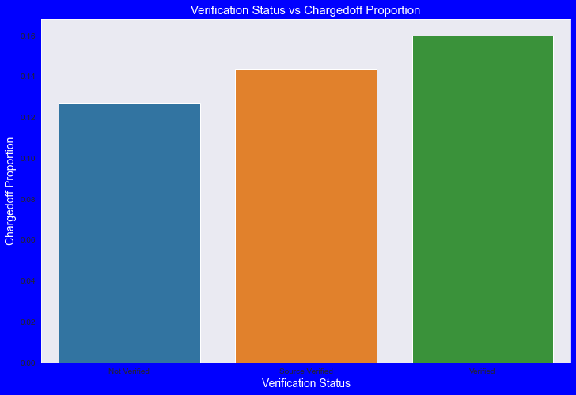
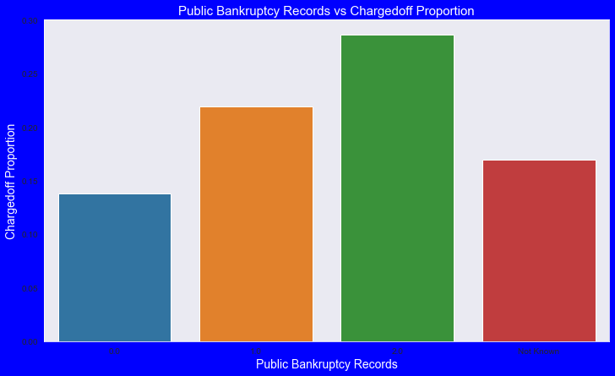
Bi-Variate Analysis
Observations:
There is not much difference in charged off proportion.
This variable doesn't provide any insights for charged off.
Observations:
Those who already have pub_rec_bankruptcies value 1, have charged off proportion higher than who have no pub_rec_bankruptcies.
pub_rec_bankruptcies count 2 has even higher charged off proportion but those numbers are not significant to decide.
Not known is the column for which we don't have any information about borrower.
This also makes sense that who has defaulted before has more chances of defaulting in future as well.

Slide 17
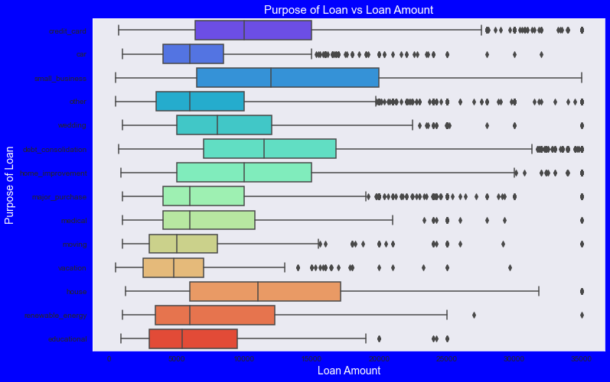
Bi-Variate Analysis
Observations:
Median,95th percentile,75th percentile of loan amount is highest for loan taken for small business purpose among all purposes.
Debt consolidation is second and Credit card comes 3rd.

Slide 18
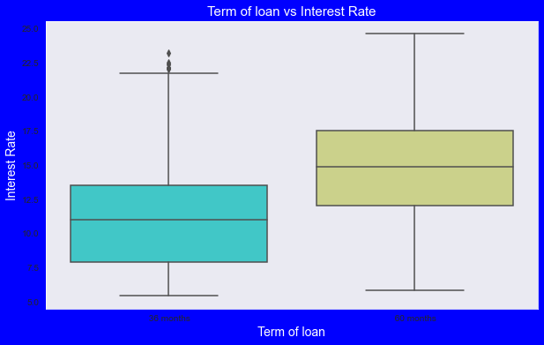
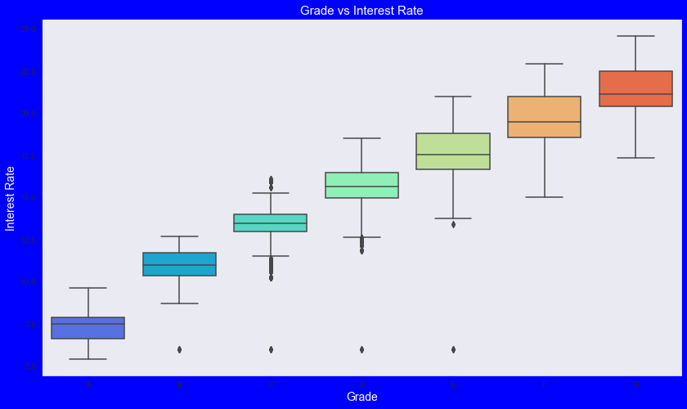
Bi-Variate Analysis
Observations:
It is clear that average interest rate is higher for 60 months loan term. Most of the loans issued for longer term had higher interest rates for repayment.
Observations:
A-grade is a top letter grade for a lender to assign to a borrower.
The higher the borrower's credit grade, the lower the interest rate offered to that borrower on a loan.
It is clear that interest rate is increasing with grades moving from A to F.

Slide 19
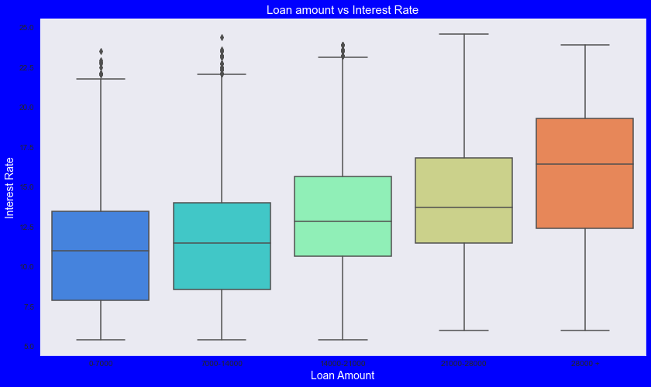
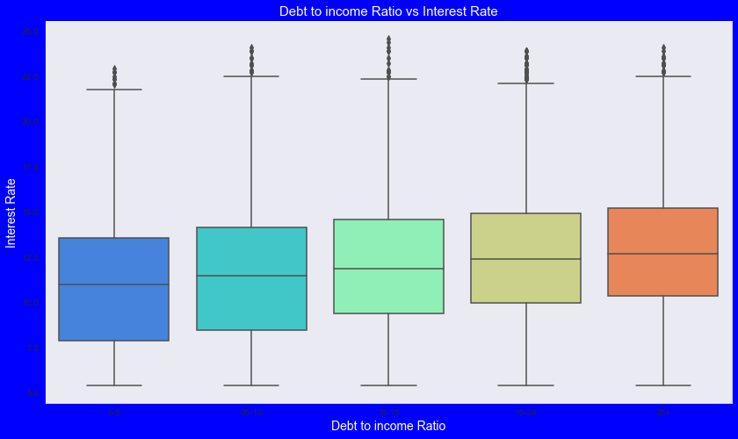
Bi-Variate Analysis
Observations:
It is clear that interest rate is increasing with loan amount increase. Probably when loan amount is more it is taken for longer loan term, we saw earlier that longer the loan term more the interest rate.
Observations:
If your DTI is low enough you may get a lower interest rate. Plot shows no significant variation but there is slight increase in interest rate with increase in DTI.

Slide 20
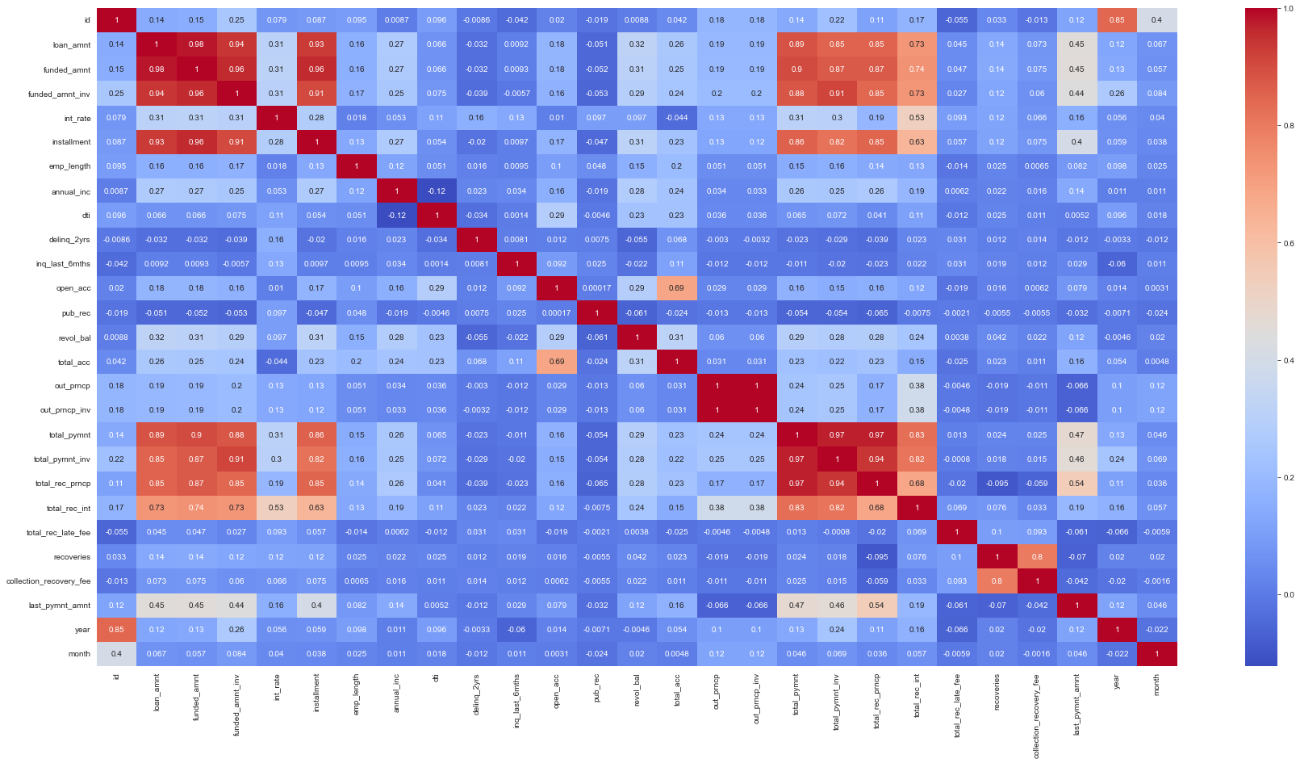
Bi-Variate Analysis
Correlation Matrix :
Observation:
Loan amount, investor amount, funding amount are strongly correlated.
Annual income with DTI(Debt-to-income ratio) is negatively correlated.
Debt income ratio is the percentage of a consumer's monthly gross income that goes toward paying debts which means when annual income is low DTI is high & vice versa.
Positive correlation between annual income and employment years which means income increases with work experience ;)

Slide 21
Conclusion
Lending club should reduce the high interest loans for 60 months tenure, they are prone to loan default.
Grades are good metric for detecting defaulters. Lending club should examine more information from borrowers before issuing loans to Low grade (G to A).
Lending Club should control their number of loan issues to borrowers who are from CA, FL and NY to make profits.
Small business loans are defaulted more. Lending club should stop/reduce issuing the loans to them.
Borrowers with mortgage home ownership are taking higher loans and defaulting the approved loans.
Lending club should stop giving loans to this category when loan amount requested is more than 12000.
People with more number of public derogatory records are having more chance of filing a bankruptcy.
Lending club should make sure there are no public derogatory records for borrower.

