Slide 1
Enterprise AI
Platform Demo
Platform at a glance
Ingest
Train
Serve
End-to-end platform for scalable AI: ingestion → training → deployment → monitoring
Public-shareable patterns using open frameworks and abstract environment names.
Synthetic data
CI/CD stubs
IaC ready
Demo targets
Package includes
• Runnable pipeline
• Architecture PNG/PDF
• System overview deck
• One-page summary PDF
120k
records processed
92%
model accuracy
Green
drift status
Newsletter-ready case study with social launch copy included.
Notes:
[Sources] All content, visuals, and metrics in this deck are generated for a synthetic demo repository. [/Sources]

Slide 2
System overview
One platform pattern from raw data to monitored AI operations
The demo aligns engineering and MLOps concerns into a single operating model.
Governance • Security • CI/CD
Ingest
Curate
Train
Deploy
Monitor
Why it matters
• One repo demonstrates data, model, and deployment flow.
• Templates show how Snowflake, Databricks, and CI/CD fit together.
• Synthetic data keeps the case study portable and publication-safe.
Sources Files • APIs
CDC feeds
Curated Raw • quality
features
Model ops Train • register
validate
Serving Batch + API
scoring
Feedback to retraining and threshold tuning
Reference implementation components
pipeline/ ETL scripts
models/ notebooks
infra/ CI pipeline YAML + IaC stubs
data/sample_data/ synthetic dataset
docs/ architecture.png + PDF
platform_deck.pdf
one_page_summary.pdf
LinkedIn launch copy
Notes:
[Sources] All content, visuals, and metrics in this deck are generated for a synthetic demo repository. [/Sources]

Slide 3
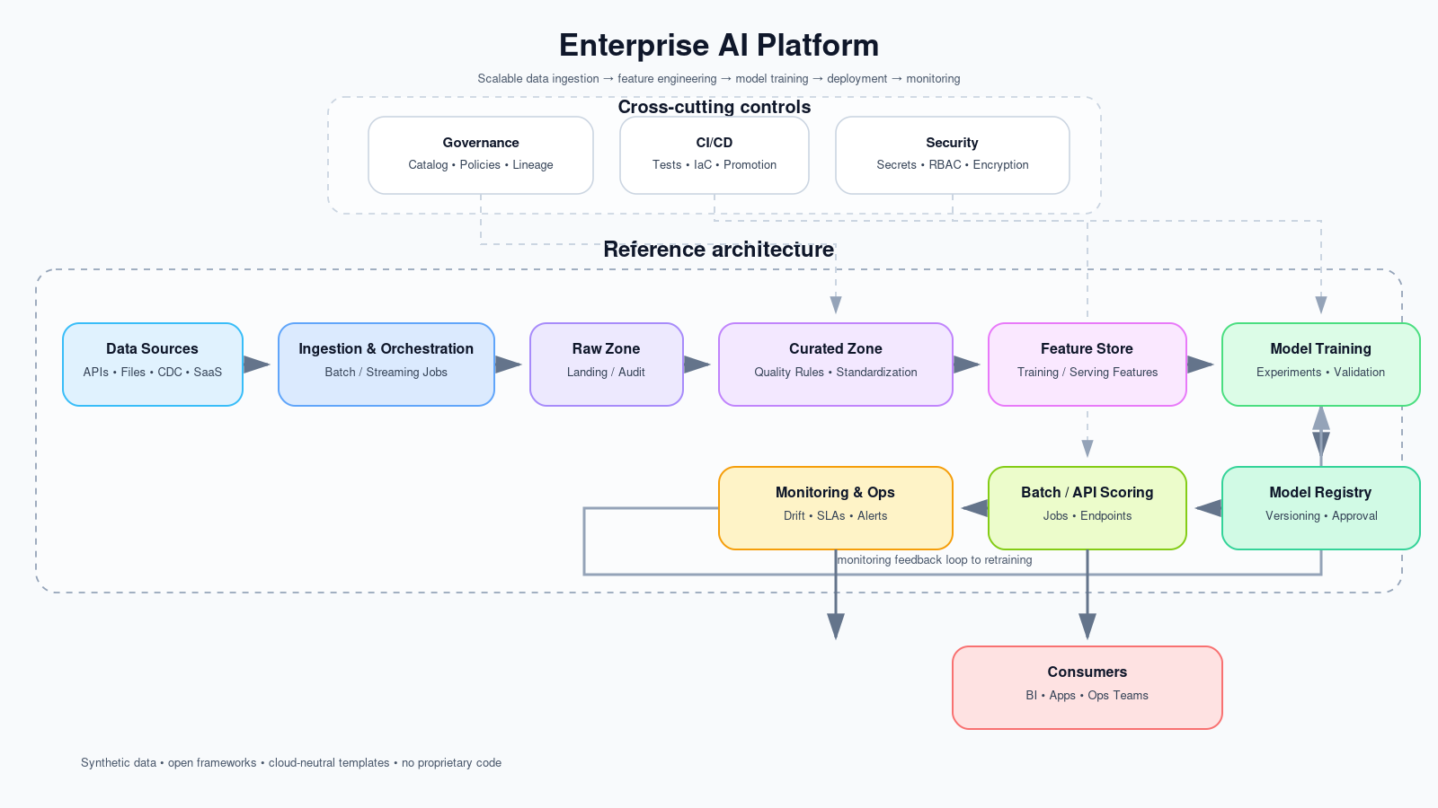
Reference architecture
Cloud-neutral pattern for enterprise data engineering, MLOps, and operations
Cross-cutting controls
Governance, security, and CI/CD sit above the platform and touch both data and model operations.
Designed for public sharing: no customer data, no proprietary code, and abstract environment naming.
Notes:
[Sources] Architecture diagram is generated within the repository for this demo. [/Sources]

Slide 4
Runnable repo + deployment scaffolding
Code structure supports local execution and stakeholder walkthroughs
Repository map
Starter CI/CD path
1 enterprise-ai-platform/ 2 ├── run_pipeline.py 3 ├── pipeline/ 4 │ ├── etl.py 5 │ ├── train.py 6 │ └── monitor.py 7 ├── models/ 8 │ ├── training_placeholder.ipynb 9 │ └── monitoring_placeholder.ipynb 10 ├── infra/ 11 │ ├── github-actions-ci.yml 12 │ ├── databricks_job_stub.yml 13 │ ├── snowflake_objects.sql 14 │ └── terraform/main.tf 15 ├── data/sample_data/ 16 │ └── synthetic_customer_usage.csv 17 └── docs/
Validate Install deps
Run pipeline
Package Build image
Archive results
Promote Deploy job
Register model
What is intentionally templated
• GitHub Actions YAML
• Databricks job stub
• Snowflake DDL skeleton
• Terraform base module
These files are scaffolding for interviews, portfolios, or a public GitHub case study.
Notes:
[Sources] All content, visuals, and metrics in this deck are generated for a synthetic demo repository. [/Sources]

Slide 5
Simulated results and publication guardrails
Use the deck as a portfolio case study or interview walkthrough
Presentation metrics are fixed demo KPIs; the code remains runnable on the included synthetic dataset.
LinkedIn launch copy
“Just launched an Enterprise AI Platform case study: scalable data pipeline + MLOps with Snowflake & Databricks.”
Publication-safe checklist
• Use public cloud services or open frameworks only.
• Keep datasets synthetic; exclude customer information.
• Abstract company and environment names.
• Emphasize architecture patterns instead of proprietary code.
Portfolio-ready asset
Pair this deck with the repo README, one-page summary PDF, and architecture PNG for a complete case study package.
Notes:
[Sources] All content, visuals, and metrics in this deck are generated for a synthetic demo repository. [/Sources]

