Slide 1
Performance Optimization

Slide 2
AGENDA
The Approach
Bottlenecks Identification
Performance Profiling and Improvement
Database Profiling and Improvement
Web Optimization
Training Task
Q & A

Slide 3
THE APPROACH
Before we start
Non-functional requirements
Supplementary Specification
Reflects in architecture
Develop with real data

Slide 4
THE APPROACH
1. SETUP THE TEST ENVIRONMENT
2. MEASURE PERFORMANCE BASELINES
3. SET ACCEPTABLE PERFORMANCE GOALS
4. IDENTIFY BOTTLENECKS
5. OPTIMIZE
6. MEASURE THE PERFORMANCE
7. IF NOT ACCEPTABLE GO TO 4 STEP

Slide 5
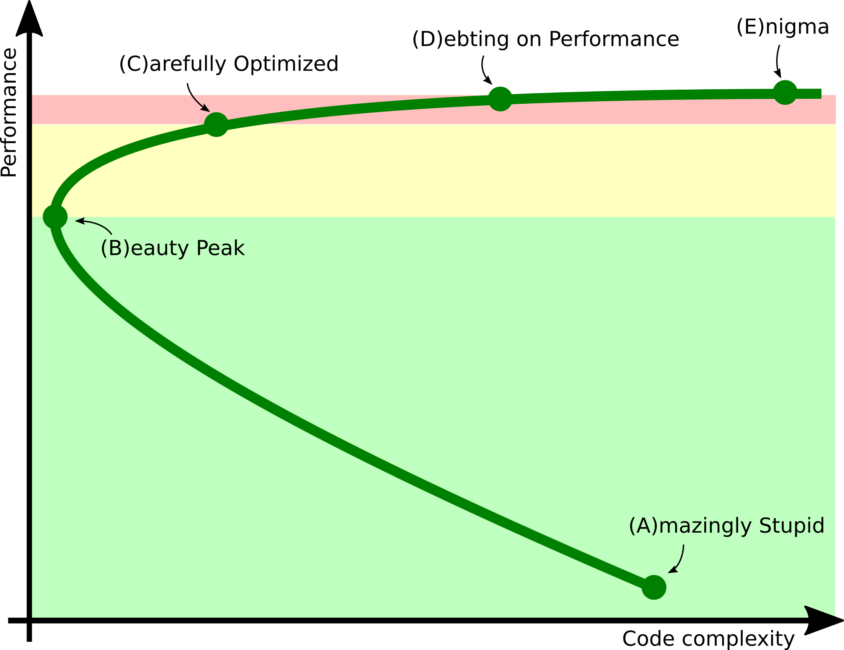
THE APPROACH

Slide 6
THE APPROACH
Environment and Test Data
Environment – Maximum close to production
Test Data – Real data
Performance Benchmarking Tools
LoadUI, Apache JMeter, etc.
Custom Auto tests

Slide 7
BOTTLENECKS IDENTIFICATION
Resources usage
CPU
Memory
IO
Network

Slide 8
BOTTLENECKS IDENTIFICATION
Tools
VisualVM
IBM HeapAnalyzer
GC Viewer
JConsole
Jprofiler
YourKit
JAMon
Java Mission Control and Java Flight Recorder
Psi Probe
Custom Logging
Honest profiler
Async profiler
Etc.

Slide 9
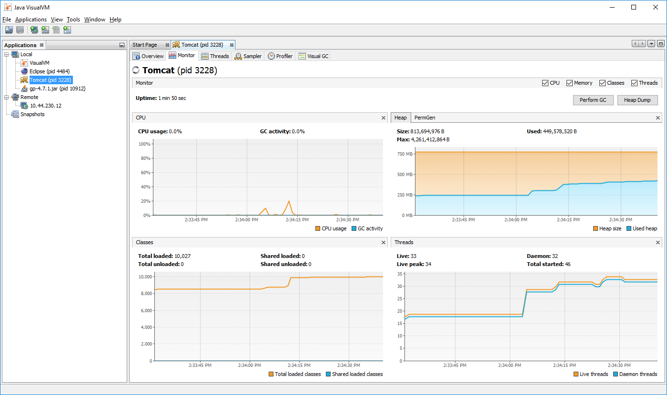
BOTTLENECKS IDENTIFICATION

Slide 10
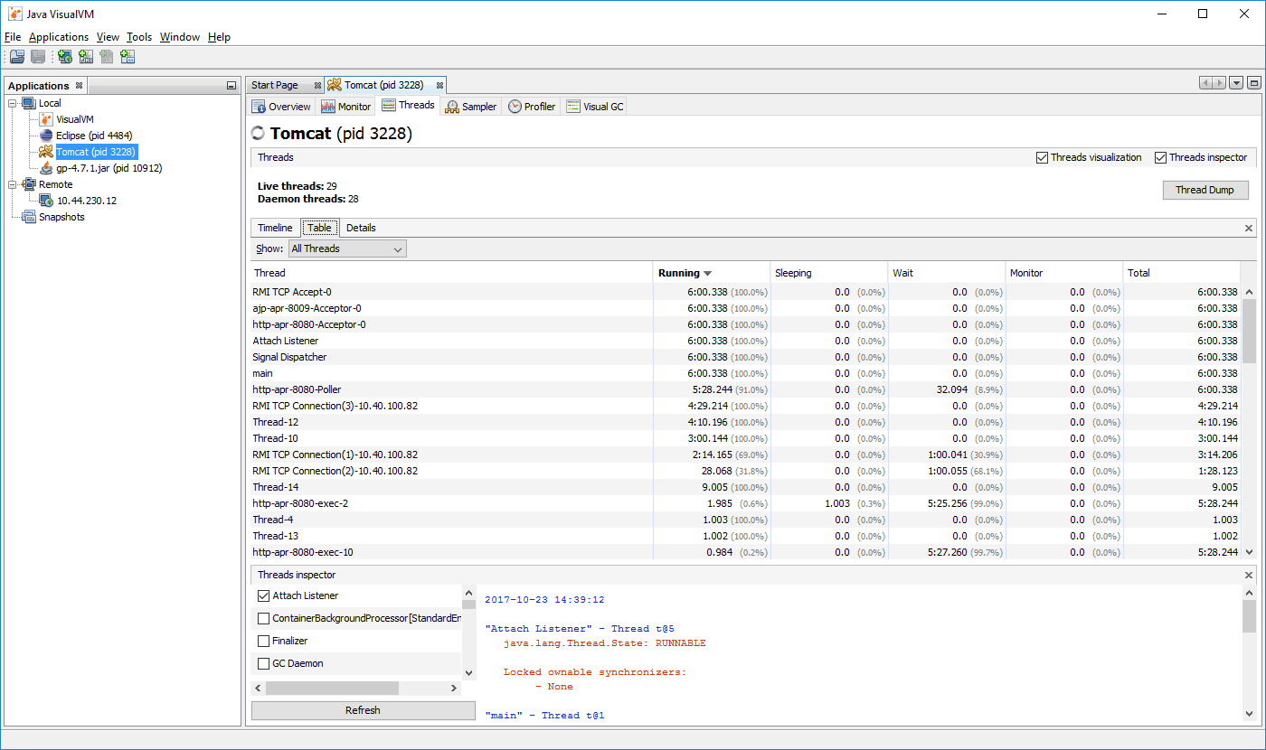
BOTTLENECKS IDENTIFICATION

Slide 11
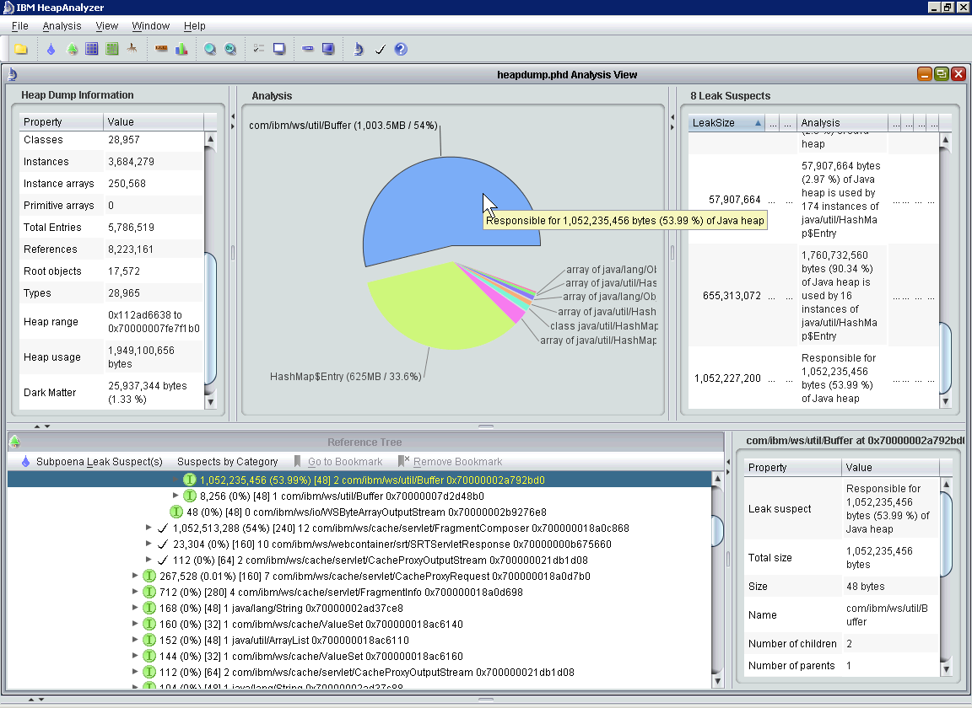
BOTTLENECKS IDENTIFICATION

Slide 12
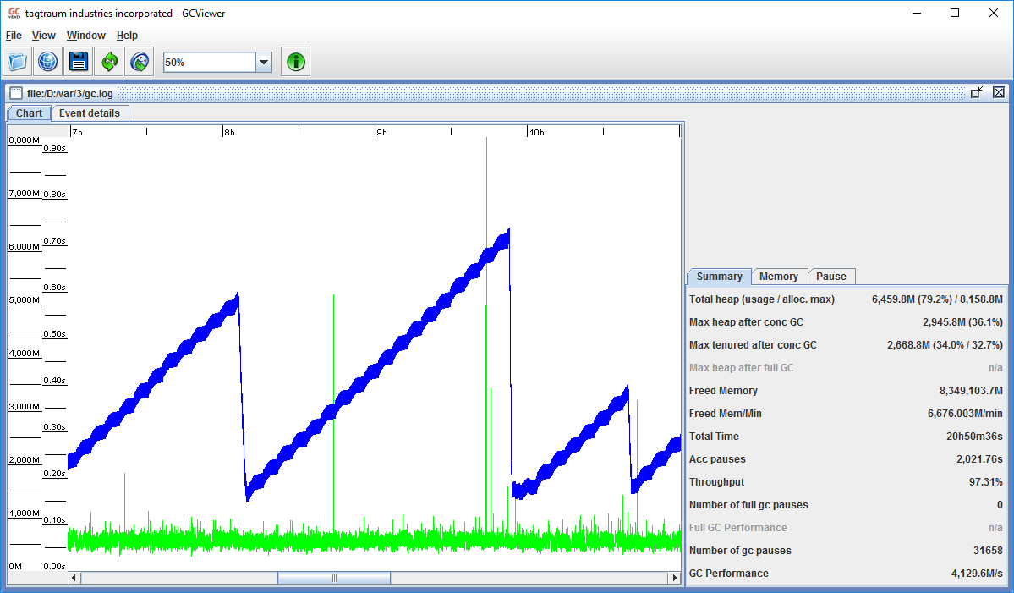
BOTTLENECKS IDENTIFICATION

Slide 13
PERFORMANCE. TOOLS
VisualVM
https://visualvm.github.io/
https://htmlpreview.github.io/?https://raw.githubusercontent.com/visualvm/visualvm.java.net.backup/master/www/gettingstarted.html
IBM HeapAnalyzer
https://www.ibm.com/developerworks/community/groups/service/html/communityview?communityUuid=4544bafe-c7a2-455f-9d43-eb866ea60091&open&S_TACT=105AGX59&S_CMP=GRsite-jw22
GCViewer
https://github.com/chewiebug/GCViewer

Slide 14
PERFORMANCE. TIPS AND TRICKS
Logical Problems / Not optimal code*
Use StringBuilder instead of +
Avoid using regular expressions
Use primitives and the stack
Avoid recursion
Use entrySet()
Use EnumSet or EnumMap
Optimize hashCode() and equals()
Tune garbage collection*
Cache data when reuse is likely*

Slide 15
PERFORMANCE. TIPS AND TRICKS
Use Exceptions only when you really need it
Use static methods
Do not use Date unless you have to use it. Use an ordinary long
Reduce methods size
Prefer local variables over fields
Use static readonly fields and constants
Use static methods and fields
Dictionary order, SortedDictionary
Override GetHashCode and Equals
Correct collections using (ArrayList)

Slide 16
PERFORMANCE. RESOURCES
Video
https://www.pluralsight.com/courses/java-understanding-solving-memory-problems
https://www.pluralsight.com/courses/understanding-java-vm-memory-management
https://www.youtube.com/watch?v=v6tJ3MTnLkc

Slide 17
PERFORMANCE. RESOURCES
Java Performance - Memory and Runtime Analysis - Tutorial - http://www.vogella.com/tutorials/JavaPerformance/article.html
The Principles of Java Application Performance Tuning - https://www.cubrid.org/blog/the-principles-of-java-application-performance-tuning
Java Performance: The Definitive Guide: Getting the Most Out of Your Code - http://shop.oreilly.com/product/0636920028499.do
Java Performance Tuning - http://www.javaperformancetuning.com/
Java Performance Companion - https://www.goodreads.com/book/show/23316035-java-performance-companion
Java Performance Optimization RefCard - https://dzone.com/refcardz/java-performance-optimization
Nitsan Wakart blog - http://psy-lob-saw.blogspot.com/p/about.html

Slide 18
DATABASE. TOOLS
MySQL Workbench
https://www.mysql.com/products/workbench/
https://www.mysql.com/products/workbench/performance/
mysqladmin
MyTOP / Mtop / Innotop (Linux)
https://www.serverdensity.com/monitor/mysql/how-to/
MySQL Performance Schema
http://mysql.wisborg.dk/2012/09/03/what-is-the-mysql-performance-schema-and-why-is-it-needed/
https://dev.mysql.com/doc/refman/5.6/en/performance-schema.html

Slide 19
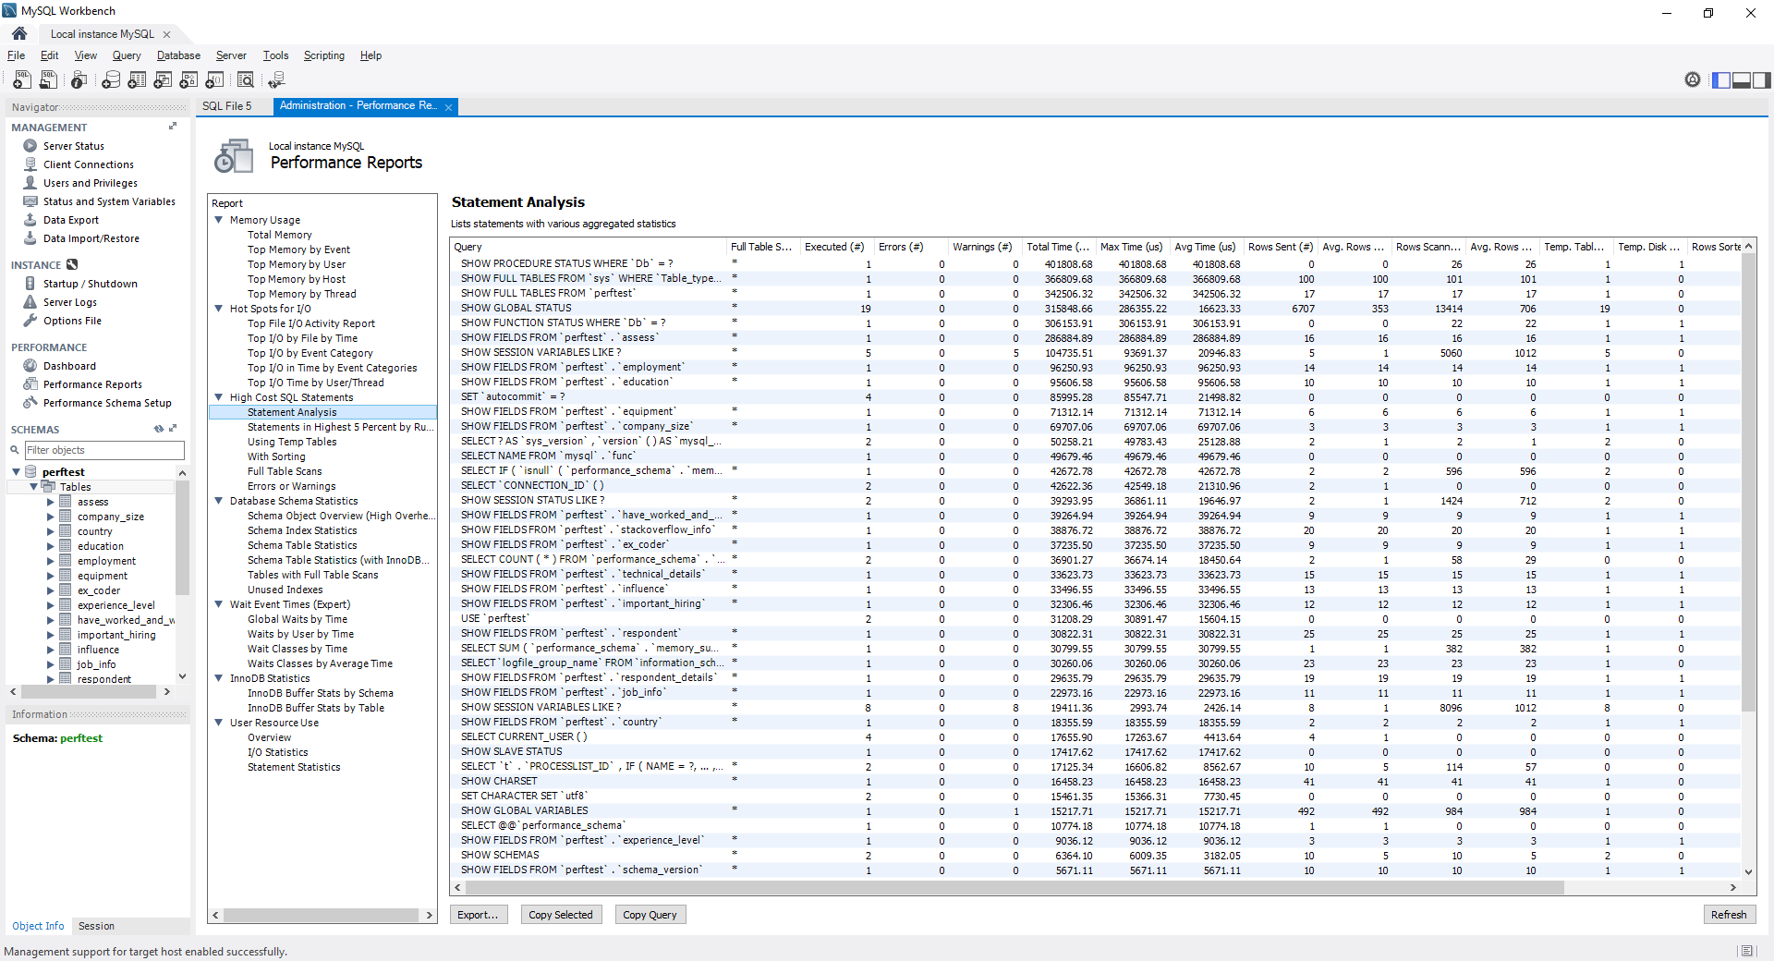
DATABASE. TOOLS

Slide 20
DATABASE. TIPS AND TRICKS
Reduce number of queries
Reduce round-trips
Retrieve only needed records
Don’t select not needed columns – SELECT * FROM Products
Entity Framework – rewrite with stored procedures
Use batch operations for multiple inserts
Use Cache
Use integer primary keys over guid

Slide 21
DATABASE. TIPS AND TRICKS
Define correct length for varchar columns
Use Indexes
Seek vs Scan – like, avoid functions in WHERE
Estimated vs Actual Query Plan
Update Statistics
Avoid transactions
Avoid cursors
Normalization\Denormalization
Partitioning
Use triggers only if necessary

Slide 22
DATABASE. RESOURCES
15 Useful MySQL/MariaDB Performance Tuning and Optimization Tip - https://www.tecmint.com/mysql-mariadb-performance-tuning-and-optimization/
MySQL Performance Tuning and Optimization Resources - https://www.mysql.com/why-mysql/performance/
10 essential performance tips for MySQL - https://www.infoworld.com/article/3210905/sql/10-essential-performance-tips-for-mysql.html

Slide 23
WEB OPTIMIZATION
Resources
https://developers.google.com/web/fundamentals/performance/
https://dou.ua/lenta/digests/wpo-digest-0/
https://www.keycdn.com/blog/website-performance-optimization/
https://medium.com/airbnb-engineering/performance-tuning-e10ac94916df
Tools
Fiddler - http://www.telerik.com/fiddler
https://www.keycdn.com/blog/website-speed-test-tools/
http://www.softwaretestinghelp.com/performance-testing-tools-load-testing-tools/

Slide 24
TRAINING TASK
Optimize test web application
Performance optimization
Investigate memory usage
Tune database queries
Create performance optimization report

Slide 25
Q & A

