Slide 1
Next Bill Amount Prediction
2,000
billing records
Predict each customer's next bill, one cycle ahead
1,222
customers
7
unseen test months
Catch bill shock before the customer does
Notes:
WHAT: predict next_bill_amount for every customer, one billing cycle ahead, using only information known when the previous bill was issued.
WHY: unexpected increases cause bill shock, support calls and late investigation, so the company wants an early view.
DATA: 2000 records, 1222 customers (1-3 records each), Jan 2024 to Aug 2026, synthetic.
Overview: chronological split, baselines, 10 models, tuning, explanation, high-bill flag.

Slide 2
The project brief in five questions
WHAT IS THE PROBLEM?
WHO ARE THE CUSTOMERS?
WHAT ARE WE SOLVING?
Customers get surprised by high bills
1,222 subscribers on monthly plans
Predict each customer's next bill
Nobody sees the next bill coming, so shock turns into support calls.
Five customer types, six regions, ten plans from Lite to Premium.
One cycle ahead, from plan, usage and past bills.
WHAT DO WE ASSUME?
WHY DO WE NEED THIS?
Bills follow plan, usage and charges
Recent history predicts the next bill
An early warning before bill shock
Only facts known at the last bill are used
The data is synthetic: it proves the method
Fewer surprise calls, earlier review, and a budget estimate for each customer.
Notes:
SCRIPT, as if the listener is the person who asked for the project. Five questions, left to right, top row then bottom row.
WHAT IS THE PROBLEM: a customer opens a bill far higher than expected. That is bill shock. Today nobody sees the next bill coming, so the shock turns into support calls and late investigation.
WHO ARE THE CUSTOMERS: 1,222 subscribers on monthly plans. Five customer types (Individual, Family, Youth, Senior, Small Business), six regions and ten plan types from Lite 199 to Premium 1549. Each has 1 to 3 monthly bills in the data.
WHAT ARE WE SOLVING: predict each customer's next bill amount one billing cycle ahead, from the plan, usage, charges and past bills. The output is one number per customer, plus a likely range and a short watch list of possible high bills.
WHAT DO WE ASSUME: (1) a bill equals plan, usage-based charges and tax, which I checked in the data; (2) recent history predicts the next bill; (3) only facts known when the last bill was issued are used, so there is no peeking at the future; (4) the data is synthetic, so the results prove the method, not a live business. Sudden spikes may also be partly random.
WHY DO WE NEED THIS: an early view of the next bill means fewer surprise calls, earlier review of unusual bills, and a budget estimate for the customer.

Slide 3
The whole project in eight steps
The story in plain words, from the problem to the result
1
The problem
2
The data
3
What we saw
4
The exam
Bill shock
2,000
45%
7 months
Surprise bills cause support calls
bills from 1,222 customers
repeat a recent bill, a few spike up to 10x
held back, never used for any choice
5
The race
6
The winner
7
The result
8
The limits
10 models
SVR
9% lower
Spikes
against five simple rules
tuned, picked by a rule set in advance
error than the best rule, in 7 of 7 months
big jumps stay unpredictable
Notes:
SCRIPT, for someone who has never heard of the project. Read left to right, top row then bottom row.
1 THE PROBLEM: a customer opens a bill that is far higher than expected. That is bill shock: support calls and late investigation. The company wants an early view of each customer's next bill.
2 THE DATA: 2,000 billing records from 1,222 customers, Jan 2024 to Aug 2026. Plan, usage, charges and the history of past bills. The data is synthetic, so this shows the method, not a live business.
3 WHAT WE SAW: bills are very stable. 45.1% of next bills equal one of the last three bills, and the median bill is 1.15 times plan price plus tax. But a long tail of spikes reaches almost 10 times. That is why I judge by MAE and use robust models.
4 THE EXAM: the last 7 months (Feb to Aug 2026) are locked away. Training uses Jan 2024 to Jan 2026 only, because a forecast predicts the future from the past. A random split would leak the future.
5 THE RACE: five simple rules (previous bill, averages, plan median, training mean) set the bar. Ten models try to beat the best rule, the plan-type median.
6 THE WINNER: tuned SVR, chosen by a rule fixed in advance: lowest tuned cross-validated MAE.
7 THE RESULT: MAE 163.5 against 179.1, about 9% lower, and lower in all 7 test months. The MAE gain is reliable (bootstrap interval 6.7 to 24.1).
8 THE LIMITS: sudden spikes stay unpredictable. The worst 10% of bills produce 53.6% of the error, and the high-bill flag is only slightly better than chance.
The next slides open each step: approach (4), models (5), result (6), drivers and limits (7).

Slide 4
My approach: why this, not that
1
Time-based split
2
Train-only cleaning
3
Baselines first
Why: Forecast the future
Why: No data leakage
Why: A bar to beat
Not: Random split
Not: Deleting spike rows
Not: Judging by R² alone
4
Time-based CV
5
Robust models + MAE
6
Tune on folds
Why: Respects time order
Why: Bills have spikes
Why: Test stays unseen
Not: Shuffled K-fold
Not: Squared loss only
Not: Tuning on test
Notes:
1 TIME SPLIT: train Jan 2024 to Jan 2026 (1563 rows), test Feb to Aug 2026 (437 rows). WHY: a bill forecast predicts the future from the past. WHY NOT random: it trains on months after some test records, so scores look better than real use.
2 TRAIN-ONLY CLEANING: clip limits (1st/99th percentile), encoders and scalers are fitted on training data. WHY NOT deleting rows: only 1563 rows and the spikes are real bills the business wants to anticipate.
3 BASELINES: previous bill, 3 and 6 bill averages, plan median, mean. Best baseline: plan-type median (test MAE 179.1). WHY NOT R2 alone: a few huge bills dominate it.
4 TIME-BASED CV: 5 expanding-window folds inside the training months. WHY NOT shuffled K-fold: it trains on the future to predict the past.
5 ROBUST MODELS AND MAE: Huber and absolute-error losses care about the typical bill. MAE is the typical error in money.
6 TUNING: GridSearch/RandomizedSearch on the same time folds, scored on MAE. WHY NOT tune on test: it would no longer be unseen.
ALSO TESTED, NOT ADOPTED: 9 engineered features (MAE gain 0.03%), feature selection (0.14%) and PCA (worse). Rule: adopt only if CV MAE improves by more than 1%.

Slide 5
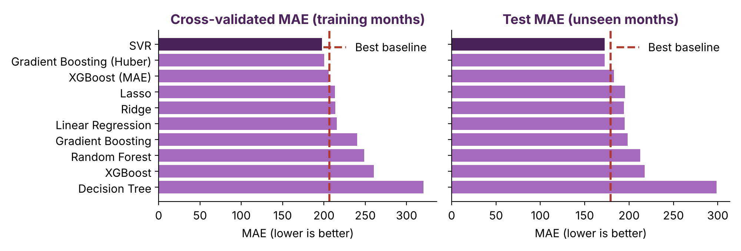
Ten models, one winner
Robust loss wins on MAE
Tuned SVR chosen
Extra features and PCA: no gain
Notes:
MODELS: Linear, Ridge, Lasso, Decision Tree, Random Forest, Gradient Boosting, Gradient Boosting (Huber), XGBoost, XGBoost (MAE) and SVR. WHY: tabular regression with about 1500 rows; linear models explain, trees and boosting capture non-linear effects, SVR is a smooth kernel model; two robust-loss versions because bills spike.
WHY NOT: ARIMA/Prophet/LSTM (customers have only 1-3 records, no real time series; deep learning needs far more data), classification models (the target is a number), CatBoost/LightGBM (similar to XGBoost, no extra library).
RESULT (CV MAE): SVR 197.5, GB Huber 200.3, XGBoost MAE 205.7, linear about 213-215, untuned trees much worse (Decision Tree and XGBoost overfit).
TUNING: SVR 197.5 to 184.5, XGBoost MAE 205.7 to 187.0, GB Huber 200.3 to 190.0. Final model chosen by a rule fixed in advance: lowest tuned CV MAE = SVR (C=1000, epsilon=10, gamma=0.003).
HONEST TRADE-OFF: the linear models have the best RMSE and R2 (about 0.54); SVR is best on MAE and WAPE. The three robust models are close in CV.

Slide 6
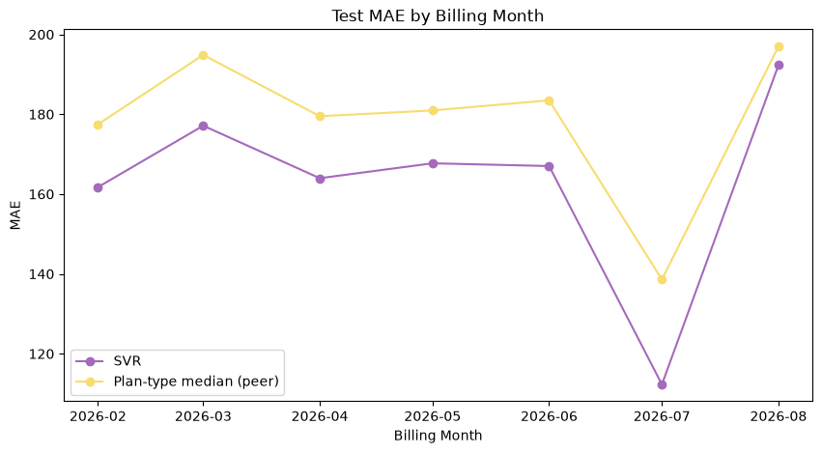
Results on unseen months
163.5
MAE (best baseline: 179.1)
20.2%
WAPE (best baseline: 22.1%)
7 of 7
Test MAE by month: SVR (purple) vs best baseline (yellow)
test months beat the baseline
Notes:
FINAL MODEL: tuned SVR. Test months Feb to Aug 2026, never used for any choice.
NUMBERS: MAE 163.5 vs 179.1 baseline (about 9% lower), RMSE 328.7 vs 335.0, R2 0.508 vs 0.489, WAPE 20.2% vs 22.1%.
IS IT RELIABLE: paired bootstrap, MAE reduction 15.5 with 95% interval [6.7, 24.1] so reliable. RMSE reduction 6.4 with interval [-7.1, 18.9] so NOT clear: both model and baseline miss the big spikes.
OVERFITTING: train MAE 157.0 vs test MAE 163.5, so no sign of overfitting. Lower MAE than the baseline in all 7 months, only a small gap in August.
WEAK SPOT: bills above 1500 (MAE about 817); the ten largest errors are all under-predicted spikes; the worst 10% of records give 53.6% of the total error.

Slide 7
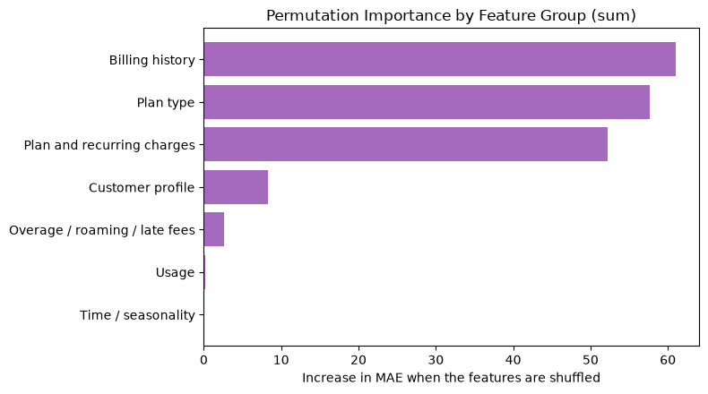
Drivers, trust and limits
0.565
high-bill flag ROC-AUC: a review list, not an alarm
75.5%
of bills inside the 80% interval
What moves the prediction (by feature group)
Plan and history drive the bill. Big spikes stay unpredictable.
Notes:
DRIVERS: permutation importance on the test months. Top features: base_charge (+36.7 MAE when shuffled), average_bill_last_6_months (+35.9), plan type Lite 199 (+26.3). By group, billing history, plan type and recurring plan charges explain almost everything; usage, overage, roaming, late fees and calendar month add almost nothing. Customer-level drivers: each feature is set to its typical value and the change in the prediction is measured. These show influence on the prediction, not proven billing causality. WHY NOT SHAP: extra library, slow for kernel models.
HIGH-BILL FLAG: high bill = actual bill at least 1.5x the customer's own 6-month average (11.2% of test records). Flag when predicted >= t x 6-month average, t = 1.1 chosen on out-of-fold training predictions. Result: 51 flagged, precision 0.18, recall 0.18; ROC-AUC 0.565 (random 0.5); precision among the top 25 is 20% vs a base rate of 11.2%. So: better than random but weak.
UNCERTAINTY: 80% prediction interval from 10th/90th percentile boosting models covers 75.5% of actual bills (slightly narrow because of upward spikes), average width about 507.
LIMITS: only 2000 records with 1-3 per customer, synthetic data, spikes may be random. NEXT STEPS: longer monthly history, a separate bill-shock classifier, a log-target model, rolling retraining.

