Slide 1
Machine Learning-Based Financial Fraud Detection System
Identifying Suspicious Banking Transactions and Payment Activities
Domain
Approach
Financial Security & Banking
Machine Learning & Anomaly Detection
Output
Platform
Real-Time Fraud Alerts & Risk Scoring
Python-Based Intelligent Pipeline
Ms.PUTCHA HAVEELA
324129510047

Slide 2
Introduction & Problem Statement
The Core Challenge
Operational Impact
Financial institutions process millions of digital transactions daily, making manual fraud detection entirely impractical at scale. The volume and velocity of modern payment activity demand automated, intelligent solutions.
Manual analysis of large transaction volumes is operationally impractical
Undetected fraud leads to direct financial losses and reputational damage
Static rule systems generate excessive false alerts, increasing operational burden
Emerging fraud patterns go undetected until rules are manually updated
Why Traditional Systems Fail
Rule-based systems rely on manually defined thresholds and static logic. They cannot adapt to new fraud techniques as fraudsters continuously evolve their methods, rendering fixed rules obsolete over time.
Project Objective
Develop an intelligent, automated system for identifying fraudulent banking transactions and payment activities. Machine learning enables real-time detection of suspicious patterns that traditional rule-based systems fundamentally cannot capture.

Slide 3

Existing System Limitations
Current fraud detection infrastructure relies on a rule-based approach: manually defined transaction rules combined with threshold-based monitoring. While straightforward to implement, this paradigm carries fundamental structural weaknesses.
Unseen Fraud Patterns
Scalability Failure
Continuous Rule Decay
Rule-based systems cannot detect previously unseen fraud patterns. Any novel technique employed by fraudsters passes through undetected until a new rule is manually authored and deployed.
Manual investigation of large transaction volumes is operationally impractical. Human analysts cannot review the throughput of modern digital payment infrastructure at the required speed.
Rules require continuous updates as fraudsters adapt their behavior. This creates a perpetual maintenance burden and an inherent lag between new fraud techniques and detection capability.
Excessive False Alerts
No Historical Learning
Static threshold rules generate excessive false positives, overwhelming security teams and reducing the signal-to-noise ratio of genuine fraud alerts.
Rule-based systems have limited ability to learn from historical transaction patterns. Each rule is authored in isolation, with no mechanism to generalize from past fraud cases automatically.
The fundamental need: intelligent systems capable of learning and adapting to emerging fraud techniques without manual rule authorship.

Slide 4

Proposed System Architecture
End-to-End Machine Learning Pipeline — a centralized platform integrating Python-based data preprocessing, classification, anomaly detection, predictive analytics, and real-time risk scoring.
Feature Engineering
Data Collection
Gather transaction logs and metadata
Create signals for models and scoring
Modeling & Monitoring
Preprocessing
Clean, validate, and normalize records
Anomaly detection, prediction, dashboards
Each stage of the pipeline is designed to be modular and sequential, ensuring that raw transaction data is progressively transformed into actionable fraud intelligence. The pipeline culminates in an interactive dashboard that surfaces risk scores and alerts to security teams in real time.
Data Layer
ML Layer
Scoring Layer
Action Layer
Collection, preprocessing & validation
Anomaly detection & classification
Risk score generation & prediction
Alerts, dashboard & monitoring

Slide 5
Transaction Data Analysis & Features
Transaction Attributes Analyzed
Pattern Recognition Logic
The system identifies deviations from established normal behavior across multiple dimensions simultaneously:
1
Amount & Frequency
Transaction value and rate of occurrence over time windows
Unusual transaction amounts relative to account history
Unexpected geographic locations or cross-border activity
Abnormal transaction frequencies within short time windows
Unfamiliar or previously unseen device signatures
2
Location & Method
Geographic origin and payment channel (card, wire, digital wallet)
Multi-Dimensional Advantage
Multi-dimensional analysis captures complex fraud indicators that single-factor threshold rules fundamentally cannot detect. A transaction may appear normal on any single dimension while being clearly anomalous when all features are considered jointly.
3
Account Behavior
Baseline behavioral profile derived from account history
4
Device Fingerprinting
Device identity, browser signatures, and access patterns
5
Historical Patterns
Long-term transaction sequences and temporal behavior trends

Slide 6
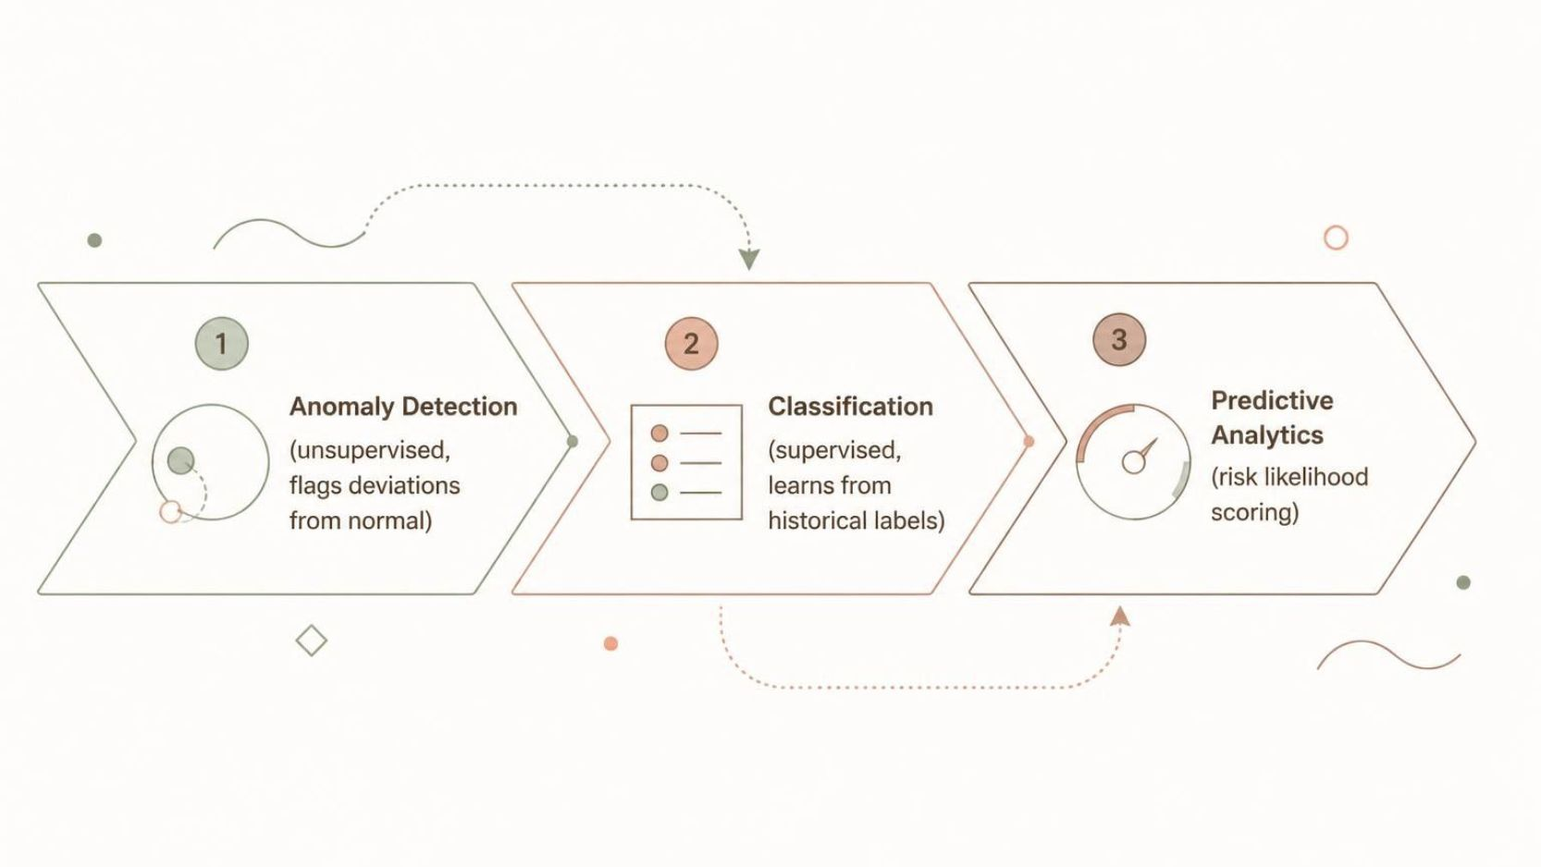
Machine Learning & Anomaly Detection Approach
The system employs a dual-strategy approach combining unsupervised anomaly detection with supervised classification algorithms, augmented by predictive analytics for fraud likelihood estimation.
Anomaly Detection
Predictive Analytics
Identifies transactions that significantly deviate from normal behavioral patterns. Flags unusual amounts, frequencies, locations, and device behavior for further investigation without requiring labeled training examples for every fraud type.
Analyzes historical transaction patterns to predict fraud likelihood for incoming transactions and prioritize the investigation queue for security analysts based on estimated risk.
Classification Algorithms
Core Advantage
Supervised models learn patterns from historical labeled transaction data to classify incoming transactions as normal or fraudulent. Algorithms under consideration:
Automated learning enables detection of previously unseen fraud patterns and continuous adaptation to evolving techniques—without requiring manual rule authorship for each new fraud variant.
Logistic Regression
Decision Tree
Random Forest
Support Vector Machine (SVM)
Gradient Boosting

Slide 7

Fraud Detection Workflow & Risk Scoring
Real-Time Detection Pipeline — from raw transaction ingestion to actionable fraud alert and security response.
Data Collection
ML Analysis
Risk Classification
Preprocessing
Risk Scoring
Ingest raw transaction events
Run models and anomaly detection
Clean data & extract features
Compute fraud probability score
Label low, medium, or high
Risk Scoring Mechanism
Risk Classification Tiers
Each transaction receives a quantitative risk score derived from its characteristics and the outputs of the trained ML models. This score drives triage: security teams focus investigative effort on high-risk transactions first, maximizing detection efficiency.
Low Risk
Medium Risk
Consistent with normal behavioral profile; auto-cleared
Minor anomalies detected; logged for review
High Risk
Strong fraud indicators; immediate alert generated

Slide 8

Interactive Dashboard & Fraud Alert System
Dashboard Functionality
Fraud Alert System
Real-Time Monitoring
The alert system identifies suspicious transactions, surfaces associated risk scores, and presents contextual transaction details to enable rapid analyst decision-making.
Security teams can prioritize investigation queues based on risk tier, reducing mean time to response for high-severity fraud events.
Live transaction feed with running count of suspicious transactions flagged by the detection pipeline
Fraud Alerts
Detailed alert records including transaction metadata, risk scores, and classification rationale
Centralized Monitoring Benefit
A single unified platform consolidates transaction monitoring, fraud analytics, and security reporting. This centralized architecture enables faster organizational response to emerging fraud threats and provides a consistent audit trail for regulatory compliance.
Transaction Analytics
Trend visualizations covering fraud rates, payment methods, geographic distribution, and device analysis
Centralized monitoring enables faster response to emerging threats by eliminating siloed, tool-by-tool investigation workflows.
Security Reports
Risk assessment summaries and account behavior analysis for compliance and audit purposes

Slide 9
Model Training, Evaluation & System Advantages
Model Training Process
Evaluation Metrics
01
Performance is assessed using a comprehensive suite of metrics, with particular emphasis on Precision and Recall given the inherently imbalanced nature of fraud datasets (fraudulent transactions represent a small minority of total volume).
Prepare Historical Data
Collect and curate labeled transaction records
Accuracy
Precision
02
Overall correct classification rate
Fraction of flagged transactions that are truly fraudulent
Preprocessing
Clean, normalize, and validate input features
Recall
F1-Score
03
Fraction of actual fraud cases successfully detected
Harmonic mean of Precision and Recall
Feature Creation
Engineer behavioral and contextual features
04
ROC-AUC
Confusion Matrix
Train & Evaluate
Discriminative power across classification thresholds
Full breakdown of TP, TN, FP, FN classifications
Fit models and assess performance metrics
Key System Advantages
05
Automated fraud detection with faster identification of suspicious transactions
ML-based pattern recognition detects unusual behavior across multiple dimensions
Risk-based monitoring and centralized transaction analytics
Reduced manual effort, improved security, and scalable architecture
Deploy
Integrate trained model into live detection pipeline

Slide 10
Applications, Expected Outcomes & Conclusion
Target Applications
Expected Outcomes
Improved identification of suspicious transactions and fraudulent payment activities
Faster detection of abnormal behavior and improved transaction monitoring
Reduced potential financial losses and improved overall transaction security
Better fraud investigation prioritization through risk-based triage
Data-driven financial risk management replacing manual rule maintenance
Banks & Financial Institutions
Core banking fraud detection across retail and corporate transaction channels
Fintech & Payment Gateways
Conclusion
Real-time screening for fintech platforms, payment processors, and digital wallets
The Machine Learning-Based Financial Fraud Detection System provides an intelligent, automated approach for identifying suspicious banking transactions. By combining Python-based data preprocessing, anomaly detection, classification algorithms, and predictive analytics, the system enables financial institutions to detect fraud more efficiently, improve transaction security, reduce financial losses, and support data-driven risk management.
Digital Banking & Online Payments
Fraud monitoring for digital banking platforms and e-commerce payment services

