Slide 1

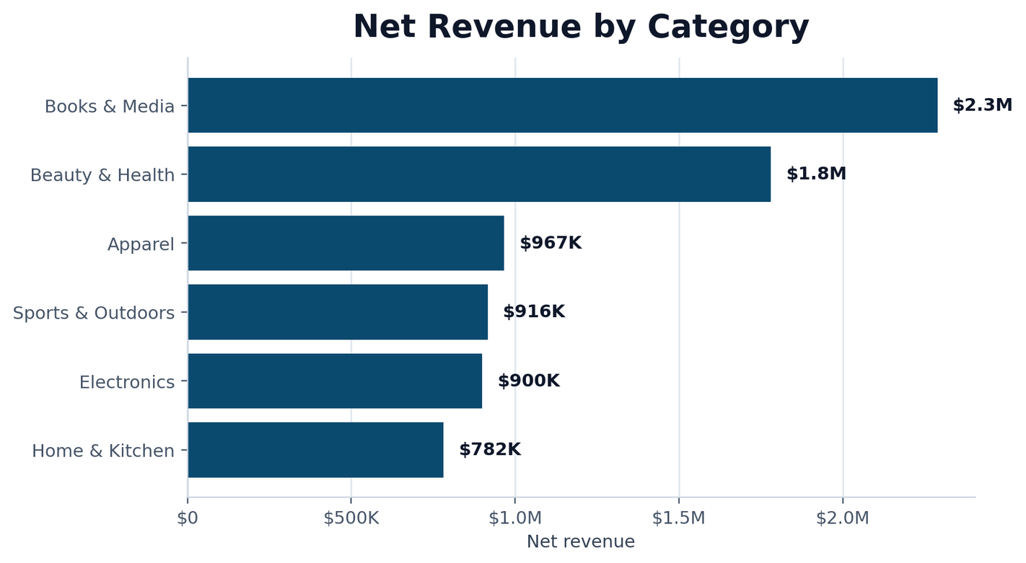

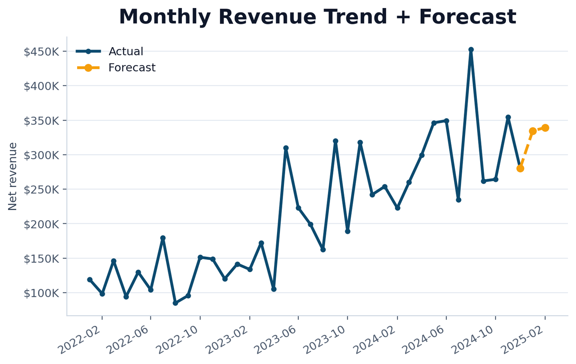
UrbanCart
Big Data Analytics
Subject: Big Data
Room: Accounting Lab
Lecturer: Mr. Min Sothearith
Group Members:
Keo Samnang • Sue Theara • Teng Nyka • Yin Panharith
SQL | pandas | NumPy | Matplotlib | Jupyter
Notes:
1

Slide 2
Presentation Roadmap
Team members
What we will cover
•
Business problem
Keo Samnang
SQL Queries 1–4, database loading, date standardization, and missing-value handling.
•
Data pipeline
Yin Panharith
NumPy methods, business charts, report preparation, and reusable pipeline.
•
Cleaning evidence
Teng Nyka
SQL Queries 5–10, outlier handling, product catalog reconciliation, and time-series analysis.
•
NumPy methods
•
8 business findings
Sue Theara
GitHub repository organization, README, requirements, presentation slides, and project validation.
•
Recommendations + deliverables
02
Notes:
2

Slide 3
Business Context
PROBLEM TO SOLVE
Goal
Messy ecommerce data makes business decisions risky.
Raw data → clean data → models → business actions
•
Who are the most valuable customers?
•
Which categories and products really perform?
•
Can legacy and supplier data be trusted?
8
1
business findings
reusable pipeline
03
Notes:
3

Slide 4
Data Sources & Workflow
Data scale
2,500
9,000
20,176
12,000
customers
orders
clean order items
web sessions
Workflow
SQL extraction → pandas cleaning → NumPy methods → charts → pipeline
External files: legacy customer export + supplier product catalog
Output: clean datasets, model results, charts, report and GitHub repository.
04
Notes:
4

Slide 5
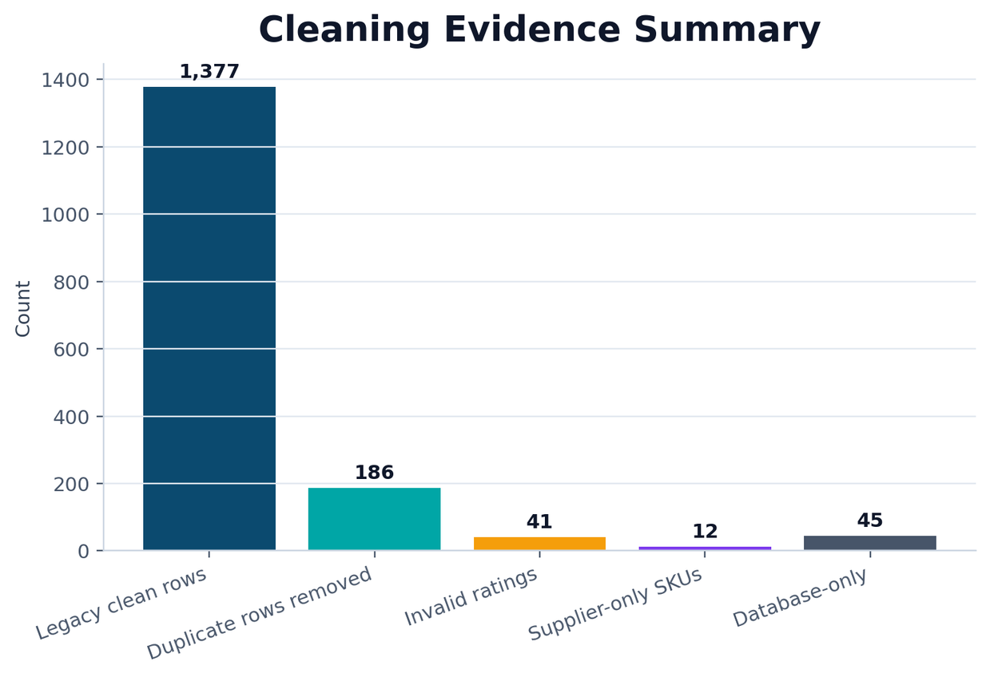
Phase 2 — Cleaning Evidence
AUDIT RESULTS
1,377
legacy customer records kept
0
unparsed signup dates
186
duplicate order rows removed
Key policy
Do not silently fill everything with zero. Keep flags and audit tables.
05
Notes:
5

Slide 6
Methods Used
PHASE 1 TO PHASE 5
SQL
10 queries + window functions
10
9
SQL queries
clean datasets
pandas
cleaning + integration
NumPy
RFM, similarity, regression, simulation
4
8
NumPy methods
insight charts
Matplotlib
8 business charts
Pipeline
python main.py
The next slides are the core findings.
06
Notes:
6

Slide 7
Finding 1 — Category Revenue
BUSINESS INSIGHT 1 OF 8
Which category generates the most revenue?
Books & Media
$2.29M net revenue
Meaning
Books & Media leads the business, with Beauty & Health close behind.
Action
Protect inventory and campaign budget for top categories.
07
Notes:
7

Slide 8
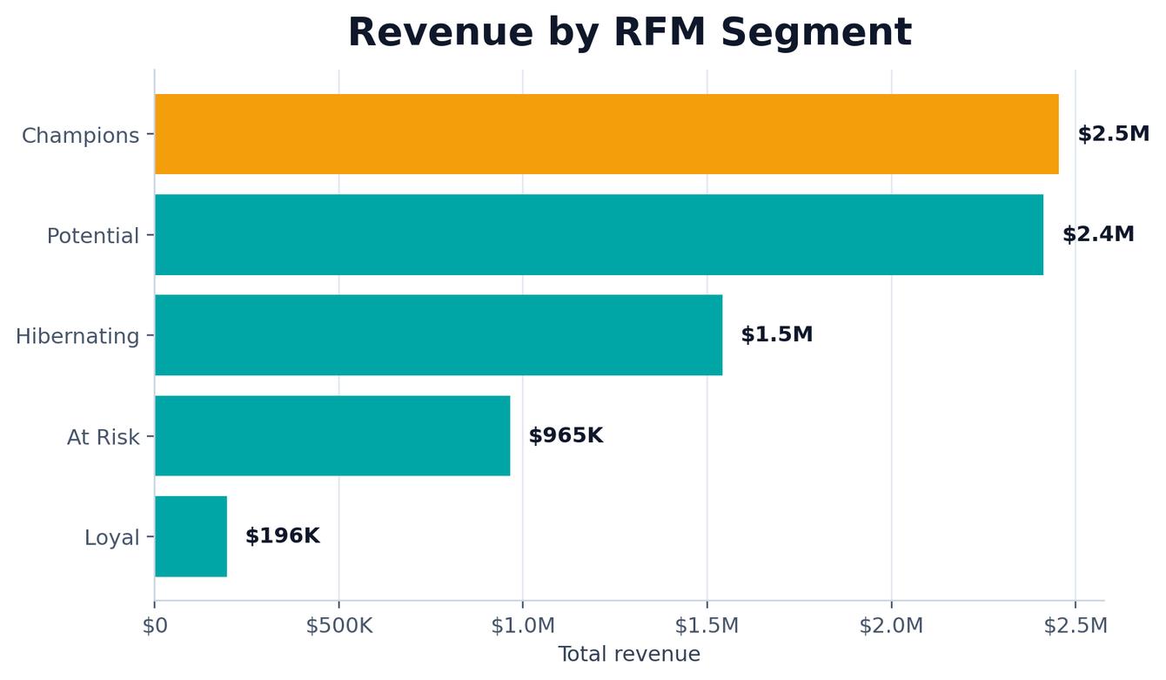
Finding 2 — RFM Customer Value
BUSINESS INSIGHT 2 OF 8
Which segment creates the most value?
Champions
$2.46M revenue
Meaning
A small customer segment contributes a very large revenue share.
Action
Give Champions loyalty rewards and early churn monitoring.
08
Notes:
8

Slide 9
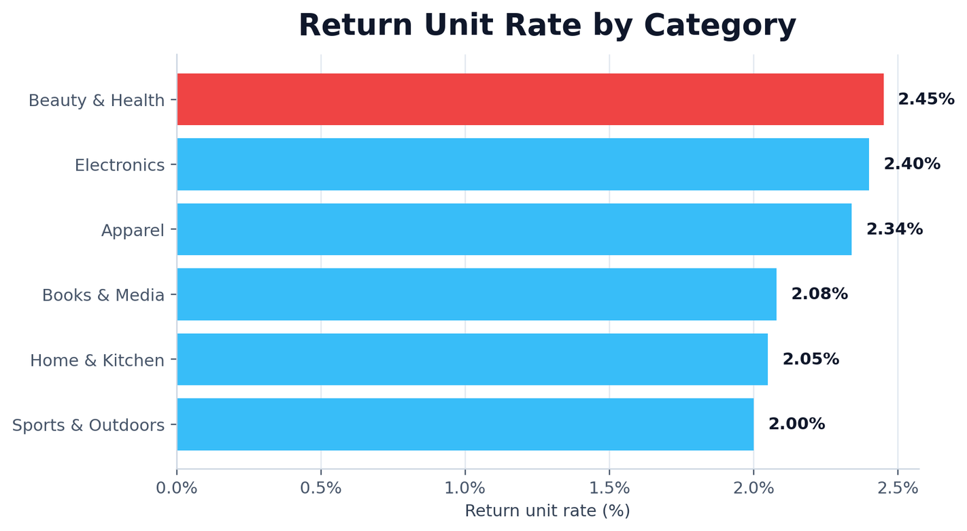
Finding 3 — Return Rate
BUSINESS INSIGHT 3 OF 8
Where is return risk highest?
2.45%
highest return rate
Meaning
Returns can reduce profit and may point to quality or description issues.
Action
Inspect suppliers, product pages and packaging in Beauty & Health.
09
Notes:
9

Slide 10
Finding 4 — Revenue Forecast
BUSINESS INSIGHT 4 OF 8
What is near-term revenue outlook?
$334.6K
month 1 forecast
Meaning
Revenue is volatile, so the forecast should be used as a planning range.
Action
Refresh the forecast monthly and prepare demand ranges, not fixed targets.
10
Notes:
10

Slide 11
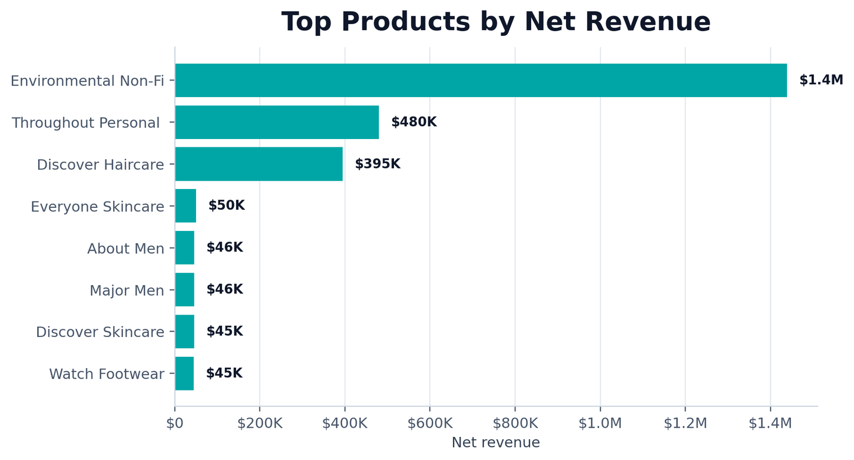
Finding 5 — Top Products
BUSINESS INSIGHT 5 OF 8
Which products need inventory protection?
Top 8
products shown
Meaning
A small set of products drives a large part of net revenue.
Action
Prioritize replenishment and recommendation placement for high-revenue products.
11
Notes:
11

Slide 12
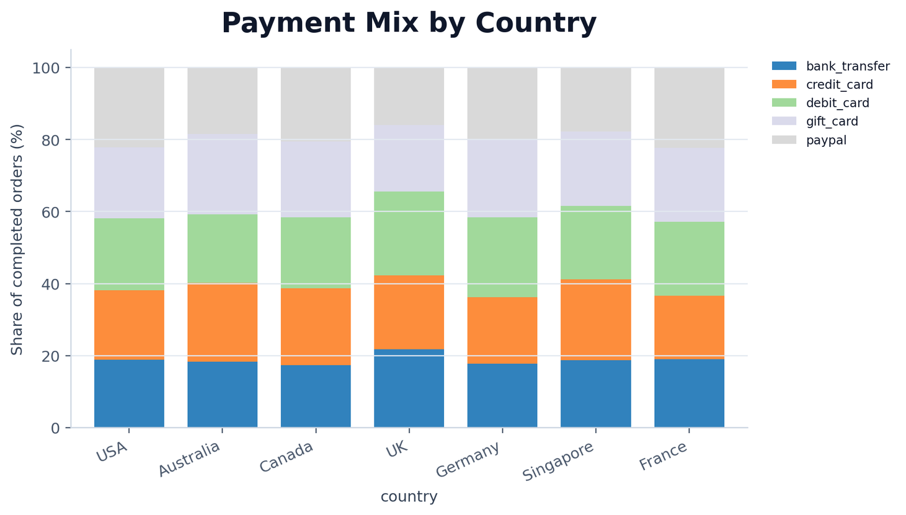
Finding 6 — Payment Mix
BUSINESS INSIGHT 6 OF 8
Do countries use the same payment methods?
22.27%
Australia gift cards
Meaning
Checkout design should not assume one universal payment preference.
Action
Localize payment options and test provider ordering by country.
12
Notes:
12

Slide 13
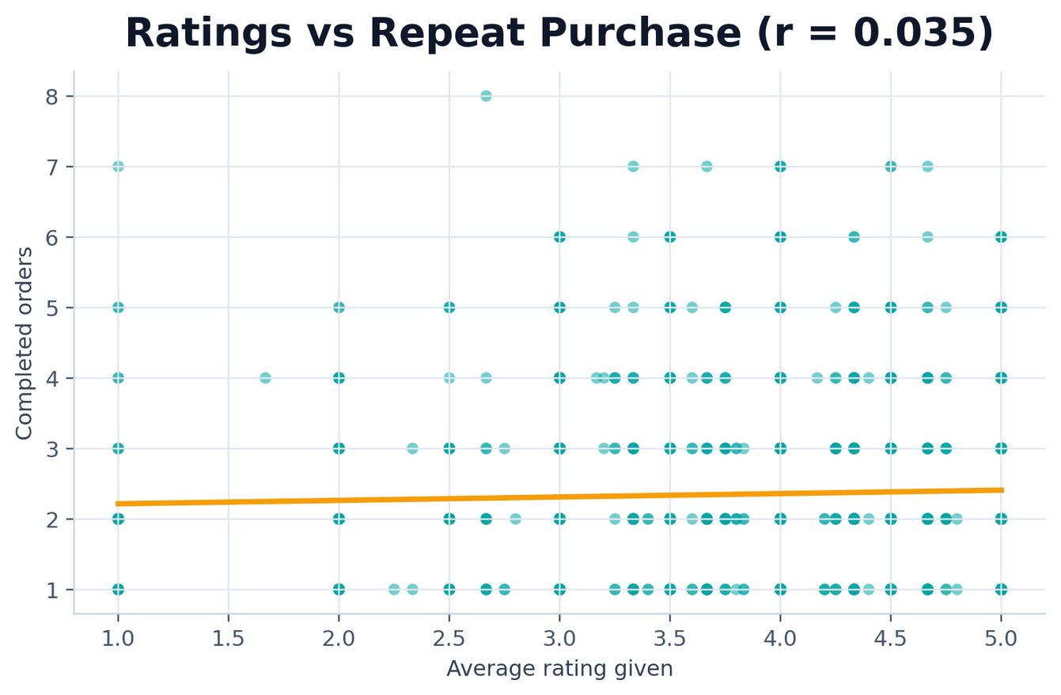
Finding 7 — Ratings vs Repeat Purchase
BUSINESS INSIGHT 7 OF 8
Do ratings explain repeat purchase?
r = 0.035
weak relationship
Meaning
Ratings alone are a weak loyalty signal.
Action
Combine ratings with RFM value, recency and web engagement.
13
Notes:
13

Slide 14
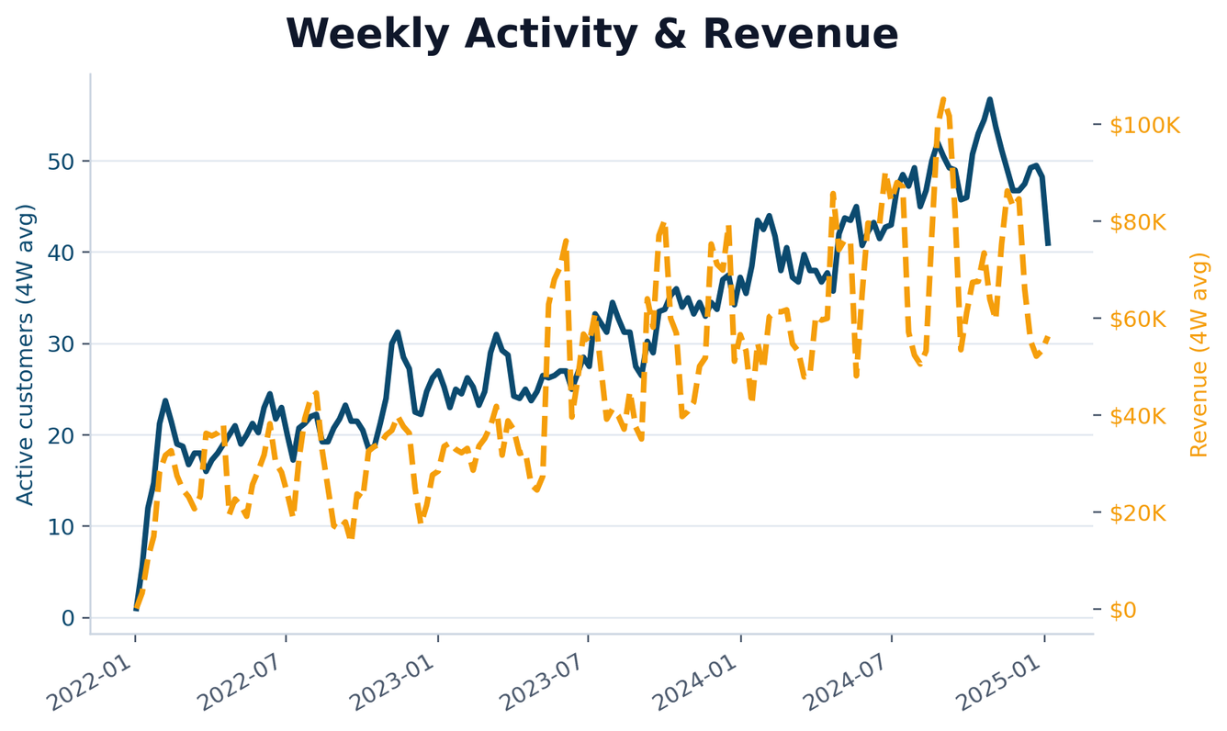
Finding 8 — Weekly Activity
BUSINESS INSIGHT 8 OF 8
Do engagement and revenue move together?
4-week
moving averages
Meaning
Active customers and revenue can diverge because of basket size, discounting and product mix.
Action
Monitor both metrics together every week.
14
Notes:
14

Slide 15
Recommendations
01
Protect high-revenue categories
Keep Books & Media and top products in stock.
02
Retain Champions
Reward high-value customers and monitor churn risk.
03
Reduce returns
Investigate Beauty & Health quality and product content.
04
Improve product governance
Resolve supplier-only and database-only SKU exceptions.
05
Plan with uncertainty
Use forecasts as ranges and refresh monthly.
15
Notes:
15

Slide 16
Submission Package
REPOSITORY CONTENTS
Run command
queries.sql
10 SQL queries
python main.py
analysis.ipynb
Phases 1–4 notebook
Regenerates clean data, tables, models and charts.
data/processed
clean reusable datasets
report.pdf
52-page written report
executive_summary.pdf
1-page management summary
README.md
run steps + team contributions
main.py + src/pipeline.py
one-command pipeline
16
Notes:
16

Slide 17
Thank you
Decision-ready analytics starts with clean data.
Group 9
Keo Samnang • Sue Theara • Teng Nyka • Yin Panharith
Q&A
Notes:
17

