Slide 1
Data Analysis, Gradient Descent, and Stochastic Gradient Descent : A Case Study
Saumya puthenveettil
Fall 2018

Slide 2
METHODS
Collect data about 50 states + District of Columbia for Median Household Income, Median Educational Attainment (At least a Bachelor’s Degree) between 2012 and 2016.
Create Scatter plot of 50 states + Washington D.C by Median Household Income and Educational Attainment. Label the states by regions. REGION 0 : Northeast, REGION 1:South, REGION 2: Midwest, REGION 3: West.
Create scatter plot that highlights regions and find the centroid of the clusters
Standardize the data and classify the regions using K Nearest Neighbor
Create a linear regression line using Gradient Descent and Stochastic Gradient Descent

Slide 3
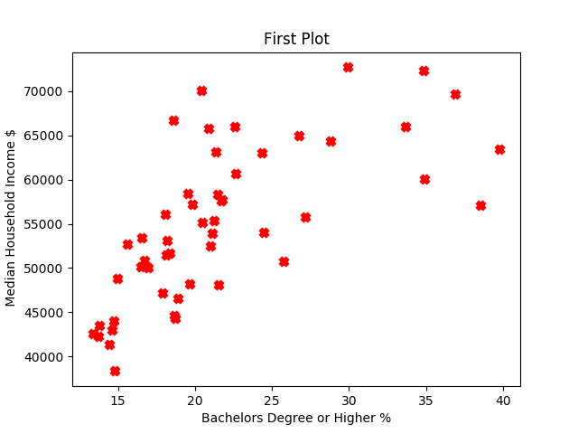
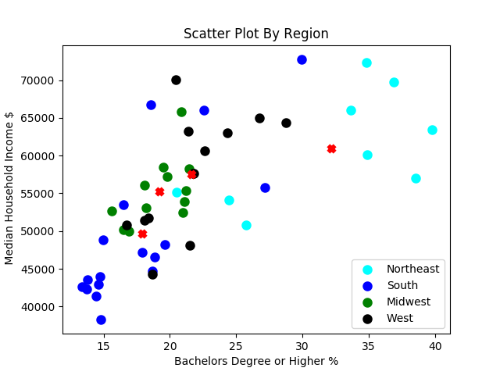
SCATTER PLOTS

Slide 4

K- Nearest Neighbor Classification
X = EDUCATION, INCOME
Y = REGION
Supervised learning
K Nearest neighbor uses the majority vote to assign a label
Use some kind of distance metric to calculate the distance between two points. Most commonly, Euclidean distance:
Take the 1-Nearest neighbor and assign this class label
Test size is 20% of Data set

Slide 5
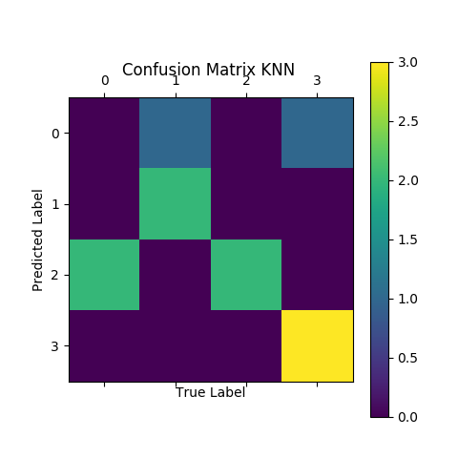
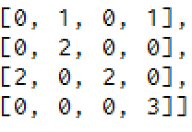
K-NN Confusion Matrix
Y True = [3, 0, 0, 2, 2, 3, 3, 2, 1, 2, 1]
Prediction= [3, 3, 1, 2, 0, 3, 3, 2, 1, 0, 1]
64% Classification Accuracy

Slide 6

Linear Regression with Gradient Descent
X = Education
Y = Income
Optimization of parameters to get the best fit line. Keep a constant Learning Rate.
Goal is to minimize the cost function J, or the Mean Squared Error
$y=m x+b$
$J= \sum_{i=1}^{N}{\frac{({Y−y)}^{2}}{N}}$
$\frac{∂J}{∂m}$ = $\frac{−2}{N}\sum_{i=1}^{N}{x(Y−y)}$
$\frac{∂J}{∂b}$ = $\frac{−2}{N}\sum_{i=1}^{N}{(Y−y)}$
$m=m − α\frac{∂J}{∂m}$
$b=b − α\frac{∂J}{∂b}$

Slide 7
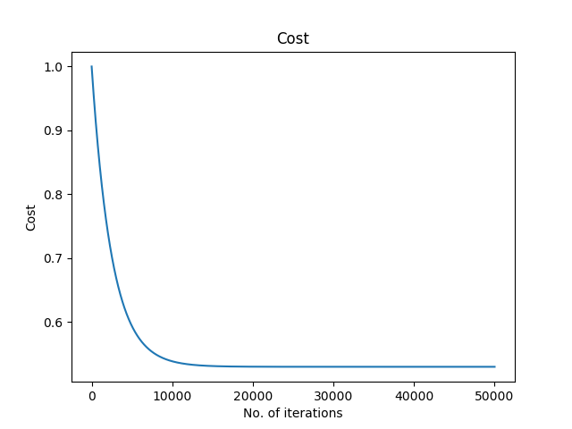
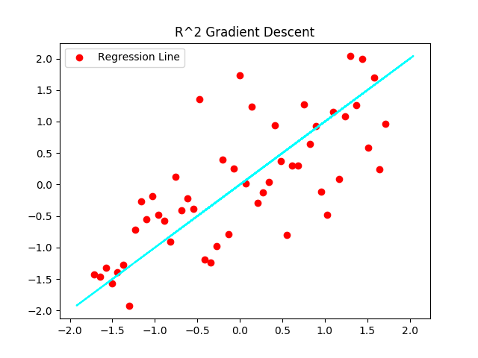
Gradient Descent
LEARNING RATE = .0001
ITERATIONS = 50,000
R^2 SCORE = .49
RESIDUAL SUM OF SQUARES = 2.02

Slide 8
STOCHASTIC GRADIENT DESCENT
Same procedure as before except first randomly shuffle the data set
In this case each iteration calculates the gradient based on a randomly chosen sample, so batch size = 1.
Remove noise from the cost curve

Slide 9
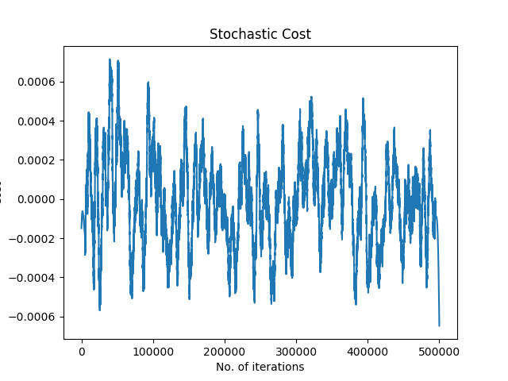
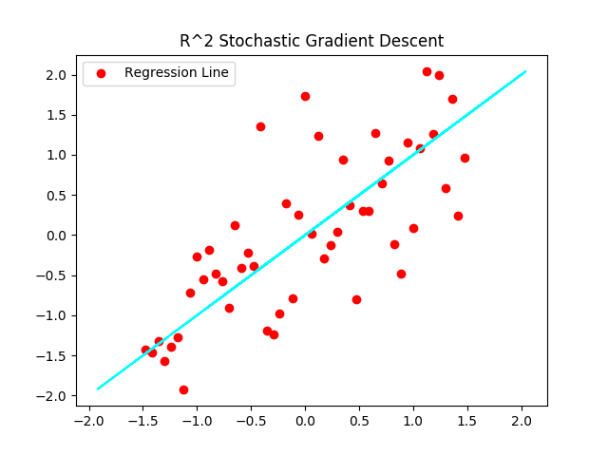
Stochastic Gradient Descent
LEARNING RATE = .0001
ITERATIONS = 500,000
R^2 SCORE = .39
RESIDUAL SUM OF SQUARES = 1.75

Slide 10
CONCLUSION
K-NN Classifier can predict what region you are in based on median income and educational attainment with a 64 % accuracy.
A linear regression model was used to predict median household income level based on educational attainment with a R^2 score of .49
Gradient Descent’s cost curve converges quickly while Stochastic Gradient Descent’s cost curve fluctuates.
Gradient Descent and K-NN are computationally expensive for larger data sets.

Slide 11
REFERENCES
1) HTTPS://WWW.ERS.USDA.GOV/DATA-PRODUCTS National Education Data up to 2016
2) HTTPS://www2.census.gov/programs-surveys/cps/tables Median Household Income by State
3) https://github.com/Columbia-Intro-Data-Science

