Slide 1
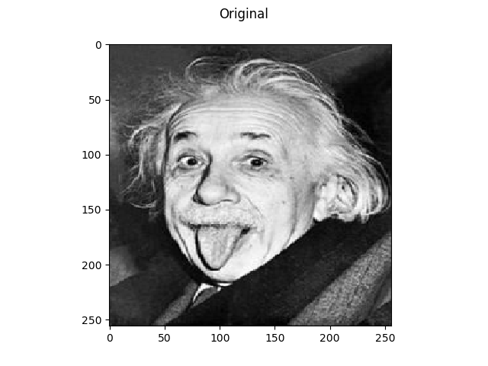
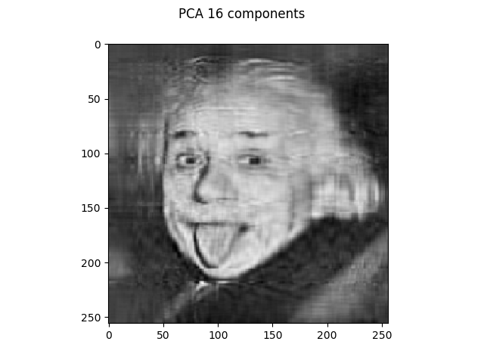
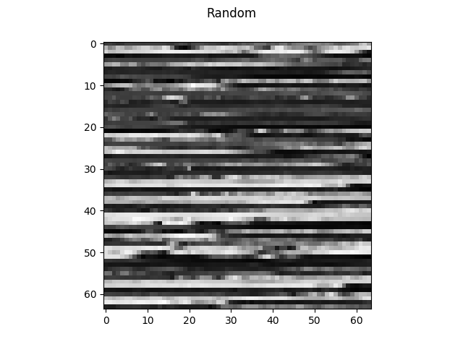
I used an Einstein image and applied PCA to reduce the number of dimensions to 16. I also randomly picked 16 shades to compress the image. If you look at the PCA image, you can see Einstein’s face still however the compression took away the image resolution. PCA to reduce dimensions is much better than randomly choosing shades since PCA keeps the most essential shades.

