Slide 1
TASK 1
BUTH PUTHIRIKA - LAY MINGHOUY - THEN RACHNA

Slide 2
1. Internet vs Web
1. The difference between the internet and the world wide web:
- The internet is a global system for connecting between countless and separate servers, computers and devices.
- The world wide web (www) is a massive collection of digital pages to access and exchange information over the internet.
You connect to the internet to access the web, and the web is a medium where we can access, discover and share the information.

Slide 3
2. Website Security
Website security, also known as cybersecurity. It is the practice or method aimed at protecting the websites and web applications from unauthorized access, use, modification, destruction, or disruption.
A padlock that is shown in the address bar indicates that there’s a secure connection between the browser and network server.
One of the reasons that websites should use HTTPS(Hypertext Transfer Protocol Secure) instead of HTTP(Hypertext Transfer Protocol) is encryption. With HTTPS, it means the site has a trusted certificate, known as SSL and the data transferred between the browser and the website is encrypted which makes it harder for a hacker to steal the information like passwords, credit card numbers, or personal details. While HTTP sends the data in plain text which can be easily intercepted.

Slide 4
3. Buying a Website
The basic steps to buy a domain name are:
Choose a domain registrar ( the one that meets your best needs) ex: Namecheap, Godaddy .
Pick your domain name, basically just choose what you want to name your domain ( make sure it’s not too long or too short).
Compare prices across the registrars
Check if the domain is available on the domain registrar, if it isn’t available they will suggest other variations.
Purchase the domain, they will ask you to select how many years you want to register then you can create an account after the payment.
For one domain, it typically costs 10-20$ per year. And it also based on the provider as well for example: Namecheap costs 8-13$ per year.

Slide 5
4. Website Address
We don’t use numbers because it’s easier to remember name than many numbers.
IP address numbers can change, but the name stays the same so even when the number changes, we can still find the website using the name because the DNS system updates the number behind the scenes.

Slide 6
5. Future of Internet Address
- Why are we running out of "IP addresses"?
We’re running out of “IP addresses” because the world’s population is constantly increasing, and advancements in technology have made the wonders of the internet accessible to a large chunk of the planet’s population. with an ever-increasing global population crossing the 8-billion mark, and nearly universal access to technology, there are many devices connected to the internet, and it is impossible to assign unique addresses for all of them.
- What does the new version (IPv6) look like compared to the old one?
Pv6 is a newer version of IP that uses a 128-bit address format and includes both numbers and letters. EX: 3002:0bd6:0000:0000:0000:ee00:0033:6778
IPv4 uses a 32-bit address. EX: 192.168.10.150
IPv6 offers 1,028 times more addresses than IPv4, which essentially solves the “running out of addresses”

Slide 7
6. How Browsers Work
- What are the three main languages browsers use to show websites?
HTML: is used to create the main content of the page (headings, paragraphs, images, etc.)
CSS: dictates how that content should appear to the user (layout, colour, typography, etc.)
JavaScript: allows users to interact with the content of the site (clickable buttons, scrolling animations)
- How is building a webpage similar to building with Lego blocks?
Instead of designing your website as fixed pages, we build it with reusable “LEGO bricks” (components). These blocks have their own special features and can be easily used in different parts of your site. They make your code simpler to manage and update, and they work well across different web browsers. Think of it as building a dynamic and adaptable website, ready for anything.

Slide 8
7. Website Safety
- Find one example where a website got hacked because it wasn't secure.
In 2014, UCLA suffered a data breach that exposed the personal information of approximately 4.5 million individuals. The breach was caused by a vulnerability in a database that allowed the attacker to gain unauthorized access to sensitive data.
The data compromised in the breach included names, Social Security numbers, dates of birth, addresses, and medical information of patients and staff associated with the university’s health system.
- How could HTTPS have helped prevent this?
HTTPS helps prevent unauthorized access to sensitive data. HTTPS encrypts all data that passes between the browser and server using an encryption protocol called Transport Layer Security (TLS), preceded by Secure Sockets Layer (SSL). This encryption renders data undecipherable until a site owner unlocks it, allowing users to share sensitive data, such as passwords and other personal information, safely and securely over

Slide 9
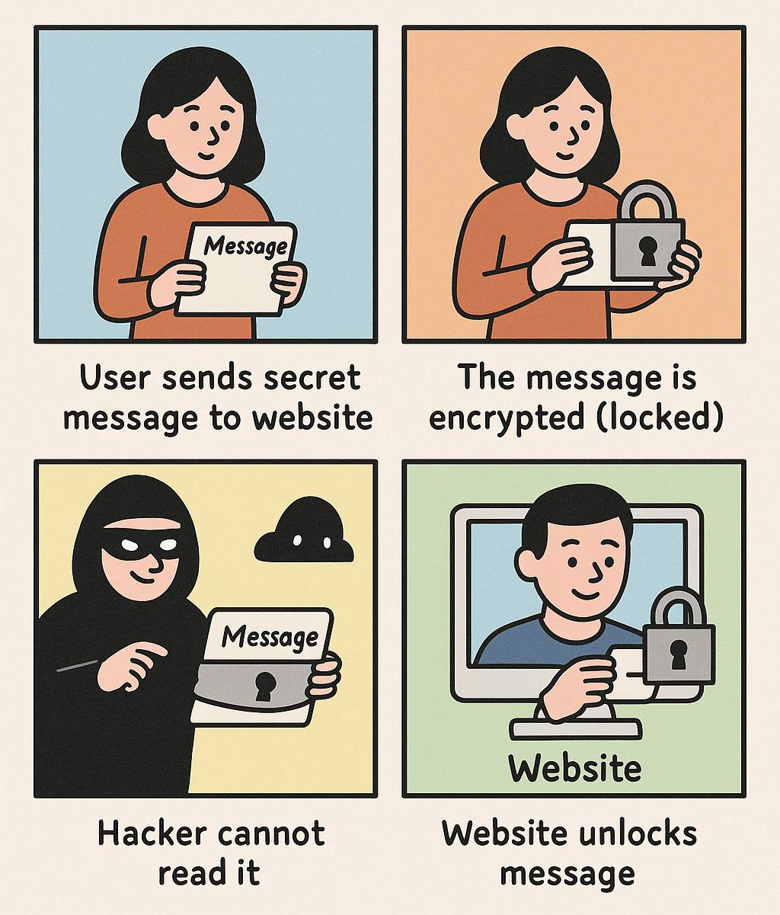
How HTTPS keep information safe:

