Slide 1
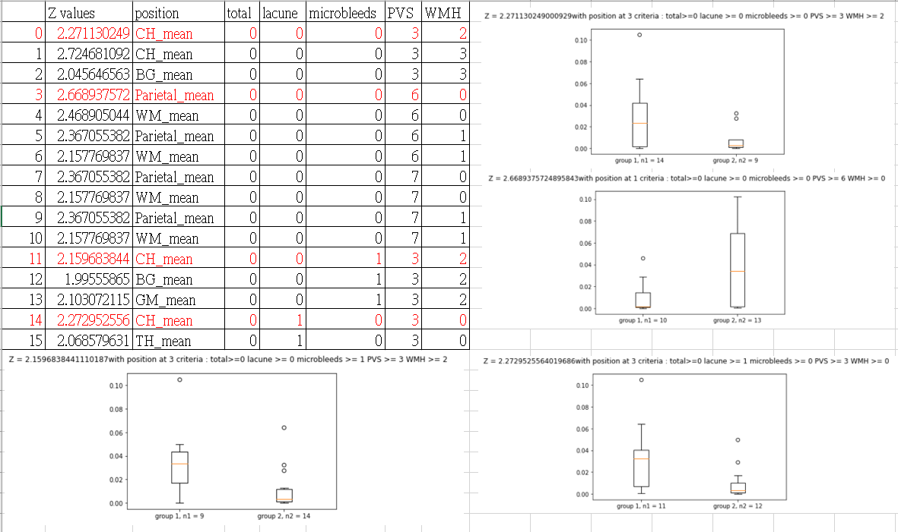
DM中各項數據關聯

Slide 2
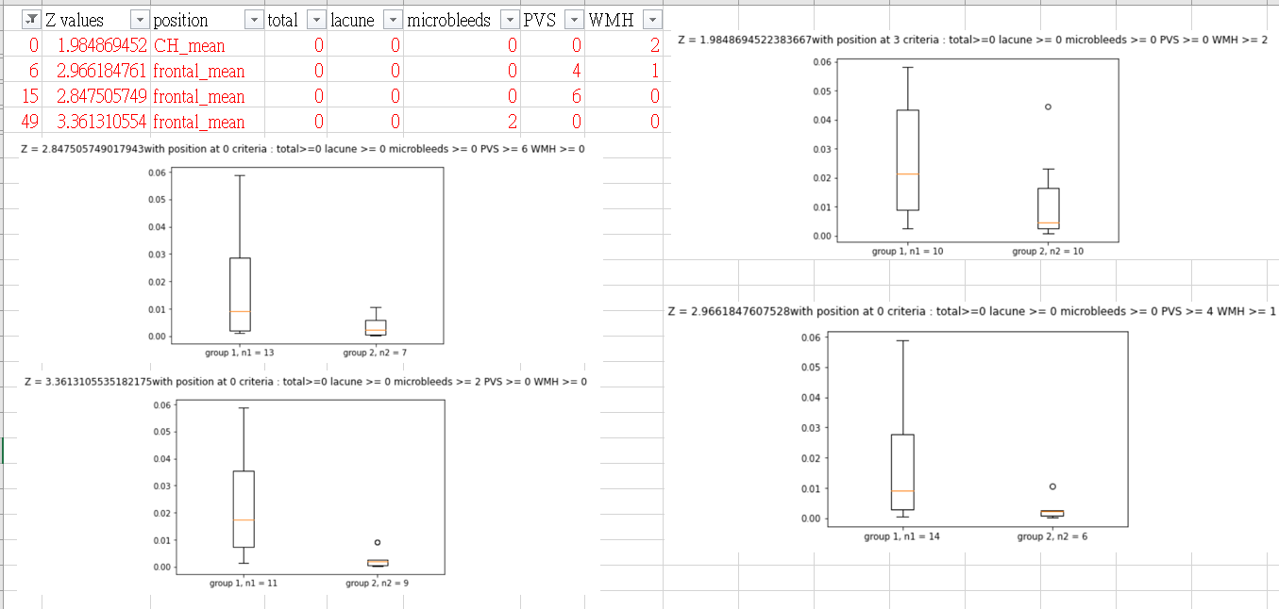
CSVD+Control中各項數據關聯

Slide 3
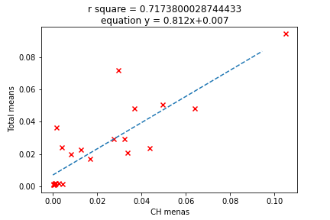
DM 裡CH mean跟total mean關聯

Slide 4
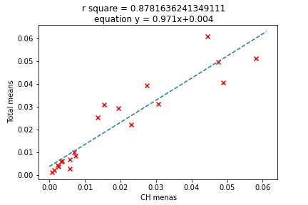
CSVD+Control 裡CH mean跟total mean關聯

Slide 5
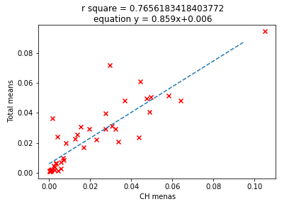
全部total 跟CH mean

Slide 6
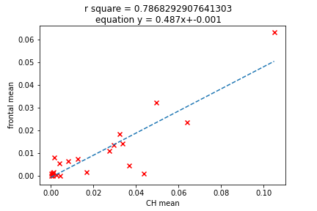
DM 裡GM 跟 WM子項之間關係
 | frontal mean | parietal mean
CH mean | 0.7868 | 0.2112
BG mean | 0.5541 | 0.3828
TH mean | 0.4896 | 0.1210

Slide 7
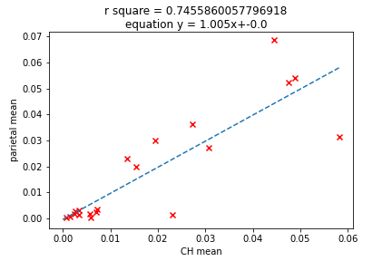
CSVD+control裡面GM WM 子項關係
 | frontal mean | parietal mean
CH mean | 0.4895 | 0.7456
BG mean | 0.3891 | 0.4911
TH mean | 0.2479 | 0.5263

Slide 8
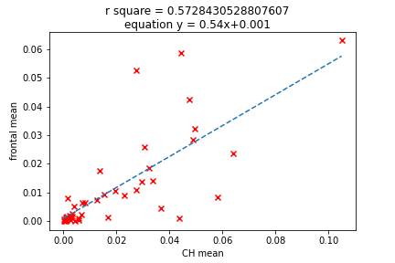
全部裡面GM跟WM之間子項關係
 | frontal mean | parietal mean
CH mean | 0.5723 | 0.3256
BG mean | 0.4284 | 0.4096
TH mean | 0.3607 | 0.1929

Slide 9
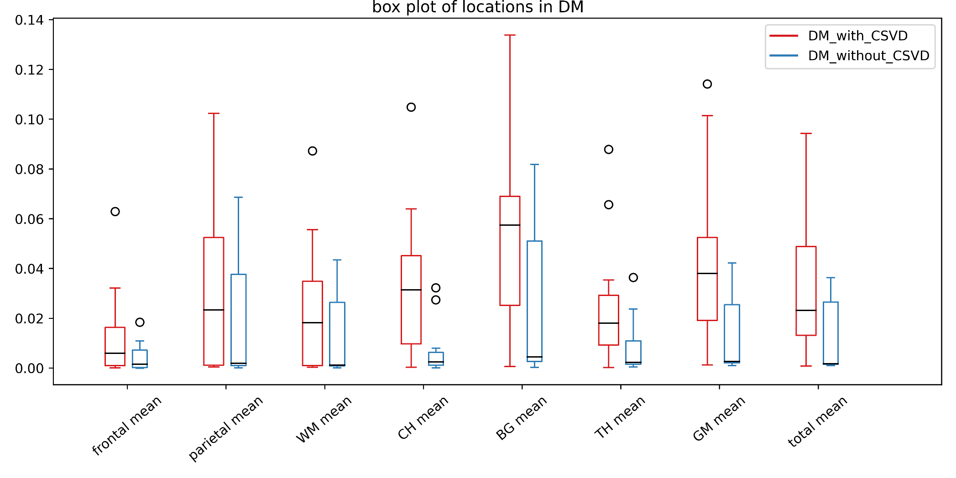
DM 裡，CSVD有無的關聯
1.62
0.99
1.18
2.76
1.85
2.09
2.53
2.18

Slide 11
結論

