Slide 1
StarR3D Qualification Parameter Tuning
Justin Liang
1/20/2020

Slide 2
Qualification process flow
New Case
Checkout and run qualification test suite (from Austin)
If there is outlier, iteratively do :
Adjust parameters in C++ codes and compile
Rerun cases
Final qualification check
Checkin code
Run QA (Rapid3D)
Check Outlier
Adjust code and Compile
Pass Criteria?
No
Code change
Yes
Manual work
Check-in fixing codes

Slide 3
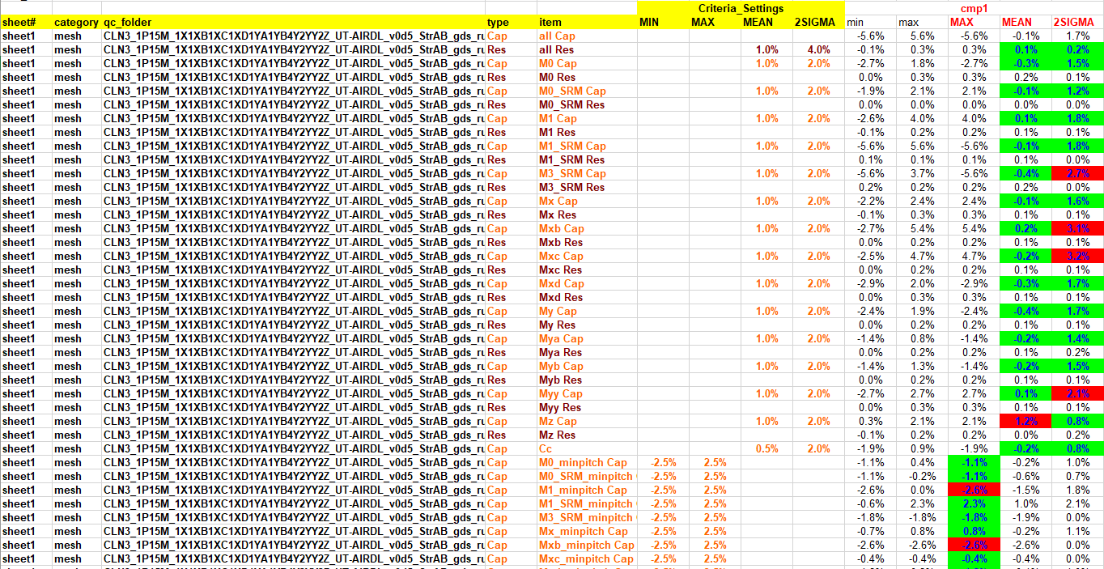
Report file (StarFS BEOL)
Category:
Mesh
StrAB_gds
StrAB_lefdef
mesh_gds
mech_lefdef
BEOL
dummy
beol
Ct criteria:
StrAB
MEAN: 0.5%
2SIGMA: 2%
Mesh
MEAN: 0.5%
2SIGMA: 3%
Others
MAX
StarRC: only need to pass the item “all Cap”
StarQTF: need to pass all item

Slide 4
Rapid3D test pattern
Top View
Side View
z
Layer: M x+1
Metal line width
Layer: M x
Spacing
Layer: M x-1
y
Target Net
x
Target Net
All StrAB patterns can be classified with metal line width and spacing.
Mesh patterns are more complicated.
Metal line projection length, upper layer, lower layer

Slide 5
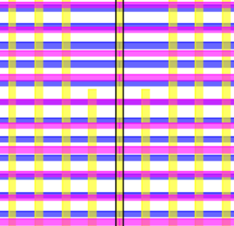


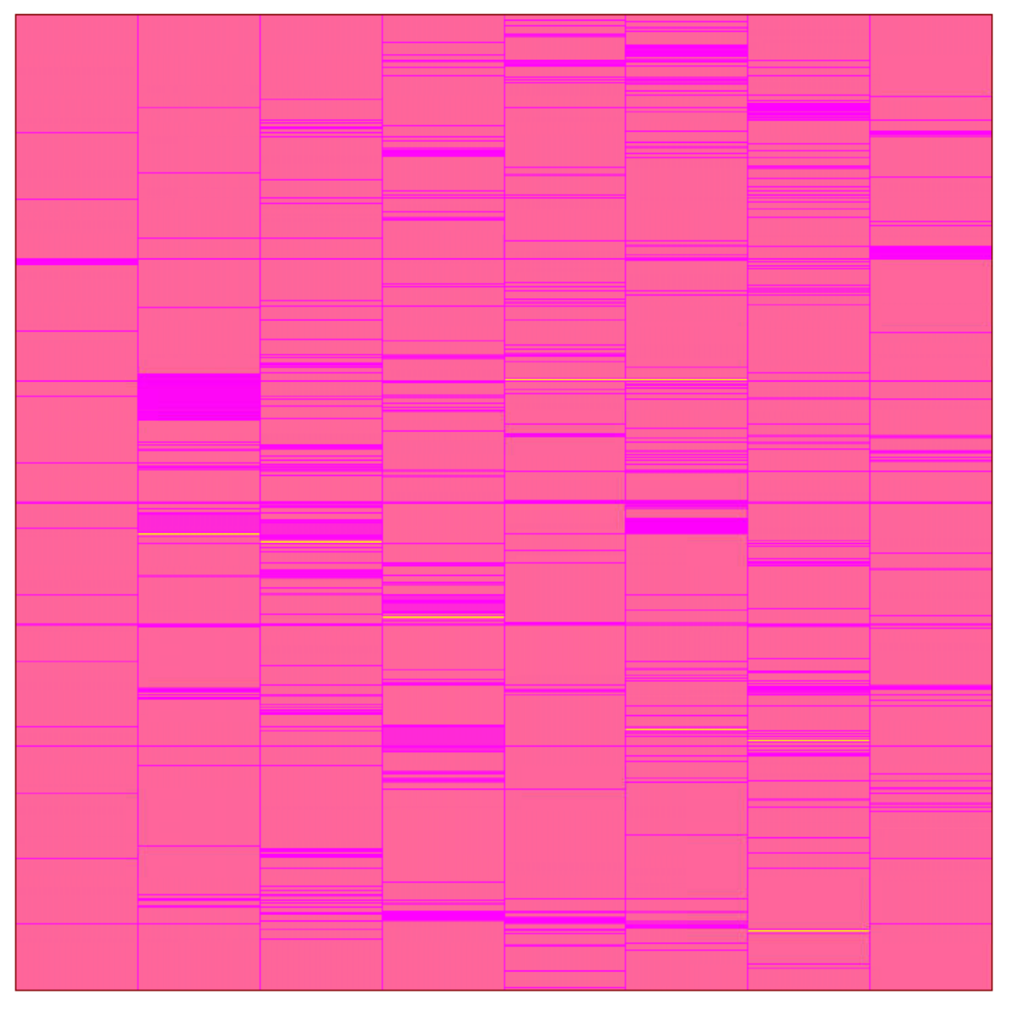

Rapid3D test pattern
StrAB
Mesh
M1
M2
M3
M2
200um X 200um
200um X 200um
*Upper and lower layers are metal plat and not show here.
*Upper and lower layers are perpendicular metal lines with different pitches.
** The nearby lines can be shorter than the target net metal line. (Projection length <= 100% length of center lines)

Slide 6
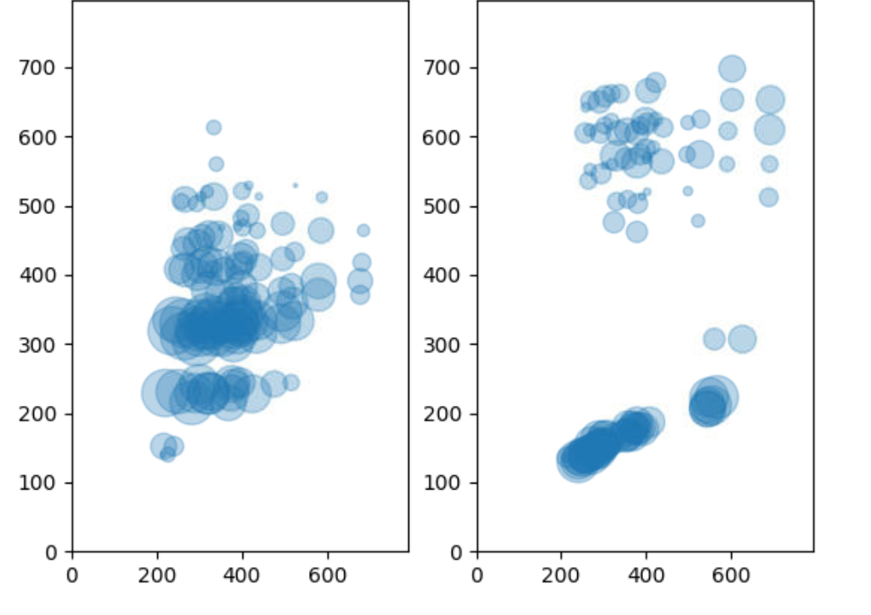
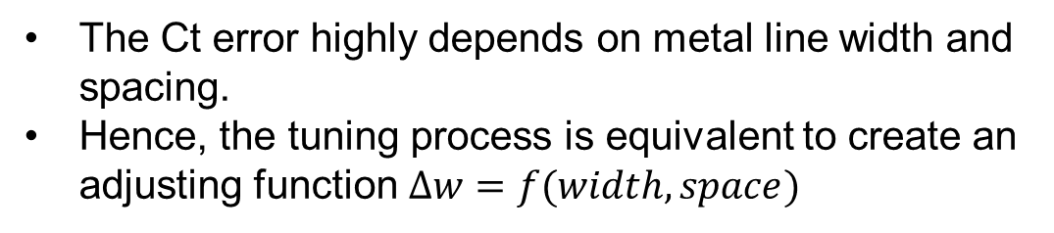
Tuning for outlier
Ct error (before tuning)
Ct < golden
Ct >= golden
The Ct error highly depends on metal line width and spacing.
Hence, the tuning process is equivalent to create an adjusting function $∆w=f(width,space)$
Spacing (Å)
Width (Å)
Width (Å)
Each circle stands for Ct error of a pattern. Circle size is proportional to the Ct error.
Ct error = (Ct – CtRef) /CtRef
Pattern number for StrAB: 200 (N16) ~ 2200 (N3)

Slide 7
Rapid3d code for tuning
Code for Qualification
Hard coding every qualification rules in C++
Tuning flow
Add code for new process version
For specific test patterns
Add/adjust rule for specific test patterns
E.g. if width within (w1, w2) and spacing within (sp1, sp2) adjust_width(w_ext1);
Compile and check again till converged
Repeat for all category/layers/patterns
wext
If foundry == …
if process == …
if version == …
if layer == …
if width within (w1, w2) and spacing within (sp1, sp2)
adjust_width(w_ext1);
z1adj
z0adj
zhiadj
zloadj
There are 5 parameters used for tuning.
wext for Ct
zhiadj, zloadj for decoupling Cc and Ct

