Slide 1
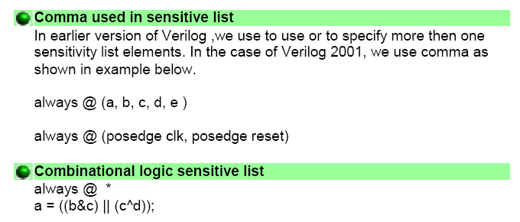
What's new in Verilog 2001
Ref: Deepak Kumar Tala, “Verilog Tutorial” 2003. http://www.deeps.org

Slide 2
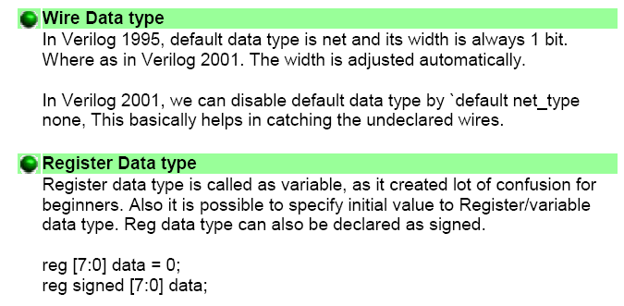

Slide 3


Slide 4
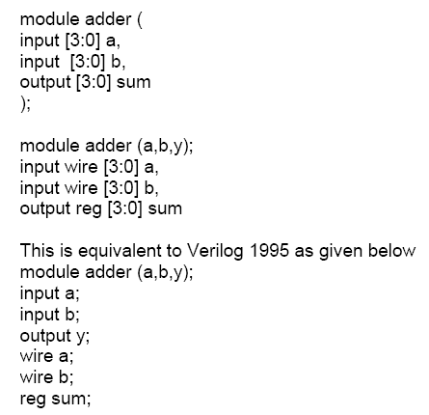

Slide 5
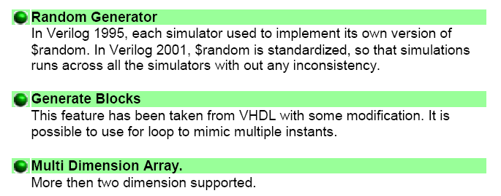

Slide 6
To be continue …….

