Slide 1
Lab1 Flash LED 2023.03.30
指導教授：范志鵬
主講人：林軒宇

Slide 2
Lab1
此次實驗使用到的I/O
中間Butten(S2)作為輸入
16顆LED燈做為輸出
功能
學會「除頻」技術，降低頻率，控制LED燈依序閃爍。
並讀取按鍵是否按下，進而決定跑馬燈速度。

Slide 3
除頻
透過計數器累加，讀取計數器某一位元，做為新的時脈。
3 bit 計數器 counter (cnt)
cycle | cnt[2] | cnt[1] | cnt[0]
0 | 0 | 0 | 0
1 | 0 | 0 | 1
2 | 0 | 1 | 0
3 | 0 | 1 | 1
4 | 1 | 0 | 0
5 | 1 | 0 | 1
6 | 1 | 1 | 0
7 | 1 | 1 | 1
cycle | 0 |  | 1 |  | 2 |  | 3 |  | 4 |  | 5 |  | 6 |  | 7 |  | 8
clk
cnt[0]
cnt[1]
cnt[2]

Slide 4

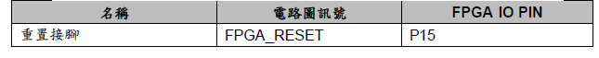
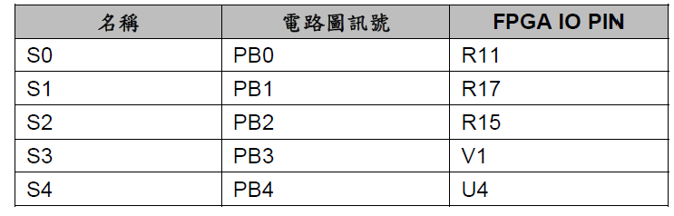
Lab1 constraint file

Slide 5
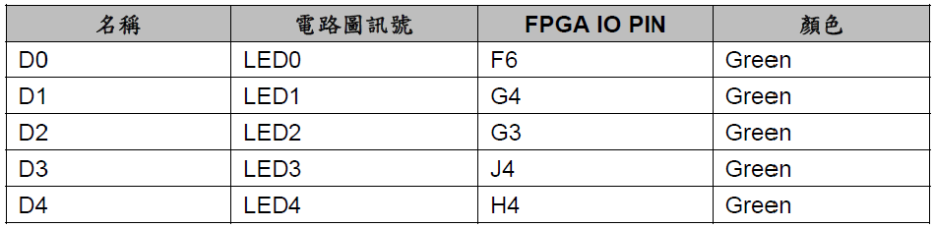
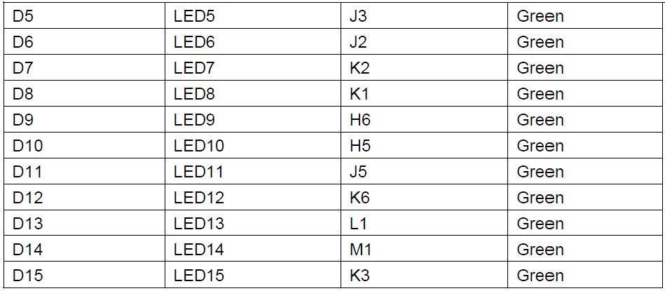
Lab1 constraint file

Slide 6
Lab1 作業(下午班)
下午班:
將Lab1稍作修改，設計功能如下:
1.降低跑馬燈的速度
2.改為從兩側到中間
1.(○ ● ● ● ● ● ● ● ● ● ● ● ● ● ● ○)
2.(● ○ ● ● ● ● ● ● ● ● ● ● ● ● ○ ●)
3.(● ● ○ ● ● ● ● ● ● ● ● ● ● ○ ● ●)
4.(● ● ● ○ ● ● ● ● ● ● ● ● ○ ● ● ●)
5.(● ● ● ● ○ ● ● ● ● ● ● ○ ● ● ● ●)
6.(● ● ● ● ● ○ ● ● ● ● ○ ● ● ● ● ●)
7.(● ● ● ● ● ● ○ ● ● ○ ● ● ● ● ● ●)
8.(● ● ● ● ● ● ● ○ ○ ● ● ● ● ● ● ●)

Slide 7
Lab1 作業(下午班)
下午班:
將Lab1稍作修改，設計功能如下:
1.降低跑馬燈的速度
2.改為從兩側到中間
9.(● ● ● ● ● ● ○ ● ● ○ ● ● ● ● ● ●)
10.(● ● ● ● ● ○ ● ● ● ● ○ ● ● ● ● ●)
11.(● ● ● ● ○ ● ● ● ● ● ● ○ ● ● ● ●)
12.(● ● ● ○ ● ● ● ● ● ● ● ● ○ ● ● ●)
13.(● ● ○ ● ● ● ● ● ● ● ● ● ● ○ ● ●)
14.(● ○ ● ● ● ● ● ● ● ● ● ● ● ● ○ ●)
15.(○ ● ● ● ● ● ● ● ● ● ● ● ● ● ● ○)
16.(● ● ● ● ● ● ● ○ ○ ● ● ● ● ● ● ●)
3.按下btn會反向

Slide 8
Thank you for your attention!

