Slide 1
iStudentPlus Website Development
STATUS UPDATE — 16 JUL 2026
Implementasi Next.js: lihat banner di tiap slide

Slide 2

Menu
SELESAI
Nav + dropdown + CTA pink + Login. Ikon search/wishlist belum
Menu | Home | About Us | Study Abroad | Services | Courses & Universities | Language Programs | Blog | Contact Us
Sub Menu - Drop Down List |  |  | Australia UK USA Canada China Japan | Admission Counselling | Konsultasi Akademik Visa & Immigration | Visa & Imigrasi Language Test Preparation | Tes Bahasa Student Accommodation | Akomodasi Pelajar Insurance | Asuransi | Qualification | Jenjang Study VET Courses | Pendidikan Vokasi & Diploma Bachelor Degree | Sarjana (S1) Master Degree | Pascasarjana (S2 & S3) Student Exchange Program | Program Pertukaran Pelajar | General English Conversation Class IELTS JLPT | Recent News Immigration Student Life Study Tips | Our Offices Email Phone Number Social Media
Additional Button:
Book Free Consultation (linked to admission form, using pink color, top right)
Login

Slide 3
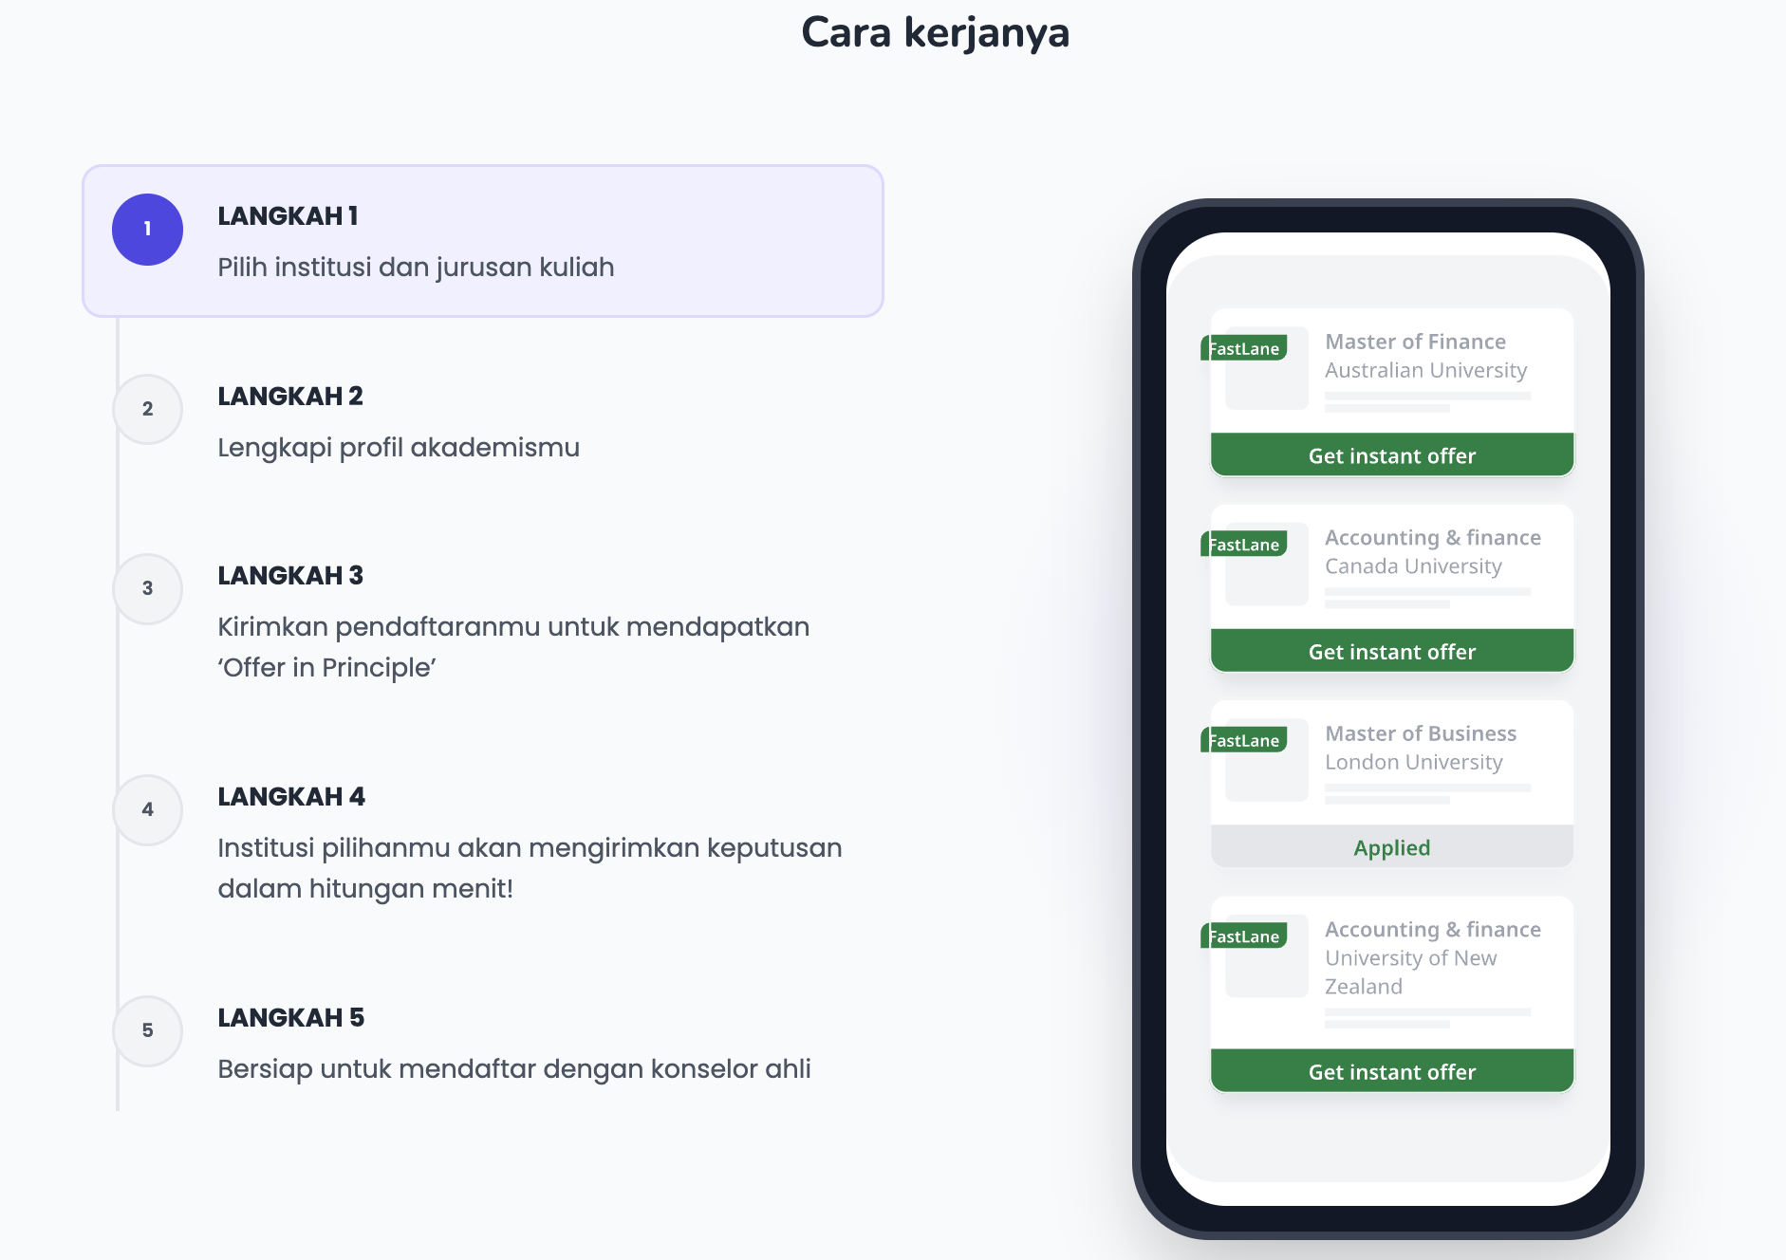


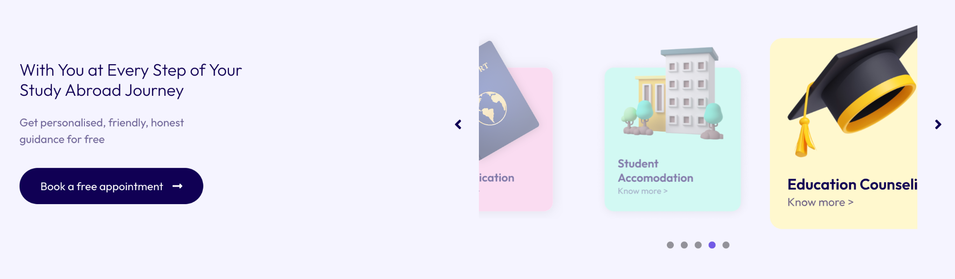
Home
SELESAI
Hero foto siswa, 6 langkah, kartu layanan pastel
Brief about what we do and how many partners we have
3. Step by step guidance with CTA button that links to Registration Form
Your Journey to Study Abroad, Simplified in 6 Steps
From your first consultation to landing at your dream university, we guide you every step of the way.
Personal Assessment – Explore your study goals, country preference, and career path.
Document & Finance Check – Review academic and financial readiness.
Admission Process – Apply and secure offers from partner universities.
Visa & Immigration – Full support for a smooth application process.
Pre-Departure Prep – Orientation, accommodation, and travel guidance.
Enrollment Abroad – Begin your study journey with confidence.
2. How we can help (linked to the services page)

Slide 4
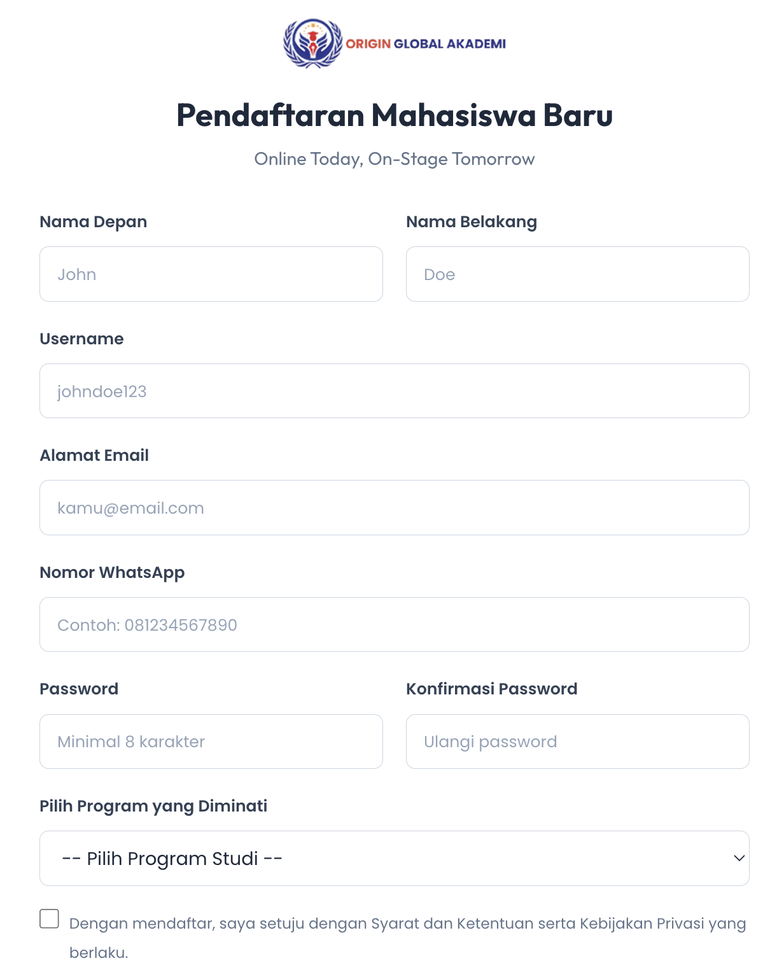
Home
SELESAI (UI)
Form lengkap di Home. Pengiriman ke backend belum
3. Step by step guidance with CTA button that links to Free Consultation Form.
FREE CONSULTATION FORM
Name
Email Address
WhatsApp Number
Preferred study destination: Australia, Japan, China, UK, USA, Canada, Others
Preferred field of study: Business, IT, Hospitality, Health, Language and Linguistic, Others.
Preferred level of qualification: VET or Diploma, Bachelor Degree, Master Degree, PhD, Language Study, Others
Latest qualification: High School, ET or Diploma, Bachelor Degree, Master Degree, PhD, Language Study, Others
Attach your most updated CV for assessment purposes prior to the consultation.

Slide 5
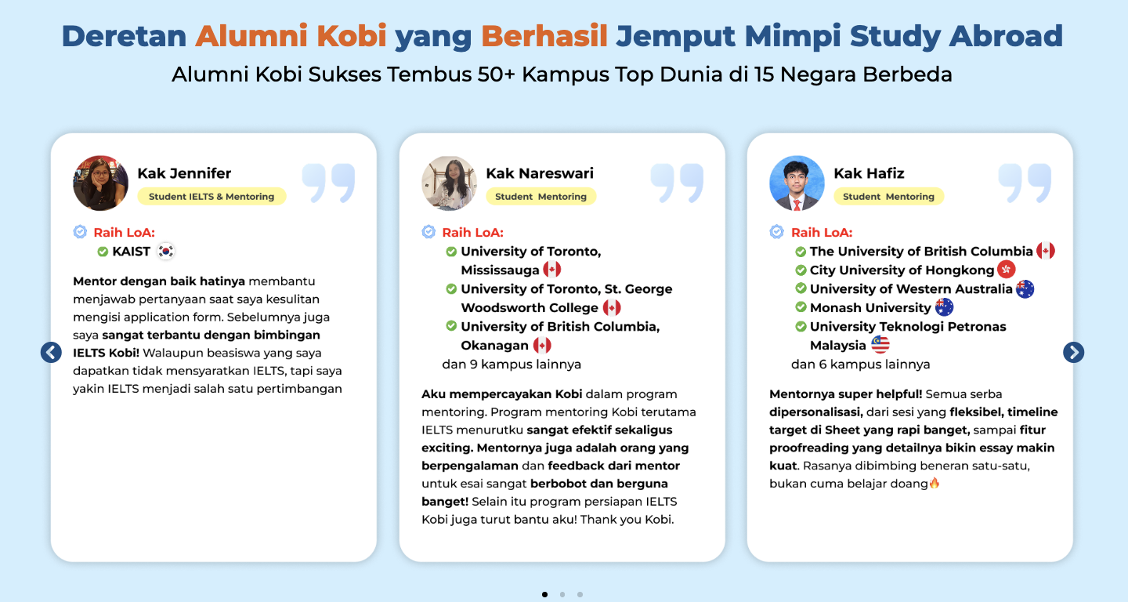
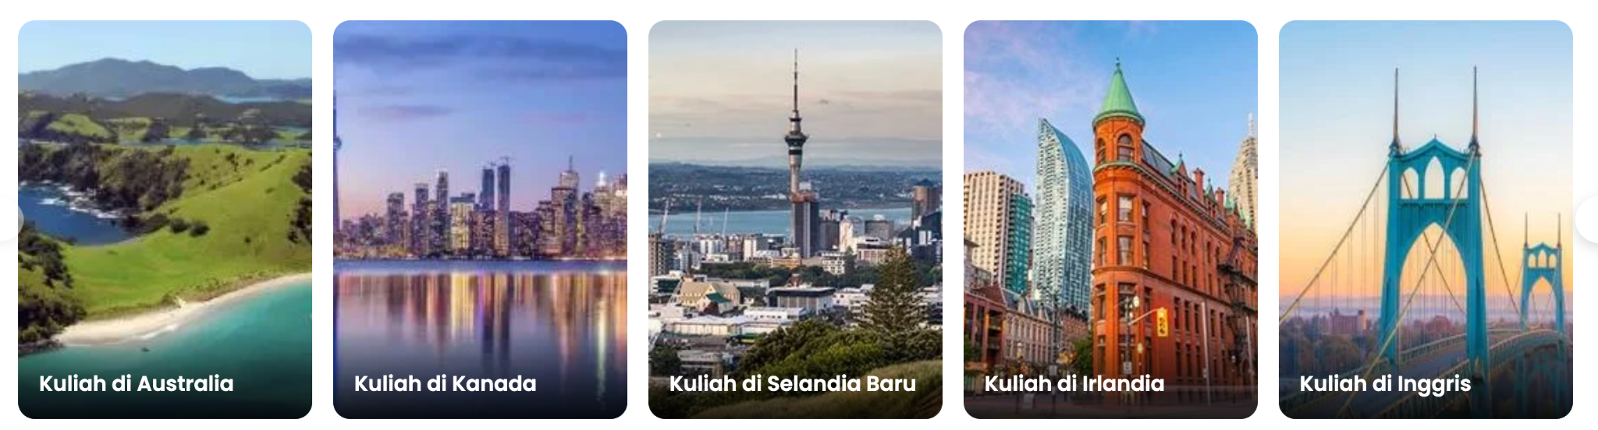

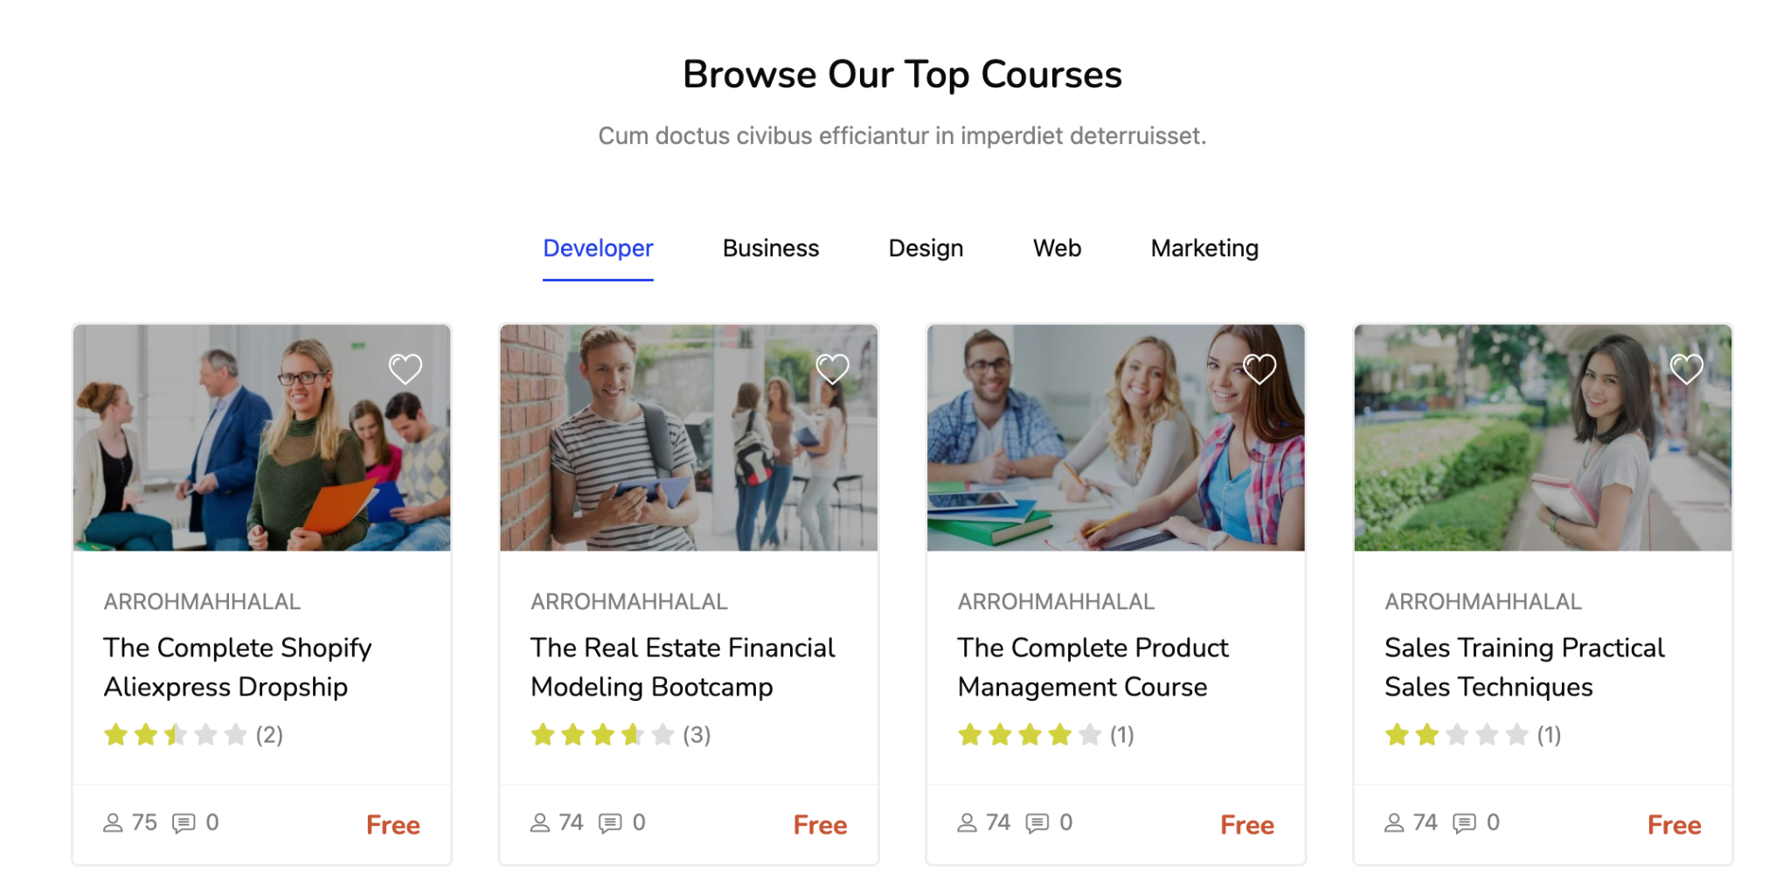
Home
SEBAGIAN
Kartu negara + testimoni OK. Logo partner & katalog kursus belum
4. Study Abroad section using cards of different countries
5. List of university partners logo
7. Student testimonial
6. Browse our language program

Slide 6
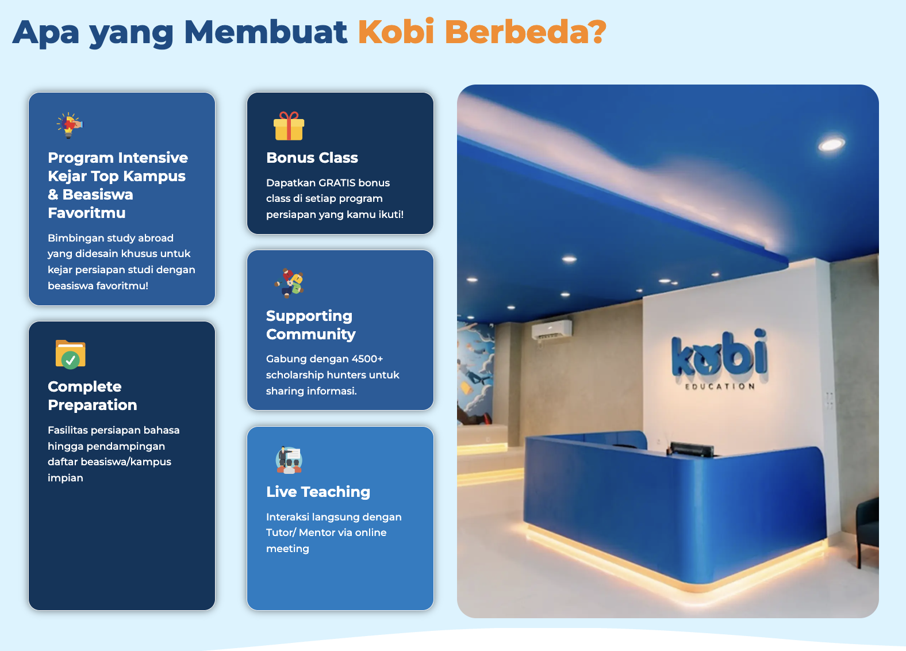
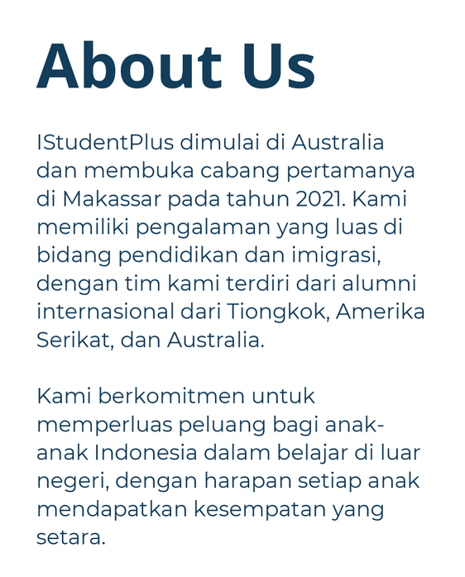


About Us
SELESAI
Story, Vision/Mission, sertifikasi QEAC/ISEAA terpasang
Our Story
Welcome to ISTUDENTPLUS: Your Global Student Network and Media Agency!
Our Mission: Promote inclusivity and empower students locally and internationally. We offer comprehensive support throughout their educational journey.
Specialization: Assisting students with educational and migration needs, especially for studying in Australia. Offices in Australia and Indonesia provide easy access to services.
Holistic Support: Personal guidance from language preparation, application/ enrollment, visa, accommodation assistance, and more for a nurturing student experience.
Services Offered: Expert visa guidance, English language courses, short-term study programs, and collaboration with top educational institutions.
Join Our Community: Be part of a supportive network committed to your success. Connect with us for a transformative educational journey with ISTUDENTPLUS.
Our certification

Slide 7
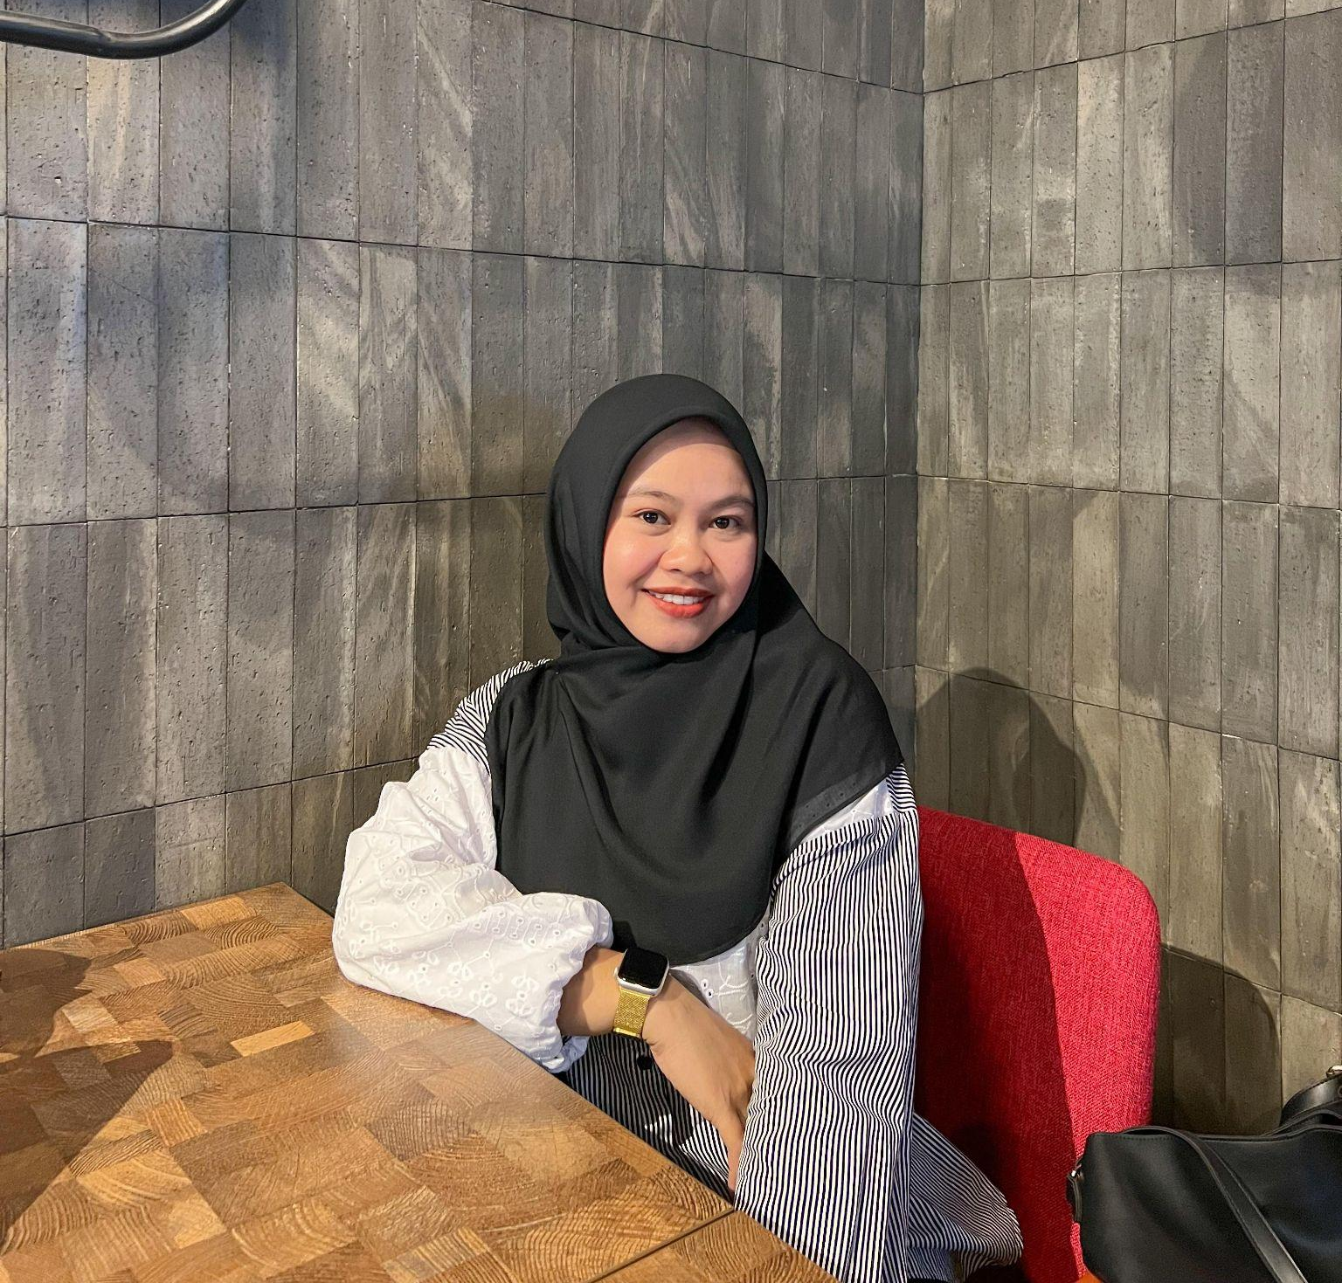
About Us
Our Team
Cindy Christella - CEO & Education Consultant
Please provide 1-2 paragraphs of your expertise and experience here
SEBAGIAN
Nur Fadillah OK. Menunggu foto+bio Cindy dari tim
Our Team
Nur Fadillah - Education Consultant
I am an Education Consultant with more than two years of experience assisting international students in choosing the right study pathways abroad. My role includes providing personalized guidance on course selection, visa processes, and applications to educational institutions, ensuring that students receive the best options aligned with their academic and career goals. I have a strong understanding of international education systems and student visa regulations, which enables me to deliver accurate and practical advice.
During my career at iStudentPlus, I have successfully supported students from diverse backgrounds, maintained effective communication with partner institutions, and ensured smooth application processes. My strengths lie in attention to detail, problem-solving, and the ability to build trusted relationships with students, partner institutions, and other related parties. I am passionate about education and committed to helping students achieve their goals through professional guidance and quality support.
Please provide photo
Notes:
DILLA - I am an Education Consultant with more than two years of experience assisting international students in choosing the right study pathways abroad. My role includes providing personalized guidance on course selection, visa processes, and applications to educational institutions, ensuring that students receive the best options aligned with their academic and career goals. I have a strong understanding of international education systems and student visa regulations, which enables me to deliver accurate and practical advice.
During my career at iStudentPlus, I have successfully supported students from diverse backgrounds, maintained effective communication with partner institutions, and ensured smooth application processes. My strengths lie in attention to detail, problem-solving, and the ability to build trusted relationships with students, partner institutions, and other related parties. I am passionate about education and committed to helping students achieve their goals through professional guidance and quality support.

Slide 8
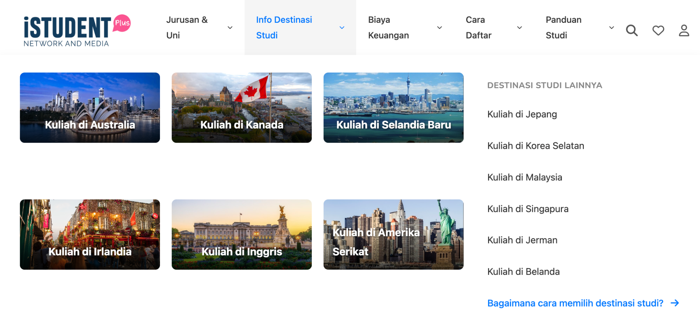
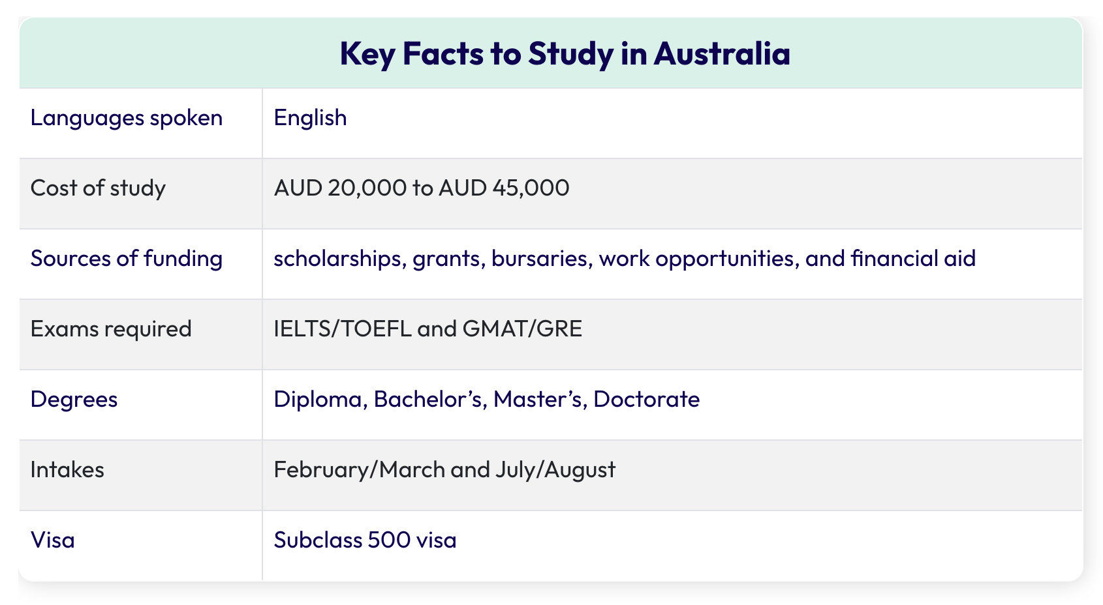
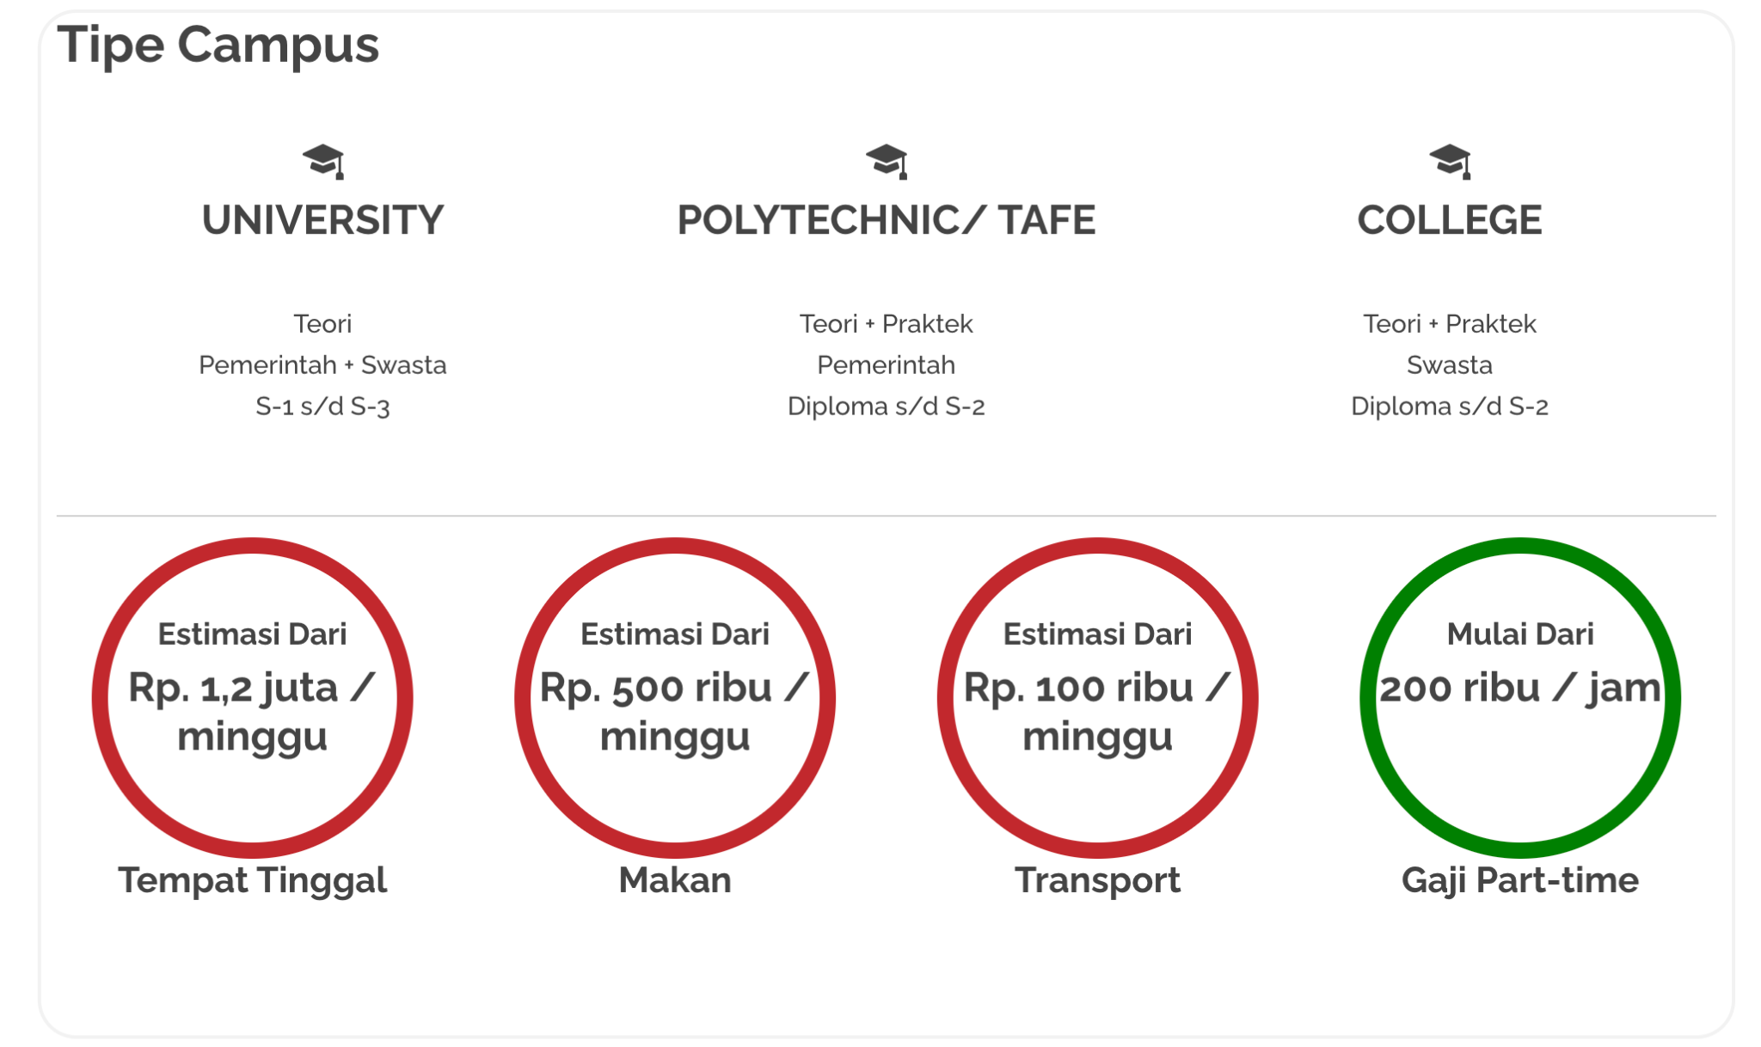
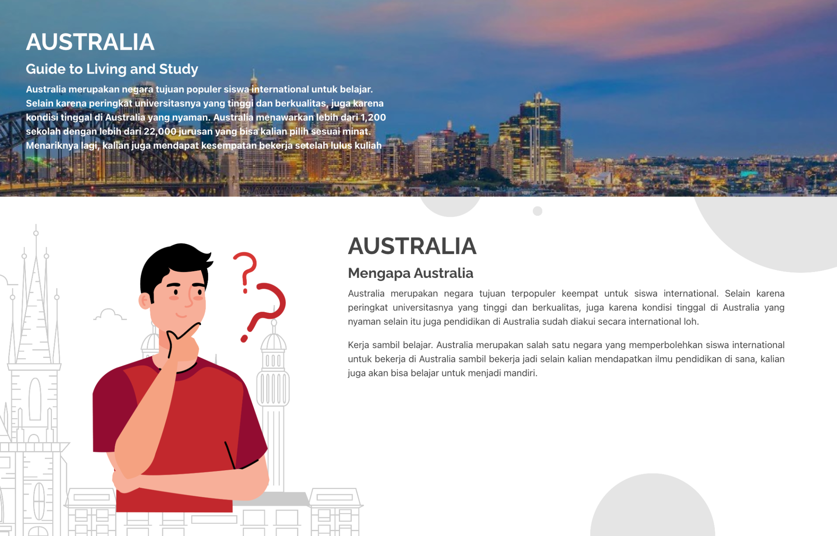
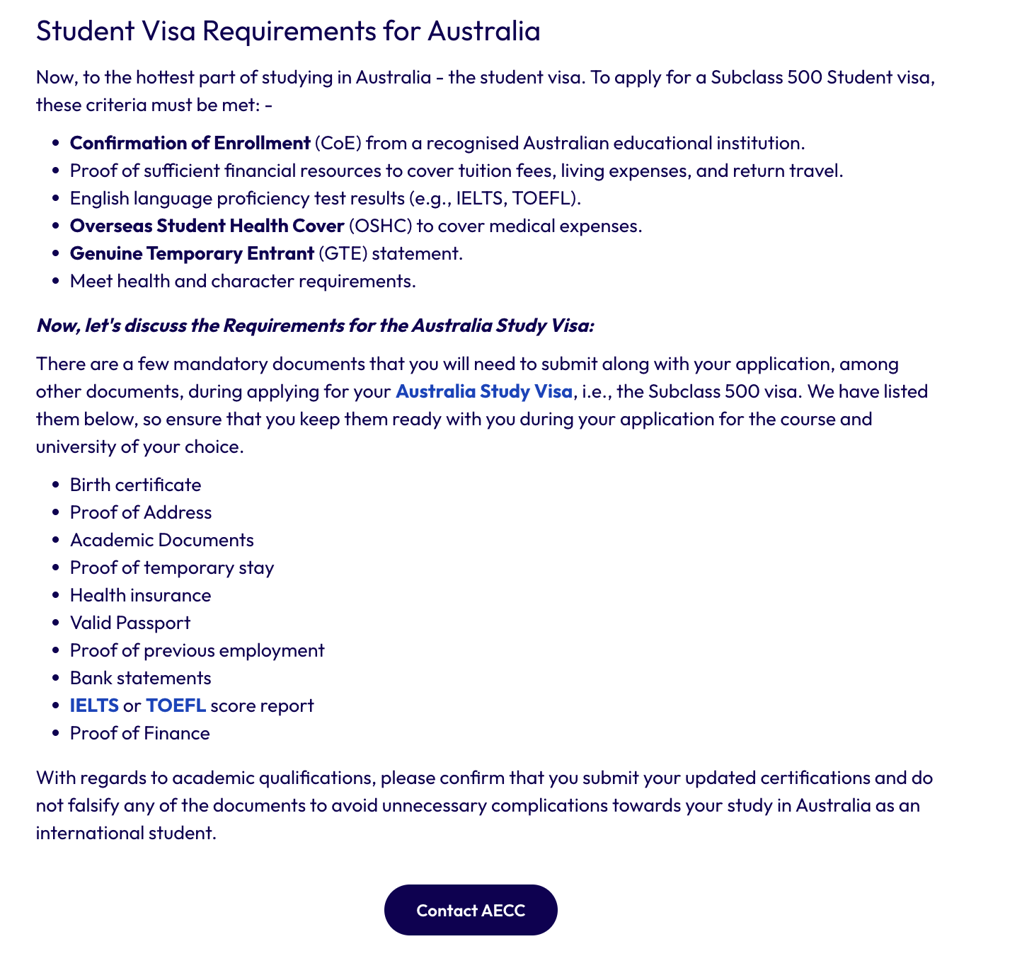
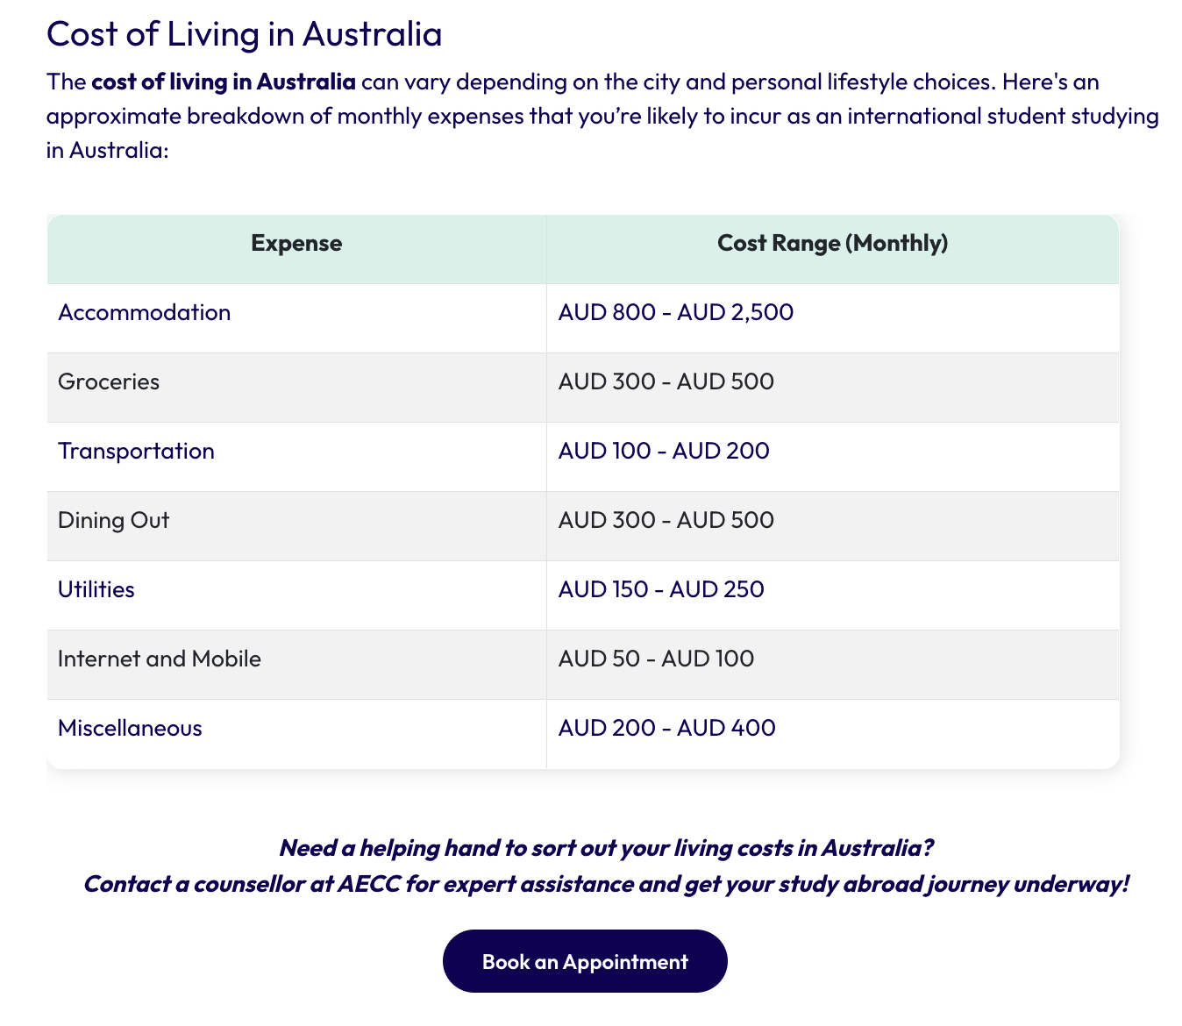
Study Abroad
SEBAGIAN
6 halaman negara live. Australia lengkap; negara lain ringkas
Look from sub menu
Each country page consists of information such as
Why study in that country
Top courses or type of qualification >> linked to Courses and Universities page for more list
Overview of living cost, career orientation, admission process, accommodation, culture and lifestyle

Slide 9
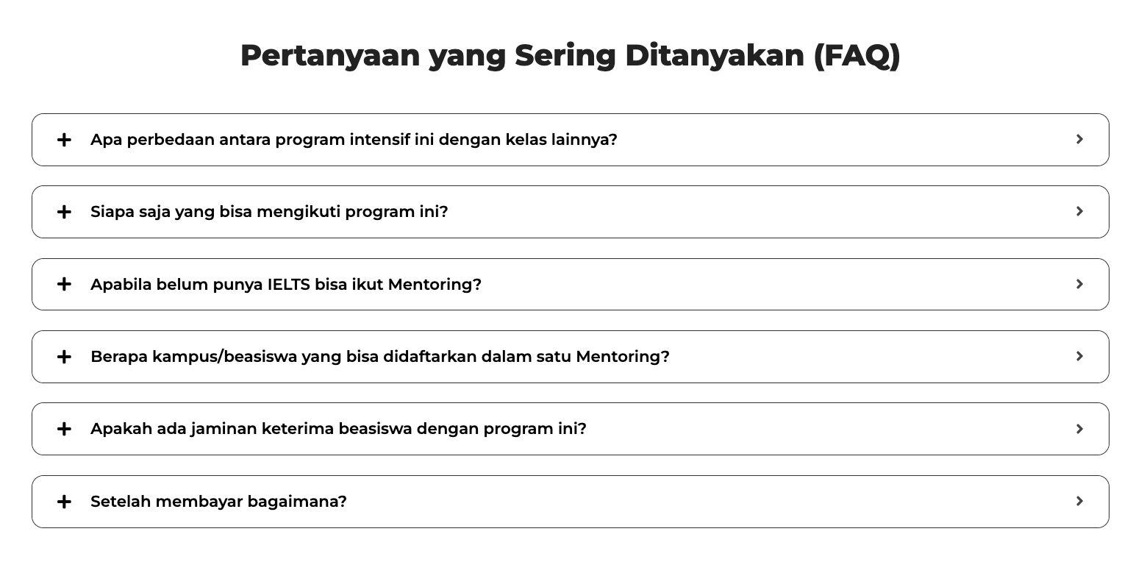
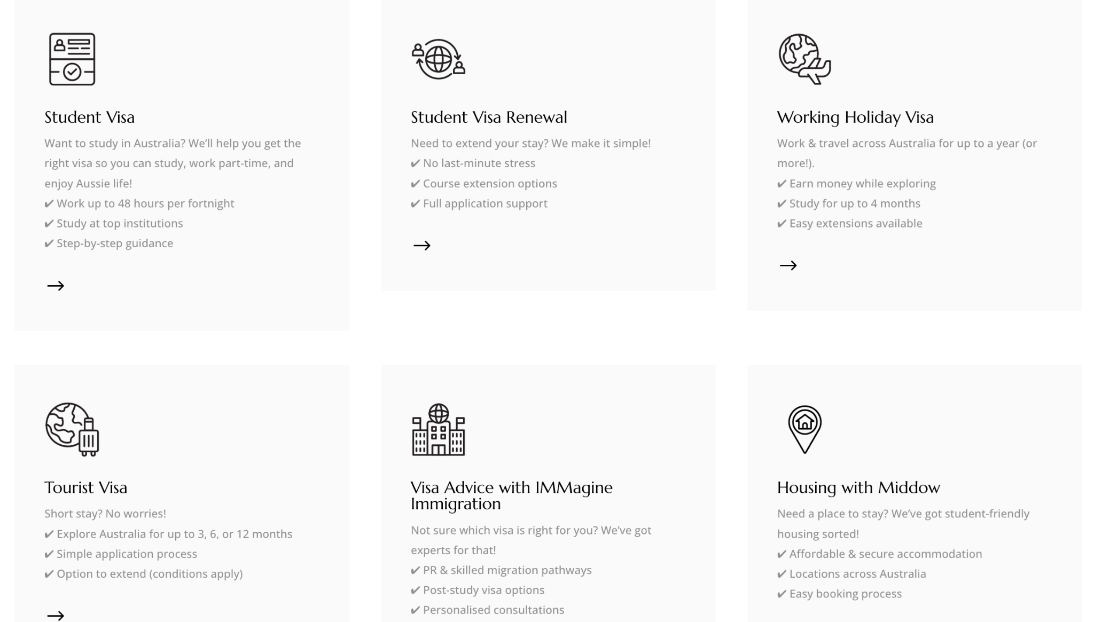
Services
SELESAI
6 layanan visa + IMMagine/Middow + FAQ accordion. PDF checklist belum
Visa & Admission
Visa Process Made Easy: Simple explanation of application flow for Australia, Japan, etc.
Checklist Download: Provide a PDF checklist of required documents (email capture opportunity).
Common Pitfalls to Avoid: e.g., incomplete forms, insufficient funds proof, etc.
Assistance Coverage: Detail which visa types you cover (student, dependent, graduate).
Success Rate / Case Examples: Numbers or stories showing smooth approvals.
CTA: “Talk to Our Visa Expert.”
Admission Counselling
Service Overview: Explain how counseling helps students choose the right country, program, and university aligned with their career goals.
Step-by-Step Guidance: Outline the admission process (course matching → application → offer letter).
Why Choose Us: Emphasize personalized 1:1 counseling vs. generic agencies.
FAQs Section: Common questions like “What documents are required?” / “When should I start applying?”
CTA: “Book a Free Consultation Today.”

Slide 10
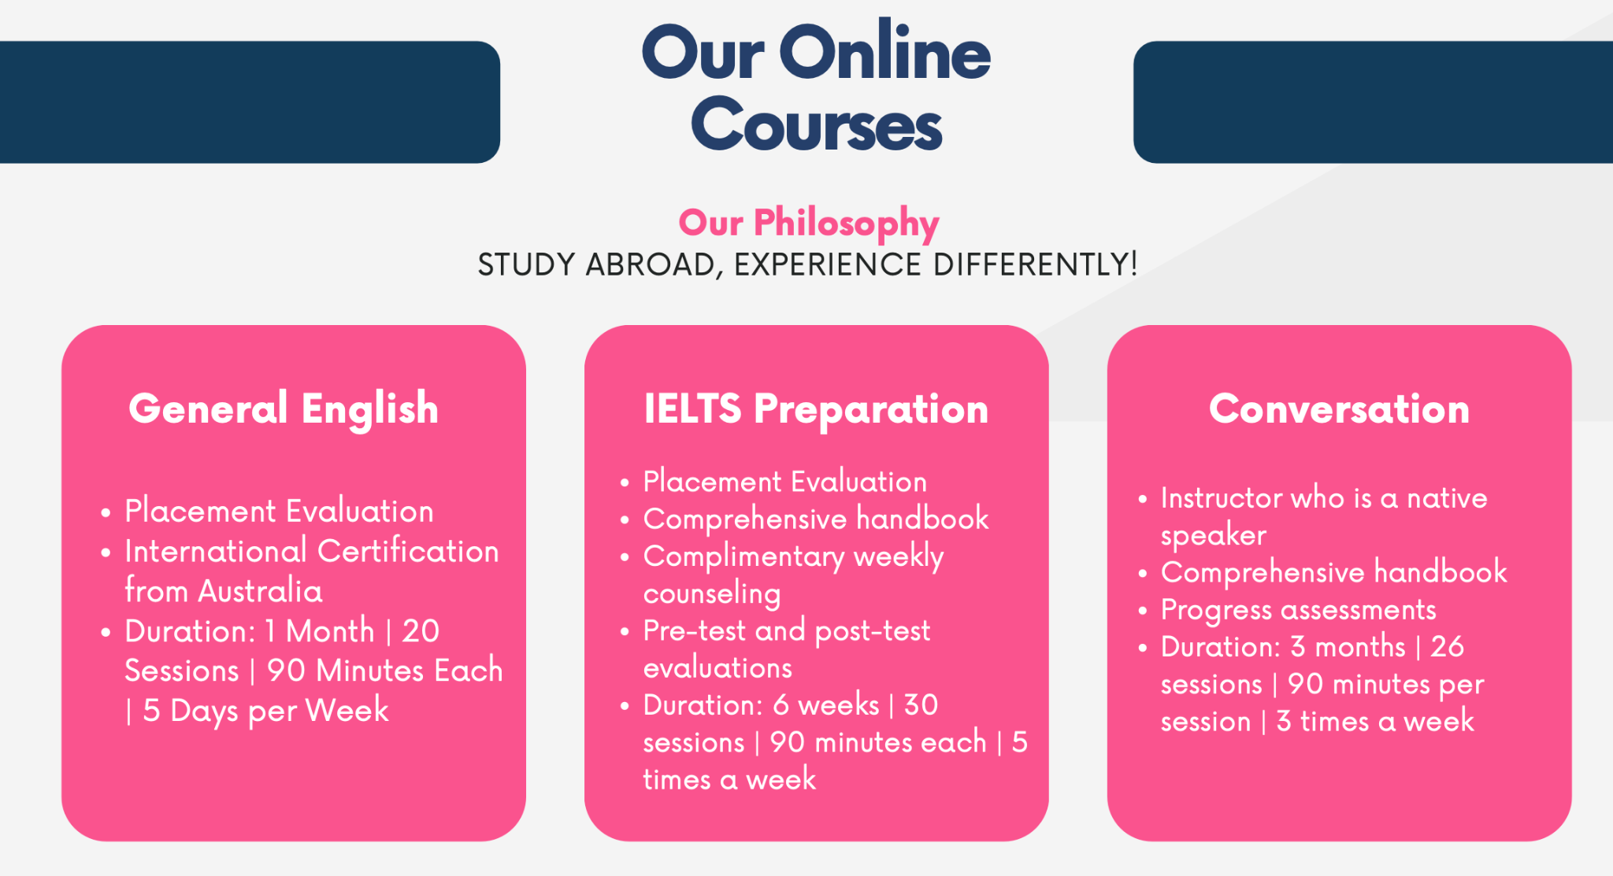
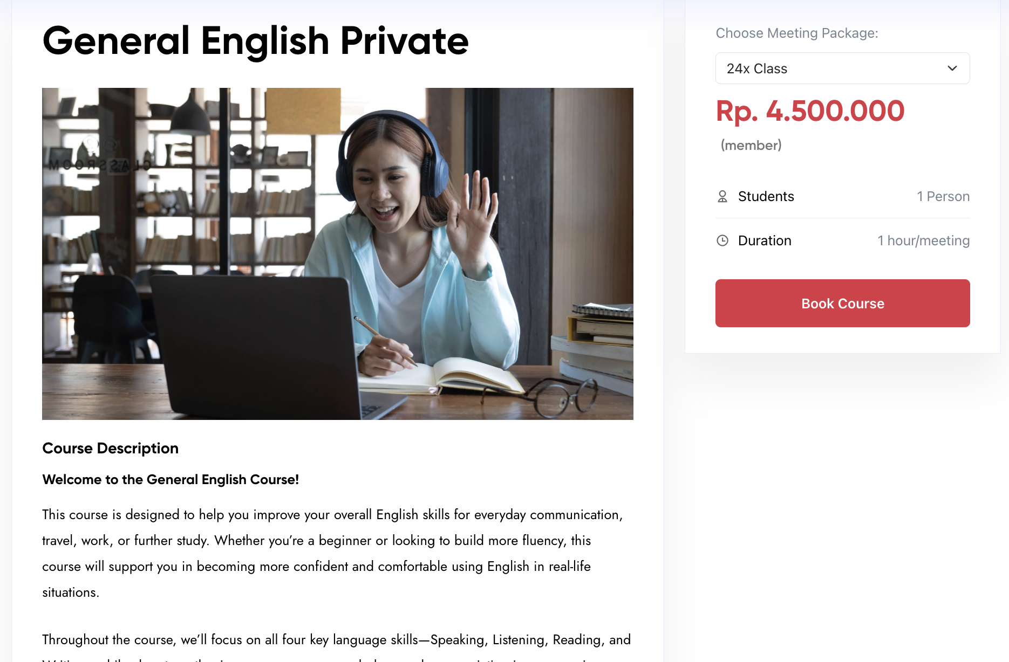
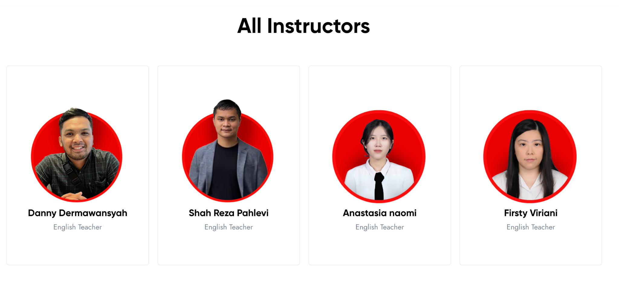
Services (same as Language Programs Webpage)
SELESAI
Data kursus asli + profil 4 pengajar terpasang
Language Test Preparation
Course Overview: IELTS, JLPT, Conversation Class – short descriptions.
Teaching Method: Small group, online option, mock test support.
Schedule & Flexibility: Highlight time options (evening/weekend).
Student testimonial
Teacher profile

Slide 11
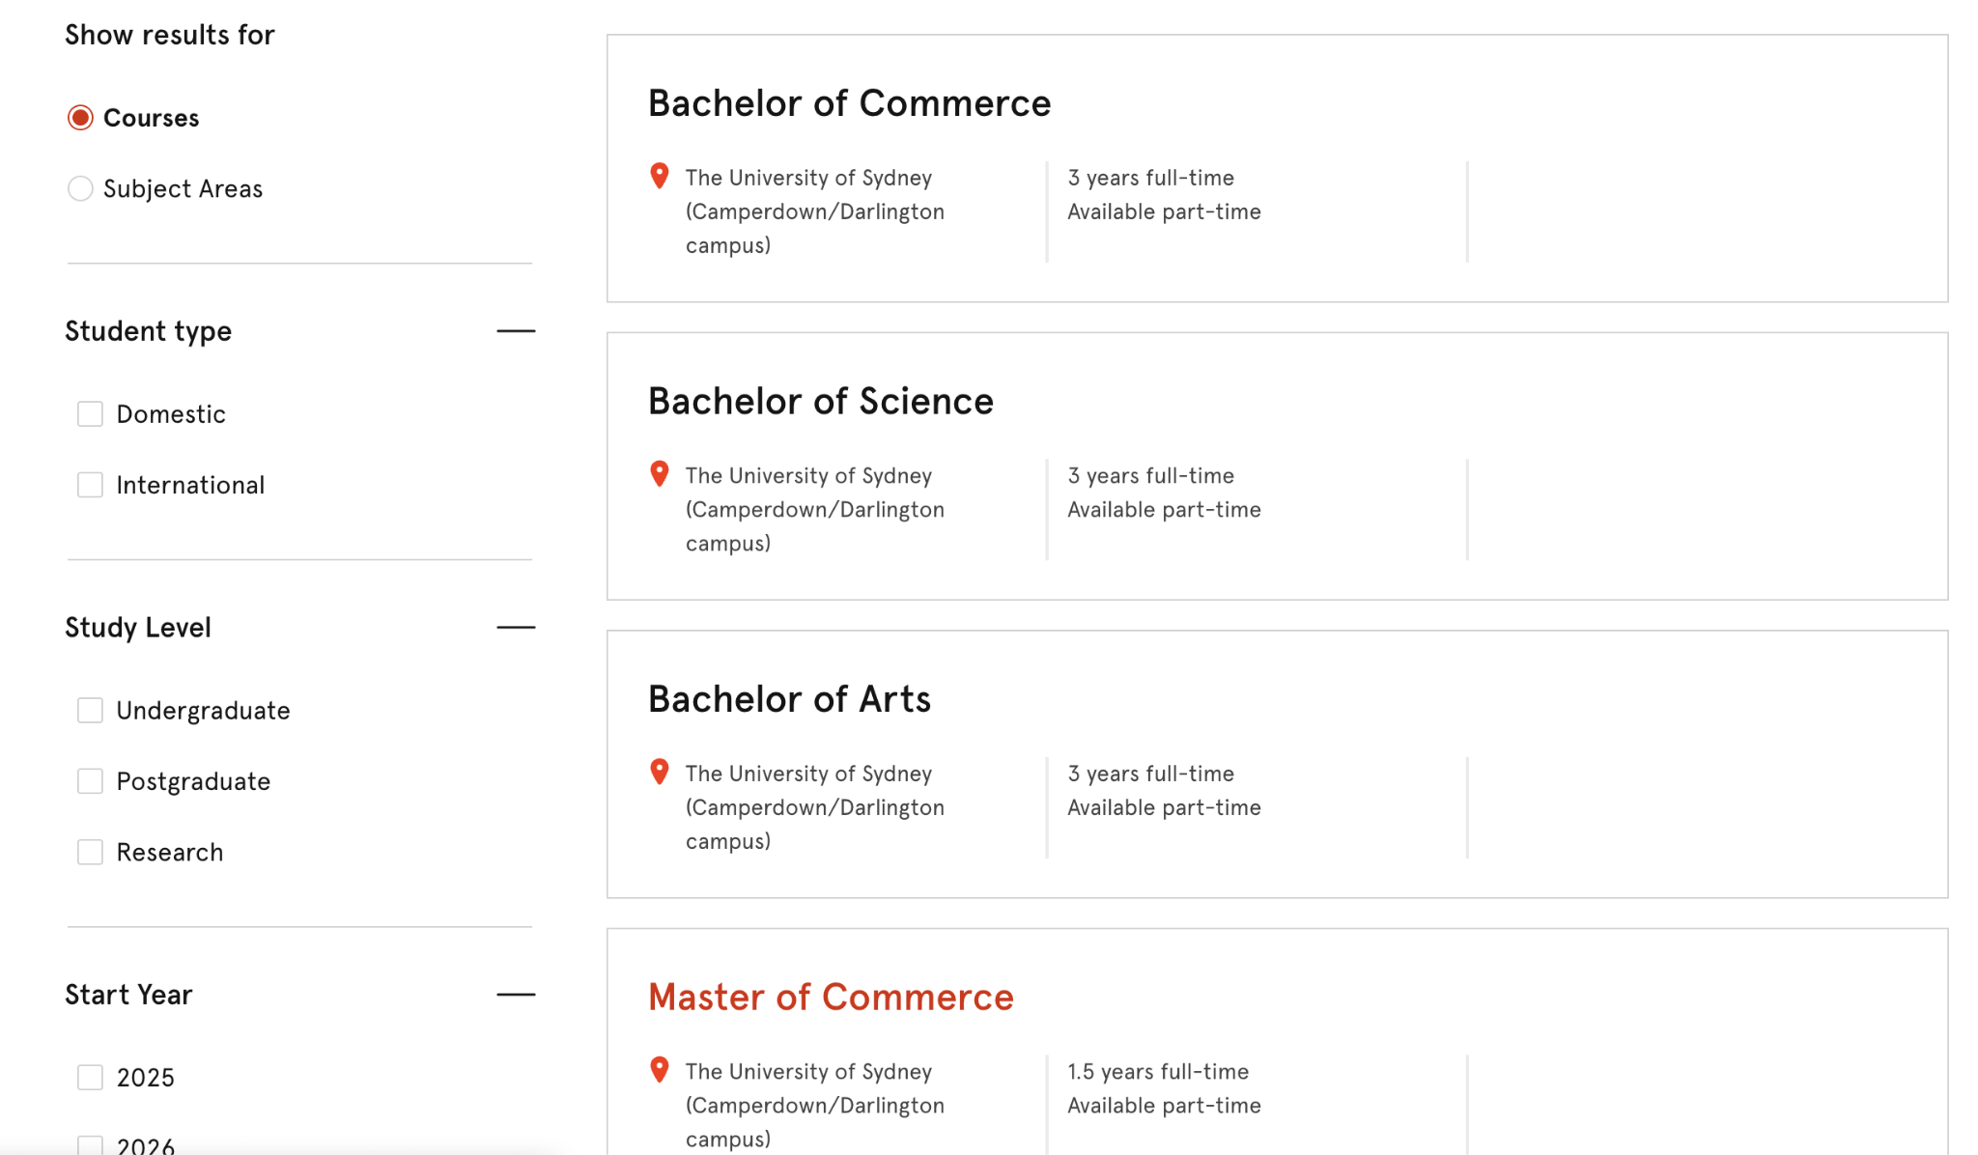
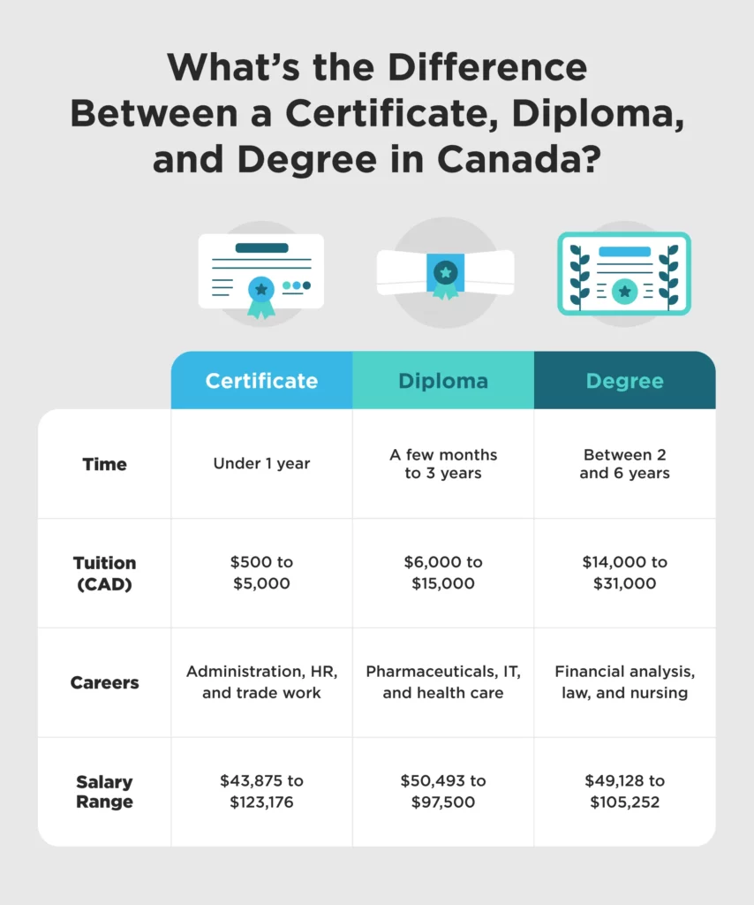

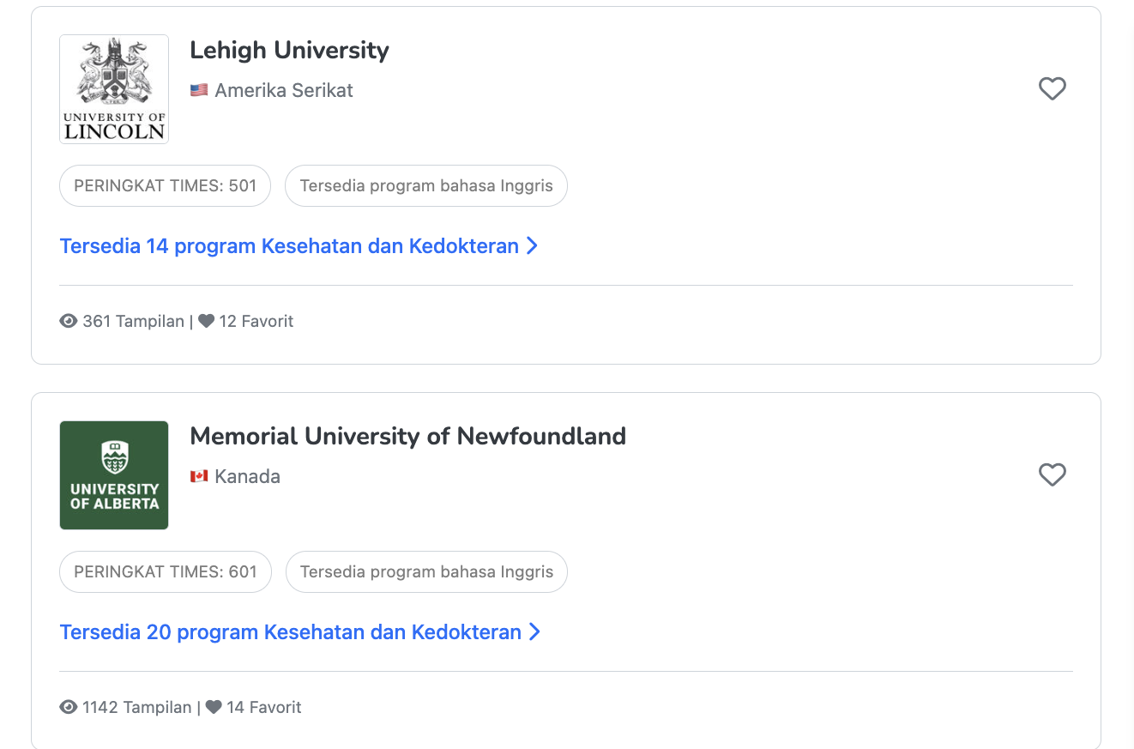
Courses & Universities
SEBAGIAN
Overview kualifikasi + filter UI. Database universitas live belum
An overview of difference between Vocation and Diploma, Bachelor Degree, Master Degree and PhD, Language Study, and Exchange Program
Benefits i.e.VET is, benefits (hands-on learning, fast entry to workforce).
Emphasize career advancement, research, and migration pathways.
Popular fields among Indonesian students: For Bachelors are Business, Engineering, IT, Health. For VET/Diploma are: Hospitality, IT, Business, Design.
Length of Study
Show filters so students can view the relevant courses and universities such as qualification, country, study field,

Slide 12

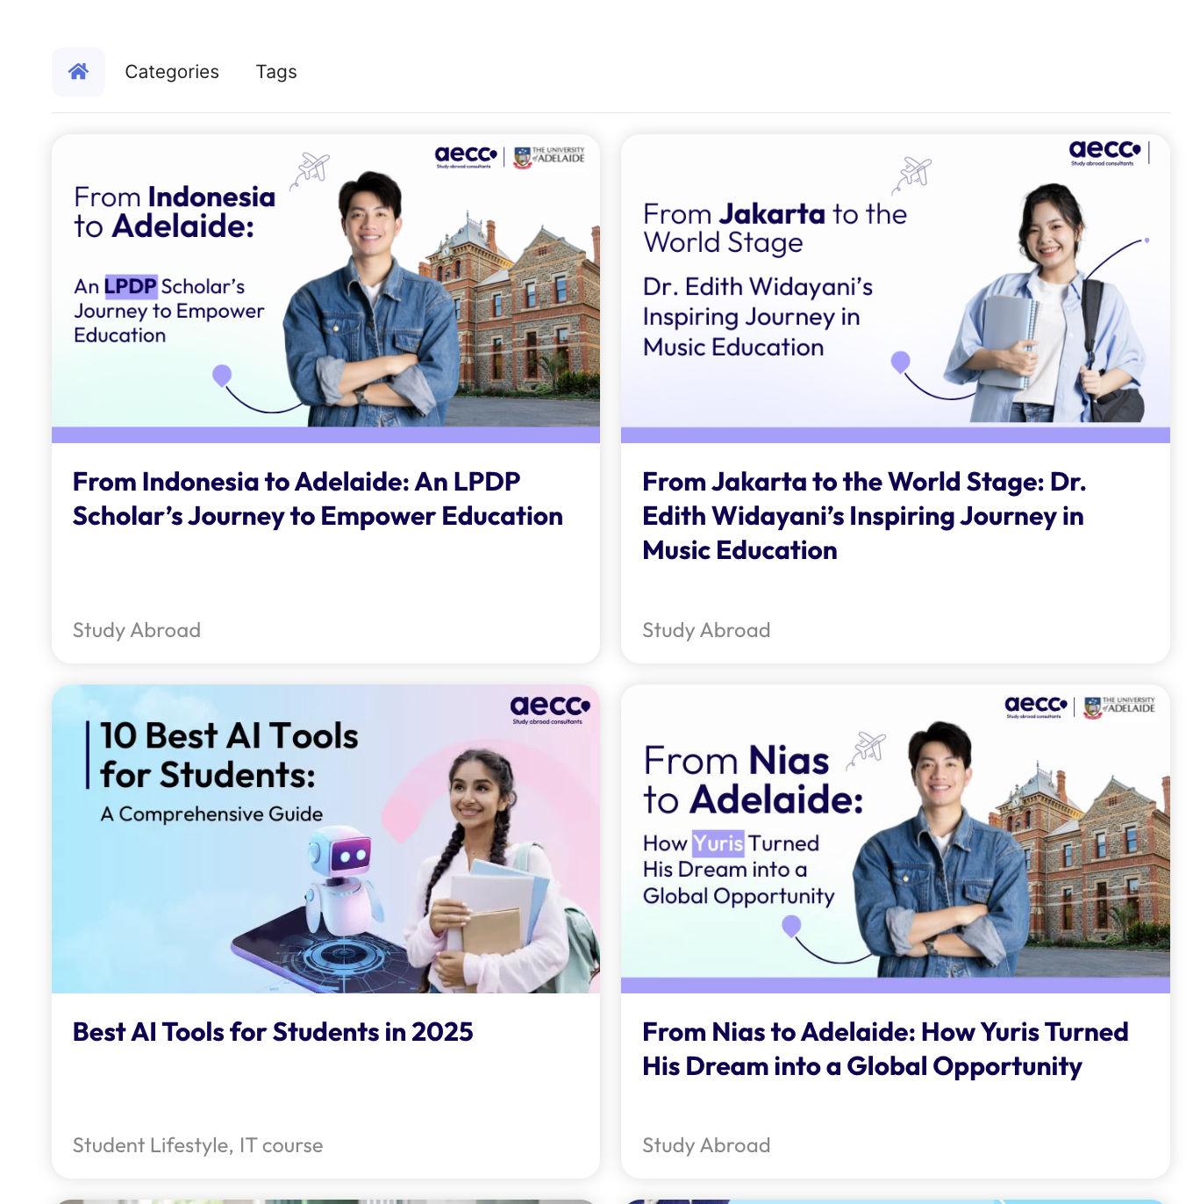
Blog
SEBAGIAN
Filter kategori + 3 artikel. Halaman detail artikel menunggu keputusan CMS
Categories (using filter):
Recent News – updates on scholarships, partner universities, policy changes.
Immigration – visa updates, regulations, step-by-step guides.
Student Life – lifestyle tips, cultural adjustment, alumni stories.
Study Tips – exam prep, language hacks, productivity guides.

Slide 13
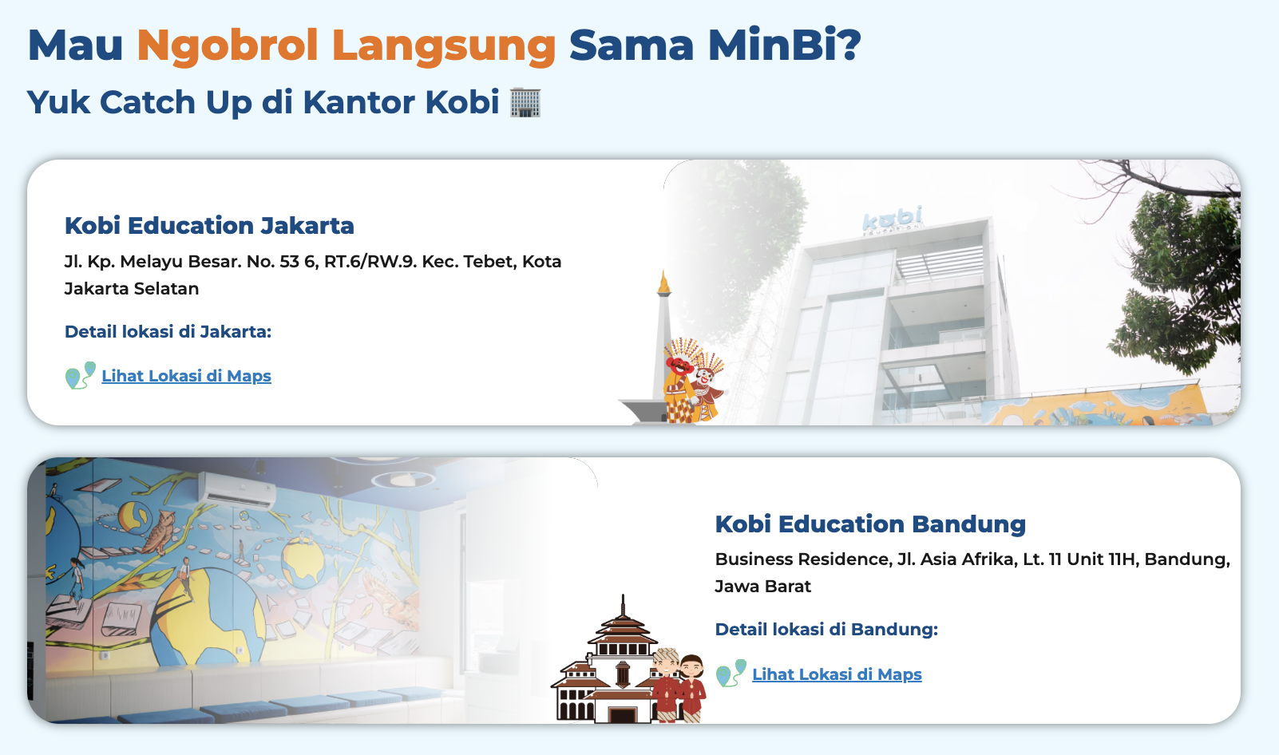
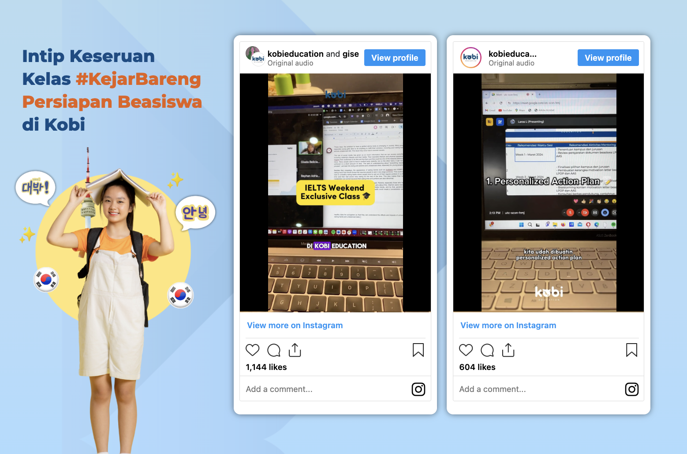
Contact Us
SEBAGIAN
Kantor + WA + sosmed OK. Alamat lengkap & embed Maps menunggu data
Intro:
📞 Need help with your study abroad plan? Our team is ready to assist you at every step.
Content:
Our Offices – Pangkalpinang, Makassar, (soon Jakarta). Address + Map embed.
Email & Phone Number – clickable for mobile users.
Social Media – IG, FB, WhatsApp button.
Our Offices

Slide 14
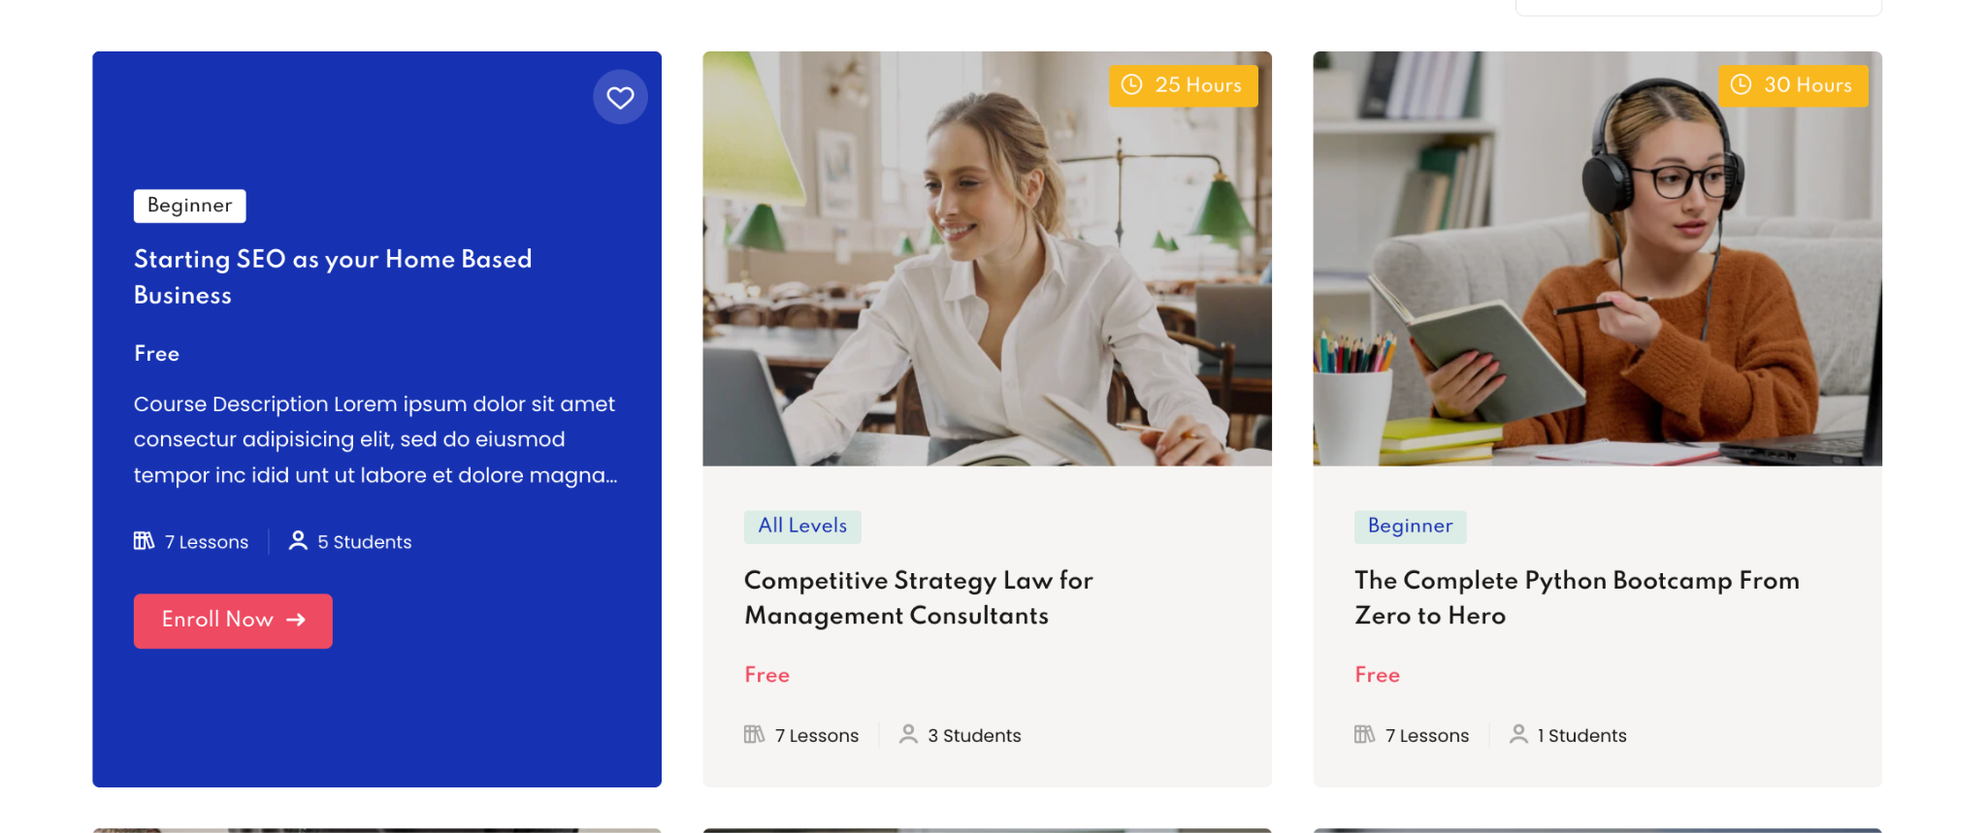
Language Course Enrollment
BELUM — BACKLOG
Butuh keputusan payment gateway & sistem booking
Enrollment Flow:
Student choose their desired course and click Join/Register
They will be directed to Registration Form to ask their details and proceed with payment
Once payment is successful, they will be given timetable in calendar format in which every time they want to start the class, they can login and enroll the course.
Student will be reminded via email prior to start their first class

Slide 15
Ringkasan Status Implementasi — 16 Juli 2026
Rebuild Elementor → Next.js + TypeScript + SEO/GEO
SELESAI: • Navigasi lengkap sesuai panduan (dropdown, CTA pink, Login) • Home: hero, 6 langkah, form konsultasi, testimoni alumni • About Us: story, Vision/Mission, sertifikasi, tim • Services: 6 layanan visa + IMMagine & Middow + FAQ • Language Programs: data kursus & 4 pengajar asli • 6 halaman negara (Australia terlengkap) • SEO dasar + structured data (GEO)
MENUNGGU DARI TIM / KEPUTUSAN: • Foto + bio Cindy Christella • Alamat kantor lengkap & kontak resmi (telepon/email) • Logo universitas partner resmi • Keputusan CMS untuk Blog • Payment gateway untuk enrollment kursus bahasa • PDF checklist dokumen visa • Konten detail negara selain Australia

