Slide 1
FUNDING PROPOSAL · UNIVERSITI PENDIDIKAN SULTAN IDRIS
Pengetahuan Suluh Budiman Est. 1922 · Tanjung Malim
SULUH
Southeast Asia's first university-built sovereign educational AI — trained, governed, and served entirely inside UPSI.
A 35-billion-parameter model bound to four institutional harnesses under one PDPA-compliant governance layer. Malaysian student data never leaves Malaysian soil.
THE ASK
TIMELINE
BREAKEVEN
LICENSING
v3.3 · 21 July 2026 UPSI Research Management
RM 450,000
12 months
Month 14
RM 0
Notes:
Open on the motto: SULUH is not a brand we invented — it is the word at the centre of UPSI's own motto, Pengetahuan Suluh Budiman. This is a funding decision: RM 450K, 12 months, breakeven month 14.

Slide 2
WHY UPSI · WHY THE NAME
SULUH · 02
UPSI has been first before. The torch is already in our motto — Pengetahuan Suluh Budiman.
1922
1997
2006
2026
First teachers' college
First education university
Digital pioneer
First sovereign educational AI
Sultan Idris Training College opens in Tanjung Malim — the cradle of Malay education and intellect.
SITC becomes UPSI — Malaysia's first university dedicated to education itself.
MyGuru makes UPSI an early national adopter of open-source learning platforms.
SULUH — to our knowledge, the first higher-education-focused sovereign AI built and owned by a university in Southeast Asia.
Suluh (Malay): a torch — the light that guides. The system is named by the university's own founding motto.
Notes:
Land the emotional argument first: UPSI has been first before. 1922 first teacher college, 1997 first education university, 2006 early LMS pioneer with MyGuru. SULUH is the fourth first — and the name was already in our motto.

Slide 3
EXECUTIVE SUMMARY
SULUH · 03
For RM 450K over 12 months, UPSI owns a sovereign educational AI that reaches cost-parity with the cloud by Month 14 — and never sends a single student record offshore.
SITUATION
95% of students already use AI. UPSI's grading, advising, and analytics are heading the same way — and every leading option runs in a foreign cloud.
WHAT RM 450K BUYS
Sovereign compute cluster
RM 200K
COMPLICATION
Cloud AI puts student PII under foreign jurisdiction just as PDPA penalties rose to RM 1 million with personal liability for officers — and bills compound at RM 15–25K monthly, forever.
RM 250K
Engineering team, 12 mo
Annual OPEX thereafter
RM 30K
RESOLUTION
Build it on-premise once. A 35B sovereign model, four harnesses, and IsRAG provenance on every answer — RM 0 software licensing , breakeven in 14 months.
36-MO SAVING VS CLOUD
RM 240–600K
Sources: SULUH v3.3 economic analysis · HEPI Student Generative AI Survey 2026 · PDPA (Amendment) Act 2024 · model tags verified live 20 Jul 2026
Notes:
Situation-complication-resolution on one slide. The number to remember is RM 450K; the reason is that sovereignty now pays for itself — and, since June 2025, protects the people in this room personally.

Slide 4
HOW THIS DECK READS
SULUH · 04
Six questions, one decision.
Why
What
Who
Where
When
How
Students moved first, attackers moved next, the law moved last — the cloud is now the wrong foundation.
One system, two fundable halves — and a first-of-its-kind position in the region.
Four harnesses owned by the UPSI units that live the problem — and what UPSI gains.
Five desktop nodes and 10,000 laptops, all inside the firewall.
Three tracks in parallel; sovereign serving live from Month 2.
Novel research incl. IsRAG, governance in code, and economics that break even.
The last question — How — resolves into the decision on the final slide.
Notes:
The spine of the pitch: six questions in order, resolving into one decision. Tell them where we're going.

Slide 5
PART ONE · THE IMPERATIVE
Why.
Three forces converged in twenty-four months: students adopted AI faster than any technology in university history, universities became the world's most-attacked sector, and Malaysian law grew teeth. The foreign cloud is now the wrong foundation.
SULUH · 05
Notes:
Divider. Three forces converged in 24 months: students adopted AI en masse, universities became the most-attacked sector on earth, and Malaysian law grew teeth. Any one alone justifies sovereignty. Together they make it urgent.

Slide 6
WHY · 01 THE ADOPTION WAVE
SULUH · 06
The question is no longer whether UPSI adopts AI — students already did. The question is whose AI, under whose law.
95%
of students now use AI in some form — up from 66% just two years ago
Every day that UPSI has no institutional AI, students and staff fill the gap themselves — pasting assignments, drafts, student records, and research data into free consumer chatbots hosted overseas, under terms of service no one has read.
94%
use generative AI on assessed work — grading integrity is already an AI problem
That data trains someone else's model, sits under someone else's jurisdiction, and is governed by no UPSI policy. Doing nothing is not a neutral option — it is an unmanaged data-export programme.
38%
of institutions provide AI tools. The other 57 points of usage are ungoverned shadow AI
SULUH replaces shadow AI with a governed alternative that is better for students — bilingual, curriculum-aware, and free — not just a policy that bans what we cannot see.
Source: HEPI/Kortext Student Generative AI Survey 2026 (n=1,054 undergraduates) · 2024→2026 trend: 66% → 92% → 95% any-AI use
Notes:
Force one: adoption already happened without us. HEPI 2026: 95% of students use AI, 94% on assessed work — but only 38% of institutions provide tools. The gap is shadow AI: coursework and personal data flowing into foreign consumer chatbots today, ungoverned.

Slide 7
WHY · 02 THE THREAT IS REAL
SULUH · 07
Universities are now the most-attacked institutions on earth — and the biggest breaches came through third-party vendors, not campus firewalls.
4,388
3.9M
39%
cyberattacks per education organisation every week — the highest of any sector (Q2 2025)
education records exposed in confirmed 2025 ransomware attacks — up 27% year-on-year
of identity-based attacks Microsoft observed targeted research and academic institutions
CASE · UNIVERSITY OF PHOENIX
CASE · COLUMBIA UNIVERSITY
CASE · POWERSCHOOL
3.5M people exposed via one vendor zero-day
870K records, 460 GB, two months undetected
62M students exposed by one ed-tech vendor
Attackers exploited Oracle's E-Business Suite weeks before the vendor even knew. Three months of dwell time before detection. Names, birthdates, ID numbers — gone.
One phished phone call. Attackers roamed the network from May to June 2025, taking academic histories, financial aid files, and health information.
A single compromised support credential — no MFA — reached the records of 18,000 schools. The largest student-data breach in history was a supply-chain failure.
Sources: Check Point via DeepStrike (Q2 2025) · Comparitech Education Ransomware Roundup 2025 · Microsoft Digital Defense Report 2025 · public breach disclosures 2025 · CISA: education is "target rich, cyber poor"
Notes:
Force two: the threat is not hypothetical. Education is now the most-attacked sector globally. Walk the three case studies — Phoenix, Columbia, PowerSchool. Universities are target-rich and cyber-poor; every foreign vendor multiplies the attack surface.

Slide 8
WHY · 03 THE LAW GREW TEETH
SULUH · 08
Since 2025, mishandling personal data is a RM 1 million offence — and liability reaches named officers, personally.
RM 1M
Personal
maximum fine per offence — up from RM 300K — plus up to 3 years' imprisonment
directors, managers, and officers are personally liable unless they prove due diligence
Every cloud AI query that carries a student record is a cross-border transfer UPSI must justify, a vendor contract UPSI must audit, and a breach surface UPSI cannot see into — yet UPSI keeps 100% of the liability .
72 hrs
DPO
mandatory breach notification to the Commissioner — failure alone costs up to RM 250K
a registered Data Protection Officer is mandatory since June 2025 at UPSI's data scale
Sovereignty inverts the equation: when data never leaves campus, the hardest compliance questions never arise . SULUH doesn't manage this risk. It removes it.
Cross-border
Offshore transfers are only lawful to jurisdictions with substantially similar protection — a test each foreign AI vendor must pass, and UPSI must evidence, for every data flow.
Source: Personal Data Protection (Amendment) Act 2024, in force Jan–Jun 2025 · JPDP Guidelines Feb 2025 · avg. Malaysian breach cost est. RM 3.2M incl. fines, legal & churn (Simply Data 2025)
Notes:
Force three: PDPA grew teeth in 2025. RM 1M fines, personal liability reaching directors and officers, 72-hour notification, mandatory DPO, and a stricter cross-border regime. This is the slide for top management: the risk is now personal.

Slide 9
WHY · 04 SOVEREIGNTY BY DESIGN
SULUH · 09
Every cloud option forces student data offshore — SULUH makes the question structurally impossible to ask.
Jurisdiction
Foreign cloud = foreign legal reach over Malaysian student records — including subpoena powers UPSI cannot contest.
Grading, advising, and staff analytics all run on real student and employee records. Sending them to a foreign API means UPSI can no longer guarantee where that data lives, who can subpoena it, or how it is retained.
Consent & purpose
PDPA requires granular, purpose-bound consent — unenforceable across a vendor boundary you cannot audit.
Sovereignty is not a feature of SULUH — it is the design constraint. No raw student PII ever leaves UPSI. Cloud teachers touch only anonymised curriculum data.
Breach accountability
72-hour notification and audit trails are UPSI's obligation — even when the breach is the vendor's, as in every 2025 case study.
PDPA = Personal Data Protection Act 2010, as amended 2024 · governance architecture detailed in Part Six
Notes:
Synthesis of the legal case: jurisdiction, consent, breach accountability. Sovereignty is the design constraint, not a feature.

Slide 10
WHY · 05 ECONOMICS
SULUH · 10
Cloud AI is a bill that never stops; a sovereign build is a cost that ends.
RM 15–25K
per month, every month, for as long as UPSI uses AI
TWO COST STRUCTURES
Cloud — operating expense
compounds ↗
Cloud pricing scales with usage — the more UPSI adopts AI, the faster the meter runs. There is no asset at the end, no licence owned, no capability retained.
SULUH — capital expense
flattens →
RM 0
software licensing — the entire stack is open source
SULUH spends CAPEX once and RM 30K/year to run. After the build phase the curve flattens; the cloud's keeps climbing.
Breakeven at Month 14. Full quantified curve in Part Six.
Illustrative cost shape; quantified 36-month analysis in Part Six · Economics
Notes:
The money case. Cloud is an operating expense that compounds forever; sovereign is a one-time build. Preview the breakeven proven later.

Slide 11
WHY · 06 WHY NOW
SULUH · 11
The sovereign-AI wave is cresting now — and no university in the region has staked the higher-education claim. The window belongs to the first mover.
THE MOMENT
100+ countries committed to AI sovereignty in the Bangkok Declaration (Feb 2026) — sovereignty is now the global default, not the exception.
WHAT THE FIRST MOVER WINS
Malaysia's national push — ILMU, NAIO, MyDIGITAL — is funded and moving, but it targets nation-scale and industry. Education is unclaimed.
The standard: UPSI's governance gates and golden set become the national reference for educational AI.
Analysts warn that institutions which don't build become "permanent renters" of foreign AI — paying forever, owning nothing.
The partnerships: ministries, MQA, and 20 public universities need exactly this — the first builder hosts the conversation.
The talent: the researchers and students who build sovereign AI come to — and stay at — the place that builds it.
The cost of one year of waiting: RM 180–300K in cloud spend, twelve more months of shadow-AI exposure — and the first-mover title passes to another campus.
Sources: Bangkok Declaration (Feb 2026) · Digital in Asia, Sovereign AI in Asia 2026 · Fulcrum/ISEAS 2026 · regional landscape detailed in Part Two
Notes:
Close Part One with urgency for top management: the sovereign-AI wave is cresting now. 100+ countries signed the Bangkok Declaration; Malaysia's national momentum is real but no university has staked the higher-ed claim. The first mover defines the standard, wins the partnerships, and hosts the benchmark. Every semester of delay is money and data leaving.

Slide 12
PART TWO · THE SYSTEM
What.
SULUH is one system with two fundable halves: a sovereign model, and the institutional harnesses that put it to work — occupying a position no one in the region holds.
SULUH · 12
Notes:
Divider. Define the thing precisely so funders know exactly what they are buying — and where it sits in the regional landscape.

Slide 13
WHAT · 01 STRUCTURE
SULUH · 13
Two projects, funded separately, operationally inseparable — that separation is what makes each one fundable.
SULUH AI
R&D · this ask
SULUH Ecosystem
Deployment-ready
The sovereign model — a 35B-parameter educational AI trained, adapted, and served entirely on-premise.
The institutional harness layer — four production applications consuming SULUH AI as their inference backend.
RM 450K
Grant
Separate
Infra
200K hardware + 250K manpower
peer-reviewed research novelty
operational IT budget
code already exists
A research novelty needs peer review and reproducibility; institutional infrastructure needs operational budgets. Splitting them lets each be funded through the right channel — this deck is the bridge.
Notes:
Explain the AI/Ecosystem split and why it matters for funding: research grant vs operational budget.

Slide 14
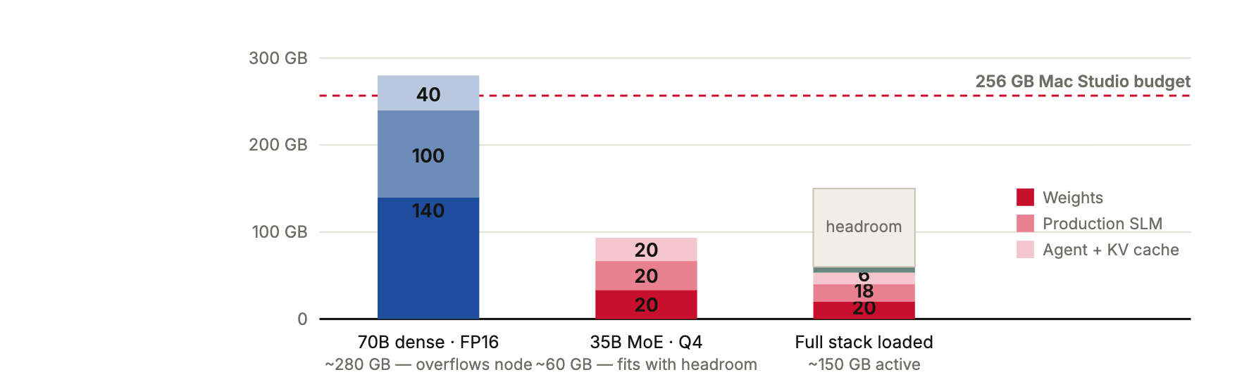
WHAT · 02 THE MODEL
SULUH · 14
A 35B mixture-of-experts delivers 70B-class quality while fitting our hardware six times over.
A 70B dense model needs ~280 GB once weights and KV cache are counted — it overflows a single node. A 35B MoE activates just 3B parameters per token , matching quality at a fraction of the memory.
6×
Apache 2.0
headroom on the cluster
Qwen3.6-35B-A3B, no licence fee
Full 100B pre-training is a Phase-2 vision contingent on national compute — upside, not a Year-1 dependency .
Figure — memory footprint. The full stack (teacher + production + agent + embedding) serves in ~150 GB of 896 GB aggregate.
All model tags verified live on Ollama & HuggingFace, 20 Jul 2026 · MoE = mixture of experts
Notes:
The technical choice that de-risks the whole build: 35B MoE, not 70B or 100B. It fits our hardware six times over. Walk the memory figure.

Slide 15
WHAT · 03 THE REGIONAL LANDSCAPE
SULUH · 15
Nations are spending tens of millions on sovereign AI. Nobody has claimed higher education — SULUH takes that seat for 0.2% of Singapore's budget.
PROGRAMME
BACKER
INVESTMENT
FOCUS
NMLP / SEA-LION
IMDA · AISG · A*STAR
S$70M≈ RM 230M
National, general-purpose regional LLM
Singapore
ILMU
YTL Corp × Universiti Malaya
Corporate· 500MW DC
National Bahasa Malaysia model, from scratch
Malaysia
Sahabat-AI
GoTo Group
Corporate
Consumer & government services ecosystem
Indonesia
SULUH
A public university
RM 450K
Education-domain, university-owned, on-campus — first of its kind in SEA
Malaysia · UPSI
National programmes prove the thesis and supply the upside — SULUH is designed to plug into NAIO/MyDIGITAL compute for its Phase-2 100B vision.
The education university building educational AI is not a coincidence of budget — it is exactly the institution that should define this category .
Sources: IMDA/AISG NMLP announcements · Fulcrum (ISEAS) 2026 · Digital in Asia 2026 · "first of its kind": no university-owned, higher-ed-domain sovereign LLM programme identified in SEA as of Jul 2026
Notes:
The comparison slide for leadership: where SULUH sits among SEA sovereign AI programmes. Singapore spent S$70M nationally; ILMU is corporate-backed with a 500MW data centre; Sahabat-AI is a corporate ecosystem. Nobody has built education-domain, university-owned, on-campus sovereign AI. SULUH does it for ~0.2% of Singapore's programme.

Slide 16
PART THREE · OWNERSHIP
Who.
Seven scattered proposals collapse into four harnesses — each owned by the UPSI unit that already lives the problem. And the whole university rises with them.
SULUH · 16
Notes:
Divider. Ownership and accountability — and what the institution gains.

Slide 17
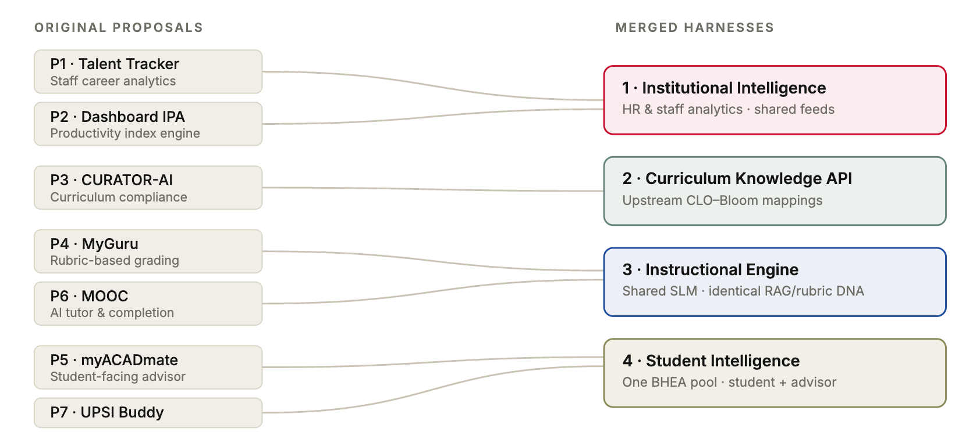
WHO · HARNESSES & OWNERS
SULUH · 17
Seven proposals consolidate into four harnesses on one governed data fabric — no duplicate backends.
1
Institutional Intelligence
BSM
Dr. Ahmad Amri · Dr. Nurul Hila
2
Curriculum Knowledge API
PPA
Dr. Amelia
3
Instructional Engine
ICT
Dr. Mohd Muslim · Dr. Ahmad Wiraputra
4
Student Intelligence
BHEA
Dr. Vasanthan · Pn. Nurul Ashikin · Jason Wong
P1/P2 share HR data · P4/P6 share grading & tutoring · P5/P7 share the student pool · P3 becomes an upstream API
Notes:
Consolidation story: from 7 duplicated backends to 4 harnesses on one data fabric, with named owners.

Slide 18
WHO · WHAT UPSI GAINS
SULUH · 18
SULUH is an institutional elevator: it lifts UPSI's research standing, its classrooms, its talent, and its national position — simultaneously.
Research standing
NeurIPS · ACL · Nature MI
Teaching & learning
Every student, every lecturer
Five planned publications on a 10,000-device evaluation testbed few labs on earth can replicate . Citations, rankings, and grant capital compound from here.
Rubric-faithful grading in seconds, a bilingual tutor on every laptop, advising that sees the whole student record — without a single record leaving campus.
Talent & capability
Owned, not rented
National position
The education university
An in-house team that can train, align, and govern frontier-class models — and graduates who learned on a sovereign stack. This capability cannot be bought later at any price.
When ministries, MQA, and 20 public universities look for educational AI done right, they will look at the university whose motto carries the torch . That seat is taken by whoever builds first.
Publication plan and evaluation targets detailed in Part Six · Proof of rigor
Notes:
The 'what does UPSI get' slide for the VC's office. Four dimensions of uplift: research standing (a 10,000-device testbed and five papers), teaching and learning, talent and capability, national positioning. Malaysia's education university leading educational AI is a strategic fit no other campus can copy.

Slide 19
PART FOUR · THE FOOTPRINT
Where.
Everything runs on five desktop nodes and 10,000 campus laptops — all inside the UPSI firewall. No data centre required.
SULUH · 19
Notes:
Divider. Physical footprint — reassure that this fits in a wall cabinet, not a data centre.

Slide 20
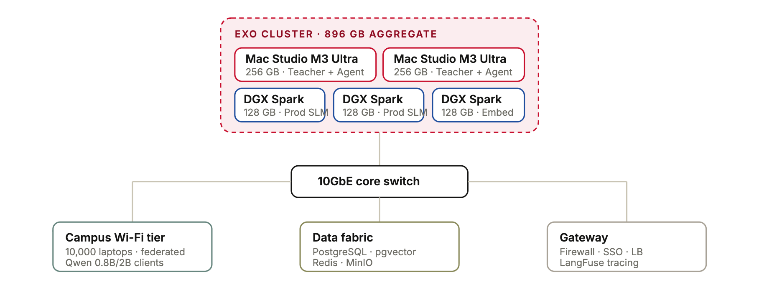
WHERE · SOVEREIGN COMPUTE
SULUH · 20
Five desktop nodes aggregate 896 GB; 10,000 laptops train the edge — and only adapter deltas ever move.
896 GB
12U
aggregate memory, 5 nodes
wall cabinet — not a rack room
Desktop form factor
Two Mac Studios and three DGX Sparks on ventilated shelves. A 30-minute UPS rides through outages.
The privacy guarantee
The laptop swarm exchanges only LoRA adapter deltas with the cluster — never raw student data .
Figure — compute topology. EXO disaggregates model layers across nodes; no single node holds the full 35B at FP16.
Hardware total RM 200K · orchestration: EXO layer parallelism + vLLM · entire software stack open source (RM 0 licensing)
Notes:
Walk the topology: EXO cluster of 5 nodes aggregating 896 GB, plus the laptop swarm that exchanges only adapter deltas. Form factor: 12U wall cabinet.

Slide 21
PART FIVE · THE PLAN
When.
Three tracks run in parallel across 12 months. The sovereign model is serving from Month 2 — value arrives early, not at the finish line.
SULUH · 21
Notes:
Divider. Timeline and momentum — sovereign serving is live from Month 2, not the end.

Slide 22
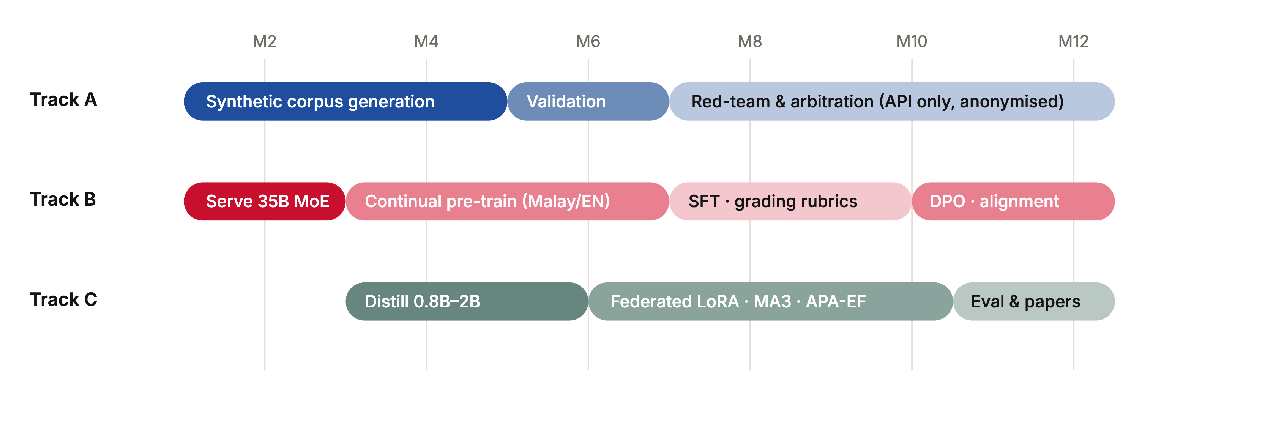
WHEN · THREE-TRACK ROADMAP
SULUH · 22
Three tracks, each matched to what its hardware can verifiably do — from anonymised cloud teachers down to campus laptops.
A · Cloud teacher
B · Sovereign teacher
C · Federated student
Generates synthetic training data from anonymised rubrics. No PII ever leaves UPSI. ~RM 3–5K over 12 mo.
The 35B MoE, served on-prem from Month 2 and continually adapted through six stages to DPO alignment.
0.8–2B models distilled from the teacher, trained across 10,000 laptops under differential privacy.
SFT = supervised fine-tuning · DPO = direct preference optimisation · LoRA = low-rank adaptation
Notes:
The three parallel tracks: cloud teacher (anonymised only), sovereign teacher (serving M2, DPO by M10), federated student swarm. Emphasise matched to what each tier can verifiably do.

Slide 23
PART SIX · EXECUTION
How.
Four proofs turn the plan into a fundable reality: novel research, a provenance engine that makes AI show its receipts, governance enforced in code, and economics that break even.
SULUH · 23
Notes:
Divider. The how splits into four proofs: research contribution incl. IsRAG, governance, and economics. This is where credibility is won.

Slide 24
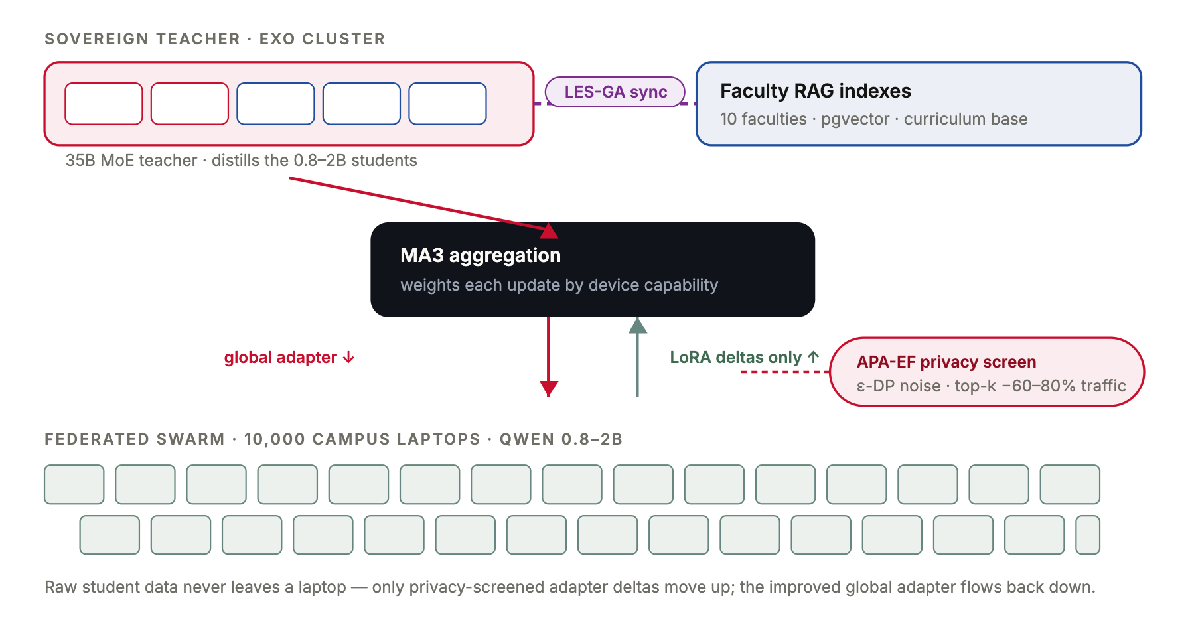
HOW · 01 RESEARCH ENGINE
SULUH · 24
The swarm is the research engine — three novel algorithms, evaluated at a 10,000-device scale few labs can replicate.
MA3
AGGREGATION
Model-Agnostic Adaptive Aggregation
Weights adapter updates by device capability — Mac Studios and campus laptops reconciled in one round.
APA-EF
PRIVACY
Adaptive Privacy-Aware Elastic Federated
ε-differential privacy with top-k sparsification — 60–80% less traffic, no individual update ever inspected.
LES-GA
ALIGNMENT
Localized Elastic Search, Gradient-Aligned
Faculty-local RAG indexes stay consistent with the global curriculum base — no full-model retraining.
Figure — the swarm loop. Laptops train locally; APA-EF screens the updates; MA3 aggregates them into the teacher; LES-GA keeps faculty knowledge aligned.
Foundational proof: Psyche
Nous Research's Psyche already proved transformers can be trained across untrusted internet nodes. SULUH operates under a strictly easier trust assumption — all 10,000 devices are institution-owned — which is exactly what enables APA-EF privacy and LES-GA alignment. Our contribution is deploying it safely, privately, and educationally within a sovereign boundary .
Notes:
The swarm is the research engine. Three algorithms, validated at 10,000-device scale. Psyche proves distributed training works; SULUH's contribution is doing it safely inside an institution.

Slide 25
HOW · 02 ISRAG — THE TRUST ENGINE
SULUH · 25
Chatbots fabricate up to half their citations. In education, that is disqualifying — IsRAG is the architecture built to end it.
55% / 18%
56%
58–88%
Worst
of citations fabricated by GPT-3.5 / GPT-4 in literature reviews (Walters & Wilder)
of GPT-4o citations fake or erroneous in academic reviews (Deakin Univ., JMIR 2025)
hallucination rates on legal queries across major models (Stanford)
where students need help most: niche, low-resource topics — exactly UPSI's Malay-language domain
A chatbot's fabricated citation looks identical to a real one — and a student cannot tell the difference. Retrieval alone doesn't fix it: even RAG systems still fabricate. A citation tells you where; an isnad tells you whether to trust. IsRAG verifies every claim against a provenance chain before it ever reaches a student.
EVERY ANSWER CARRIES ITS CHAIN
Provenance
Trust score
Cultural context
every author, verifier & adapter, immutable
5-factor TrustEngine, 0–1 calibrated
13-framework registry, incl. Malaysian & Islamic
Up to 10×
100%
fewer false citations than today's chatbots — ≤5% golden-set target vs their 18–56%
of answers auditable — IRB & PDPA-ready by design
TRUSTENGINE — FIVE WEIGHTED FACTORS
Verification level
30%
Source credibility
25%
Why this is the only viable answer for educational AI
Verification quality
20%
A university cannot deploy a system that invents scholarship — every false citation is a defective teaching act with accreditation consequences. Frontier chatbots answer; SULUH answers and proves , adapting the Isnad (إسناد) — Islamic scholarship's millennium-old chain-of-transmission methodology — born naturally at a Malaysian university.
Cross-references
15%
Freshness
10%
Sources: Walters & Wilder 2023 (42 topics) · Linardon et al., JMIR 2025 (GPT-4o: 19.9% fabricated + 45.4% erroneous) · Stanford HAI legal-hallucination studies · pooled 6-study fabrication rate 51% (PMC 2023) · Paper 1: IsRAG, target ACL/EMNLP/FAccT, evaluated on the 200-pair bilingual golden set
Notes:
The flagship differentiator. Open with the evidence strip: peer-reviewed studies show chatbots fabricate 18-56% of academic citations, worst on niche and low-resource topics — exactly our Malay-language domain. In education a fabricated citation is a defective teaching act. IsRAG attacks it architecturally: every answer carries a provenance chain, 5-factor trust score, and cultural-context tag, adapted from the millennium-old Isnad methodology. Target: ≤5% on the golden set — up to 10x fewer false citations than the chatbots students use today. No frontier model offers this.

Slide 26
HOW · 03 GOVERNANCE
SULUH · 26
PDPA is enforced in code at one layer — not promised in policy — so no harness can bypass it, and every 2024 amendment maps to a gate.
GATE 01
Consent & purpose
GATE 02
Data minimisation
Granular per-harness opt-in — pdpa_gate.py rejects non-consented queries at the API boundary.
7-year retention with 3-year auto-purge, enforced by PostgreSQL TTL and a cron audit.
GATE 03
Security
GATE 04
Federated privacy
AES-256 at rest, TLS 1.3 in transit, with automated certificate rotation.
ε-differential privacy on every swarm update — no device identifier in the gradient payload.
GATE 05
Accountability — the amendment's own checklist
A registered DPO from Day 1 (mandatory since Jun 2025), annual audit, 72-hour breach notification drill, IRB review, and full LangFuse trace logging — the due-diligence evidence that shields UPSI's officers from personal liability .
Enforced at Layer 3 (orchestration) once for all four harnesses · no application touches raw data directly · maps to PDPA (Amendment) Act 2024 obligations
Notes:
PDPA is enforced in code at Layer 3, once, for all apps. Walk the gates. This answers the RM 1M / personal liability slide from Part One — gate by gate.

Slide 27
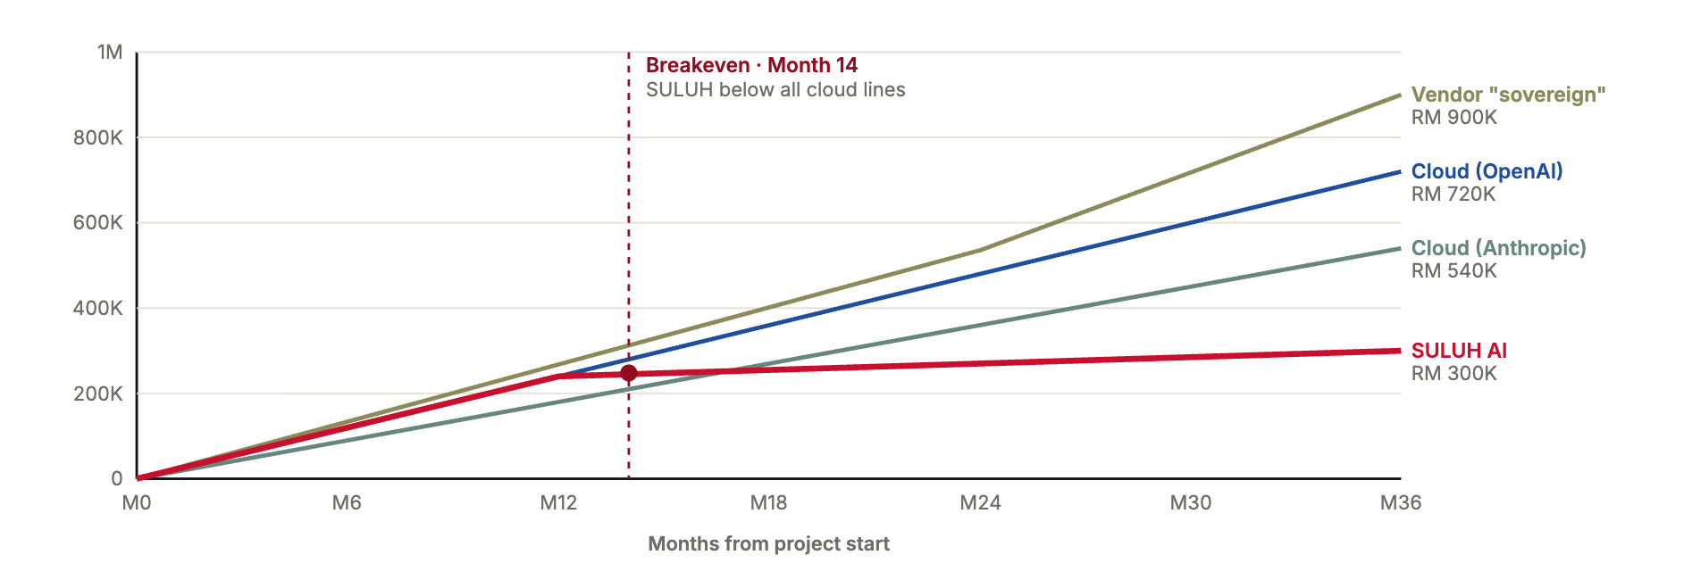
HOW · 04 ECONOMICS
SULUH · 27
SULUH crosses below every cloud line by Month 14 — and saves RM 240–600K by Month 36.
Month 14
breakeven against every cloud option
RM 300K
36-month total cost of ownership
RM 30K
annual OPEX in steady state
Figure — cumulative 36-month cost. SULUH's curve flattens after the build; cloud keeps accumulating at RM 15–25K/month.
And the asset is owned: capability, model weights, and data all stay with UPSI — plus the unquantified saving of breach risk removed (avg. Malaysian breach: RM 3.2M).
TCO = total cost of ownership · cloud lines assume RM 15–25K/month at UPSI-scale usage · breach cost: Simply Data Malaysia Threat Report 2025
Notes:
The money proof. Breakeven Month 14; RM 240-600K saved by Month 36. This closes the loop opened in Why-Economics.

Slide 28
HOW · PROOF OF RIGOR
SULUH · 28
Success is measured, not asserted — a bilingual golden-set evaluation and five planned publications.
TARGET METRICS · 200-PAIR GOLDEN SET
PLANNED PUBLICATIONS
Grading accuracy (rubric adherence)
≥ 85%
1
IsRAG — Isnad-chain provenance RAG
ACL/EMNLP
Curriculum compliance (KPT/MQA)
≥ 90%
2
Dewan Council — multi-agent deliberation
EMNLP
Malay language fluency
≥ 90%
3
SULUH AI — sovereign 35B model
Nature MI
Hallucination rate (IsRAG-verified)
≤ 5%
4
Federated Swarm — MA3, APA-EF, LES-GA
NeurIPS
PDPA compliance
100%
5
Deployment Study — four-harness evaluation
LAK/AIED
Benchmarked against Kimi K3, Claude, Gemma 4 and GPT-4o · authored by 30+ UPSI researchers.
Latency targets: <3s grading, <1s chat · IRB gate accuracy ≥98% · full metric set in the proposal appendix
Notes:
De-risk further: this isn't a hope, it's measurable. 8-metric golden-set eval and 5 planned papers. Show accreditation-readiness intent.

Slide 29
HOW · EYES OPEN
SULUH · 29
We are asking with eyes open — every major risk has a named mitigation already in the plan.
RISK
IMPACT
MITIGATION IN PLAN
Model underperforms on bilingual tasks
High
Phase-0 benchmark of Qwen3.6 vs Gemma 4 vs Qwen3.5 before commitment; swap paths maintained
PDPA non-compliance
Critical
Privacy-by-design, DPO appointed Day 1, five governance gates in code, annual audit
SSO integration complexity
High
Phase-0 critical path, started Week 1 with Pusat ICT
Federated swarm attrition
Medium
Incentive design, gamification, academic credit for participating students
Phase-2 national compute never materialises
Medium
35B is already production-viable — 100B is upside, not a dependency
Full ten-item risk register with likelihood ratings in SULUH v3.3 §10
Notes:
Answer the question before it's asked: what could go wrong, and what's already in place. Five risks that matter most to leadership; the full ten-item register is in the proposal.

Slide 30
THE DECISION
SULUH · 30
Approve RM 450K, and in 12 months UPSI owns Southeast Asia's first university-built sovereign educational AI.
Sovereign by design, provable by IsRAG, breakeven by Month 14, shielded from RM 1M liability by governance in code — with every byte of student data staying home.
THE INVESTMENT
THE RETURN
THE UPSIDE
RM 450K · 12 mo
RM 240–600K saved
5 papers · 4 systems
200K hardware + 250K team, phased
by Month 36 — plus breach risk removed
live at UPSI · first-mover seat · Phase-2 to 100B
"Pengetahuan Suluh Budiman" — the torch was always ours to carry. SULUH simply lights it for the age of AI.
Notes:
Close. Restate the ask as a decision with three defined outcomes. Make the yes easy — and remind them the torch is in the motto.

