Slide 1
Electrical Plan
Tuguss 4 April 2023
Rev 2

Slide 2
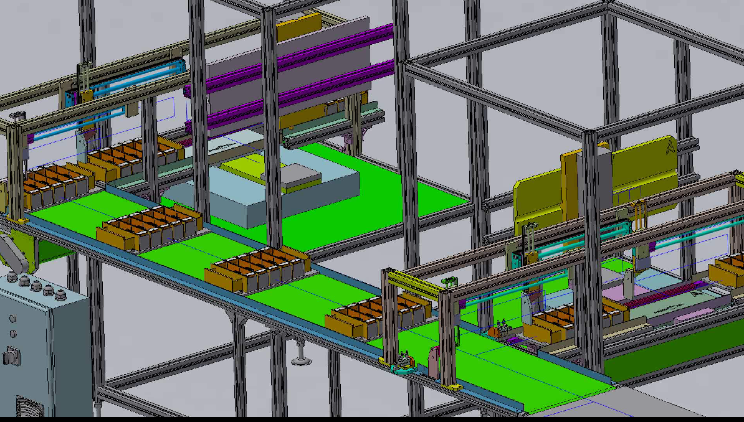
B
A

Slide 3
2
Main Panel
B
Main Panel
Sub JB5:
1.24V
2.Q:7
Qty Wire: 8
1
opt1
opt2
4
Junction B
24V =1
0V =1
I = 21
Q: 7
EMG = 2
Qty Wire: 34
3
Sub JB1:
1.24V
2.0V
3.I:6
Qty Wire: 8
Sub JB2:
1.24V
2.0V
3.I:4
4.EMG: 2
Qty Wire: 8
Sub JB3:
1.24V
2.0V
3.I:4
Qty Wire: 6
Sub JB4:
1.24V
2.0V
3.I:4
Qty Wire: 6
Sensor pallet base mc 1 pcs
PB Start MC man 1 pcs
JB B
PB Start 1
PB Stop 1
SS 2 pos 2
SS 3 Pos 1
EMG State 1
Buzer 1
Error 1
PL RUN A 1
PL RUN B 1
RL Motor 1
Sensor pallet 4 pcs
Sensor Cylinder 7*2=14 pcs
I: 1+1+4+14+1 =21
Q:7
IO = 28
Power = 4
EMG = 2
Cylinder 7 pcs
opt3B
Sub JB2: (1+2)
1.24V
2.0V
3.I:11
4.EMG: 2
Qty Wire: 15
EMG 1 pcs
34
Main Panel
Disable 2 (I)
PL ALARM 1(Q)
Motor 1(Q)
RUNA, RUNB 2(Q)
Selector Sw 2(I)
Buzer
Sub JB1:
1.24V
2.Q:7
Qty Wire: 8
Sub JB3(3+4)
1.24V
2.0V
3.I:12
Qty Wire: 14
PB Step 1 pcs
Sensor pallet base mc 1 pcs
JB A
PB Start MC man 1 pcs
I: 1+1+4+18+1 =25
Q:8
IO : 33
Power : 4
EMG : 2
Junction A
24V =1
0V =1
I =25
Q: 8
EMG = 2
Qty Wire: 39
Sensor pallet 4 pcs
opt3A
Sub JB2: (2)
1.24V
2.0V
3.I:4
4.EMG: 2
Qty Wire: 8
Sub JB4: (1)
1.24V
2.0V
3.I:9
Qty Wire: 11
Sensor Cylinder 9*2=18 pcs
Sub JB1:
1.24V
2.Q:8
Qty Wire: 9
Sub JB3(3+4)
1.24V
2.0V
3.I:12
Qty Wire: 14
Cylinder 9 pcs
39
EMG 1 pcs
A
PB Step 1 pcs
Multicore 42x0.5 = 5m
Multicore 16x0.5 = 20m
Multicore 10x0.5 = 20m
Total I : 21+26+7=54
Total Q : 7 + 8 + 5 = 20
Sub Panel

Slide 4
Option 3 Distribution Electrical Main Panel to Target Objek (Sensor, PB,SV)
MAIN PANEL
ELCB
MCB
Power Supply 24V
Relay Emergency
Relay Motor
PSU
PLC
MOTOR
Electrical Distribution
Sensor
SV
Relay Motor
Relay Emg
Speed Control motor
Motor Conv.
PLC
Sensor
Sensor
Kabel sensor bawaan sensor
Sensor
JB B1 SOLENOID VALVE BLOK
JB B2
JB B3
Sensor
Sensor
Multicore
10x0.5mm
Multicore
16x0.5mm
Kabel sensor bawaan sensor
IO Distribution JB A
IO Distribution JB B
JB A2
JB A3
JB A4
Multicore
10x0.5mm
Multicore
42x0.5mm
SUB PANEL
Multicore
16x0.5mm
JB A1
SOLENOID VALVE BLOK

Slide 5
Option 3 Distribution Main Panel
MAIN PANEL
ELCB
MCB
Power Supply
Relay Emergency
Relay Motor
PSU
PLC
MOTOR
SUB PANEL
Electrical Distribution
Speed Control motor
Motor Conv.
PLC
Sensor
Sensor
Kabel sensor bawaan sensor
JB B1 SOLENOID VALVE BLOK
JB B2
JB B3
Multicore
10x0.5mm
Multicore
16x0.5mm
IO Distribution JB A
IO Distribution JB B
Multicore
42x0.5mm

Slide 6
Option 3 Distribution Sub Panel
MAIN PANEL
SUB PANEL
JB A1
SOLENOID VALVE BLOK
Electrical Distribution
Sensor
Multicore
10x0.5mm
Kabel sensor
bawaan sensor
Multicore
42x0.5mm
JB A2
PLC
Multicore
16x0.5mm
JB A3
IO Distribution JB A
IO Distribution JB B
JB A4
Kabel sensor
bawaan sensor
Sensor
Sensor

Slide 7
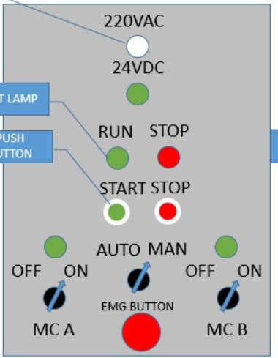
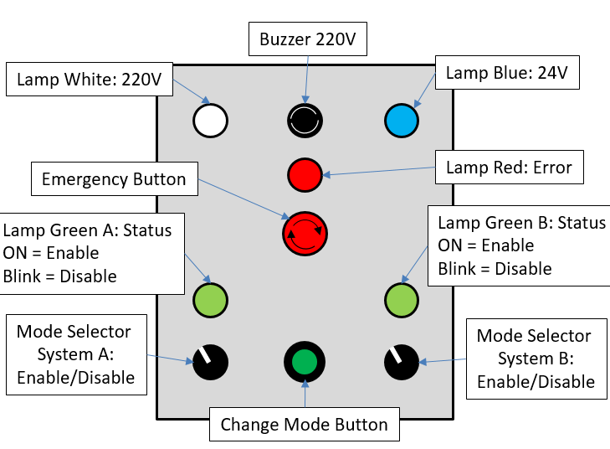
Option 3
MAIN PANEL
List:
PL Putih 220V
PL Biru 24V
PL Merah 24V
Buz 24V
EMG 3x
PL Hijau 24V 2x
PB Hijau
PB Merah
PB Hitam 2x
SS 2 Pos 2x
SS 3 Pos 3x
220V
BUZZER
24V
24V
ERROR
Emg
A
B
RUN
START
RUN
EN DIS
STOP
EN DIS
SUB PANEL
ERROR
BUZZER
24V
Emg
Emg
MODE
MAN SEMI_AUOT FULL_AUTO
A
B
RUN
RUN

Slide 8
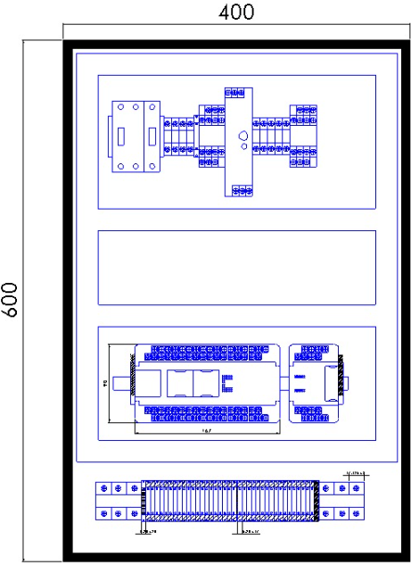
Design Layout main Panel & Sub Panel
Main panel
Sub panel
Electrical Distribution
IO Distribution JB A
PLC
Main Panel
Power Distribution JB A
IO+Power Distribution JB A
IO+Power Distribution JB B

Slide 9
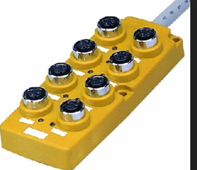
Design JB
Sensor 1
Sensor 2
Sensor 3
Sensor x
Molex 3P M
Molex 3P F
Inspirasi
Multicore
SIDE
Box Plastik hitam/PVC cream
Multicore
TOP

Slide 10
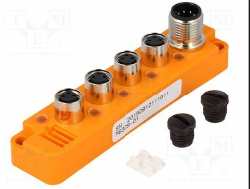
Design JB
Sensor 1
Sensor 2
Sensor 3
Sensor x
Molex 3P M
Molex 3P F
Inspirasi
Multicore
SIDE
Box Plastik hitam/PVC cream
Multicore
TOP

Slide 11
Group A
Group B
S_ph 1
JB A4
Sub Panel
Main Panel
S_ph 1
JB B4
S_ph 2
S_ph 2
8x0.5
8x0.5
S_ph 3
S_ph 3
S_ph 4
S_ph 4
S_ph 5
S_ph 5
PB inc,mc
JB A3
PB inc,mc
JB A3
PB EMG
8x0.5
8x0.5
PB EMG
S Cyl 8
10x0.5
S Cyl 8
10x0.5
S_Cyl 1
JB A2
INPUT C
SS 4 pcs
PB 2 pcs
State EMG
S_Cyl 1
JB B2
S_Cyl 2
7 pcs
S_Cyl 2
S_Cyl 3
42x0.5
S_Cyl 3
S_Cyl 4
OUTPUT C
Buz 1 pcs
PL 3 pcs
RL Motor
S_Cyl 4
S_Cyl 5
10x0.5
S_Cyl 5
10x0.5
S_Cyl 6
5 pcs
S_Cyl 6
S_Cyl 7
S_Cyl 7
INPUT A
Photo sensor 5 pcs
Sensor Cylinder 18 pcs
PB Step: 1 pcs
PB ON mc: 1 pcs
INPUT B
Photo sensor 5 pcs
Sensor Cylinder 14 pcs
PB Step: 1 pcs
PB ON mc: 1 pcs
JB B1
SV 1
JB A1
SV 1
SV 2
25 pcs
21 pcs
SV 2
SV 3
SV 3
SV 4
SV 4
SV 5
OUTPUT A
Cylinder 8 pcs
OUTPUT B
Cylinder 7 pcs
SV 5
8 pcs
7 pcs
SV 6
SV 6
SV 7
SV 7
TOTAL INPUT : 25 + 21 + 7 = 53 PCS
TOTAL OUPTUT : 8 + 7 + 5 = 20 PCS

Slide 12
Jual Kabel Control Multicore YSLY-JZ 42x0.5mm Meteran Potongan - Jakarta Barat - JayaMandiriElectric | Tokopedia
5m
Jual Kabel Control Multicore YSLY-JZ 8x0.5mm Meteran Potongan - Jakarta Barat - JayaMandiriElectric | Tokopedia
20m
Jual Kabel Control Multicore YSLY-JZ 10x0.5mm Meteran Potongan - Jakarta Barat - JayaMandiriElectric | Tokopedia
20m

Slide 13
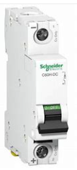
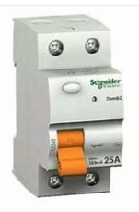
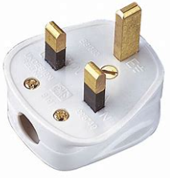
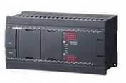
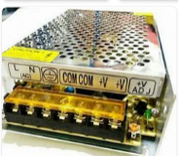
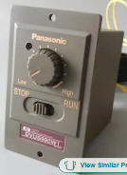

Slide 14
MCB
PSU
Terminal Distribution A,B
Plug 220V
ELCB
MCB
Speed Control Motor
Motor
Comm Q Relay EMG
MCB
PLC
I
Q
PSU
PB EMG 1
PB EMG 1
PB EMG 1
PSU 24V
R EMG
Common Q PLC

Slide 15
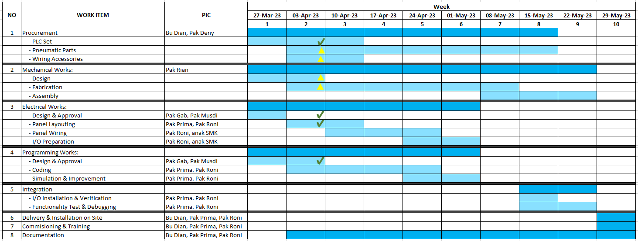
Time line
TODAY

Slide 16
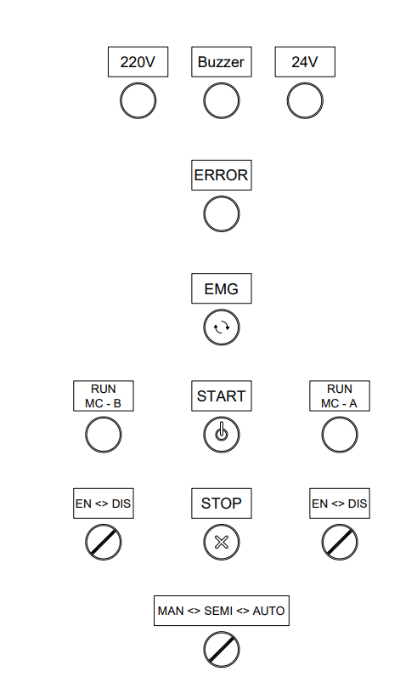
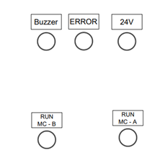
Layout depan panel
Plan:
1. Panel, sub panel, JB dipersiapkan di Tuguss
2. Kebutuhan item 1 disiapkan dalam minggu ini
Main Panel
Panel 600x400
Wire duct 32x45
Wire 1.5 coklat, biru, kuning-hijau
Wire AWG24 coklat, hitam, kuning, biru
Skun
Terminal Blok
DinRail
Plug 220V
ELCB
MCB
PSU
Motor Driver
PLC
PL220VAC putih
Pl24VDC biru
Buzer24VDC
PL24VDC merah
EMG button
PL 24VDC hijau 2X
PB NO Hijau
PB NC Merah
SS 2 Pos 2x
SS 3 pos
Sub Panel
Panel 400x300
Wire duct 32x45
Wire 1.5 coklat, biru, kuning-hijau
Wire AWG24 coklat, hitam, kuning, biru
Skun
Terminal Blok
DinRail
Pl24VDC biru
Buzer24VDC
PL24VDC merah
PL 24VDC hijau 2X
Main Panel
Sub Panel
JB
Box JB1 2x
Box JB2 2x
Box JB3 2x
Box JB4 2x
Molex 3 pin
Molex 4 pin
Molex 2 pin
JB1
JB2
JB3
Box Button Control Machine
BOX button isi 3 lubang 22mm 2x
EMG SW 2x
PB NO Hitam 2x
PB NO Kuning 2x
JB3
Installation
Multicore 42x0.5 5m
Multicore 1

Slide 17
PLC Software
KV Studio
KV Studio Version 11 Update
Version 11 Manual Set

