Slide 1
BUSINESS MODEL CANVAS
By Fery Yudha Bakhroni

Slide 2
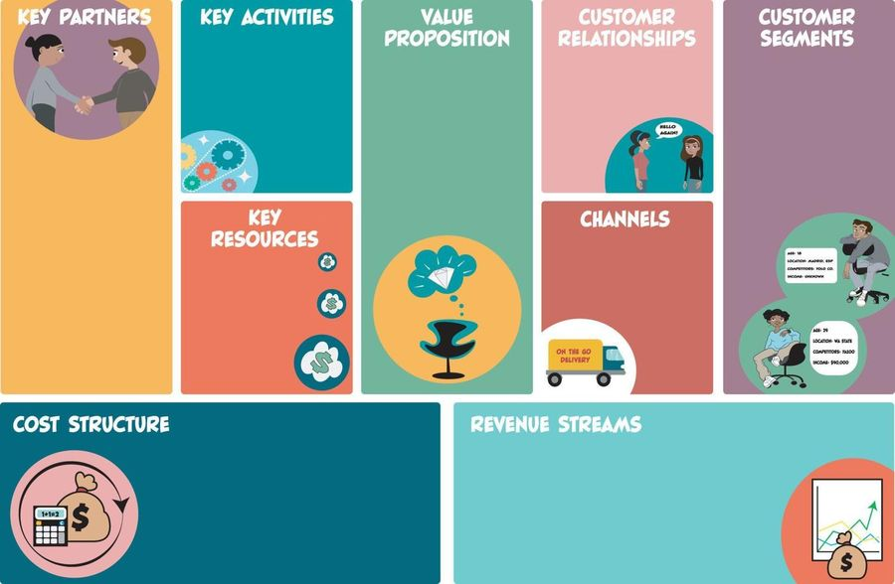

Slide 3
