Slide 1
Sudoku Solver
Kyle Smyth and Pooya Samizadeh-Yazd

Slide 2
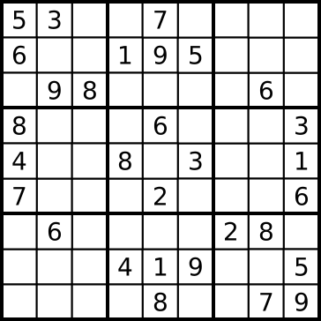
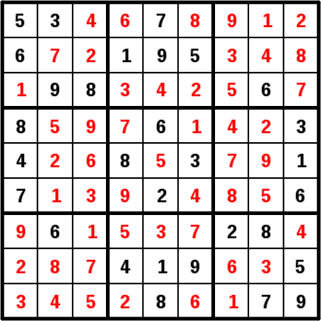
Sudoku
A logic-based combinatorial number-placement puzzle
Objective: To fill a 9x9 grid with digits so that each column, row and each of the 9 3x3 sub-grids contains the digits 1 to 9

Slide 3
Sudoku Rules
Only the numbers 1 – 9 may be used
The game is over when each row, column and 3x3 sub-grid contains the numbers 1 - 9
The same integer may NOT appear twice in:
The same row
The same column
The same 3x3 sub-grid

Slide 4
The Puzzle
A Sudoku puzzle begins with a partially filled grid
The difficulty level is denoted by the number of integers given and their positions on the grid
Each puzzle has a unique solution that can be reached logically

Slide 5
The Solver
Goal:
To solve easy rated puzzles
Solve puzzles quickly
Provide a friendly user-interface

Slide 6
Possible Solutions
Brute Force
Logic Based
Can solve ANY puzzle difficulty
Could take up to 30 minutes to solve
81^9 permutations
Processor intensive
Will require complex algorithms for harder puzzles
Solution in seconds
Very efficient

Slide 7
Logic-based Solution
Similar to how a human would solve the puzzle
Recursive
Helper methods to perform various validations and updates on the puzzle
Brute Force Solution
Backtracking
Iterative

Slide 8
Hybrid Solution
Our program is a hybrid of both solutions
It will attempt to solve the puzzle first with the easy logic algorithm
This will fill in as many values as possible to make the brute force faster if it is needed
If the logic algorithm gets stuck, it will invoke the brute force method to finish the puzzle

Slide 9
Data Structures
Grid Class
LinkedList of 81 Nodes in row-major order
Integer count
Node Class
LinkedList of 9 integer possibilities
Integer value
Boolean isPermanent

Slide 10
Data Structures Diagram
Possibilities: null value: 3 isPermanent: true
Grid position 0
Possibilities: [1,2,4,7] value: null isPermanent: false
Grid position 9

Slide 11
The Algorithm – Logic
Determine non-possibilities
- Remove from Possibilty LinkedList
Find any nodes with only one possibility
Make that value permanent

Slide 12
The Algorithm - Logic
Solve
Iterate through grid
Update possibilities
Possibilities = 1?
Yes
No
Set value = last possibility
Did something change?
Set permanent = true
No
Yes
End

Slide 13
The Algorithm – Brute Force
Is this valid?
Collect all empty indexs
Value = 0
Empty[index] = value
Yes
No
index++
Is value =9?
Value ++
No
Yes
Value = Empty[index] +1
Index--

Slide 14
Important Methods
Grid::SolveSimpleRecursive
Grid::Update
Updates the possibilities at the given node by removing them from the linkedlist
Uses CheckRow, CheckColumn, CheckGrid to check if the number exists in each respectively
Sudoku::GetValues
Gets the values from the GUI, checks if they are valid and inserts them in the game
Grid:bruteForce

Slide 15
Dr. Morgan’s Suggested Changes
Originally would load a game from a text file and produce console output
Changed to a Java Applet GUI and allowed the user to manually enter in a Sudoku puzzle to solve

Slide 16
Changes
Surprisingly a lot of time needed to be allocated to accomplish this
Tasks:
Creating the GUI
Create setters/getters for the GUI JTable
Loading examples into the GUI
User input validations
Illegal characters/invalid puzzles
Feedback for the user

Slide 17
Future Ideas
An algorithm for advanced puzzles in order to scrap the brute force method all-together
Change the user-interface so you would be playing a game rather than just solving
Generate valid Sudoku puzzles

Slide 18
Demonstration

