Slide 1







Empowering Youth Climate Action through Digital Engagement
Integrating Climate Resilience into Community-Based Learning and Local Development Planning
${\text{I Putu Arisgunarta}}^{1.3}$,
${\text{Arrozaq Ave}}^{1.2}$, ${\text{Nasya Augusta}}^{1.4}$, ${\text{Qory Salsabilla}}^{1.5},$
¹MyCarbonSteps, Bogor, Indonesia
²Coordinating Ministry for Economic Affairs of the Republic of Indonesia, Indonesia
³Department of Applied Climatology, Faculty of Mathematics and Natural Sciences, Graduate School, IPB University, Bogor, Indonesia
⁴Department of Digital Business, Faculty of Economics and Business Education, Universitas Pendidikan Indonesia, Bandung, Indonesia
⁵Department of Sociology, Faculty of Social Sciences and Law, Universitas Negeri Jakarta, Jakarta, Indonesia

Slide 2
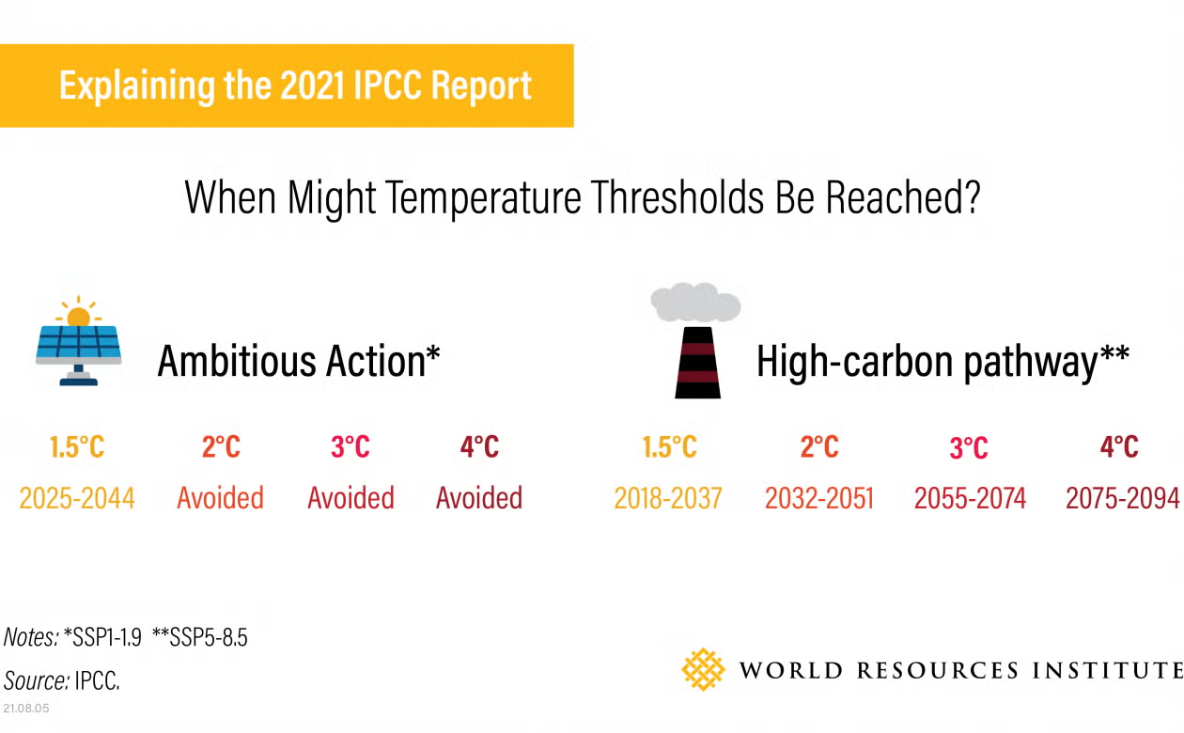
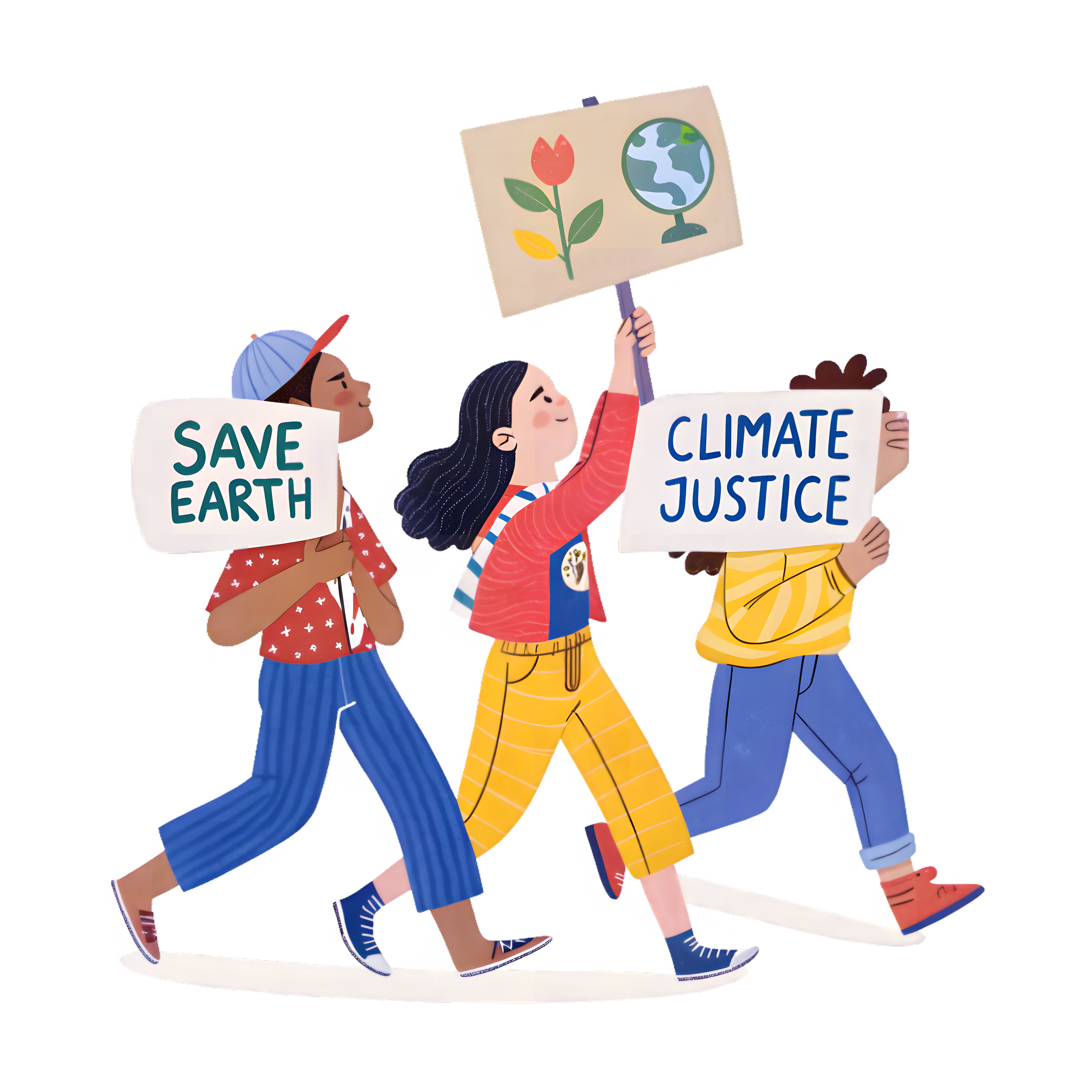

The Problem
Climate change: a global challenge with tangible impacts across multiple sectors.
High carbon emissions: driven by human activities, highlighting the urgent need for both mitigation and adaptation.
Youth exhibit high levels of digital connectivity (BPS, 2023):
94% use the internet.
96% own a smartphone.
49.7% of Indonesian adolescents have low climate literacy (Martha et al., 2025).
A persistent gap remains between environmental awareness and climate action (Moser, 2016; Chen et al., 2025).
Limited evidence exists on how youth-generated content contributes to local development planning. Our study addresses this gap
https://www.shutterstock.com/image-vector/set-young-characters-phones-teens-260nw-1960376221.jpg
https://pngtree.com/freepng/youth-marching-for-climate-action_22303969.html

Slide 3
Goals
“Empowering Youth as Climate Action Multipliers through Digital Engagement and Green Skills Development”
1. To empower youth to lead climate action through green skills and creative digital engagement.
2. To develop a scalable approach for integrating climate communication into community and local climate action.

Slide 4



Methodology
Our Approach
Data Analysis Method
AIDA Model
Digital engagement (Attention, Interest, Desire, Action)
1
Pre/Post-test
Climate literacy assessment
Content Analysis
13 educational vlogs produced
Qualitative Analysis
Participant reflections & feedback
Participants
30 youth (age 17-25) from 10 provinces
2
Limitations
Small sample (n=30)
Short intervention
Long-term behavioural change not evaluated

Slide 5
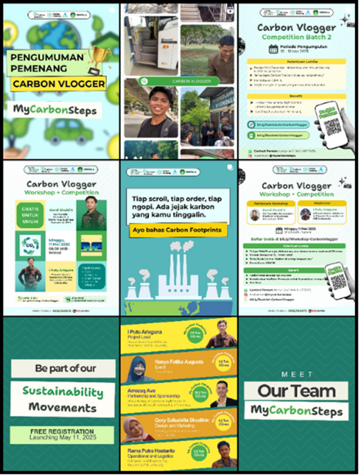
The Innovation: Carbon Vlogger Challenge 2025
Hybrid model:
Climate education workshop + digital storytelling
Online workshop on carbon footprint awareness & video creation
Youth-led vlog production challenge
Peer-to-peer knowledge sharing at scale
Low-cost, replicable model for local governments
Bottom-up approach using creative communication as both educational tool and catalyst for change

Slide 6
Outcome
Knowledge Increase
14.7%
Average Knowledge Increase
in carbon footprint understanding
77%
Workshop Participation
(Pre-test & Post Test)
0.38
N-Gain Score
Medium effectiveness
(Hake 1998; Colleta & Steinert 2020)
13 Vlogs
Educational Vlogs
youth-created videos
(56.7% from total participants)

Slide 7
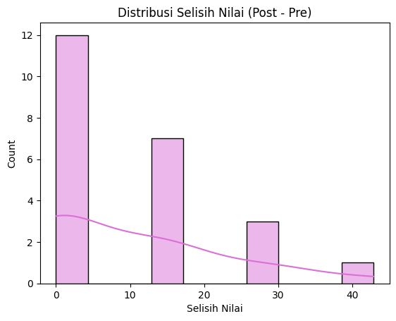
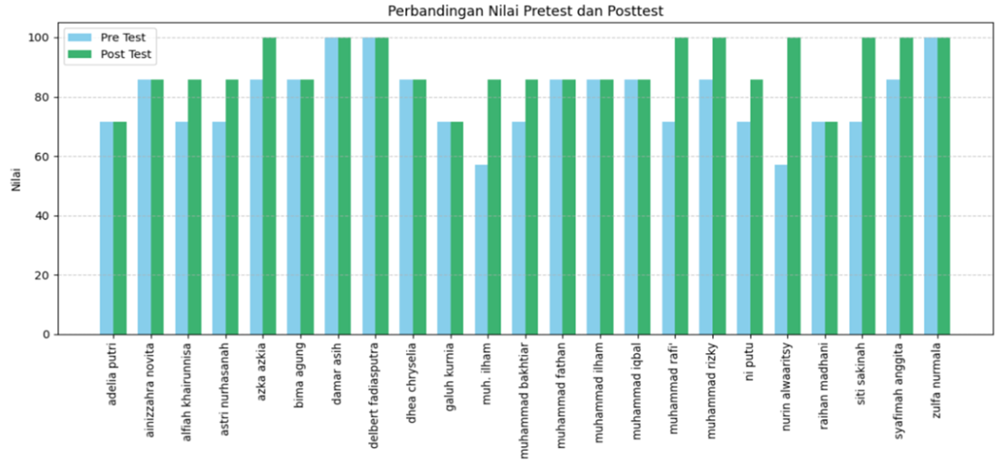
Outcome: Knowledge Increase
Ceiling Effect on Pre-Post Test Assesment
R01 R02 R03 R04 R05 R06 R07 R08 R09 R10 R11 R12 R13 R14 R15 R16 R17 R18 R19 R20 R21 R22 R23
Figure 1. Pre–Test and Post–Test Results (left: blue color indicate pre test, green indicate post test) and Score Distribution (right: purple graph)
There was an overall improvement in participants' pre-test and post-test scores, with 52.17% of participants maintaining their scores and 47.83% demonstrating score improvement.
Ceiling Effect
Several participants achieved high baseline scores during the pre-test, leaving limited room for measurable improvement in the post-test. Consequently, modest score gains should not be interpreted as limited learning outcomes, but rather as a reflection of participants' already strong initial understanding of carbon footprint concepts (Resch et al., 2018, Staus et al., 2021; Wang et al., 2009).

Slide 8
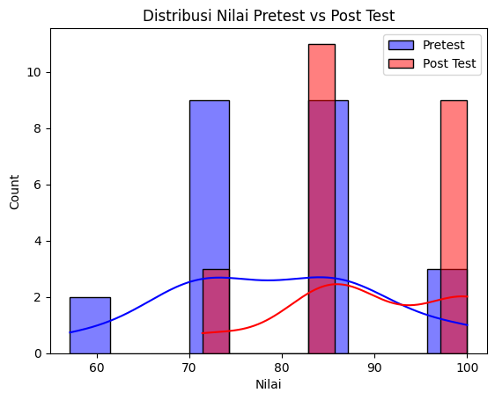
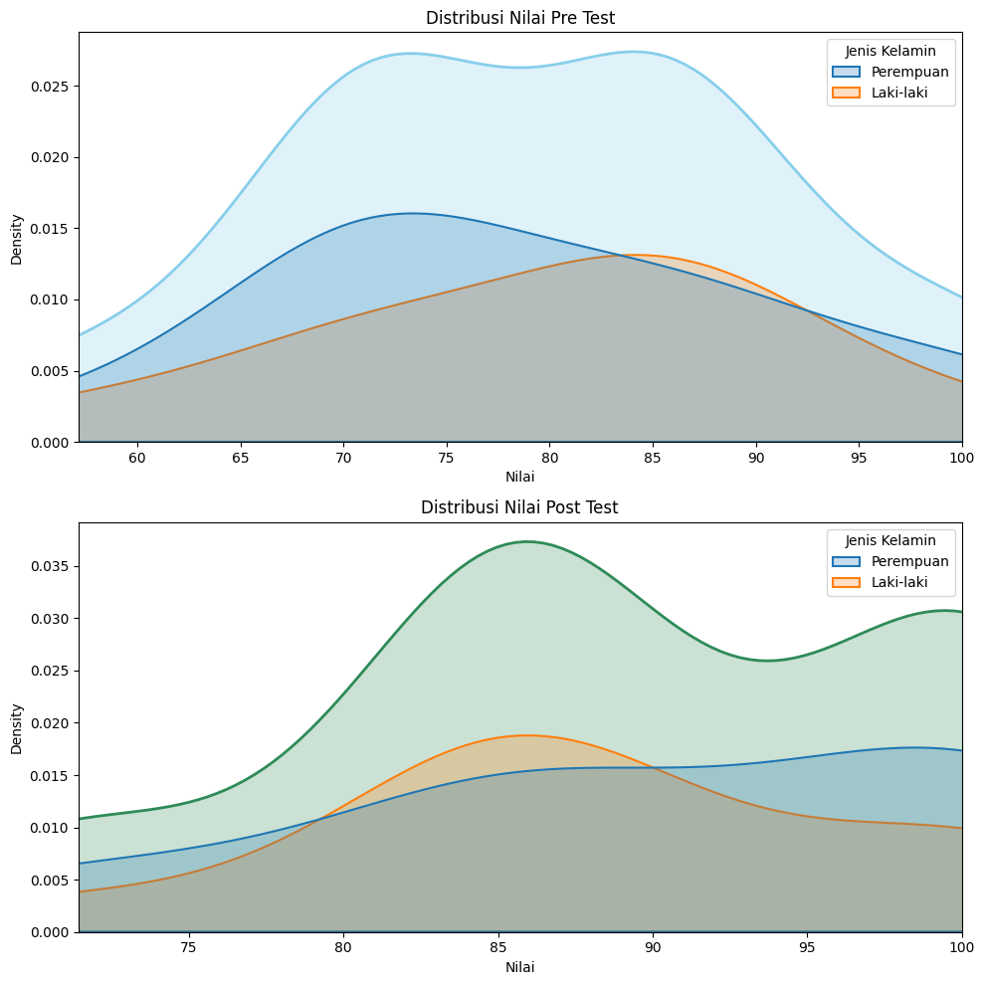
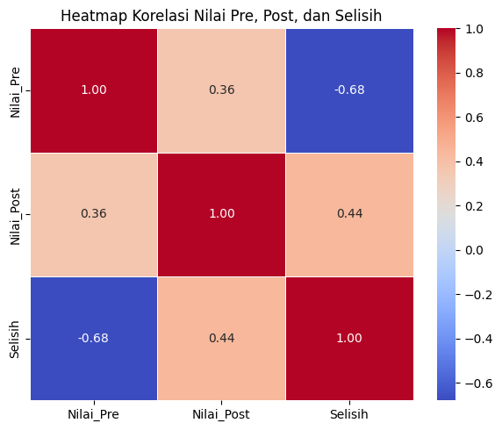
Outcome: Knowledge Increase
(a) (b) (c)
(a) Post-test scores shifted toward higher values, indicating improved climate literacy.
(b) Learning gains were observed across both genders, with slightly greater gains among female participants.
(c) Lower baseline knowledge was associated with greater learning gains (r = −0.68), whereas smaller gains among high-scoring participants likely resulted from a ceiling effect. (Staus et al., 2021; Wang et al., 2009).

Slide 9

Outcome
Digital Outreach Impact
20.000+
Total Vlog Views
30.000+ Impressions
133 Profile Visits
25 New Followers
IDR 50.000 Total Ad Spend
IDR 1,400,000 Rewards

Slide 10
Conclusion
Youth as pillars of low-cost, scalable digital climate literacy
Key Findings:
Youth digital engagement (RQ1): improves carbon footprint literacy through interactive learning, workshop and vlog challenge.
Low-cost digital outreach (RQ2): offers a scalable pathway for community and local governments to integrate climate adaptation communication into development planning.
“Digital engagement is not just about technology—it's about empowering voices”

Slide 11

Conclusion
Recommendation
for academia:
for private sector
for government
Mainstream youth-centered digital climate learning models
Strengthen climate literacy initiatives
Adopt and include youth as a pillar of digital climate awareness model CSR or ESG
Expand opportunities for green jobs in climate advocacy & communication roles
Align RAN-API with replicable low-cost digital engagement model
Build climate resilience through both infrastructure AND social innovation

Slide 12

Thank You
I Putu Arisgunarta
Putuarisgunarta@apps.ipb.ac.id
MyCarbonSteps | IPB University
#CarbonVlogger #ClimateResilience #YouthAction
Take-home Message
"Empowering youth through digital storytelling transforms climate literacy into scalable climate resilience."

Slide 13
Resch, A. M., Springer, M. G., & Walters, K. (2018). How do test scores at the ceiling affect value-added estimation? Journal of Research on Educational Effectiveness, 11(4), 580–602. https://doi.org/10.1080/19345747.2018.1460226
Staus, N. L., O'Connell, K., & Storksdieck, M. (2021). Addressing the ceiling effect when assessing STEM out-of-school time experiences. Frontiers in Education, 6, Article 690431. https://doi.org/10.3389/feduc.2021.690431
Wang, L., Zhang, Z., McArdle, J. J., & Salthouse, T. A. (2009). Investigating ceiling effects in longitudinal data analysis. Multivariate Behavioral Research, 44(4), 476–496. https://doi.org/10.1080/00273170903103362

