Slide 1
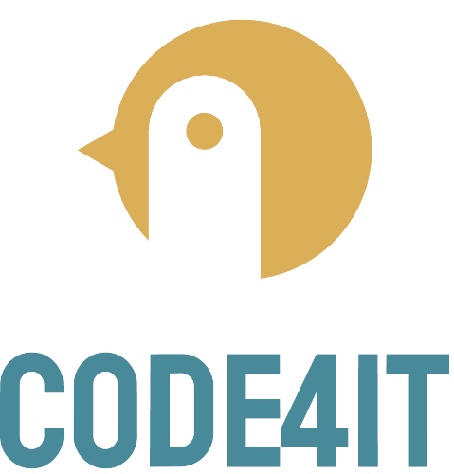

C# TIP Profiling code with MINIPROFILER

Slide 2
Clean Code tip F.I.R.S.T. Unit tests

