Slide 1

Gmail Smart Compose:
Real-Time Assisted Writing
Asty Nabilah Izzaturrahmah Ni Putu Winda Ardiyanti
Stephane Rabenarisoa Stanislas Lange

Slide 2

Research goal
Research background
This paper introduces Smart Compose, a system for providing real-time, interactive suggestions to help users compose messages quickly and with confidence in Gmail.
Improving the user experience by simplifying the writing process.
Previously Gmail introduced Smart Reply, a system for automatically generating short replies in response to incoming e-mail messages.
While such a feature significantly reduces user response time, the suggestions are constrained to short phrases and appear only once in the composition process.
Unlike Smart Reply, Smart Compose assists with composing new messages from scratch and provides much richer and more diverse suggestions along the way, making e-mail writing a more delightful experience.

Slide 3
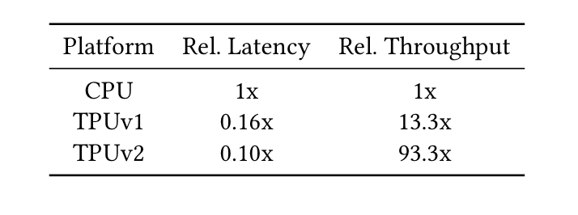
Scale
Choosing a model: latency over quality (to a certain extent)
The dataset is the billions of user-composed emails stored on Gmail
Need hardware acceleration for Tensorflow operations -> Cloud TPU
A tensor processing unit (TPU) is an AI accelerator application-specific integrated circuit developed by Google specifically for neural network machine learning.
Notes:
Part 4 and 5

Slide 4
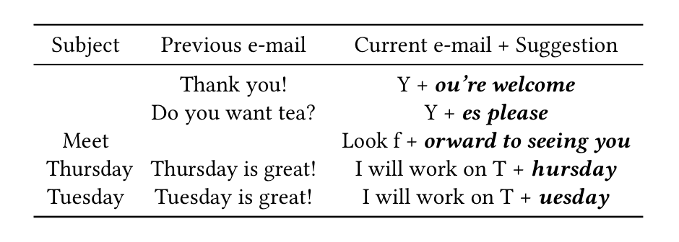

Personalization
For each user, periodically train a light-weight language model adapted to the user’s personal mail data (sent emails)
This light model is blended with the global model for optimal efficiency
Final prediction (α is the weight):

Slide 5
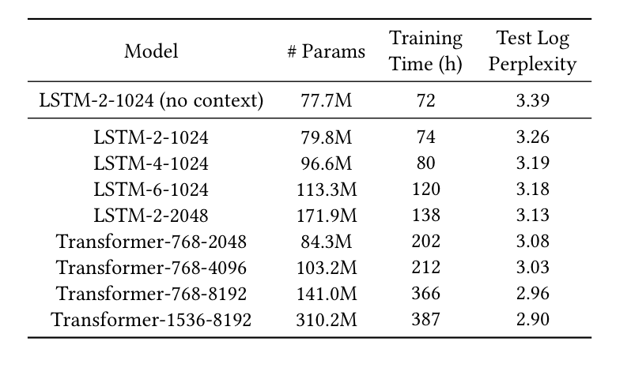
Choosing a model
Log perplexity is a typical measure used for language model evaluation. It measures how well a model fits the data.
Google chose LTSM-2-1024 for its global model because of better accuracy and performance
The light model for personalization is an “n-gram language model” (a statistical model) which is easier to train and require much less data to attain a reasonable quality.

Slide 6
Lessons Learned
This paper give us a brief information about Gmail’s smart compose, like how smart compose works, the model architectures, and many more.
Smart Compose system gives us one example of how neural language models can be served at industry-scale with huge datasets
Language modelling is a fundamental and indispensable component of many natural language processing (NLP) and automatic speech recognition (ASR) systems
Personalization at scale: multiple models and techniques blended together

