Slide 1
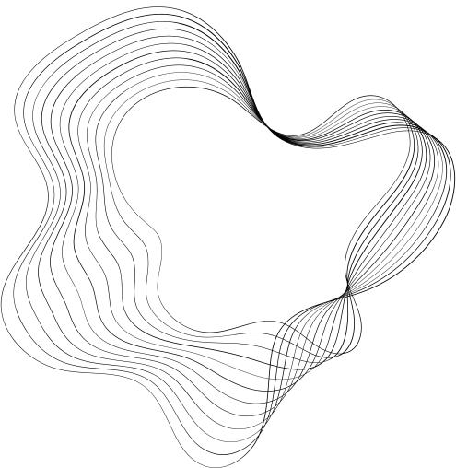


SEMANTIC SEARCH
ENGINE
PRESENTED BY : POOJAN KOJU‘
10TH OCTOBER 2024

Slide 2
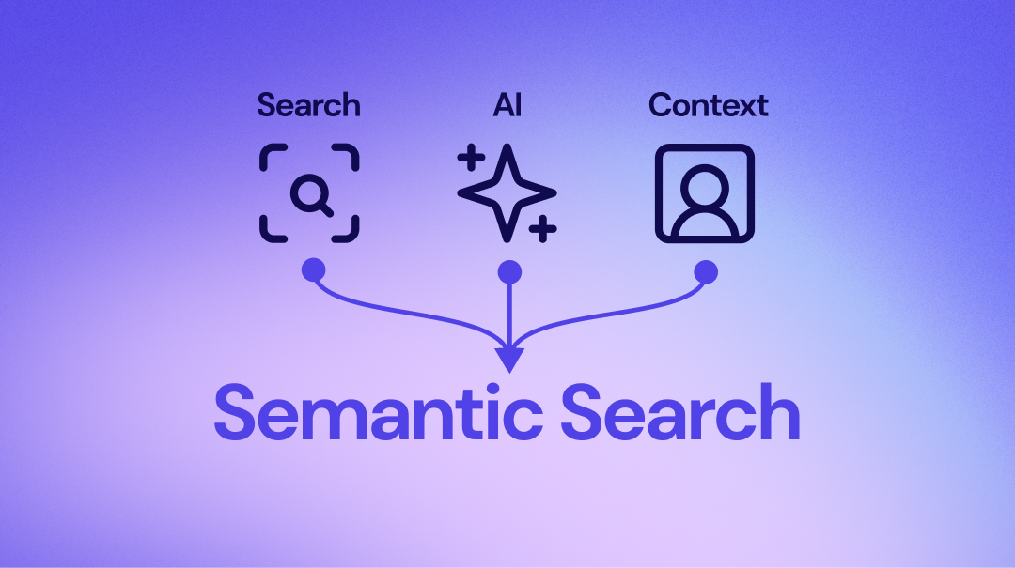

SEMANTIC SEARCH ENGINE
A search engine that goes beyond simple keyword matching to understand the context and meaning of queries, delivering more accurate and relevant results.
Leverages Natural Language Processing (NLP) techniques to comprehend query intent.
Uses pre-trained language models like BERT to grasp the semantic relationships between words.
Finds results based on concepts rather than exact terms.

Slide 3


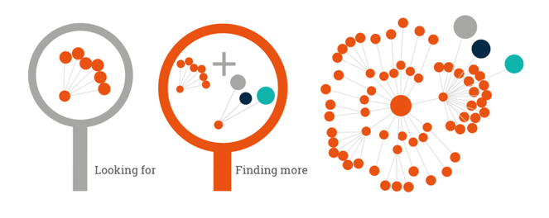


APPLICATIONS OF SEMANTIC SEARCH
E-commerce
Healthcare
Research & Education

Slide 4
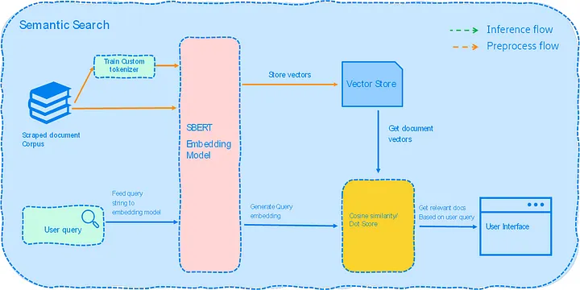
ARCHITECTURE OF THE SEMANTIC SEARCH ENGINE

Slide 5
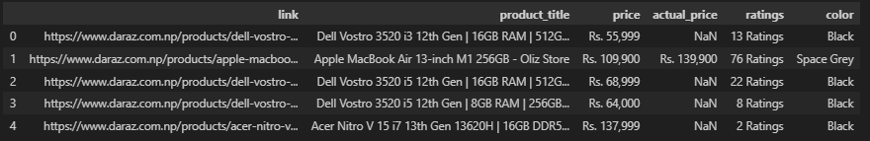

DATA PRE-PROCESSING
DATASET USED : DARAZ LAPTOP DATA
600 record of laptops
UN-CLEANED DATA
CLEANED DATA

Slide 6
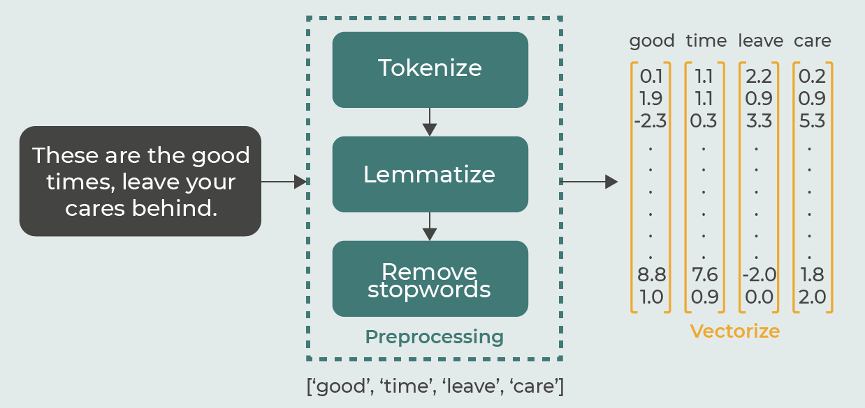
VECTORIZATION USING BERT SENTENCE TRANSFORMER
WHAT IS VECTORIZATION?
Vectorization is the process of converting textual data (queries and documents) into numerical representations called embeddings.
These embeddings are high-dimensional vectors that capture the semantic meaning of text, allowing the search engine to perform similarity comparisons between queries and documents.

Slide 7
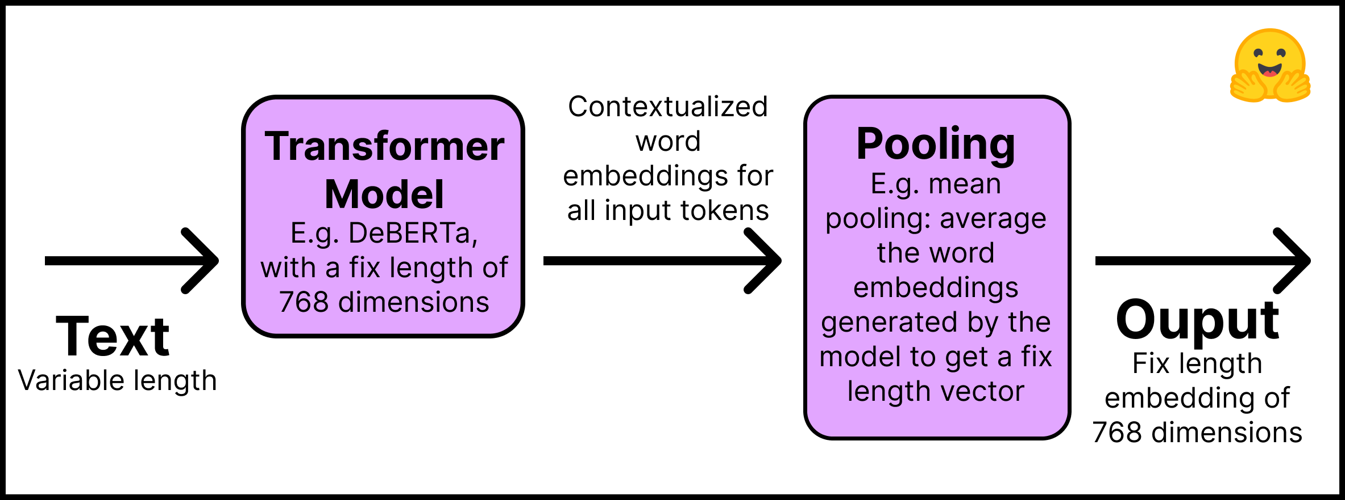
VECTORIZATION USING BERT SENTENCE TRANSFORMER
Why Use BERT Sentence Transformer?
The BERT Sentence Transformer model is a powerful NLP model that understands the context of words within a sentence, producing embeddings that reflect deeper meanings and relationships.
Contextual Understanding: Unlike traditional word embeddings (like Word2Vec), BERT takes into account the entire sentence structure, improving accuracy for complex queries.
Rich Semantic Representation: Captures relationships between words, enhancing search relevance.
Performance: Provides better generalization for unseen data, making it suitable for a wide range of search applications

Slide 8
Index in Elastic search and Ingesting Data
Creating the Index:
Indexing involves organizing the data to make it searchable by storing and managing documents in a way that allows for quick retrieval.
The index contains mappings that define the structure of the stored data, including the field types and vector representation.
Ingesting Data into the Index:
Once the index is created, we ingest the data, which includes :
Text documents that will be searchable.
Vector embeddings generated using the BERT Sentence Transformer, which are added to the index to enable semantic search.
The ingestion process involves sending these vectors and their corresponding metadata (e.g., document ID, title) to the Elasticsearch index.

Slide 9
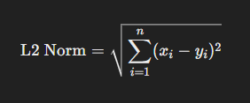
SIMILARITY METRICS
Similarity metrics are mathematical measures used to determine how similar two vectors (representations of text) are to one another.
In a semantic search engine, these metrics play a crucial role in ranking documents by comparing the vector embedding of a query with the vector embeddings of documents.
Similarity metrics : Cosine Similarity , L2 Norm, Dot Product
Euclidean Distance (L2 Norm)
This metric calculates the straight-line distance between two vectors in space.
It’s particularly useful for measuring how "far apart" two vectors are in a multi-dimensional space.
Formula : L2 Norm

Slide 10
GENERATING SEARCH QUERY
Sentence Transformer
vector embedding
Search Query
Input Keyword
Elastic Search Indexed Documents
Search Output
Similarity Matching

Slide 11
THANK YOU

