Slide 1
AIML-515 · WORKSHOPS 1–6 · INDIANA WESLEYAN UNIVERSITY
StudyCite
and BiteWise
Two grounded assistants. Each one answers only from records it is allowed to use.
Pu Zeng
October 18, 2026
STUDYCITE PROTOTYPE
BITEWISE PUBLIC APP
triallens-ai.ai.studio
bitewise-ai.ai.studio
Single-file host. Still titled TrialLens AI.
Google AI Studio on Cloud Run. Pages and API together.
Notes:
Open with both names and both addresses before any architecture. StudyCite is the first app. Its live prototype is still at triallens-ai.ai.studio and still wears the working title TrialLens AI. The React repository was renamed StudyCite. BiteWise is the second app, public at bitewise-ai.ai.studio.
Do not claim an awsapprunner.com address for either app. StudyCite has an apprunner.yaml and a verified AWS CLI identity in us-west-2. It does not have a recorded public App Runner URL. BiteWise was published through Google AI Studio because App Runner is closed to new customers.
I am Pu Zeng, Indiana Wesleyan University. StudyCite is the AIML-515 project. BiteWise lives in the AIML 505 repository.

Slide 2
TITLE AND OVERVIEW
Both problems, both solutions
STUDYCITE
BITEWISE
Stop citing a superseded protocol.
Stop inventing a meal that is not on the menu.
• Problem: study teams search long, amended documents and can use an outdated page.
• Solution: a cited answer, or an abstention, from approved text for the active study.
• Scope: knowledge retrieval. Not diagnosis, eligibility automation, or treatment advice.
• Problem: choosing from a long menu when budget and diet already rule most of it out.
• Solution: the server drops ineligible meals, then Gemini ranks what remains.
• Scope: eight fictional restaurants, 40 dishes. No orders, payment, or delivery.
8
7
12 / 12
2
Gold-standard
StudyCite cases
StudyCite defects
fixed in one pass
BiteWise API
tests passing
Hosts that
answer today
Pu Zeng · StudyCite and BiteWise
2 / 24
Notes:
The shared idea is grounding. StudyCite will not answer from a document the role cannot use. BiteWise will not recommend a meal over the budget or missing a required dietary label.
The four figures are documented, not estimated. StudyCite seed data holds eight gold-standard cases: six answerable, one version trap, one abstention. The September 16, 2026 testing report lists seven defects that were fixed in that pass. BiteWise has twelve API tests in tests/api.test.js, and that file passes. The two hosts that answer are triallens-ai.ai.studio and bitewise-ai.ai.studio.
The Evaluation page also shows seeded gate cards such as 93 percent precision. Those are demonstration figures inside the prototype. They are not a field study, so they are not on this summary.

Slide 3
APPLICATION 1 · PHASE 1 · WORKSHOP 1
The study-team problem
Study teams lose time searching lengthy, frequently amended controlled documents. Manual search creates delays, and a superseded source can still look official.
ClinOps lead
CRA
Amendment rollout and cross-site compliance.
Visit windows, deviations, and laboratory eligibility.
Clinical scientist
Site coordinator
Inclusion, exclusion, PK, and dose changes.
Visit windows, tube handling, and IP storage.
AI use case: ask in ordinary language, retrieve from the authorized study, and return a short answer with a citation — or abstain.
The product is knowledge retrieval and source summarization. The MVP excludes diagnoses, treatment recommendations, eligibility automation, and patient-level data.
Pu Zeng · StudyCite and BiteWise
3 / 24
Notes:
This is the problem statement from the Architecture page, Phase 1, not a slogan I added later. Read the sentence at the top as the original framing.
The four personas are the ones named in that page: Clinical Operations Lead, Study Monitor, Clinical Scientist, and Research Site Coordinator. The testing report adds a fifth demo role, Data Programmer. A site coordinator is limited to study TL-301 and cannot open TL-204.
Emphasize the boundary. If someone asks for a surgical technique, the correct behavior is abstention. That case is gold-standard item g8. The product must not drift into clinical decision support just because the language model can sound confident.

Slide 4
APPLICATION 1 · PHASE 1
What the assistant is allowed to say
PROBLEM STATEMENT
Fragmented protocols, lab manuals, pharmacy binders, and monitoring plans, plus version uncertainty when a site still holds a superseded amendment.
Pain
Requirement
Out of scope
• Information split across document types.
• An old amendment can look current.
• Hard to verify document, version, section, and page.
• Authorization filter before retrieval.
• Only approved, indexed documents for the active study.
• Clickable citation, or an explicit abstention.
• No diagnosis or treatment advice.
• No eligibility automation.
• No patient-level data in the MVP.
Pu Zeng · StudyCite and BiteWise
4 / 24
Notes:
Walk the three columns as a contract. Pain is why the team searches. Requirement is what a correct answer looks like. Out of scope is what a fluent wrong answer would be.
The version trap makes this concrete. Protocol v2.0 allowed dosing at 80,000 platelets per microliter. v3.0 requires at least 100,000. Gold case g7 asks whether 80,000 is acceptable under current approved guidance. The expected result is no, with a warning that v2.0 is superseded.
If I only say "the model should cite sources," I have not specified this contract. The later BiteWise design is the same contract in a different domain: the model never sees the records that already failed the rule.

Slide 5
APPLICATION 1 · PHASE 2
Stack decisions, and the target diagram
Production target from the Architecture page. The running prototype does not use this stack.
Browser
API
Retrieval
Data
Next.js in the production target. React in the prototype.
Python and FastAPI on ECS / Fargate.
About 20 candidates, reranked to about 5.
PostgreSQL with pgvector. PDFs in S3.
Why RAG
Why pgvector
Why Cognito
Chunking
Documents change. An answer has to stay traceable to a version, section, and page.
Metadata and embeddings stay together for an MVP, before a separate vector service.
Role switching in the demo stands in for identity. It is not production authentication.
500–800 tokens, about 100 tokens of overlap, with study and version on every chunk.
Pu Zeng · StudyCite and BiteWise
5 / 24
Notes:
Label this slide as a target before you describe a box. Phase 2 of the Architecture page names Next.js, FastAPI, PostgreSQL with pgvector, S3, Cognito, ECS/Fargate, RDS, SQS, and CloudWatch. Phase 5 adds CloudFront, an ALB, Secrets Manager, and a scale path from 100 to 10,000 users. None of that is what the repository runs today.
The retrieval design is specific: authorization filters apply before retrieval; retrieve about 20 candidates and rerank to about 5; chunks are 500 to 800 tokens with about 100 tokens of overlap.
The prototype decision was different on purpose. Workshop 2 needed a React project an instructor can open: Vite, TypeScript, Material UI, and in-browser retrieval over seed data. I kept the target written on the Architecture page so the MVP would not be mistaken for the production design.

Slide 6
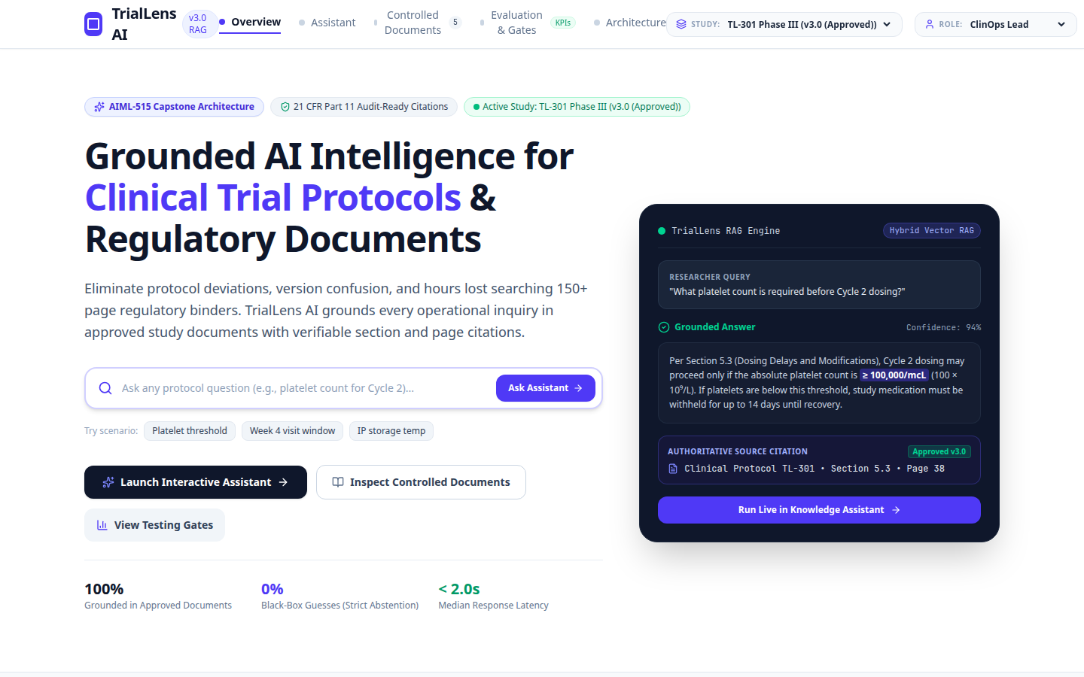
APPLICATION 1 · PHASE 3 · WORKSHOP 1
The single-file prototype
A shared URL was the fastest way to see the workflow.
• Hosted at triallens-ai.ai.studio. It still answers, and it still says TrialLens AI.
• One file showed Overview, Assistant, documents, evaluation, and architecture.
• Strength: no install, easy to react to, easy to share.
• Limit: routing, types, and Git are hidden inside one document.
Live prototype, October 18, 2026. Working title still on the page.
Hero numbers on that page are interface claims. They are not a measured study.
Pu Zeng · StudyCite and BiteWise
6 / 24
Notes:
Click the screenshot only to show that the prototype is real. The address is https://triallens-ai.ai.studio. I checked it on October 18, 2026: HTTP 200, served behind Google Frontend. Last-Modified on an earlier check was September 7, 2026.
The page still uses the working title TrialLens AI. The reflection explains the rename: Clinical ink already uses TrialLens, and "lens" does not describe the job. StudyCite names the rule that every answer must be citable against the current approved source.
Do not read the hero line — 100 percent grounded, 0 percent black-box guesses, under 2 seconds — as a result. The same caution applies to the confidence badge in the sample card. Point at the workflow instead: a protocol question, a grounded answer, and a citation to Protocol TL-301, Section 5.3.
Claude-style single-file hosting, including this AI Studio host, was the right Workshop 1 surface. It was the wrong place to finish.

Slide 7
APPLICATION 1 · PHASE 3 · WORKSHOP 2
From one file to a repository
I built a fresh Vite project in Cursor instead of splitting the original file line by line. Local conversion took about 2 hours 45 minutes.
25 min
45 min
40 min
Review spec, prototype, and the rename
Scaffold Vite, routes, and components
Seed data, retrieval, evaluation cases
20 min
15 min
20 min
Browser checks and TypeScript fixes
Code screenshots, eight PNGs
The development reflection
Stack that actually runs: React 19, TypeScript, Vite 8, Material UI 9, React Router 7. Pages: Overview, Assistant, Controlled Documents, Evaluation, Architecture. Studies TL-301 and TL-204. More than 2,000 lines, so the code screenshots were split into eight images.
Pu Zeng · StudyCite and BiteWise
7 / 24
Notes:
These times are the ones I wrote in the September 16, 2026 development reflection. They cover the local conversion only. They do not include the earlier single-file prototype or the six-phase lifecycle paper.
The path was build-fresh. The prototype showed the intended screens, but it was not organized as modules. A new project from the AIML-515 specification produced pages, components, services, seed data, and context. I kept study and role switching, citations, the version trap, and abstention.
Two compiler issues are worth a sentence if someone asks what the assistant actually fixed. Material UI v9 rejected Stack alignItems. JSX treated a greater-than-or-equal sign in the copy as an operator. The agent used the compiler errors to patch those files.
Cursor was the IDE: file explorer, terminal, Git, and the in-editor agent. npm start and npm run dev both launch Vite on port 5173.

Slide 8
APPLICATION 1 · PHASE 3
What the StudyCite prototype actually runs
Role and study
Approved chunks
Retrieve, then rerank
Cite or abstain
ClinOps, CRA, scientist, coordinator, or programmer. TL-301 or TL-204.
Seed passages for that study only. Draft uploads stay out.
ragService.ts in the browser. No separate API.
Source drawer with version and page, or a refusal.
No server in this MVP
Authorization first
Five routes
100-document cap
Retrieval is in memory. There is no SQL database and no API key in the repository.
setStudyId returns false unless the role may open that study. Coordinators stay on TL-301.
Overview, Assistant, Controlled Documents, Evaluation, and the six-phase Architecture page.
English text. Uploads index as Draft and are not used for answers.
Pu Zeng · StudyCite and BiteWise
8 / 24
Notes:
This is the diagram to contrast with the previous target slide. Say "in the browser" out loud. src/services/ragService.ts does retrieve, rerank, and either a cited answer or abstention. src/data/seed.ts holds the studies, passages, eight gold cases, and the KPI cards. src/context/AppContext.tsx holds role, study, uploads, and history. src/security/validate.ts holds the input checks.
There is no backend process. The apprunner.yaml later serves the built Vite preview, which is still this frontend. Do not describe FastAPI or pgvector as deployed.
The important security property already present in the prototype: a draft upload cannot become an answer source, and a role cannot select a study it is not allowed to open.

Slide 9
APPLICATION 1 · PHASE 4
Responsible AI and the security pass
Abstain
Security checklist
Out-of-scope medical questions return no clinical advice. The surgical-bypass case is the gold example.
Selected from the twelve items marked complete in the September 16 report.
Version warning
• No API keys in source.
• No SQL, so no string-built queries.
• Role filter before retrieval.
• Approved documents only.
• Length limits: 500, 120, and 80.
• PHI and injection patterns blocked.
• React text only. No innerHTML.
• Error boundary and referrer policy.
80,000/mcL is a trap. v2.0 is superseded. v3.0 requires at least 100,000/mcL.
No patient text
Questions are checked for PHI-like patterns. The UI warns people not to enter identifiers.
Demo identity
The role menu is a stand-in for Cognito. The report says so, instead of calling it authentication.
Pu Zeng · StudyCite and BiteWise
9 / 24
Notes:
Treat responsible AI as behavior, not a policy paragraph. Three behaviors are enough: abstain on the surgical question, warn on the 80,000 platelet trap, and reject PHI-like input.
The length limits are question 500 characters, document name 120, and search 80. Document types and filters are whitelisted. Control characters are stripped. User text is rendered as React text, not HTML.
The hardest honesty point is on this slide. Role switching is not Cognito. Data stay in browser memory. Real tenant isolation and server-side authorization are future work. The September 16 report says the challenge was to add meaningful controls without pretending a client-only prototype is a regulated system.
The checklist in the report has twelve marked items. I grouped the last ones on the slide so the type stays readable. Referrer policy is strict-origin-when-cross-origin.

Slide 10
APPLICATION 1 · PHASE 4
Bugs fixed, and what the tests actually show
Fixed in the September 16 pass
Evidence
• Empty Overview questions still opened Assistant. Submit now validates first.
• A failed ask could leave loading stuck. Both paths use try/finally.
• Uploads were auto-approved. They now stay Draft and cannot be cited.
• Retrieval used a global catalog. It now uses the active study only.
• Any study id was accepted. Unauthorized roles are refused.
• Document cards were mouse-only. They are keyboard buttons.
• Labels and a main landmark were missing. Both were added.
8
Gold cases: 6 answerable, 1 version trap, 1 abstention.
5
Pages covered by the manual checklist, plus an unknown-URL redirect.
Seed
KPI cards in the UI are demonstration figures, not a field study.
Pu Zeng · StudyCite and BiteWise
10 / 24
Notes:
The left column is the bug list from the testing report, in the report's own order. The most critical functional bug was the stuck loading state. The most important security bug was treating unreviewed uploads as approved and citing a global catalog.
The gold set is real content in seed.ts. Answerable examples include the platelet threshold, the Week 4 visit window, IP storage at 2°C to 8°C, renal impairment, SAE reporting within 24 hours, and inverting PK tubes 8 to 10 times. The version trap is 80,000 per microliter. The abstention case is a coronary bypass technique.
The Evaluation page renders seven KPI cards with observed values such as 93 percent precision at 5, 97 percent citation correctness, 1.9 seconds median latency, and 4.3 out of 5 satisfaction. Those numbers are hardcoded in seed.ts and every card is marked met. Say that plainly if someone asks for the metrics. They are the demonstration gate, not an independent measurement. The manual checklist in the report is a list of controls to exercise. I am not claiming a recorded pass rate for that list.

Slide 11
APPLICATION 1 · PHASE 5 · WORKSHOP 3
An App Runner file, and the URL that answers
AWS CLI
1
Identity check succeeded from Cursor on September 19, 2026. Region us-west-2.
apprunner.yaml
2
Node 22. npm ci and npm run build. Then Vite preview on 0.0.0.0 port 8080.
What is not recorded
3
The README has no public App Runner hostname. I will not invent one.
What answers
4
The Workshop 1 prototype at triallens-ai.ai.studio still returns the app.
Pu Zeng · StudyCite and BiteWise
11 / 24
Notes:
Be direct about Workshop 3. The assignment asked for an AWS App Runner deployment and a live App Runner demo link. What I can show is the configuration and the identity check. What I cannot show is a running App Runner service URL, because the StudyCite README does not record one, and I will not fabricate an awsapprunner.com address or a console screenshot.
The AWS note from September 19, 2026 says CLI version 2 was installed, the default region is us-west-2, and GetCallerIdentity succeeded for an IAM user. Do not read the account number, user id, or access-key suffix aloud. They are not needed to make the point.
apprunner.yaml is in the repository: runtime nodejs22, build commands npm ci and npm run build, run command npm run preview on host 0.0.0.0 port 8080, network port 8080. There is also a Dockerfile and an amplify.yml. The preview command serves the static React app. It does not add a Python API.
The live demo link for Application 1 is the prototype: https://triallens-ai.ai.studio.

Slide 12
APPLICATION 1 · PHASE 5
Deployment challenges
A config file is not a service
The prototype was sometimes unreachable
App Runner settings are checked in. No public service URL was recorded, so the live demo remains the prototype host.
During the IDE conversion the agent could not copy the original file. The Word specification and later screenshots filled the gap.
A static preview cannot hold the target stack
Naming collided
Vite preview has no FastAPI, no pgvector, and no Cognito. Shipping the preview would not have made Phase 2 true.
TrialLens is already used by Clinical ink. The repository name StudyCite matches the citation rule. The old host still shows the old name.
Live demo for Application 1: https://triallens-ai.ai.studio
Pu Zeng · StudyCite and BiteWise
12 / 24
Notes:
Four challenges, each with a consequence. First, I will not demo a service I cannot open. Second, the reflection records that the hosted prototype was not always reachable, which is why the local build used the specification plus screenshots. Third, do not let the App Runner file be described as the Phase 2 architecture. Fourth, if the live page says TrialLens AI, that is expected. The rename is in the repository.
The useful comparison for later: BiteWise has one public URL where the page and the API are the same host. StudyCite's runnable demo and StudyCite's repository are still two different things.
If asked what I would redeploy, the answer is a server that enforces approved-only retrieval, not a second static preview.

Slide 13
APPLICATION 1 · PHASE 6 · WORKSHOP 4
Feedback the product can collect
Every answer can be marked helpful or not helpful. A negative reason has to name the failure, not just the mood.
Incorrect answer
Wrong source
Incomplete answer
Outdated document
Unclear wording
Also watched
Citation opens, repeated reformulations, abandoned sessions, latency, and which documents are used.
Blueprint, month by month
Month 1: retrieval, citations, versioning, abstention. Month 2: source viewer and documents. Month 3: reranking, tables, multi-document questions.
Still out of scope at one year
Amendment comparison and enterprise identity are in the plan. Autonomous clinical decisions are not.
Pu Zeng · StudyCite and BiteWise
13 / 24
Notes:
Workshop 4 is the feedback design on the Architecture page, Phase 6, plus the controls that exist in the Assistant. Helpful, Not helpful, and a reason select are in the testing checklist. Query history is study-scoped and keeps document versions.
The month-by-month list and the one-year boundary are the blueprint, not a claim that those months already happened. Say "the plan says" before Month 1, Month 2, and Month 3.
Negative reasons are the useful part. "Not helpful" alone cannot tell a retrieval bug from an outdated document. The version-trap case is exactly the "outdated document" reason.
I did not run a formal user study with outside clinicians. The feedback that changed the code in this phase is the testing pass on the next slide.

Slide 14
APPLICATION 1 · PHASE 6
What the test pass changed
Defect
Before
After
Empty question
Navigated anyway
Validated before leaving Overview
Failed retrieval
Buttons stayed disabled
try/finally clears loading
New upload
Marked Approved
Stays Draft, never cited
Corpus
Global catalog
Active study, approved only
Study switch
Any id accepted
Role must be authorized
Accessibility
Mouse cards, missing labels
Keyboard cards, labels, main landmark
Pu Zeng · StudyCite and BiteWise
14 / 24
Notes:
Read this as the iteration, not as a feature list. Each row is a place where the grounding claim would have been false if the defect had stayed.
Spend the most time on the upload row and the corpus row. An authoritative tone plus a draft document is worse than no answer. Restricting retrieval to authorized, approved documents is the change that makes the citation meaningful.
Accessibility is on this slide because the testing report treated it as part of the same pass: skip link, landmarks, focus rings, aria-current, aria-pressed, tab panels, role=alert, one h1, and lang=en. Document cards had been mouse-only.
Close by saying what did not change. Role impersonation is still a demo. The production identity provider is still future work.

Slide 15
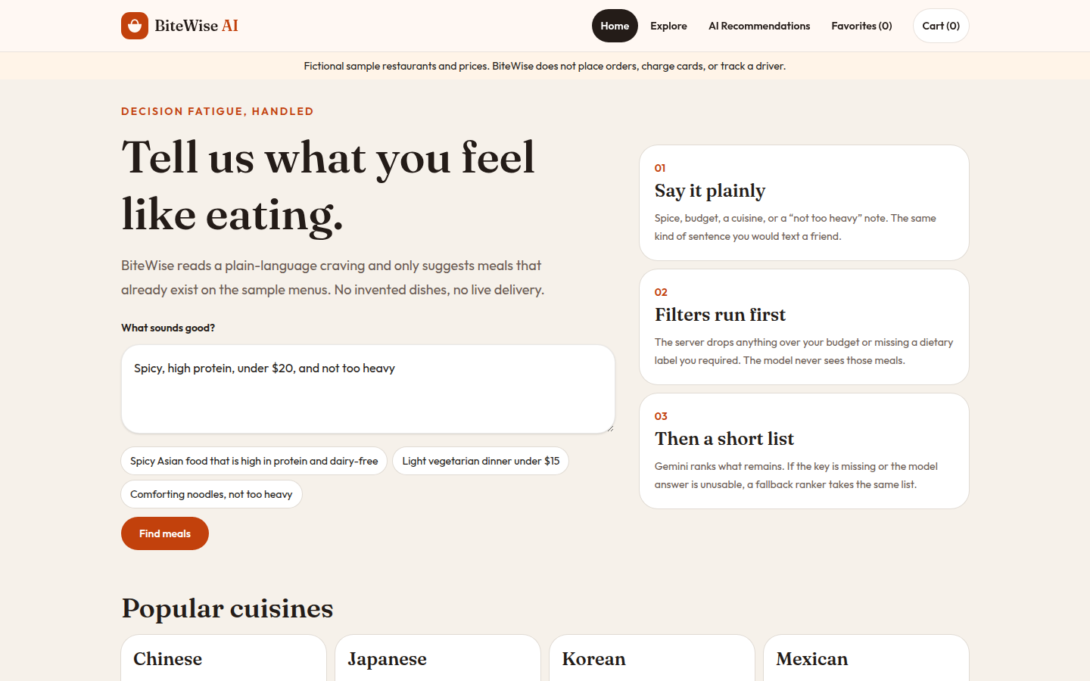
APPLICATION 2 · WORKSHOP 5
A second problem: deciding what to eat
Decision fatigue on a menu that is already longer than the craving.
• A person says “spicy, high protein, under $20, not too heavy.”
• Most of a 40-item sample menu is already ineligible.
• The assistant may suggest only meals that exist, at most three.
• Fictional restaurants. No orders, cards, or drivers.
https://bitewise-ai.ai.studio · captured October 18, 2026
Dietary tags are labels on sample rows, not a verified allergen analysis.
The page states the rule in order: say it plainly, filters run first, then a short list.
Pu Zeng · StudyCite and BiteWise
15 / 24
Notes:
Application 2 starts a new problem. Do not describe BiteWise as StudyCite with a new color. The user is someone who cannot face a long menu, not a study coordinator.
The sample catalog is eight fictional restaurants and five items each: Chinese, Japanese, Korean, Mexican, Italian, American, Indian, and Mediterranean. Nothing is a real restaurant. The cheapest sample item is Tofu Miso Soup at $6.50. A few items sit over $20, including Grilled Salmon at $22.50.
Read the three steps on the homepage, because they are the architecture in product language. Say it plainly. Filters run first. Then a short list. The disclaimer under the header is part of the product: fictional prices, no orders, no payment, no driver.
The screenshot is the live site, not the local Vite server.

Slide 16
APPLICATION 2 · WORKSHOP 5
Built and tested in the IDE
React, Vite, and Tailwind on the client. Express, SQLite, and Gemini on the server. The key never enters the browser.
01
Catalog routes return the sample menu
07
Words in the prompt are hard filters too
02
Budget, cuisine, and diet filters constrain results
08
Favorites persist and reject duplicates
03
Unknown meal ids return safe errors
09
Delete is scoped; a repeat delete is 404
04
No Gemini key means the fallback ranker
10
Empty prompts and bad JSON are rejected
05
Bad model output cannot leave the menu
11
The built client is served; /api stays JSON
06
A ranking is kept only if every id is eligible
12
Client source contains no Gemini key
Pu Zeng · StudyCite and BiteWise
16 / 24
Notes:
The stack is JavaScript, not the TypeScript and Material UI stack from StudyCite. Client workspace and server workspace. Vite proxies /api to Express. SQLite uses better-sqlite3. Gemini is called only from the server through @google/genai, model gemini-3.8-flash, and only when GEMINI_API_KEY is set. A missing key is demo mode, not an error.
These twelve names match tests/api.test.js. They are automated. I am not quoting a runtime or a coverage percentage.
Two tests carry the lesson from StudyCite. Test 6 refuses a model ranking that cites an id outside the eligible set. Test 12 fails if the client bundle contains a Gemini key. Favorites use a client token header, 16 to 64 characters, and one client cannot delete another client's row.
Local development stays on Vite port 5173 and the API on 3001. That is separate from the public URL.

Slide 17
APPLICATION 2 · WORKSHOP 5
Filters before the model
Prompt
Hard filter
Rank or fall back
Short list
Plain language, budget, and dietary labels. Body limit 32 KB.
SQL removes price and missing diet tags before any model call.
Gemini may return only eligible ids. Invalid output is discarded.
At most three meals, each with a reason, or an empty set.
Eligible means every label
The model sees a short list
Fallback is visible
One process in production
A vegetarian request does not include a meal that merely looks light. The row must already carry the tag.
It cannot invent a dish, a price, or an id. Explanations are capped at 400 characters.
If the key is missing, the call fails, or the JSON is unusable, the page says fallback ranking.
After the build, Express serves the React app and /api. The page CSP is not the API CSP.
Pu Zeng · StudyCite and BiteWise
17 / 24
Notes:
This is the diagram I want remembered. Compare it with StudyCite's browser retrieval. Here the boundary is a SQL query, not a prompt instruction.
The dietary whitelist is vegetarian, vegan, gluten-free, dairy-free, nut-free, pescatarian, high-protein, and light. The server also reads dietary phrases and a lower budget out of the sentence itself, so “under $15” is a filter even if the budget field is higher.
Empty eligible set returns source none. A valid Gemini ranking is kept only when every id is in the eligible set and the list length is one to three. Otherwise the deterministic ranker runs and the response says so.
Security headers on /api use a strict content security policy. The HTML page needs a different policy so scripts, styles, and Google fonts load. That distinction mattered when the app moved to one host. Parameterized SQL. Favorites are unique per client token and menu item.

Slide 18
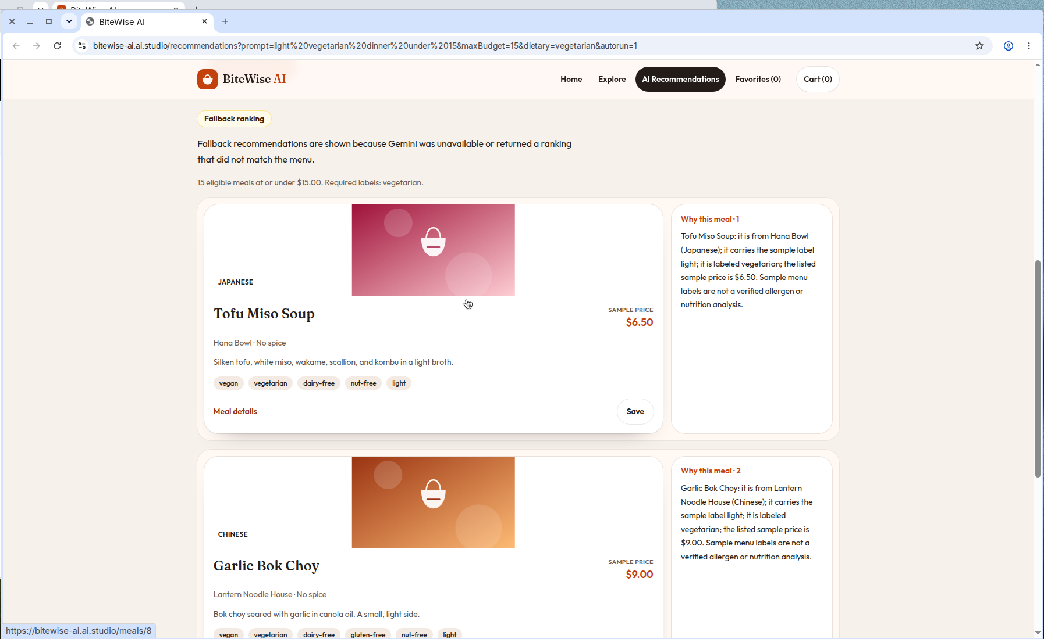
APPLICATION 2 · WORKSHOP 6
A public URL, without App Runner
• App Runner is closed to new customers. There is no awsapprunner.com address.
• Published with Google AI Studio to Cloud Run at bitewise-ai.ai.studio.
• Health on that host: demo mode off, model gemini-3.8-flash.
• This capture still shows fallback. The ranking was unusable, and the page said so.
• Fifteen vegetarian meals at or under $15 stayed eligible.
Published site, October 18, 2026, 8:22 a.m. UTC. Fallback badge, Tofu Miso Soup $6.50, Garlic Bok Choy $9.00.
Live demo: https://bitewise-ai.ai.studio
Pu Zeng · StudyCite and BiteWise
18 / 24
Notes:
Workshop 6 was supposed to be AWS deployment. Say what happened. App Runner would not take a new service. I did not create an ECS service from this environment either, because there were no AWS credentials here. The public app was published from Google AI Studio, which deploys to Cloud Run, the same pattern as the classmate app that looks like "App Runner" in conversation but is an ai.studio host.
The screenshot is the published site, not localhost. The clock on the original capture read 8:22 a.m. UTC on October 18, 2026. The badge says fallback because Gemini was unavailable or the ranking did not match the menu. Fifteen meals were eligible. The first card is Tofu Miso Soup from Hana Bowl at $6.50. The second is Garlic Bok Choy from Lantern Noodle House at $9.00.
A later health check the same day returned demoMode false and rankingModel gemini-3.8-flash, and a repeat of the same request was ranked by Gemini. Both observations are true. The key can be configured while a particular ranking is rejected. The slide shows the fallback capture because that is the behavior the tests require people to see.
npm start serves the built client and the API on PORT. The Dockerfile is set up for that host. Publish rebuilds, so the live asset hash does not have to match a laptop build.

Slide 19
APPLICATION 2 · WORKSHOP 6
What a visitor can try
Ask
“Light vegetarian dinner under 15.” Budget and the word vegetarian are both filters.
Known limits
• Sample menus only.
• Tags are not allergen tests.
• No accounts.
• No payment.
• Fallback is a feature, and it must stay visible.
Inspect
Open a meal. The reason names the restaurant, the labels, and the sample price.
Save
Favorites are stored for this browser’s client token, not as one shared list.
Miss
A craving with zero eligible meals returns an empty list, source none, not a guess.
https://bitewise-ai.ai.studio
Pu Zeng · StudyCite and BiteWise
19 / 24
Notes:
This is the showcase, not a user-research report. I did not run a formal study with outside diners. What I can demo is the public behavior.
Walk one request: light vegetarian dinner under 15. The visitor should see how many meals remained eligible, whether the badge says Gemini or fallback, and a reason that quotes the sample price. Then show a favorite saved in this browser, and mention that another client token cannot delete it.
The empty case matters as much as the happy path. If nothing matches, the product returns no meals. That is the BiteWise version of StudyCite's abstention.
Known limits are on the dark card so they are not a footnote. Dietary labels are not a lab analysis. If a label is missing, BiteWise does not know whether the meal qualifies. There is one local demo identity and no accounts. The cart does not charge anyone.

Slide 20
AI’S ROLE
Prompts and tools that earned their place
Convert this, using the spec
Fix the error on the screen
Turn the live prototype into a multi-file project from the written MVP, and propose a better name. That prompt produced StudyCite.
Material UI v9 and a greater-than-or-equal sign in JSX. The useful prompt included the compiler output, not a general plea to clean up.
Enumerate the controls
Enforce the boundary in code
List every input, search the source for secrets and unsafe APIs, and draft the security report from the diff.
For BiteWise: filter in SQL first, accept only eligible ids, and fail the tests if the client contains a key.
Pu Zeng · StudyCite and BiteWise
20 / 24
Notes:
Name the tools before the slogans. Cursor was the IDE and the agent for both apps. The single-file host, the same family of tool as a Claude artifact, was the StudyCite prototype. Google AI Studio was the publish step for BiteWise. Gemini 3.8 Flash is the ranker, and only on the server.
The prompts that worked were narrow and attached to an artifact: the prototype URL plus the specification, a compiler error, a request to enumerate controls, a test that fails if an id escapes the eligible set. The reflection says an earlier Appendix A prompt, asking for all six lifecycle phases with real technologies, kept StudyCite tied to retrieval quality, citation correctness, and abstention.
A broad prompt for a chatbot would have skipped abstention and the hard filter. I would not recommend "build me an AI app" as a useful prompt for this kind of product.
Screenshot generation was a tool use too. More than 2,000 lines could not fit in one image, so the agent split StudyCite into a file tree and grouped source listings, eight PNGs.

Slide 21
AI’S ROLE
What changed from the first app to the second
Question
StudyCite
BiteWise
Where the rule lives
Browser retrieval over approved seed text
SQL filter before the model is called
Where the secret lives
No model key in the repo
Key on the server only; test guards the client
What failure looks like
Abstain, or a version warning
Visible fallback, or an empty eligible set
What is public
Prototype host and a separate repository
One URL serves the page and the API
What I would repeat
Rename to match the job; keep the gold cases
Write the refusal test before the happy path
Pu Zeng · StudyCite and BiteWise
21 / 24
Notes:
The lesson is the left column, not the technology names. I got better at putting the rule somewhere the model cannot talk its way around.
On StudyCite I asked a browser routine to cite approved text. That was the right product rule, and the testing pass made it stricter, but the model and the documents lived in the same page. On BiteWise, meals that fail the budget or the diet never enter the prompt. Invalid ids are dropped. The key is not in the bundle, and a test checks that.
The second improvement is honesty about deployment. StudyCite taught me not to treat a YAML file as a URL. BiteWise's public host is one I can reload, and the fallback badge is part of the demo rather than an embarrassment to hide.
What I would do differently at the start of App 1: write the abstention and authorization tests before polishing the hero, and plan a server boundary even if the first week is a prototype. I would still begin with a single-file host. I would leave it sooner.

Slide 22
VALUE
Who is helped, and how the work gets smaller
STUDY TEAMS
HUNGRY PEOPLE, AND LATER A MENU OWNER
A question ends at a versioned page, or it ends.
Forty dishes become at most three that already qualify.
• Coordinators check visit windows, tube handling, and storage without hunting a binder.
• A superseded platelet threshold is labeled, instead of quoted as current.
• A site role cannot open the other study’s documents.
• Sponsors get a retrieval product, not an unlogged clinical advisor.
• The decision left is taste, not a hunt for price and diet labels.
• A restaurant group could attach the same filter to a real menu later.
• No invented dish means no false item on a ticket.
• The reason shows the sample price and the labels that qualified the meal.
Pu Zeng · StudyCite and BiteWise
22 / 24
Notes:
Value is a smaller search, not a revenue number. For a study team, the expensive mistake is acting on a superseded page. StudyCite's version trap is aimed at that mistake. The coordinator persona is the daily user. ClinOps cares about amendment rollout. A sponsor should care that the system abstains instead of inventing clinical advice.
For BiteWise, the waste is time spent on meals that were never eligible. Fifteen of forty sample meals survived a vegetarian cap of $15 in the published capture. The visitor still only sees up to three, with reasons. That is the efficiency claim I can defend.
The company value is conditional. A restaurant does not gain orders from this prototype, because it cannot place one. The transferable piece is the filter: a chain with a real menu could refuse to let a model recommend an item that fails price, diet, or availability. I am not claiming that integration exists.

Slide 23
VALUE
Benefit, cost, and the ROI I will not invent
Cost today
Benefit I can show
What ROI would require
• StudyCite runs as a frontend prototype.
• BiteWise is one published Cloud Run app.
• Sample menus, not a data contract with a restaurant.
• No measured staff-time study.
• Wrong-version answers are a named test, not a hope.
• Ineligible meals never reach the ranker.
• Failures are visible: abstain, or fallback.
• Both public hosts can be reloaded.
• A real document store and server-side auth.
• A timed baseline against manual search.
• A real menu with verified labels.
• Those numbers are not in either repository.
Pu Zeng · StudyCite and BiteWise
23 / 24
Notes:
This slide is here so I do not fabricate a payback period. The Architecture page lists design targets: precision at 5 at least 90 percent, citation correctness at least 95 percent, grounded answers at least 95 percent, unsupported claims under 2 percent, median latency under 4 seconds, and a 60 percent search-time reduction. The prototype displays seeded cards that meet those targets. That is not a before-and-after time study with coordinators.
Say the cost side without drama. I am not quoting an AWS bill, because StudyCite has no recorded public App Runner service and BiteWise's publish path is AI Studio's starter hosting. I will not invent a monthly price.
The benefit that is real today is risk removal of a specific kind: a cited superseded page, or a meal the filter already rejected. Dollar ROI needs the third column. If a later project times coordinators against the binder, or connects a verified menu, that is when a benefit figure becomes honest.

Slide 24
CONCLUSION
Keep the filter. Then earn a larger corpus.
StudyCite next
Move retrieval to a server. Replace the role menu with real identity. Keep abstention and the version trap. pgvector only after the authorization filter is server-side.
BiteWise next
A real menu only with verified labels. The same SQL filter in front of any model. Accounts only if favorites must leave this browser.
Either app
Write the refusal test first. Publish only a URL that can be reloaded. Do not describe a YAML file as a deployment.
STUDYCITE PROTOTYPE
BITEWISE
triallens-ai.ai.studio
bitewise-ai.ai.studio
Working title TrialLens AI
Page and API on one host
Notes:
Close on the roadmap and then read both URLs. StudyCite's next honest step is a server that enforces approved-only retrieval and real identity. The Architecture page already names Cognito, FastAPI, and pgvector. Those stay targets until the authorization filter moves off the client. Autonomous clinical decisions stay out.
BiteWise's next step is not a larger model. It is verified menu data. Until labels are real, the product must keep saying they are sample tags. The hard filter stays in front of Gemini either way.
End by opening one of the two links if the room has a network connection. For StudyCite, the page will say TrialLens AI. For BiteWise, run a vegetarian request under $15 and read the badge: Gemini or fallback. Either badge is a successful demo if the meals on the cards were eligible.
Thank the room. Questions are welcome on the bug list, the twelve tests, and why there is no App Runner URL.

