Slide 1
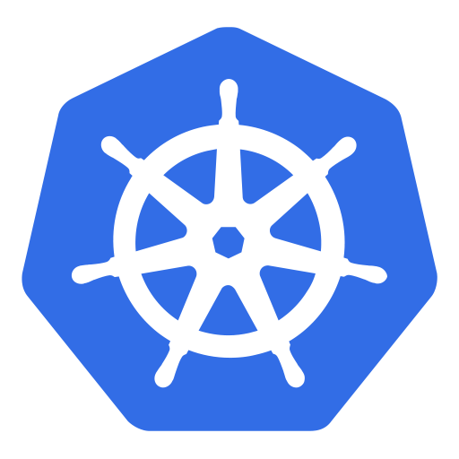
Kubernetes (k8s)

Slide 2
Agenda
What is Kubernetes?
Kubernetes Concepts
Hands on Lab
Kubernetes – Architecture
Ressource Management

Slide 3
Kubernetes – What is it?
1

Slide 4



Kubernetes – What is it?
Kubernetes is a powerful open-source system, initially developed by Google, for managing containerized applications in a clustered environment. It aims to provide better ways of managing related, distributed components and services across varied infrastructure.
Notes:
Opensource Projekt, entwickelt und betrieben von google

Slide 5
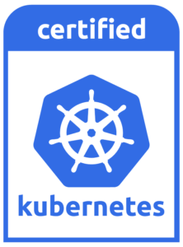


Certified Kubernetes
Consistency users want consistency when interacting with any installation of Kubernetes.
Timely Updates vendors need to provide the latest version of Kubernetes yearly or more frequently, so you can be sure that you’ll always have access to the latest features the community has been working hard to deliver.
Confirmability any end user can confirm that their distribution or platform remains conformant by running the identical open source conformance application (Sonobuoy) that was used to certify.
https://www.cncf.io/certification/software-conformance/

Slide 6
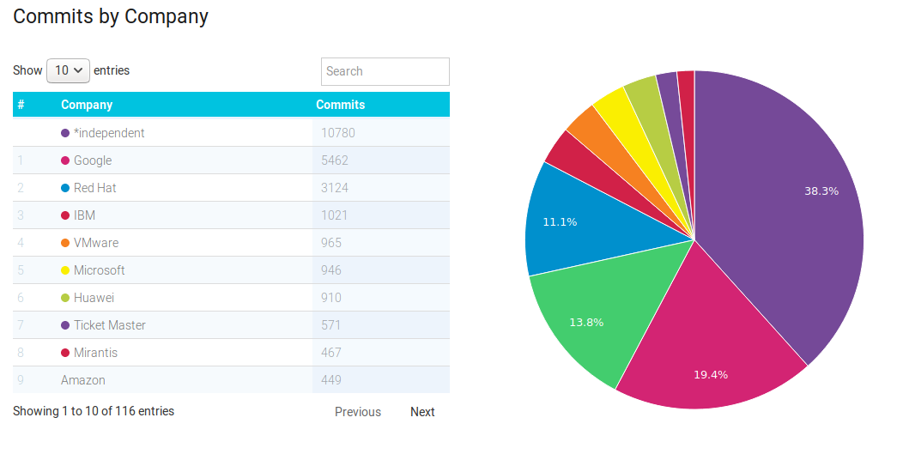
Kubernetes Community Contributions
https://www.stackalytics.com/?release=all&project_type=kubernetes-group&metric=commits

Slide 7

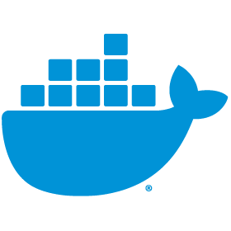
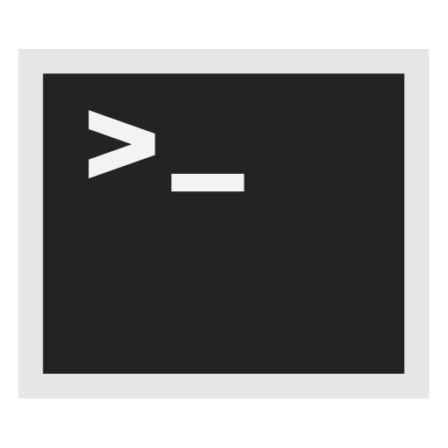
Kubernetes – What is it?
Kubernetes, at its basic level, is a system for running and coordinating containerized applications across a cluster of machines. It is a platform designed to completely manage the life cycle of containerized applications and services using methods that provide predictability, scalability, and high availability.
Notes:
Automatisiert das einrichten, betreiben und skalieren von Containerumgebungen

Slide 8
Kubernetes – Concepts
2

Slide 9
Kubernetes Objects

Slide 10
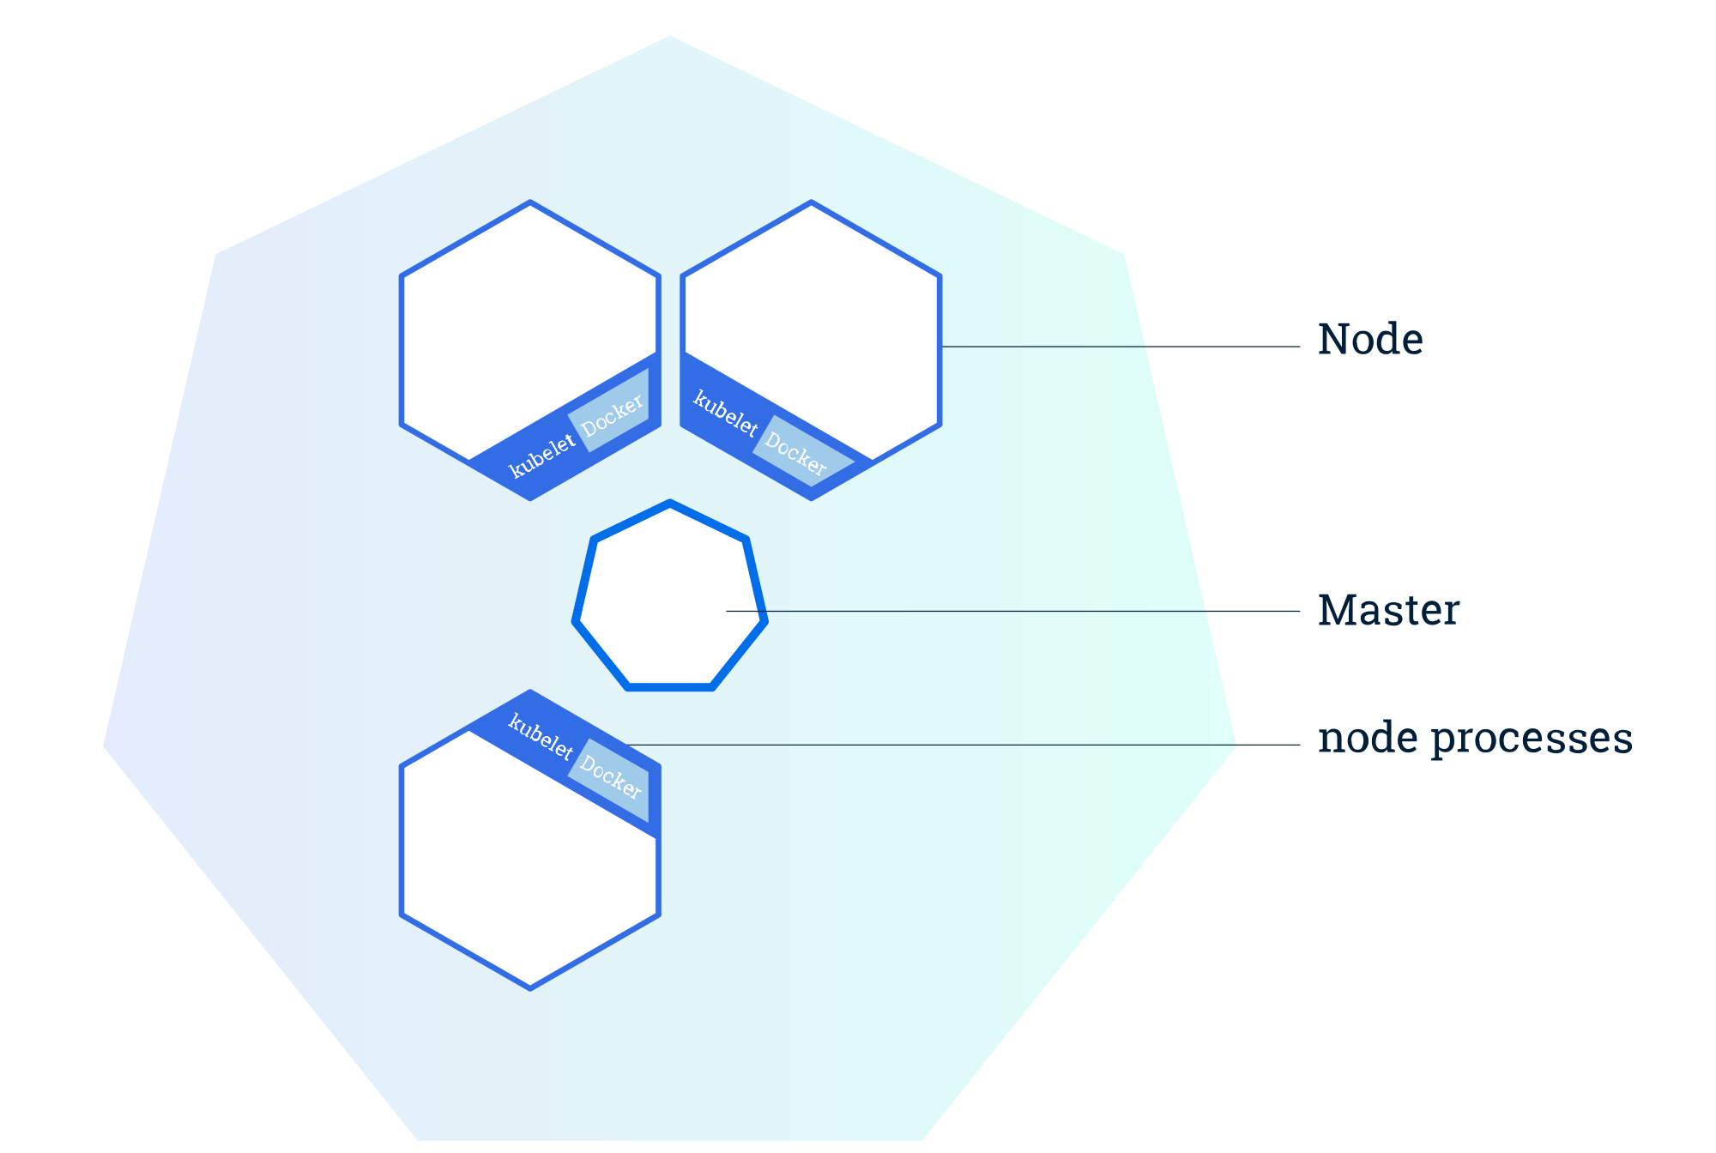
Cluster
© 2018 The Kubernetes Authors | Documentation Distributed under CC BY 4.0
Notes:
Besteht aus zwei Komponenten : Master und Nodes
Master API
kubectl
etcd

Slide 11
Kubernetes Objects - 1
Pod is the smallest deployable unit on a Node. It’s a group of containers which must run together. Quite often, but not necessarily, a Pod usually contains one container. https://kubernetes.io/docs/concepts/workloads/pods/pod-overview/
Service is used to define a logical set of Pods and related policies used to access them. https://kubernetes.io/docs/concepts/services-networking/service/
Volume is essentially a directory accessible to all containers running in a Pod. https://kubernetes.io/docs/concepts/storage/volumes/
Namespaces are virtual clusters backed by the physical cluster. https://kubernetes.io/docs/concepts/overview/working-with-objects/namespaces/

Slide 12
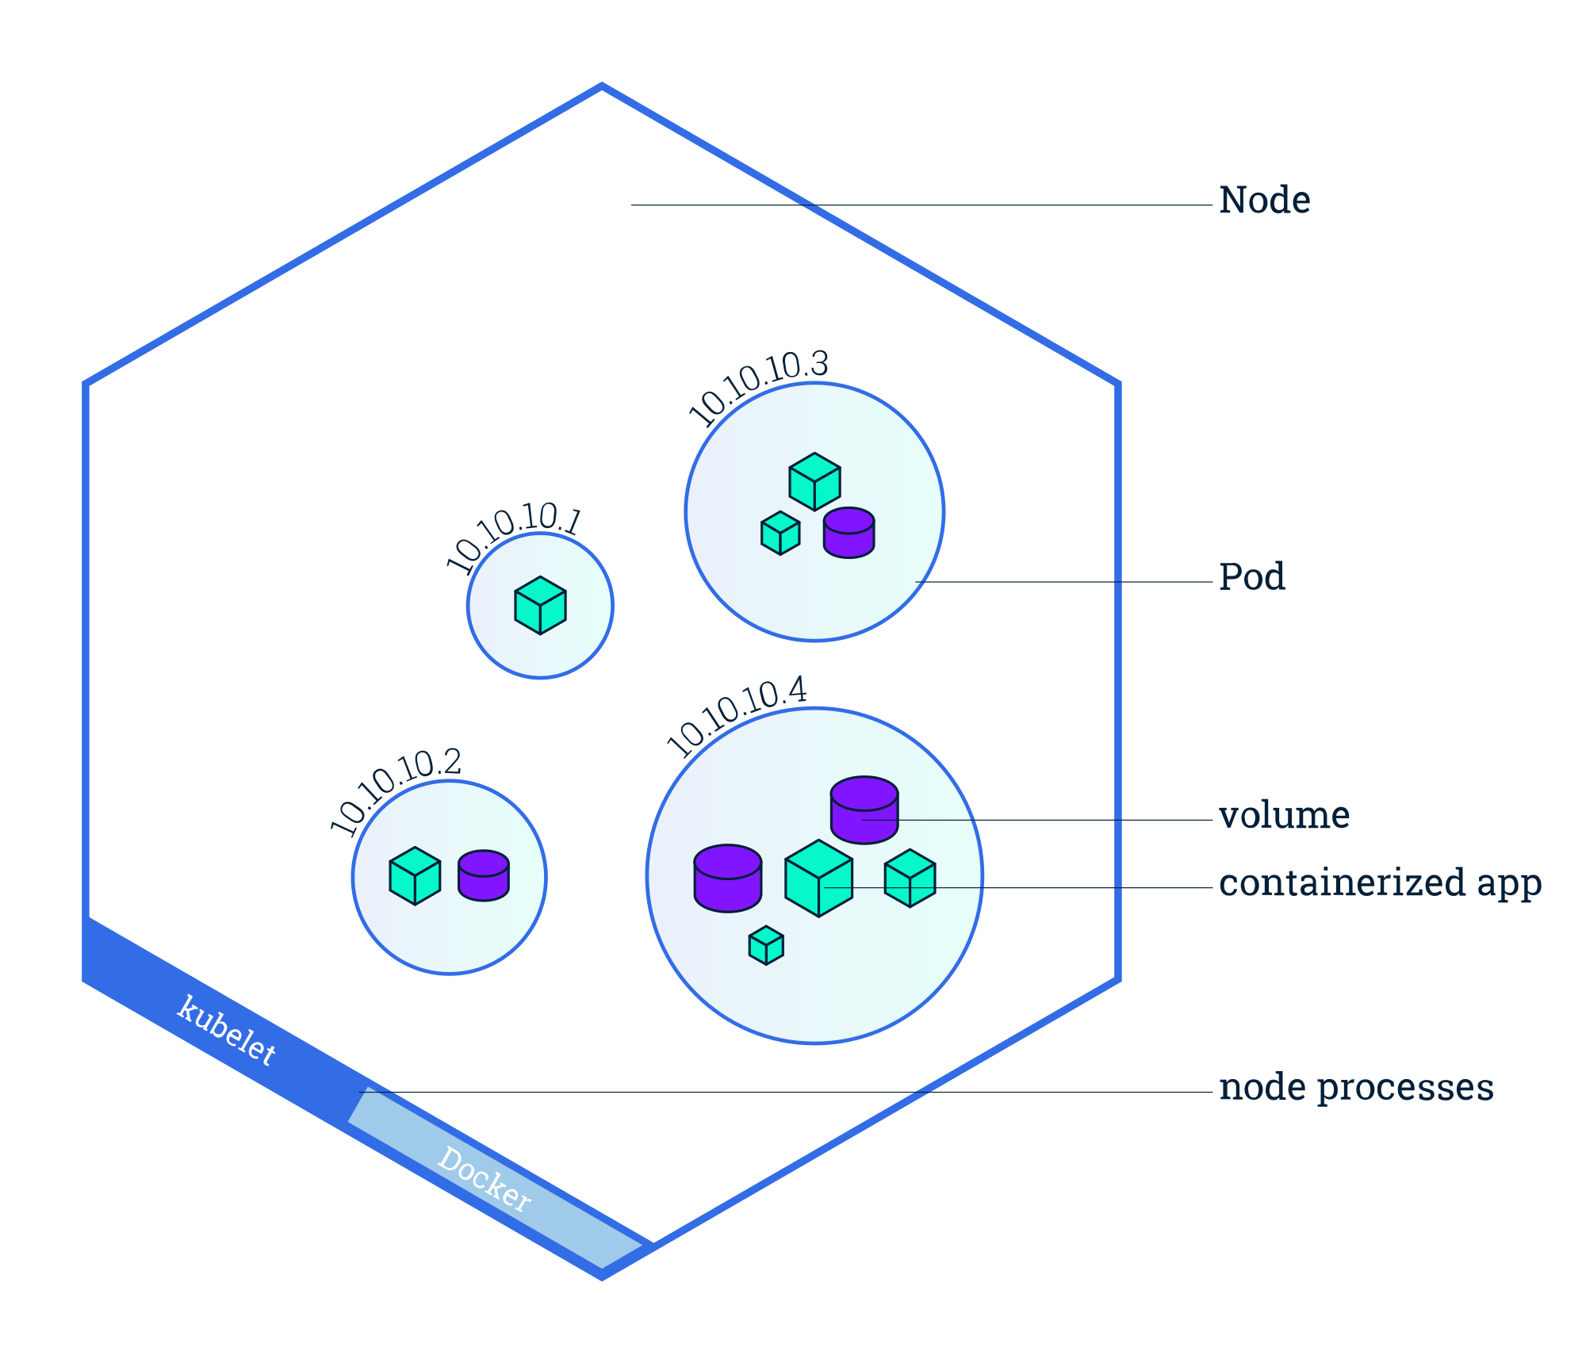
Pods
© 2018 The Kubernetes Authors | Documentation Distributed under CC BY 4.0
Notes:
Besteht aus zwei Komponenten : Master und Kubernetes/Worker Node(s) (Minion(s))

Slide 13
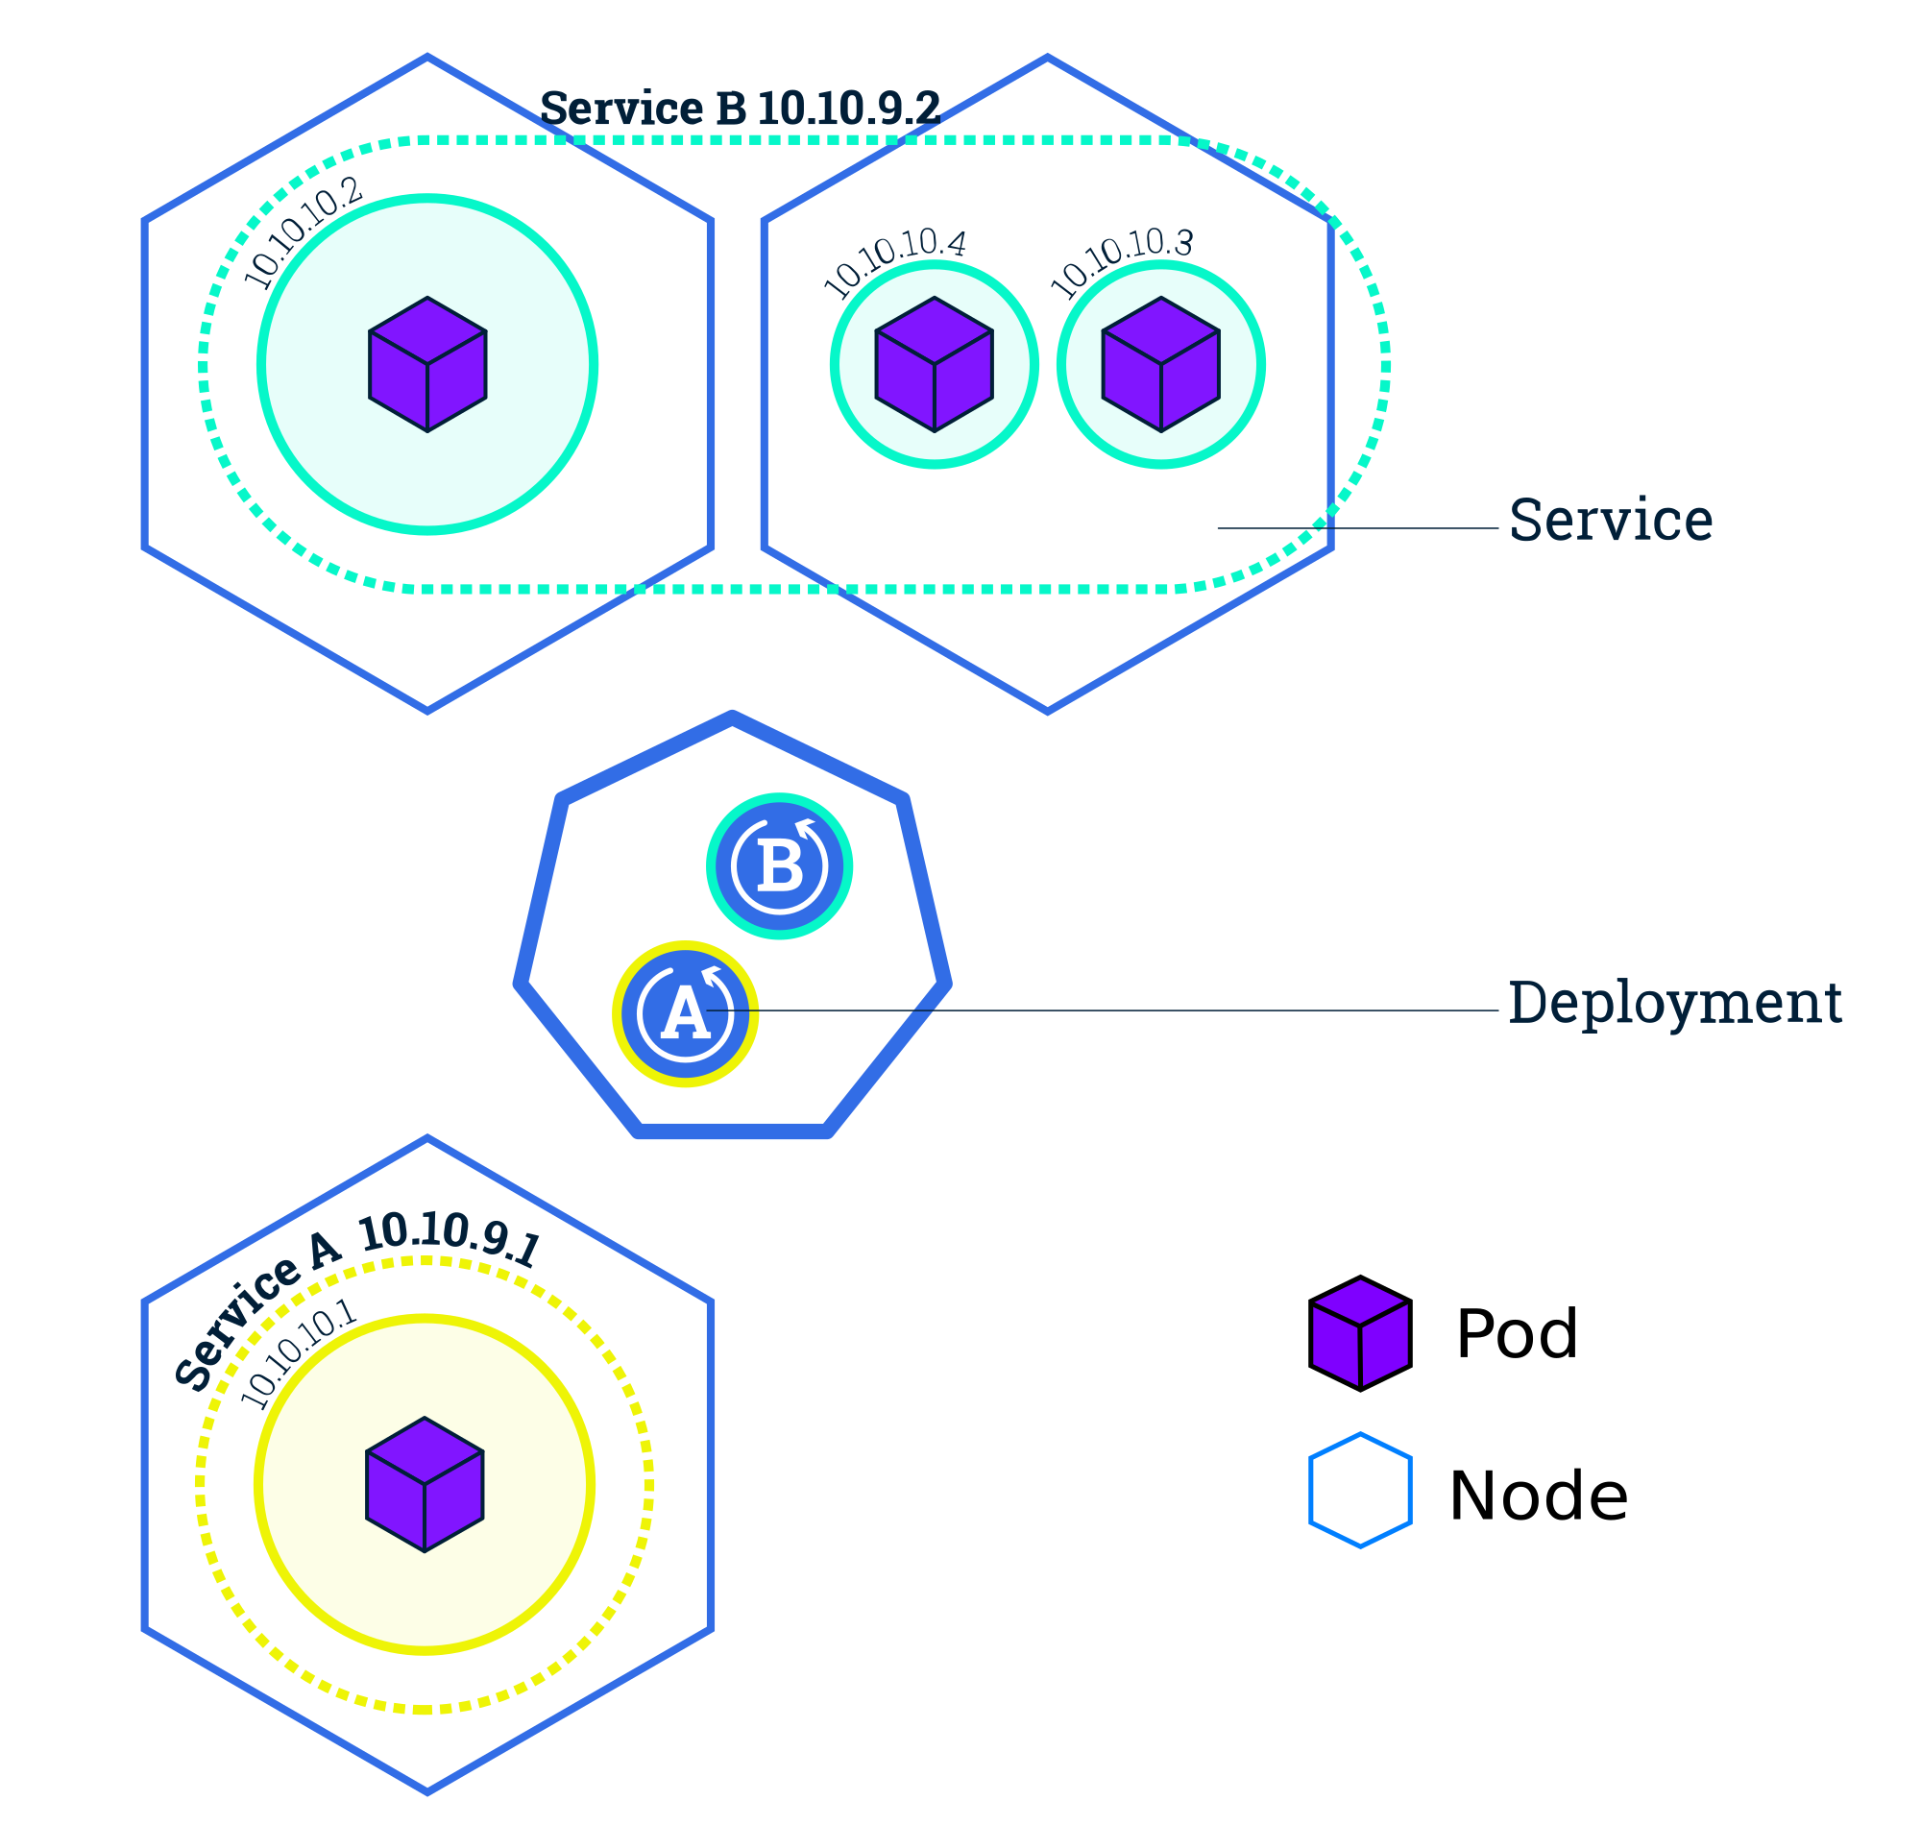
Services
© 2018 The Kubernetes Authors | Documentation Distributed under CC BY 4.0
Notes:
Besteht aus zwei Komponenten : Master und Kubernetes/Worker Node(s) (Minion(s))

Slide 14
Kubernetes Objects - 2
Replication Set is an object that defines a pod template and control parameters to scale identical replicas of a pod horizontally by increasing or decreasing the number of running copies.
https://kubernetes.io/docs/concepts/workloads/controllers/replicaset/
Deployments are one of the most common workloads to directly create and manage. Deployments use replication sets as a building block, adding flexible life cycle management functionality to the mix.
https://kubernetes.io/docs/concepts/workloads/controllers/deployment/

Slide 15
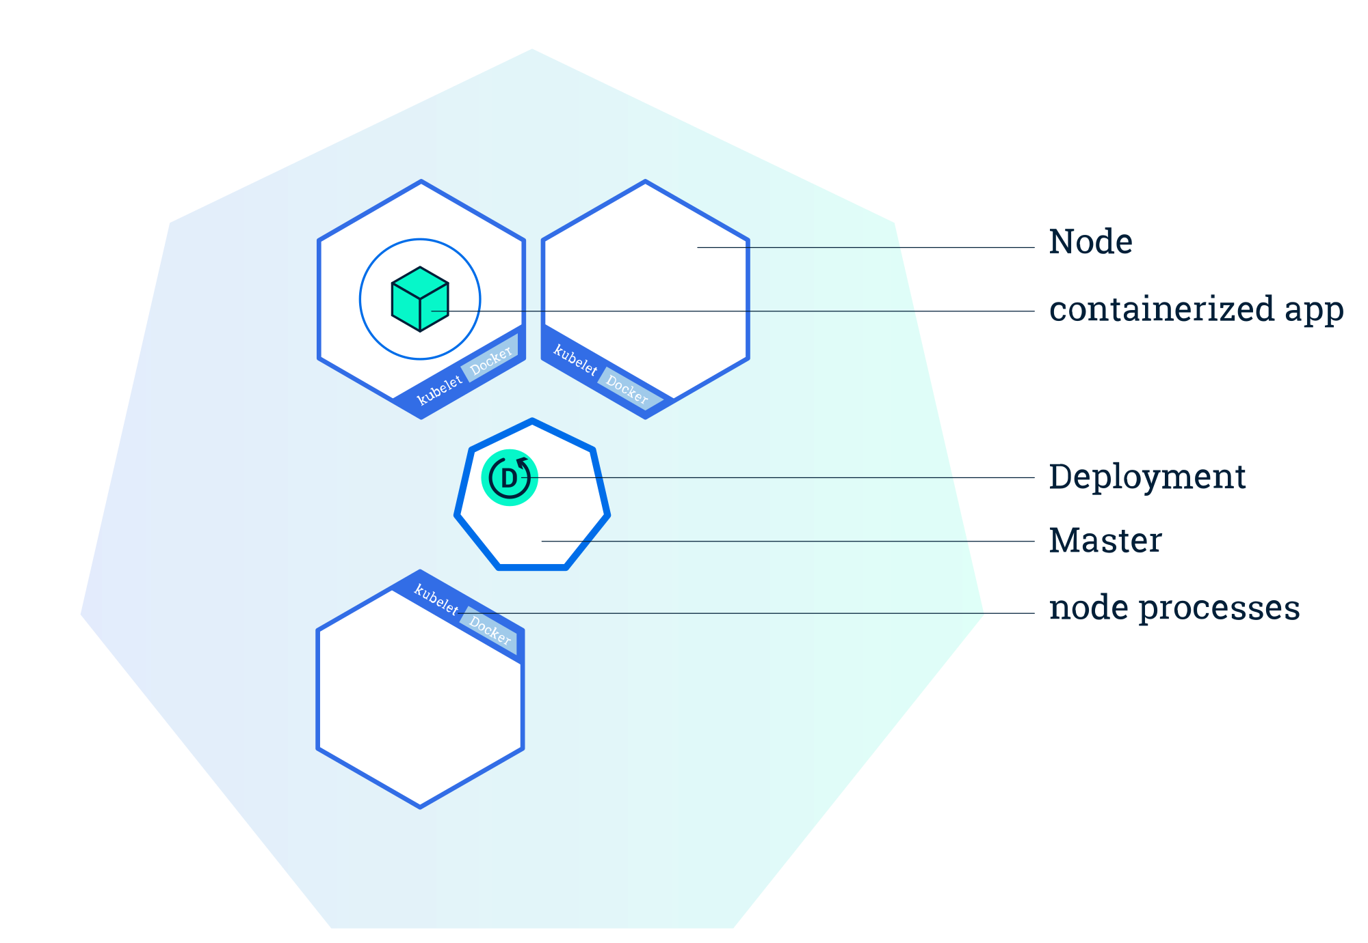
Deploy an app
© 2018 The Kubernetes Authors | Documentation Distributed under CC BY 4.0
Notes:
Besteht aus zwei Komponenten : Master und Kubernetes/Worker Node(s) (Minion(s))

Slide 16
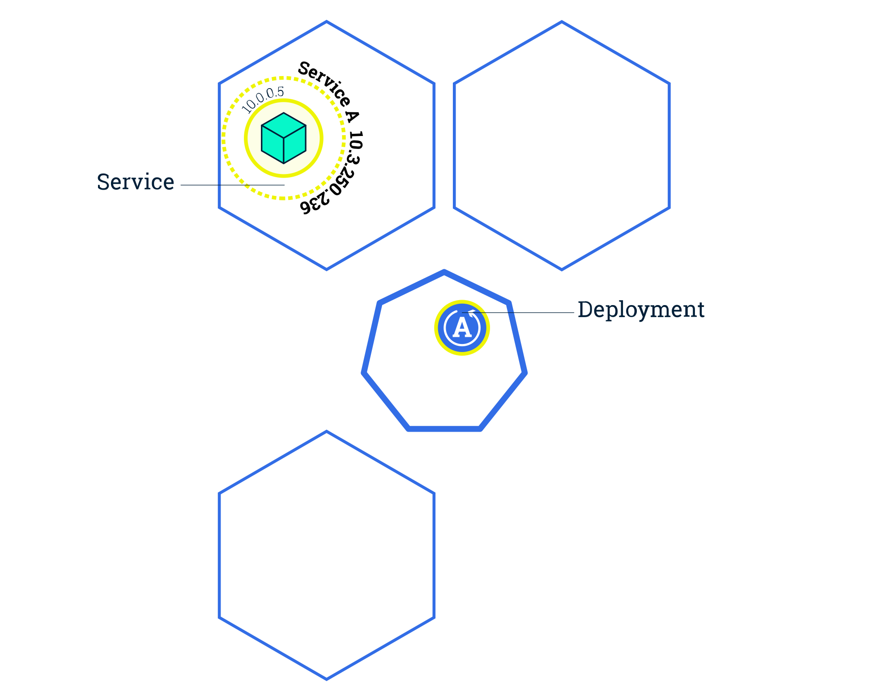
Scaling
© 2018 The Kubernetes Authors | Documentation Distributed under CC BY 4.0
Notes:
Besteht aus zwei Komponenten : Master und Kubernetes/Worker Node(s) (Minion(s))

Slide 17
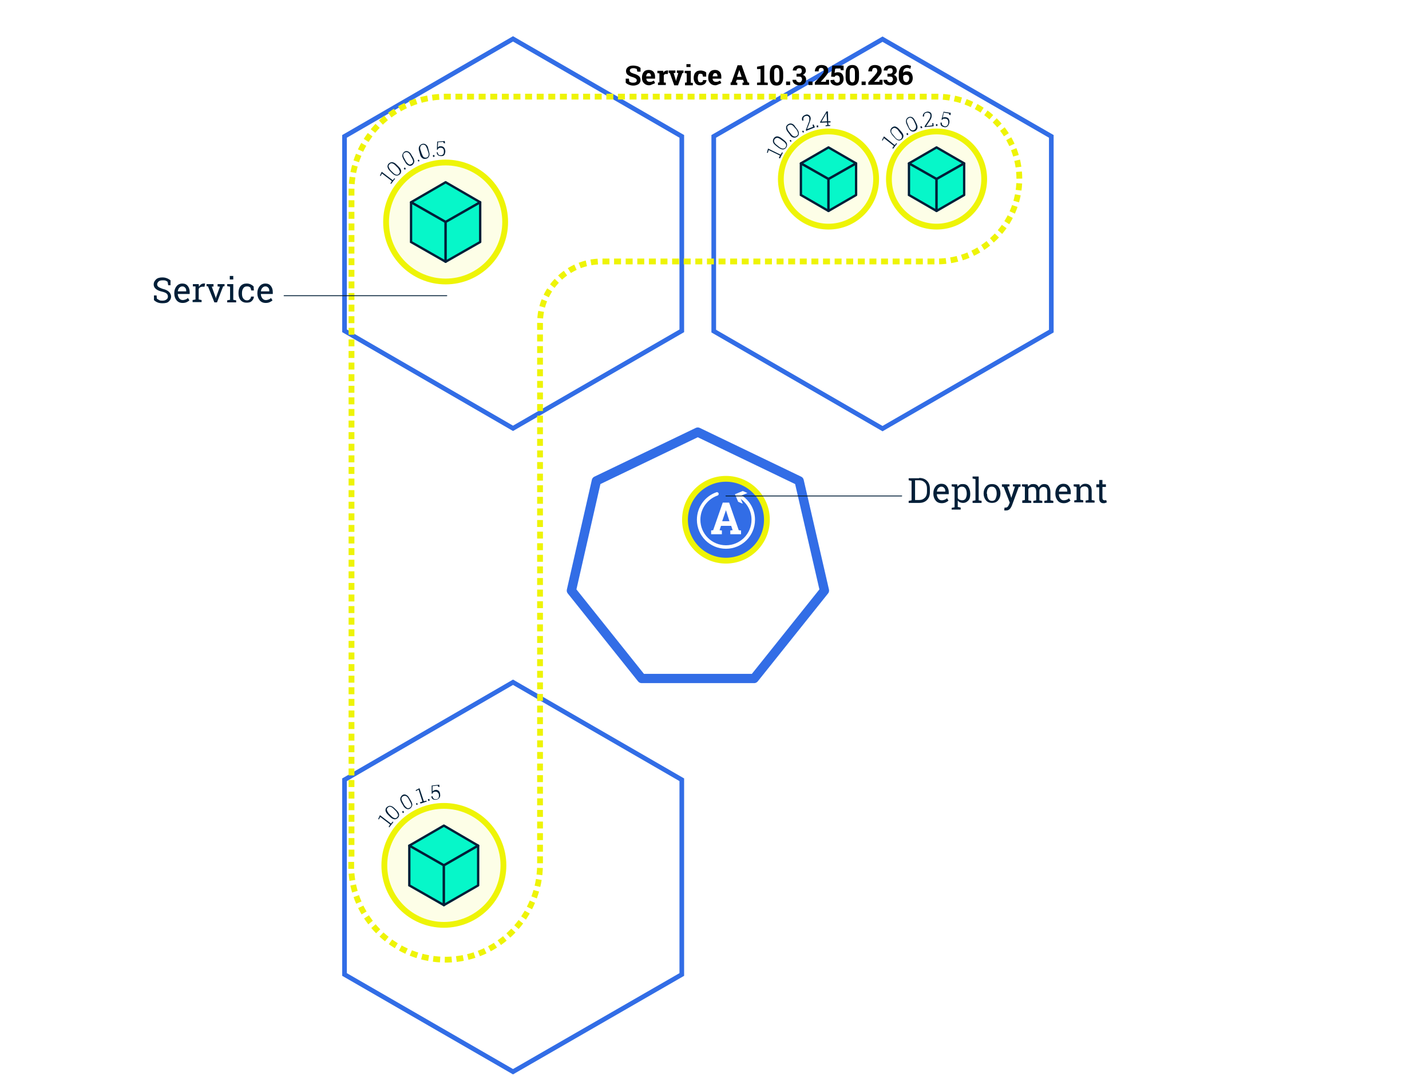
Scaling
© 2018 The Kubernetes Authors | Documentation Distributed under CC BY 4.0
Notes:
Besteht aus zwei Komponenten : Master und Kubernetes/Worker Node(s) (Minion(s))

Slide 18
Communication

Slide 19
Kubernetes – Communication
Highly-coupled container to container communication
Pod to pod communication
Pod to service communication
External to service communication

Slide 20

Kubernetes – Network Model
All containers can communicate with each other without NAT
All nodes can communicate with containers without NAT
The IP address a container sees for itself is the same address everyone else sees
https://kubernetes.io/docs/concepts/cluster-administration/networking/#the-kubernetes-network-model

Slide 21
Perstistent Storage

Slide 22
Persistent Storage
A PersistentVolume (PV) is a piece of storage in the cluster that has been provisioned by an administrator or dynamically provisioned using Storage Classes. It is a resource in the cluster just like a node is a cluster resource. PVs are volume plugins like Volumes, but have a lifecycle independent of any individual pod that uses the PV. This API object captures the details of the implementation of the storage, be that NFS, iSCSI, or a cloud-provider-specific storage system.
A PersistentVolumeClaim (PVC) is a request for storage by a user. It is similar to a pod. Pods consume node resources and PVCs consume PV resources. Pods can request specific levels of resources (CPU and Memory). Claims can request specific size and access modes (e.g., can be mounted once read/write or many times read-only).
https://kubernetes.io/docs/concepts/storage/persistent-volumes/

Slide 23


Persistent storage example
https://app.kube.puzzle.ch
10.0.0.1
10.0.0.2
10.0.0.3
Persistent
Storage
10.0.0.4
Notes:
Via Route im Netz verfügbar
Loadbalancing auf Pods
oc scale dc app --replicas=3
Verbunden über transparentes Software Defined Network (SDN)
Projekt-Setup als JSON exportier- / importierbar

Slide 24

Persistent storage example
https://app.kube.puzzle.ch
10.0.0.1
10.0.0.2
10.0.0.3
Persistent
Storage
10.0.0.4

Slide 25
Persistent storage example
https://app.kube.puzzle.ch
10.0.0.1
10.0.0.2
10.0.0.3
Persistent
Storage
10.0.0.4
Notes:
Pod wird neu gestartet
Gleiche Adresse
Persistent Volume wandert mit

Slide 26
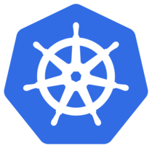
RedHat OpenShift vs. vanilla Kubernetes

Slide 27
RedHat OpenShift vs. Kubernetes
RedHat OpenShift only on RHEL, Kubernetes on any OS
OpenShift templates are less flexible than Kubernetes Helm charts
Routers on OpenShift vs. Ingress on Kubernetes
  OpenShift with HAProxy or F5 BIG-IP
  Kubernetes with more Options (NGINX, traefik, HAProxy etc)
A different approach to deployments. Deployment (Controller) vs. DeploymentConfig (controller by ded. Pods, Hooks/Trigger)

Slide 28
RedHat OpenShift vs. Kubernetes
OpenShift has more strict security policies than default Kubernetes
  Most of container images available on Docker Hub won’t run on OpenShift, as it forbids to run a container as root and even many of official images don’t meet this requirement.
Better management of container images
  ImageChange Trigger, chained builds
Integrated Image Registry
Bundeld with Logging & Monitoring

Slide 29
RedHat OpenShift vs. Kubernetes
OpenShift projects are more than Kubernetes namespaces
  trivial things such as description and display name
  Default Objects (Roles, Default Quotas, etc)
OpenShift is easier for beginners
  oc has support for logging to OpenShift cluster - with kubectl you need to obtain your credentials and create your kubeconfig
  oc lets you switch between projects/namespaces while kubectl doesn’t (you need exernal tools such as kubens/kubectx)
  oc allows you to build a container image from a source and then deploy it onto environments with a single command! (oc new-app)

Slide 30
RedHat OpenShift vs. Kubernetes
Integrated CI/CD with Jenkins
Source-to-image (S2I) / Build Pipeline

Slide 31
Hands On Lab
3

Slide 32
Hand on Lab
URLs
https://github.com/puzzle/kubernetes-techlab/tree/rancherversion
https://github.com/puzzle/kubernetes-techlab/archive/rancherversion.zip https://rancher.puzzle.ch
Accounts
Username : LDAP Account
Password : ...
Project : Team [1-15]
Cluster : techlab

Slide 33
Remarks
* Create Namespaces via Rancher WebGUI, otherwise they are not assigned to your project (or ask your teacher to assign the namespace to your project)

Slide 34
Kubernetes – Architecture
4

Slide 35
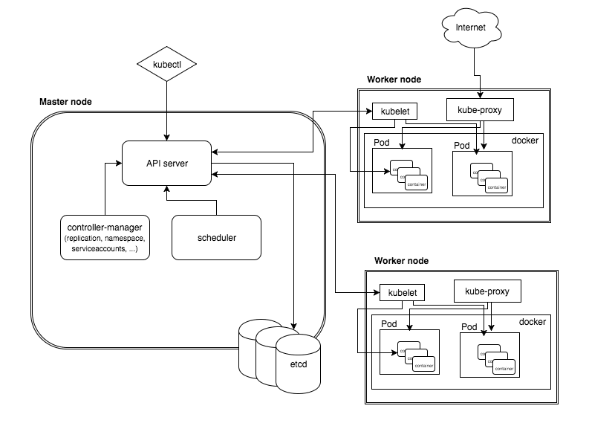
High Level Architecture

Slide 36
Master Node
The master node is responsible for the management of Kubernetes cluster. This is the entry point of all administrative tasks. The master node is the one taking care of orchestrating the worker nodes, where the actual services are running.

Slide 37
Master Node – Components - 1
API Server
The API server is the entry points for all the REST commands used to control the cluster. It processes the REST requests, validates them, and executes the bound business logic. The result state has to be persisted somewhere, and that brings us to the next component of the master node.
Etcd storage
etcd is a simple, distributed, consistent key-value store. It provides a REST API for CRUD operations as well as an interface to register watchers on specific nodes, which enables a reliable way to notify the rest of the cluster about configuration changes.

Slide 38
Master Node – Components - 2
scheduler
The deployment of configured pods and services onto the nodes happens thanks to the scheduler component.
The scheduler has the information regarding resources available on the members of the cluster, as well as the ones required for the configured service to run and hence is able to decide where to deploy a specific service.
controller-manager
A controller uses apiserver to watch the shared state of the cluster and makes corrective changes to the current state to change it to the desired one.
An example of such a controller is the Replication controller, which takes care of the number of pods in the system. The replication factor is configured by the user, and it's the controller’s responsibility to recreate a failed pod or remove an extra-scheduled one.

Slide 39
Worker Node
The pods are run here, so the worker node contains all the necessary services to manage the networking between the containers, communicate with the master node, and assign resources to the containers scheduled.

Slide 40
Worker Node – Components - 1
Docker
Docker runs on each of the worker nodes, and runs the configured pods. It takes care of downloading the images and starting the containers.
kubelet
kubelet gets the configuration of a pod from the apiserver and ensures that the described containers are up and running. This is the worker service that’s responsible for communicating with the master node.
It also communicates with etcd, to get information about services and write the details about newly created ones.

Slide 41
Worker Node – Components - 2
kube-proxy
kube-proxy acts as a network proxy and a load balancer for a service on a single worker node. It takes care of the network routing for TCP and UDP packets.
kubectl
And the final bit – a command line tool to communicate with the API service and send commands to the master node.

Slide 42
Resource Management
5

Slide 43

Kubernetes – Helm
Notes:
Automatisiert das einrichten, betreiben und skalieren von Containerumgebungen

Slide 44
Kubernetes – Helm
Chart: Kubernetes resources package
Repository: Collection of public charts
Release: Load Chart Instance
Notes:
Kubernetes Package Manager
Packages are called Helm Charts
Chart is a collection of k8s manifest templates to create an instance of a k8s application

Slide 45
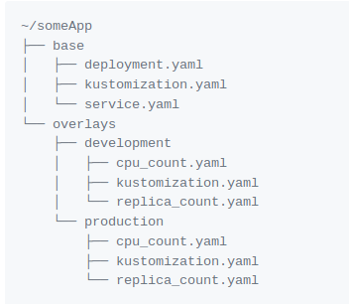
Kubernetes – Kustomize
Notes:
Kustomize: config Management mit dem man die standard templates für Applikationen/Services/etc. erweitern/überschreiben in abhängigkeit der jeweiligen Umgebung überschreiben kann ; Vorteil : Mann überschreibt dabei nicht das Original sondern schreibt pro Namespace eine zusätzliche Konfiguration

Slide 46

Thank you!

