Slide 1
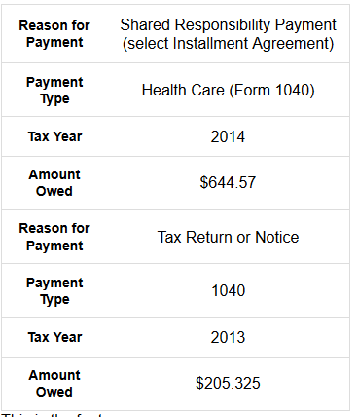
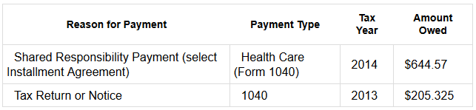
Wide View (transformed via adaptive CSS)
Mobile View (default presentation)
Table
TR (Headers)
.wide-table-header-row
{ display: none}
TH
TH
TH
TH
TBody
TR
TH
TD
TR
TH
TD
TR
TH
TD
TR
.mobile-only {display: none }
TH
TD
TBody
TR
TH
TD
.wide-table-row { display: table-row; }
TR
TH
TD
TR
.wide-table-cell { display: table-cell; }
TH
TD
TR
TH
TD
.wide-table-cell > td { display: inline; }

