Slide 1
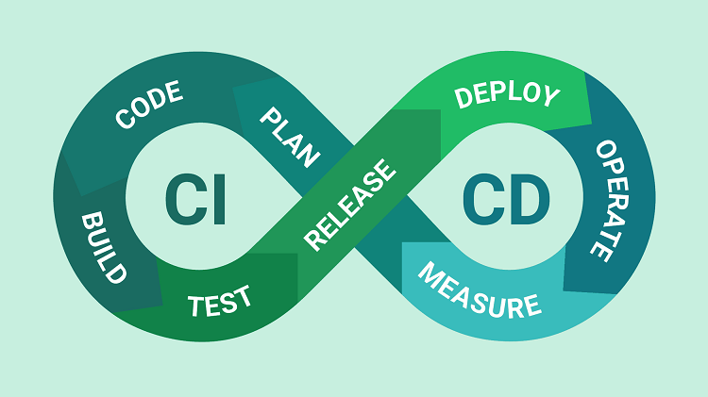
THE BENEFITS OF CI/CD MODEL

Slide 2
Speed up development and deployment
CI/CD enables automation of software testing, building, testing, and deployment. This reduces the time and effort required to develop and deploy new or updated applications. The result is faster product release, which increases revenue by quickly delivering value to customers.

Slide 3
Reduced risk of software failure
CI/CD enables continuous and automated testing to detect bugs early in the software development process. By reducing the number of bugs and issues encountered in the application, businesses can avoid losing revenue due to problems or negative customer feedback

Slide 4
Increase responsiveness and competitiveness
Using CI/CD allows businesses to react quickly and flexibly to market changes or customer requirements. Rapid and continuous deployment gives businesses a competitive advantage and the ability to quickly adapt to new requirements.

Slide 5
Control and reduce costs
CI/CD helps control and reduce software development costs. By automating development, testing, and deployment processes, the time and effort required is reduced. In addition, early fault detection helps to avoid complicated and costly problems to repair later, helping to reduce maintenance costs.

