Slide 1
Automated Lab Setup in Horizon for VirtualBox using Selenium
By: Joseph Barber

Slide 2
Introduction
What is Selenium?
How Selenium works
Current Project Status
Future Possibilities
Demo

Slide 3
What is Selenium?
Tool to automate the testing of web pages
Selenium is available in different languages, e.g. a Python module
Selenium IDE auto generates code by recording actions executed manually
Fast development

Slide 4
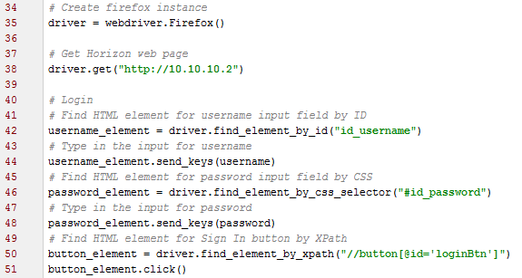
How Selenium works
Python:

Slide 5
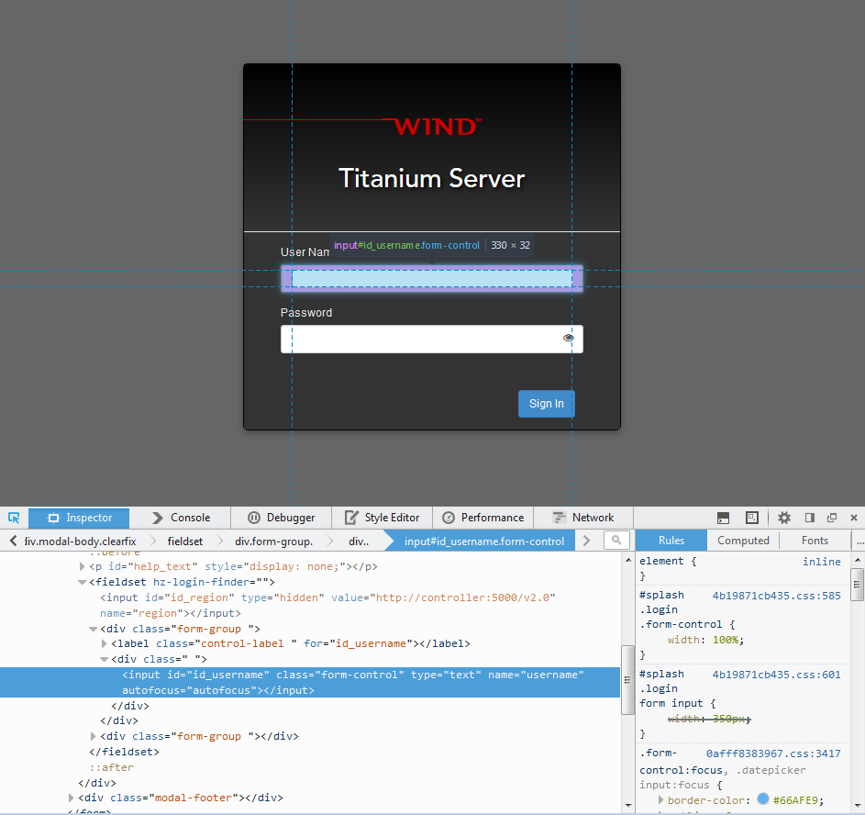
How Selenium works
Firefox:

Slide 6
Current Project Status
Automated lab setup in Horizon using Selenium for VirtualBox
Developed reusable modules for automating future test cases in Horizon
Headless mode: run as a background process
Created documentation on the basics of Selenium and README for the automated lab setup in Horizon

Slide 7
Future Possibilities
Run lab setup for any lab in Horizon other than VirtualBox
Automate tests in Horizon instead of manual execution
Expand code and create modules that cover all of Horizon features
Automate tests using a combination of Horizon and CLI
Enhance sanity or regression testing by adding Selenium automation tests

Slide 8
Demo
Lab setup in Horizon in VirtualBox

