Slide 1
Inventory Management System (IMS)
QA-Training
Final Presentation
-Vaidehee Patel

Slide 2
Agile
Scope and Project Vision
Product Backlogs
Sprint
  Sprint planning
  Implementations
  Sprint review
  Sprint retrospective
Deployment
JIRA

Slide 3
MoSCoW Prioritisation
Must Have – minimum req. CURD functanality for coustomer order and item entities
Should Have – access restrictions. So that the coustomers are not able to change the items info/ other coustome's info/ other coustomer's orders
Could Have – seperation of end user interface into sub-interfaces for the coustomers and system developers
Won't Have – images for each item

Slide 4
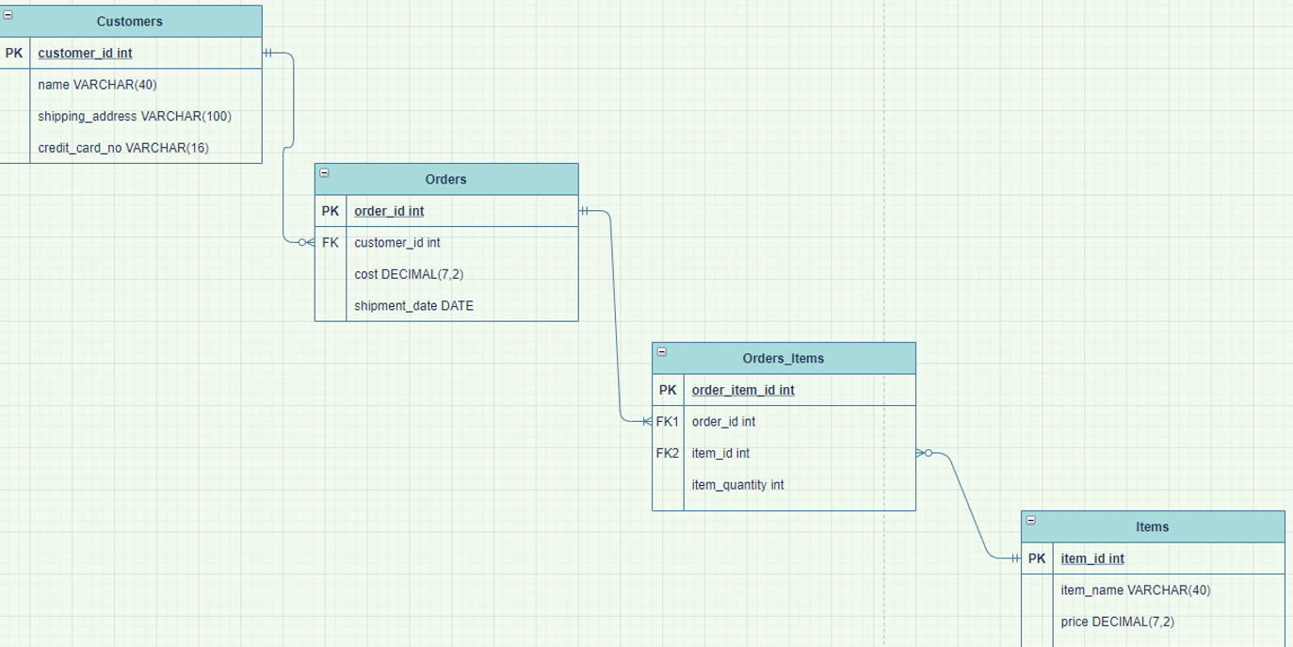
Entity Relationship

Slide 5
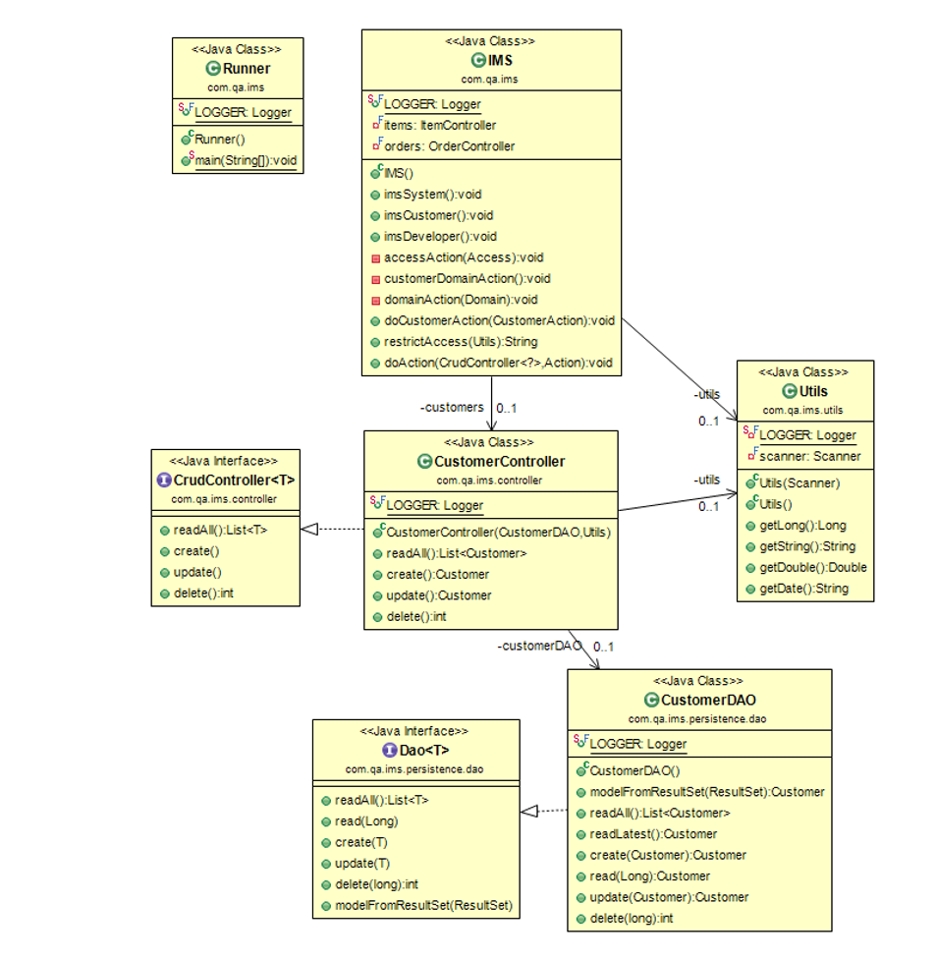
UML

Slide 6
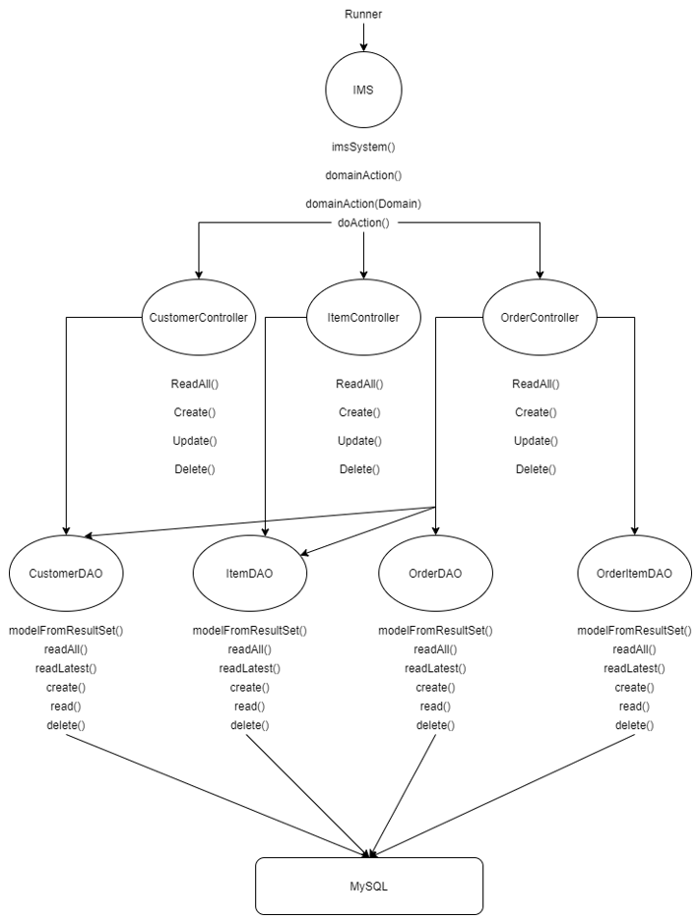
ERD

Slide 7
JIRA

