Slide 1


Design Engineering 2B Semester - 6 (2018-19)
Title: OPTICAL CHARACTER RECOGNITION SYSTEM
Prepared by
Enrollment No: 1. Ahmed Godil 160420111003 2. Archana Bajari 160420111006 3. Parantap Vakharwala 160420111031 4. Lakshesh Vyas 160420111060
Guide :Prof. Sarosh Dastoor
Class :B.E.3rd Year
Semester : 6th Semester
Year : 2018-19
Department Of Electronics & Communication Engineering
Sarvajanik College of Engineering & Technology
Dr R.K. Desai Road, Athwalines, Surat - 395001, India

Slide 2
Flow of Presentation
Introduction
Motivation
Objective
Work done in DE-IIA
Work done in DE-IIB
Literature Review
Overall Block Diagram
Software Requirement
Result
Planning till DE-IIB end
Summary
References

Slide 3
MOTIVATION
With the advent of computer science we have increasing availability to more powerful computers. Thus by the help of neural network we could train a system to interpret alpha numeric characters.
Neural Network is the backbone for identification of characters

Slide 4
INTRODUCTION
Optical Character Recognition (OCR) is to classify optical patterns corresponding to alphanumeric or other characters.
It is a type of document image analysis where a scanned digital image that contains either machine printed or handwritten script is input into an OCR software engine.
OCR works by pre-processing the digital page image into its smallest component parts with layout analysis to find text blocks, sentence/line blocks, word blocks and character blocks.

Slide 5
Objective :
Optical Character Recognition
• Input: scanned images of printed text
• Output: Computer readable version of input contents
There are several existing solutions to perform this task for English text.
The potential benefits of this approach is its flexibility, since it makes no prior assumptions on the language of the text, and it should be possible to extend it to other alphabets.

Slide 6
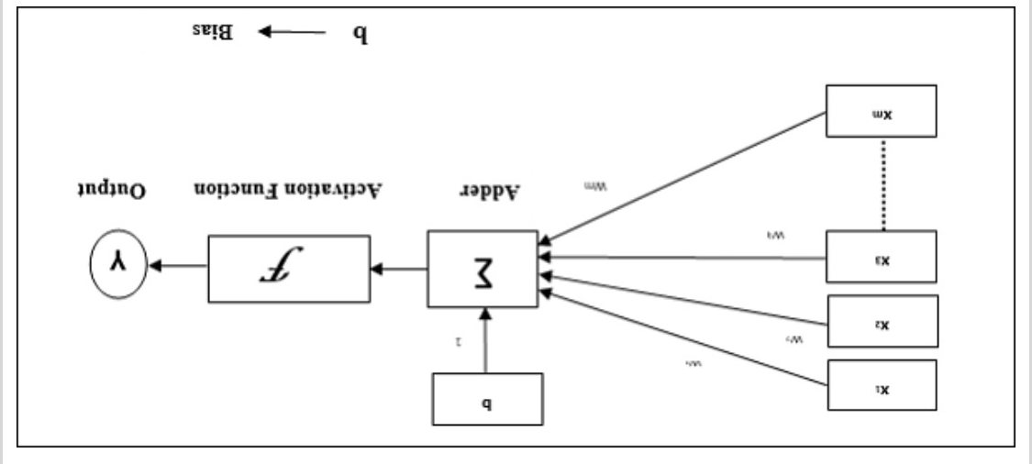
ARTIFICIAL NEURAL NETWORK
A neural network can be defined as a model of reasoning based on the human brain. The brain consists of a densely interconnected set of nerve cells, or basic information-processing units, called neurons.
An artificial neural network consists of a number of very simple processors, also called neurons, which are analogous to the biological neurons in the brain.

Slide 7
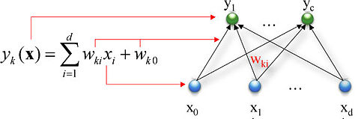

The neurons are connected by weighted links passing signals from one neuron to another.
The neuron computes the weighted sum of the input signals and compares the result with a threshold value,
The neuron uses the following transfer or activation function:

Slide 8
Feedforward neural network
A feedforward neural network is an artificial neural network wherein connections between the nodes do not form a cycle.
In this network, the information moves in only one direction, forward, from the input nodes, through the hidden nodes (if any) and to the output nodes.

Slide 9
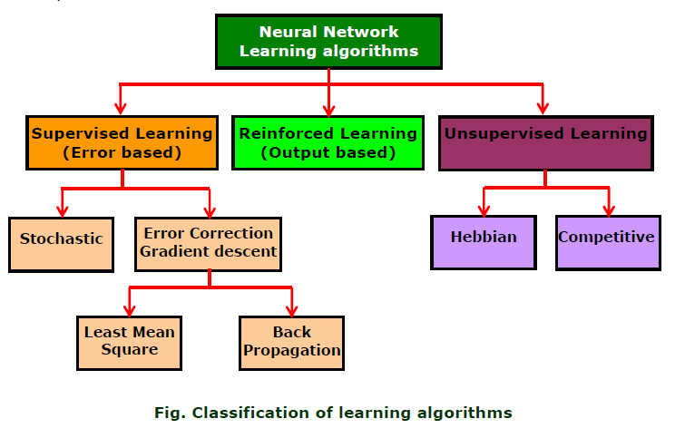

Slide 10
SUPERVISED LEARNING
Supervised learning is where you have input variables (x) and an output variable (Y) and you use an algorithm to learn the mapping function from the input to the output.
It is called supervised learning because the process of an algorithm learning from the training dataset can be thought of as a teacher supervising the learning process.

Slide 11
Work done in DE-IIA
Completed basic feed forward network algorithm in matlab.
Trained the network for limited number of characters ranging from A-Z i.e. Capital A to Z.

Slide 12
Work done in DE-IIB
Experimented with different neural network algorithms such as back propagation.
Worked with various data sets such as numbers and different characters. i.e Small a-z and 1-0 in numerics.

Slide 13
Literature Review
Literature review in divied into two sections as followed:
RECOGNITION
Klouver's research on recognition text in PayPal HIP and Ho Co. He researched on License Plate Recognition(LPR) used Templates Matching to recognize the character in image.
Klouver detailed the matching classifier into four types of classifier that are
Pixel Counting
Horizontal Projection
Vertical Projection
Template Correlations.

Slide 14
Literature Review
SEGMENTATION
Study on Malaysian License Plate Recognition by Othman proposed a modal specifically to detect and recognize the text in Malasian license plate.
For segmentation, connected components method has been proposed however this method only can use if the license plate are single row license plate.

Slide 15
BLOCK DIAGRAM
Image obtained from database
Foreground/
background Separation
Characters Segmentation
Feature Extraction
Thresh-old check
Decision
Pattern Matching
Yes
DB Templates
No

Slide 16
Software Requirement
Matlab R2012 or greater

Slide 17
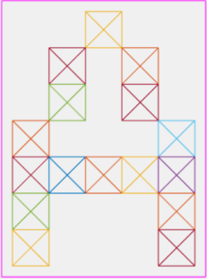
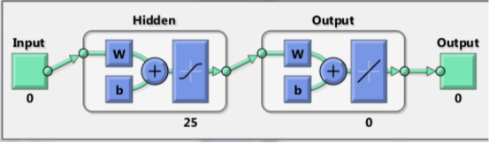
Results
Input to ANN without noise
Neural Chart for 0 Noise

Slide 18
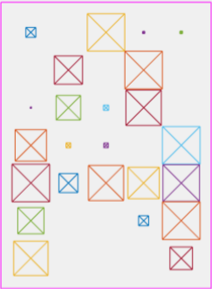
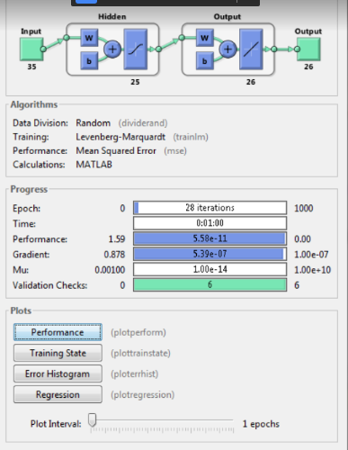
Input With Noise to ANN
Neural Chart for Noise Input

Slide 19
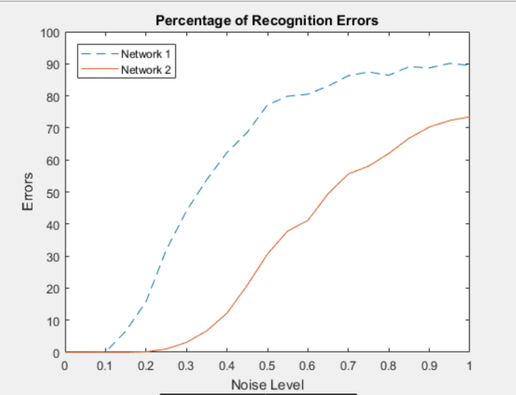
Gradient of recognition errors on application of noise

Slide 20
Planning till DE-IIB end
Improving the algorithm for more efficient recognition.
Increasing the number of recognizable fonts.

Slide 21
Summary
During this entire Design Engineering session we learned about various neural networks.
Studied different algorithms.
To achieve more efficiency we will require a more robust network solution such as CNN.

Slide 22
References
[1] Christine Guillemot and Olivier Le Meur , “ IMAGE INPAINTING OVERVIEW AND RECENT ADVANCES ,” IEEE SIGNAL PROCESSING MAGAZINE, JANUARY 2014
[2] M. Bertalmio, L. Vese, G. Sapiro, and S. Osher, “Simultaneous structure and texture image inpainting,” IEEE Trans. Image Processing, vol. 12, no. 8, pp. 882–889, Aug. 2003.
[3] Z. Xu and J. Sun, “Image inpainting by patch propagation using patch sparsity,”IEEE Trans. Image Processing, vol. 19, no. 5, pp. 1153–1165, May 2010.
[4] Takahiro Ogawa* and Miki Haseyama , “ Image inpainting based on sparse representations with a perceptual metric ,”EURASIP Journal on Advance in Signal Processing a Springer Journal.
[5] A. Bugeau, M. Bertalmio, V. Caselles, and G. Sapiro, “A comprehensive framework for image inpainting,” IEEE Trans. Image Processing, vol. 19, no. 10, pp. 2634–2645, Oct. 2010.
[6] A. Criminisi, P. Pérez, and K. Toyama, “Region filling and object removal by examplar-based inpainting,” IEEE Trans. Image Processing, vol. 13, no. 9, pp. 1200–1212, Sept. 2004
[7] M. Bertalmio, G. Sapiro, C. Ballester, and V. Caselles, “Image inpainting,” in Proc. ACM SIGGRAPH, July 2000, pp. 417–424.

Slide 23
Thank you

