Slide 1
EDA on US Road Accidents
Pradeep Kumar Vallepalli

Slide 2
Project Objective
The main purpose of analyzing the data within this US Accidents dataset, is to first fully understand the various variables and predict the severity of the accident.
What is the current trend of yearly car accidents?
What is the percentage of accident occurrences during the day? How about during the night?
What are the top cities with the most accidents within the US?
What times are accidents most likely to occur within a day? What about weekly? Yearly?
What time during the season/month are accidents highest?
Find accuracy of the model

Slide 3
Variables used from the dataset
State - Name of the US state found in the address of the accident.
City – Name of the city in the address record
County – Name of the county in the address record
Start Time - Start time of the accident in the local time zone.
Temperature - Temperature at the time of the accident in degrees Fahrenheit
Weather Condition - The description of the weather condition at the time of the accident, such as, “Fair”, “Cloudy”, “Clear” etc.
Visibility - Visibility at the time of the accident in miles
Severity – Severity of the accident rated from 1 to 4. 1 is minor injuries and 4 is Major life threating

Slide 4
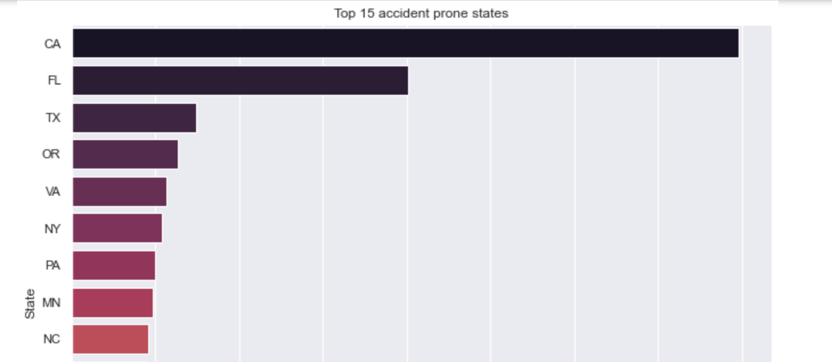
Histograms (1/7)
The top 3 states are California, Florida, Texas

Slide 5
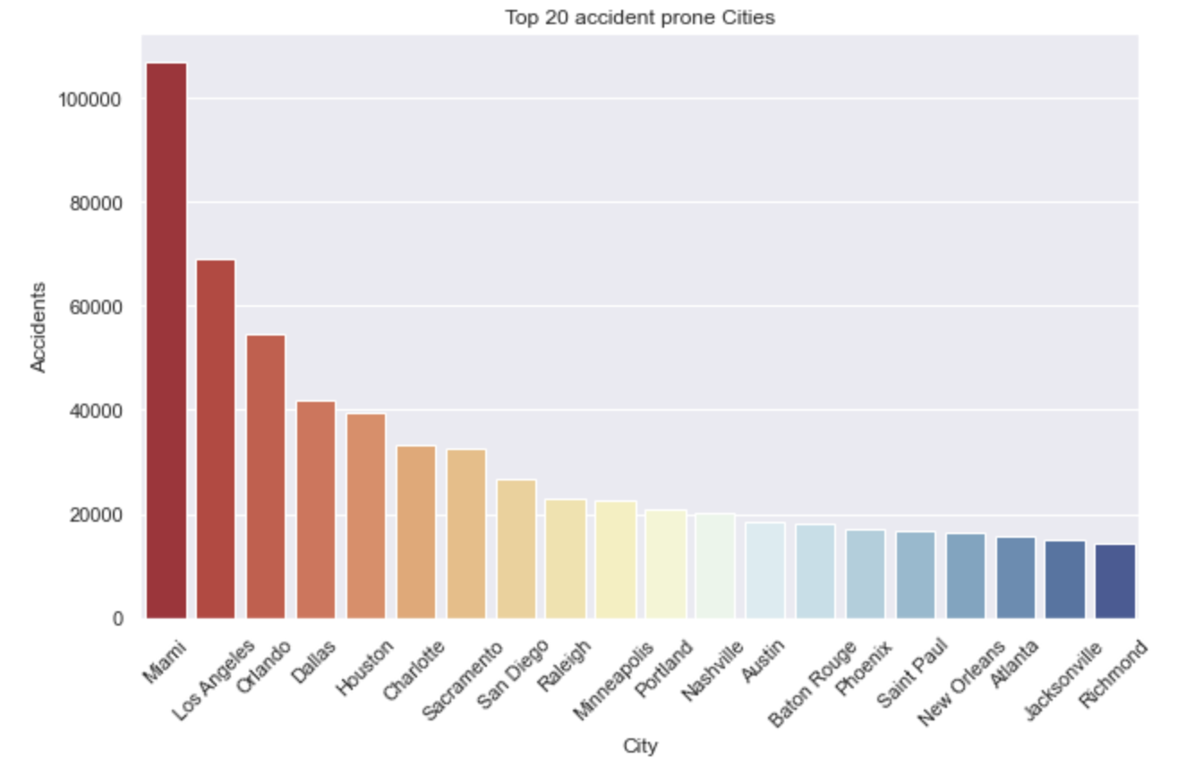
Histograms (2/7)
The below top cities include Miami, Los Angeles, Orlando, Dallas, Houston, Charlotte, etc.

Slide 6
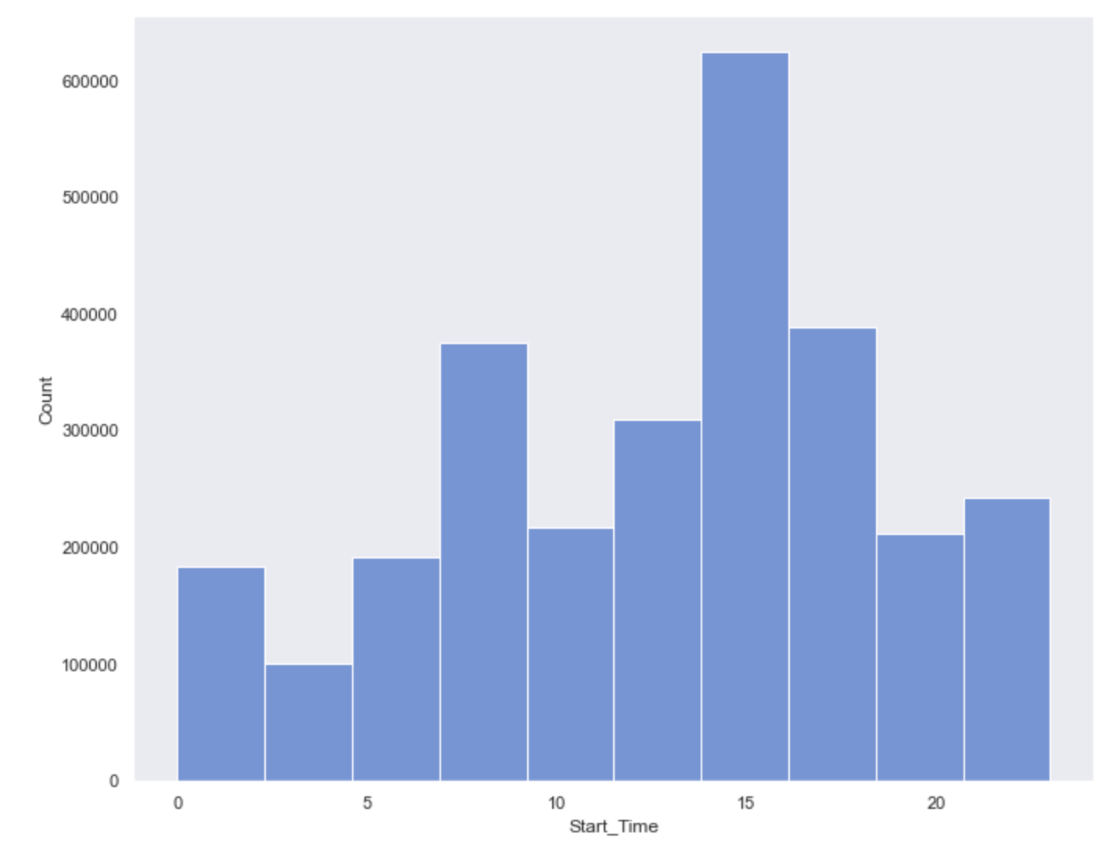
Histograms (3/7)
There are two peaks of time - one in the morning in between 6 am to 9 am and another between 3 pm and 6 pm.

Slide 7
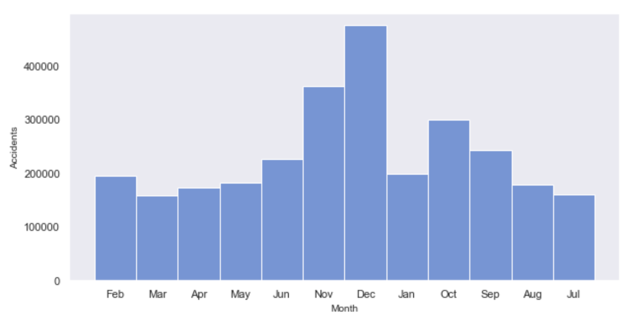
Histograms (4/7)
Peak number of accidents seem to occur during November and December indicating the holiday season

Slide 8
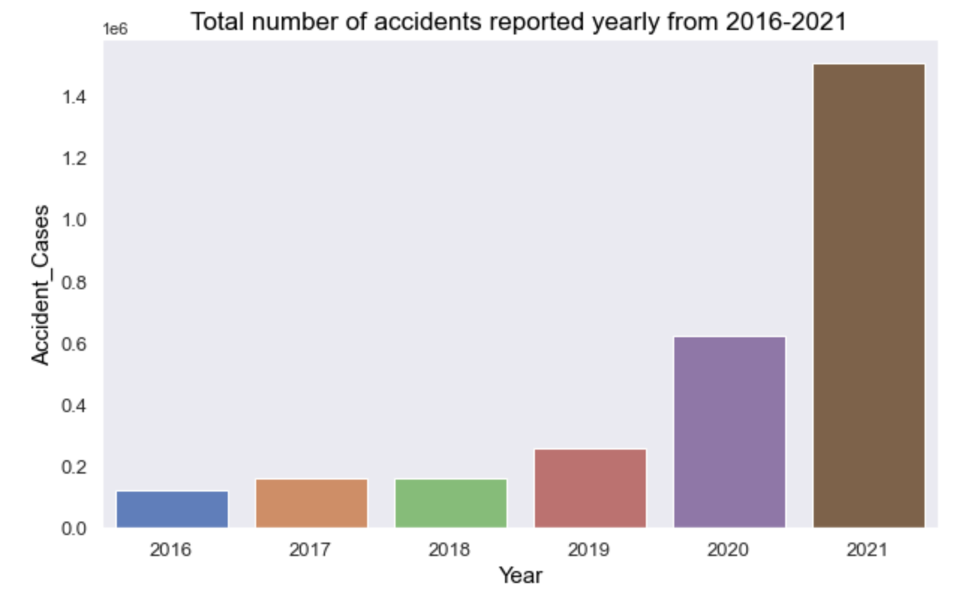
Histograms (5/7)
Such an increase in 2021 is surprising. The less vehicles on the road and police patrol could be one of the main reasons for this.

Slide 9
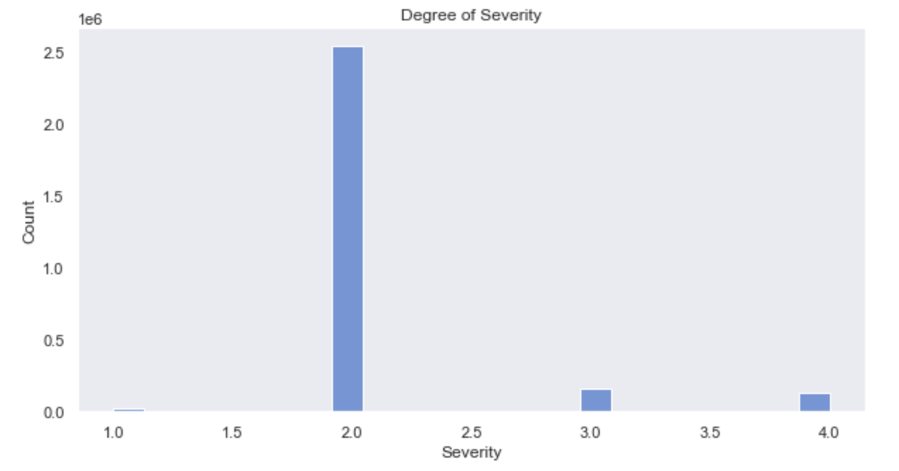
Histograms (6/7)
Majority of accidents reported were severity level 2

Slide 10
Histograms (7/7)
Weather condition during majority of the accidents is Fair and mostly cloudy indicating other factors as root cause.

Slide 11
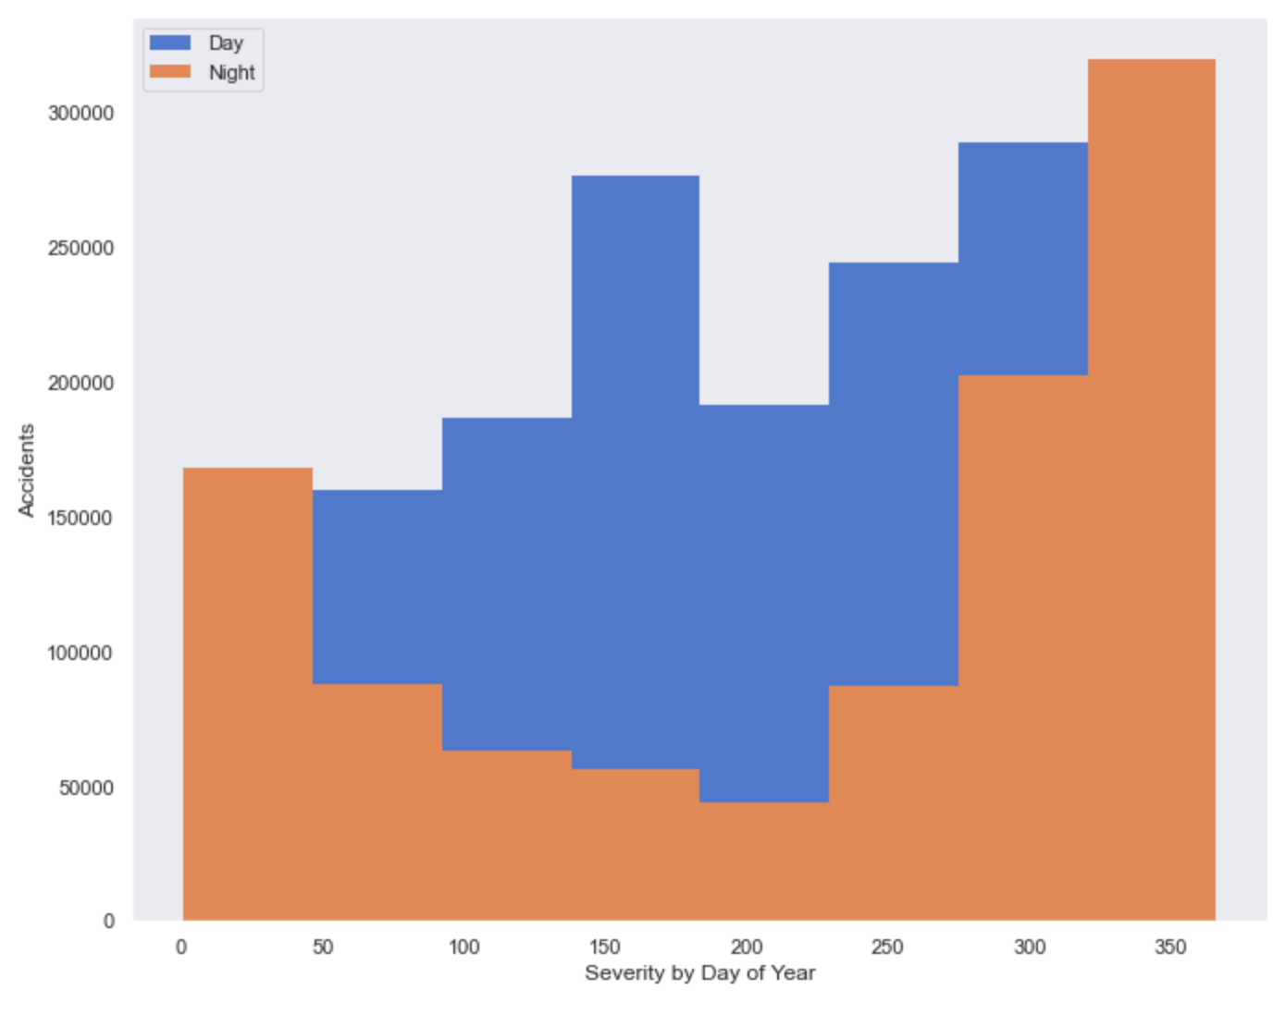
Probability Mass Function
PMF function between accidents during day and night throughout each day of the year indicates Majority of accidents that occurred during night were in November, December and January indicating driving under influence during holidays.

Slide 12
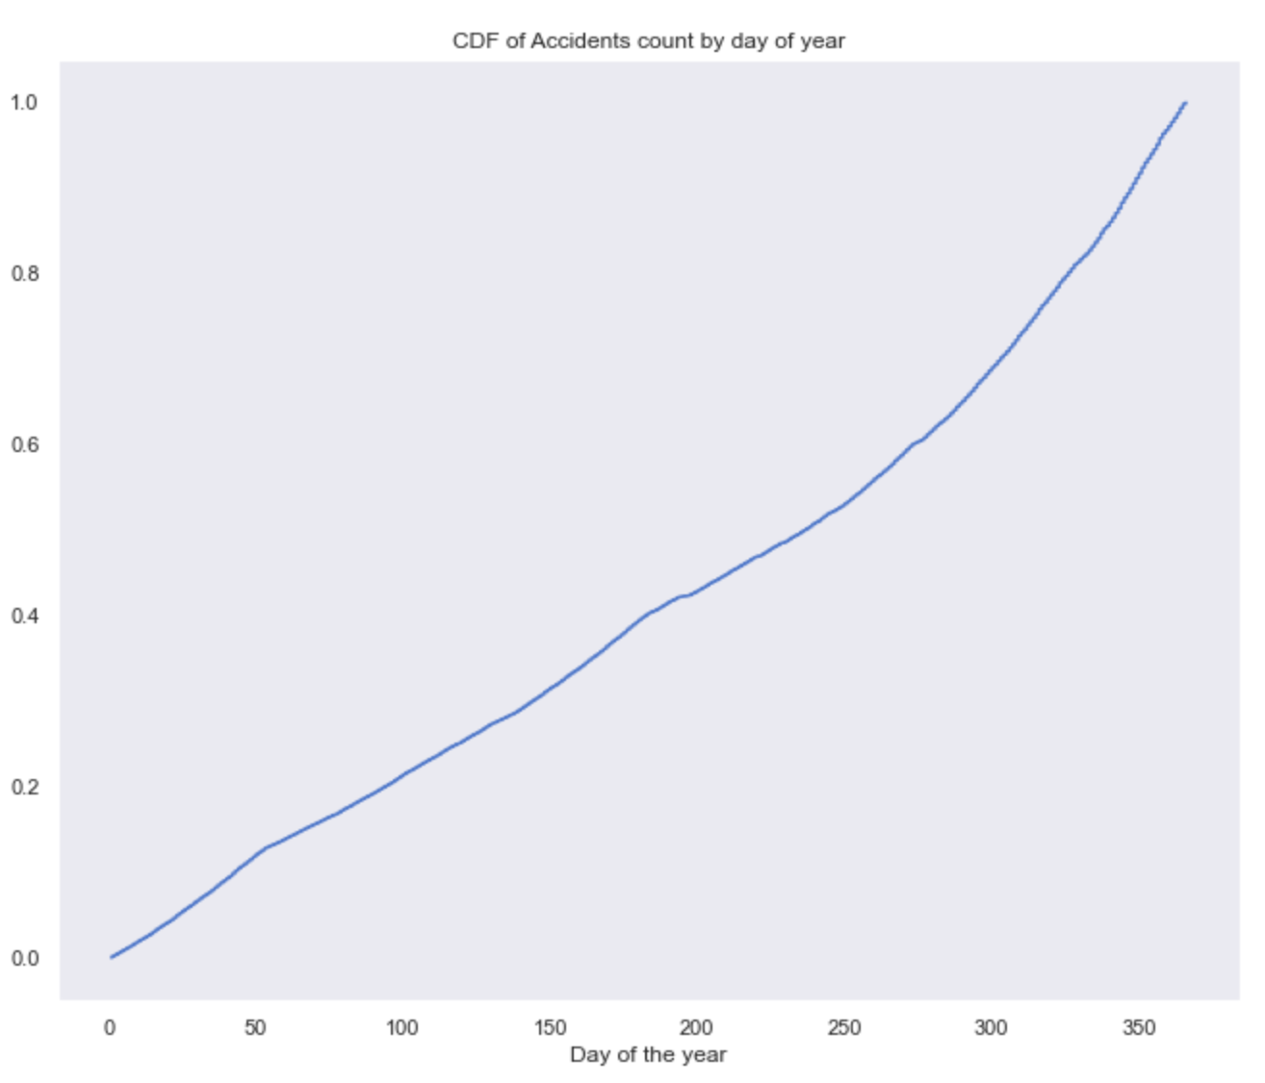
Cumulative Distribution Function
CMF indicates the steady upward trend of accidents throughout the year till December

Slide 13
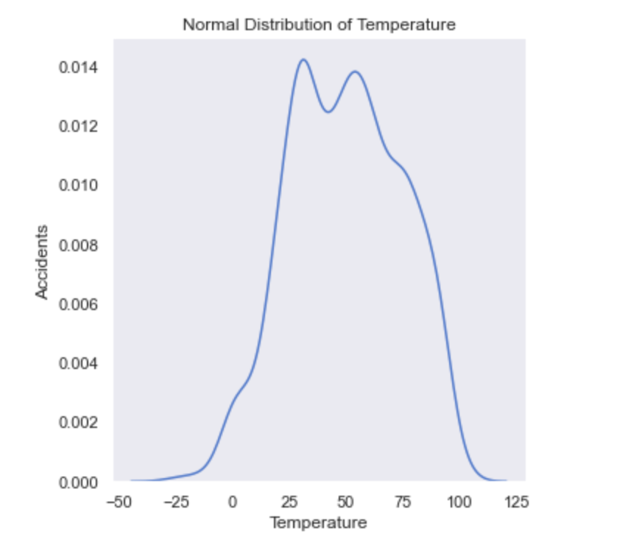
Gaussian distribution
It can be seen from the plot that temperature during the most of the accidents is between 15 to 25 and 50 to 70 degrees indicating cold weather and other factors as cause for the accidents.

Slide 14
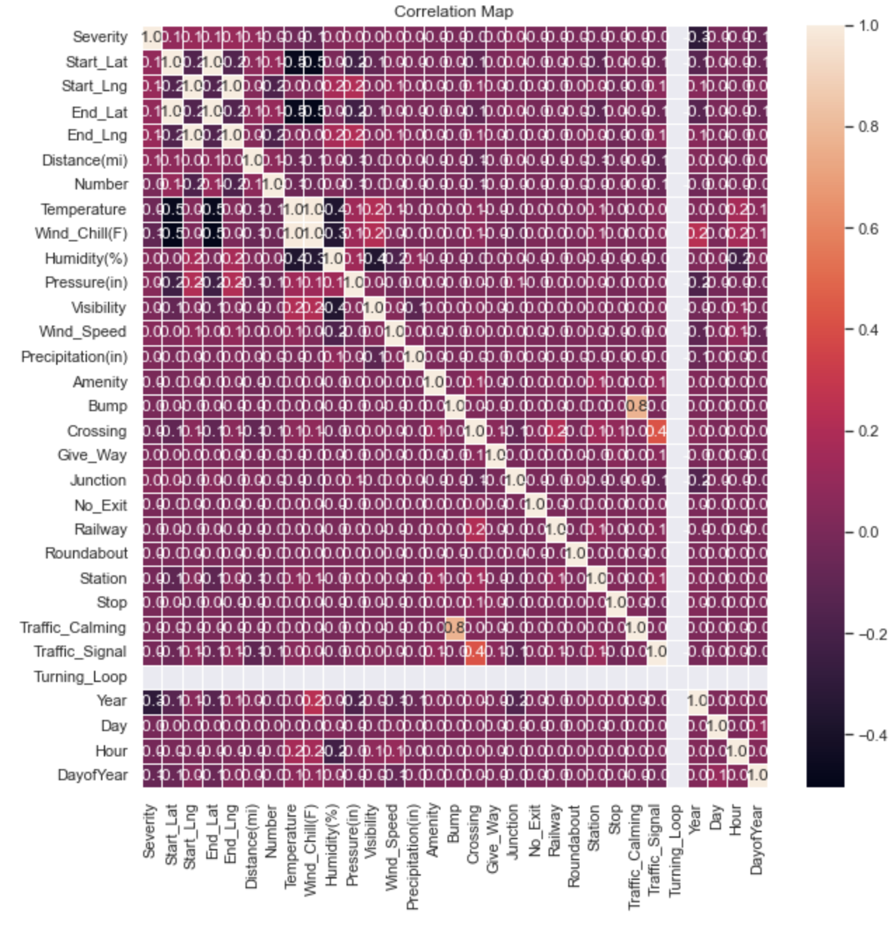
Correlation
Strength of the relationship between two variables.This is the correlation or heat map for all the features of my project ranging values from -1 to 1
Covariance and Pearson’s correlation are negative indicating the variable change in other direction when one variable changes
Pearson correlation: -0.0052207539330788874

Slide 15

Covariance
Covariance between Severity and Day of Week: -0.00466308325
Covariance between Severity and Year: -0.2131803550912

Slide 16
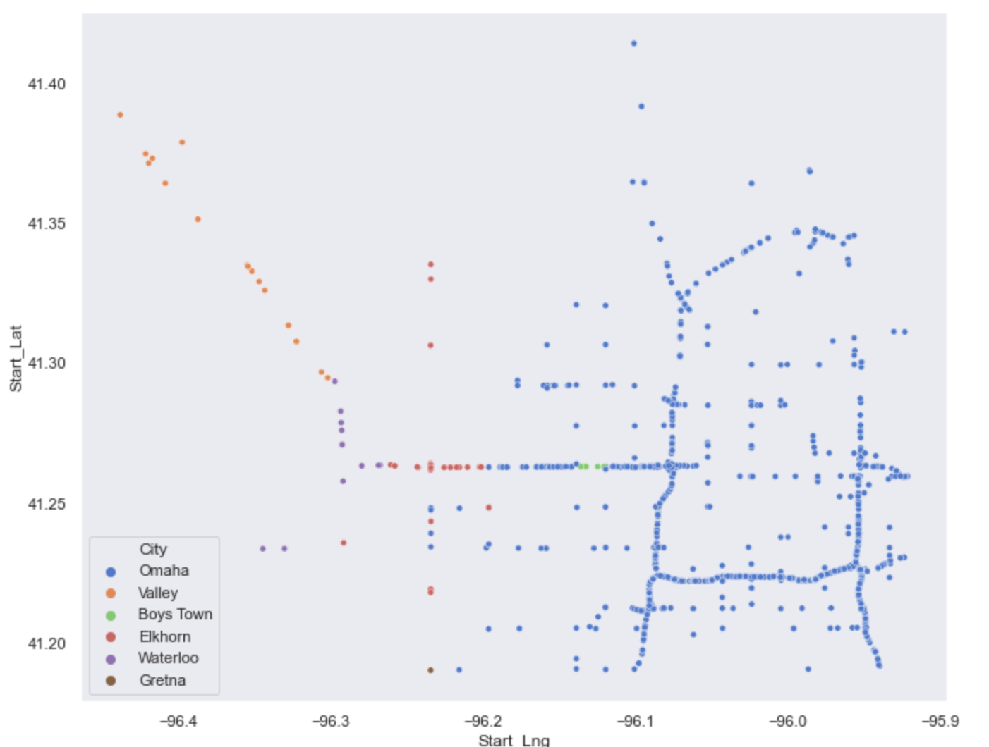
Scatter plot
This plot helps in identifying where the majority of accidents occurred in the Douglas county
Majority of accidents seems to be on the I80 in Omaha

Slide 17
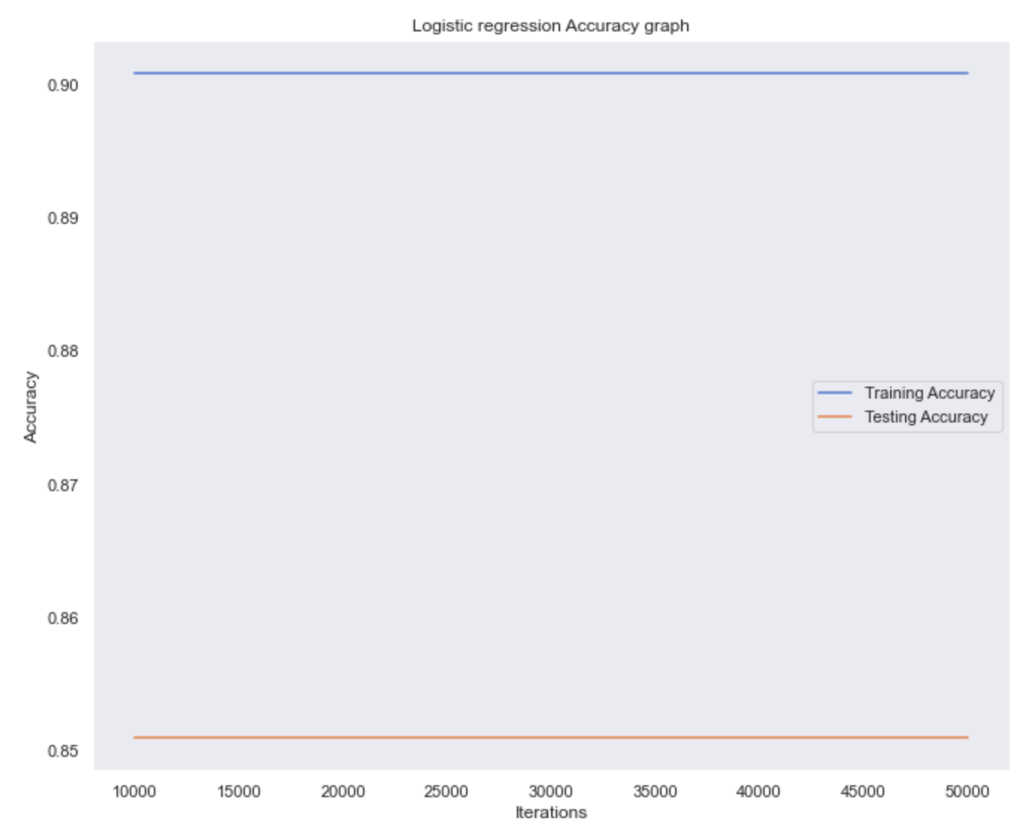
Logistic regression model
Based on the variables from the dataset, I built a logistic regression model to predict the severity of the road accidents by State and County. The accuracy of the model is around 86%

Slide 18
Conclusion
The project analyzed various parameters on accident occurrence and the following insights have been found
The severity of an accident is dependent on all the other independent variables that are given within this dataset, such as the time, date, distance, latitude, temperature, humidity, and so on. More serious severities that account for incapacitating or fatal accidents, can usually mean a longer time, traffic that reaches out a farther distance, to the type of weather or season that was present during that accident.
Therefore, we can conclude that throughout our data exploratory analysis, that traffic accidents within the US have been getting much worse

Slide 19
References
Moosavi, S. (2022, March 12). US accidents (2016 - 2021). Kaggle. Retrieved June 4, 2022, from https://www.kaggle.com/datasets/sobhanmoosavi/us-accidents

