Slide 1

Airline safety
- By DSC640 Airlines
Notes:
Hello all. Welcome to this presentation focused on airline safety. With recent concerns surrounding the safety of air travel, we will be examining key trends and measures within the aviation industry to address these concerns.

Slide 2
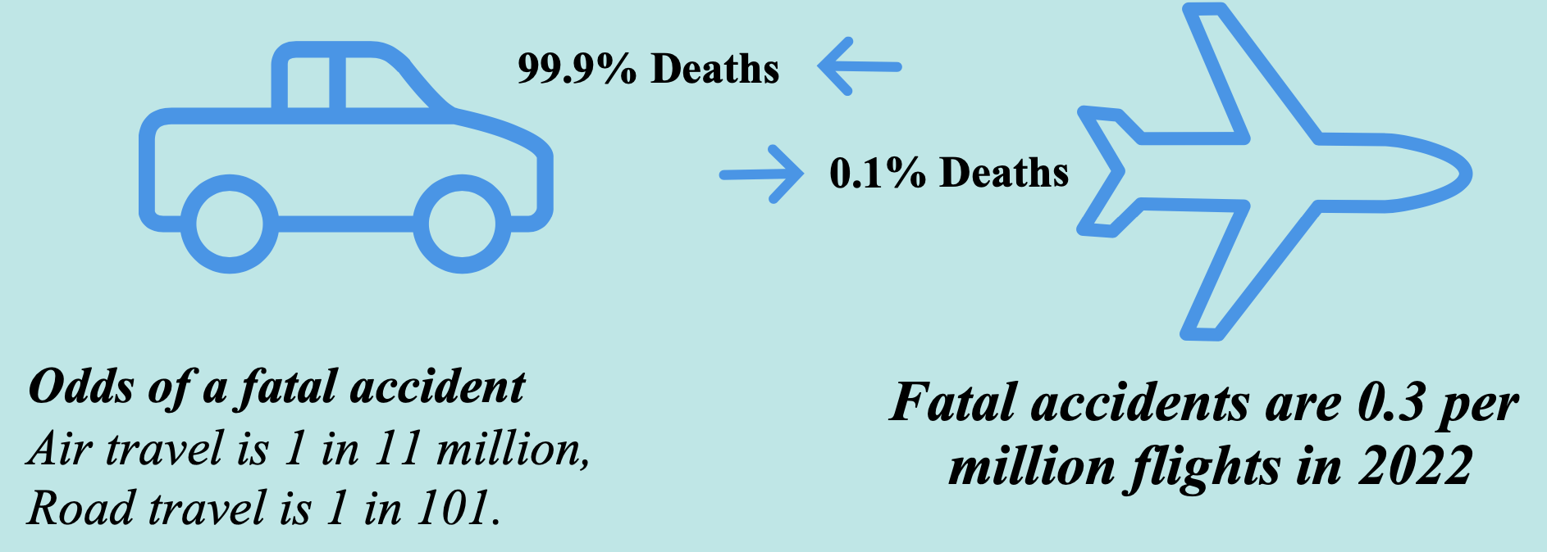
Road vs Airline safety

Slide 3
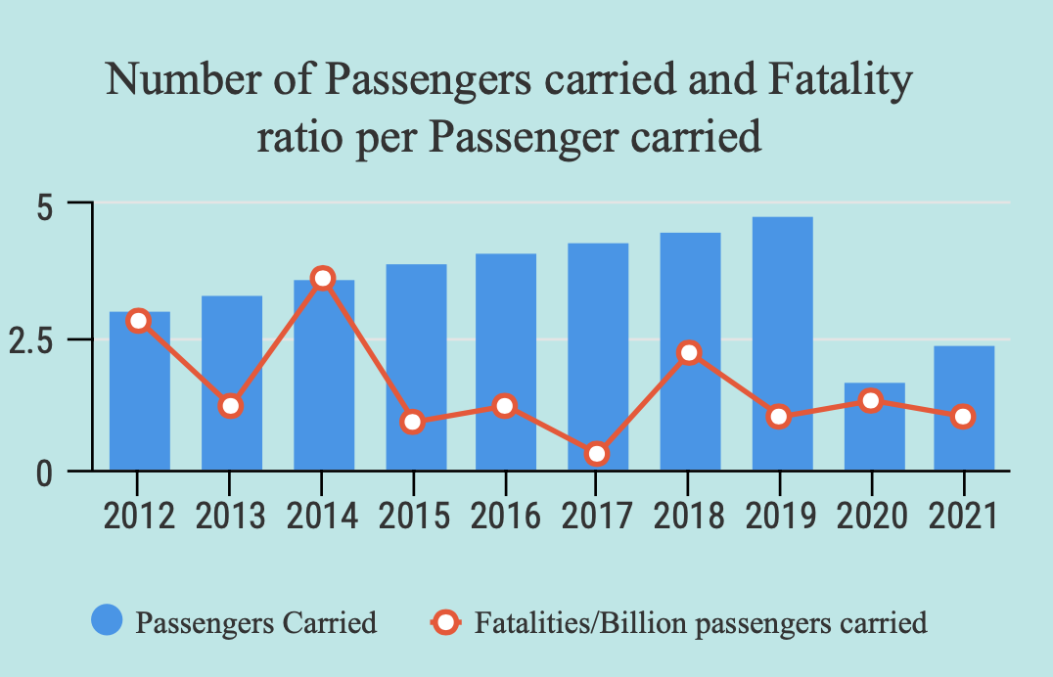
Airlines Fatality trend

Slide 4
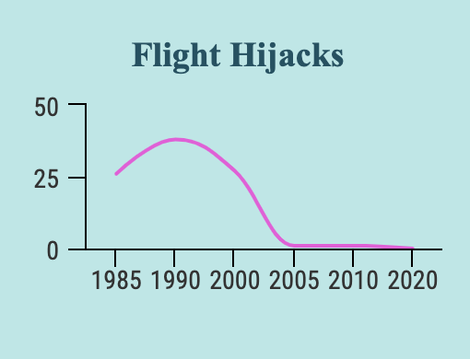
Flight hijacks

Slide 5
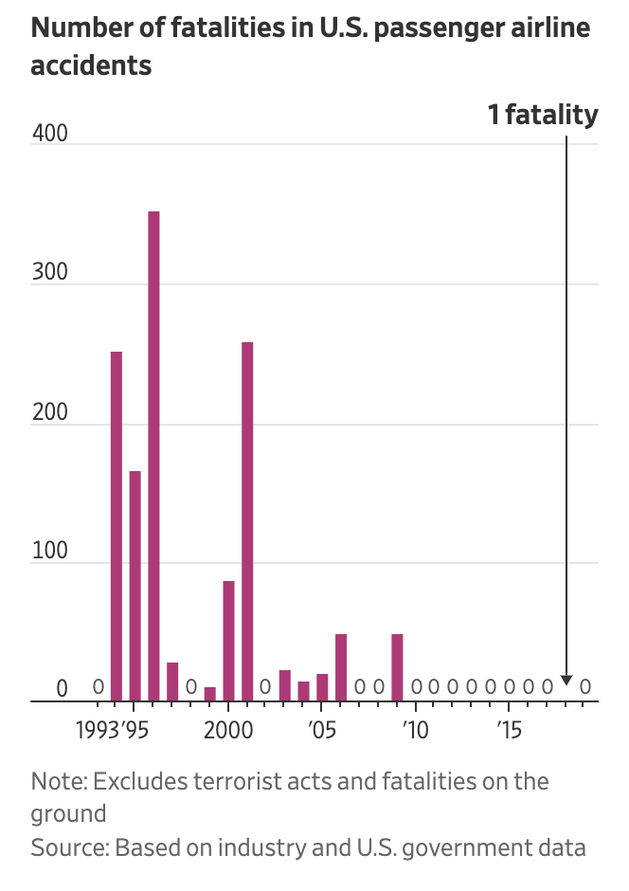
US Airline safety trend

Slide 6

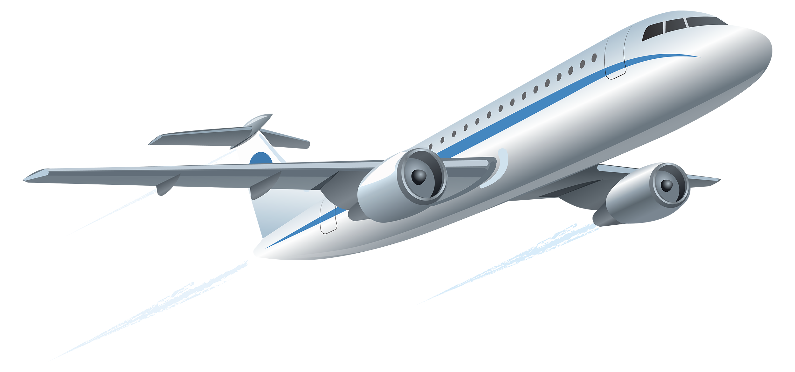
Conclusion

Slide 7

Thank you

