Slide 1

NECTAR
Nash Equilibrium CompuTation Algorithms and Resources
N Rama Suri, Sujit
Supervisor: Prof Y Narahari

Slide 2
Nash Equilibrium
Strategic Form Game: G=(N,(S_{i})_{iЄN},(u_{i})_{iЄN}), where N = {1,2,…,n} is set of players, S_{i} is strategy set for player i and u_{i} is utility function for player i.
Strategy profile
  Assigns a strategy to every player
  A pure strategy chooses one action
  A mixed strategy(ς_{i}) is a distribution over pure strategies, S_{i}. i.e. ς_{i} ∈ Σ_{i}
A Nash equilibrium is a “solution” to the game
  A strategy profile where no player can improve his payoff by unilaterally deviating from his strategy

Slide 3
Nash Equilibrium Contd…
The strategy profile s∗ = (s₁∗, s₂∗ , . . . , s_{n}∗) is said to be a Pure Strategy Nash equilibrium of G if,
u_{i}(s_{i}∗,s_{-i}∗) ≥ u_{i}(s_{i},s_{-i}∗), ∀s_{i}∈S_{i}, ∀i = 1, 2, . . . , n
The strategy profile ς∗ = (ς₁∗, ς₂∗ , . . . , ς_{n}∗) is said to be a Mixed Strategy Nash equilibrium of G if,
u_{i}(ς_{i}∗, ς_{-i}∗) ≥ u_{i}(ς_{i}, ς_{-i}∗), ∀ ς_{i}∈ Σ_{i}, ∀i = 1, 2, . . . , n

Slide 4
Algorithms Based on Simple Search Methods
Notes:
The dots mark points with a maximum number of labels.

Slide 5
Dominant Strategies
Dominated Strategy: A strategy `a’ is said to be weakly dominated by `b’ for player i,
if u_{i}(b ,s_{-i}) ≥ u_{i}(a,s_{-i}), ∀s_{-i}∈S_{-i} and
u_{i}(b ,s_{-i}) > u_{i}(a,s_{-i}), for some s_{-i}∈S_{-i}.
A strategy `a’ is said to be weakly dominant for player i,
if u_{i}(a ,s_{-i}) ≥ u_{i}(b,s_{-i}), ∀s_{-i}∈S_{-i} , ∀b∈S_{i} and
u_{i}(a ,s_{-i}) > u_{i}(b,s_{-i}), for some s_{-i}∈S_{-i} and for some b∈S_{i} .

Slide 6
Dominant Strategy Equilibrium
The strategy profile s∗ = (s₁∗, s₂∗ , . . . , s_{n}∗) is said to
be a dominant strategy equilibrium of G, if s_{i}∗ is
weakly dominant strategy for each player i.

Slide 7
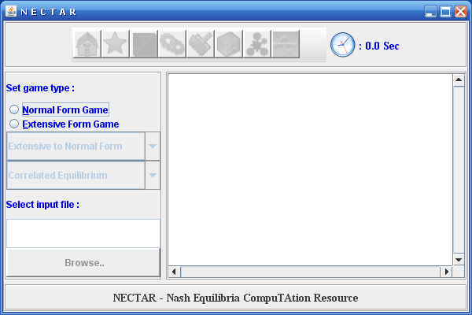

Slide 8
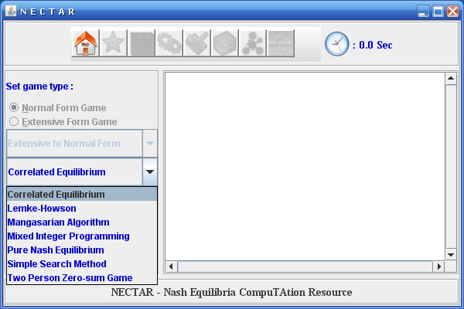

Slide 9
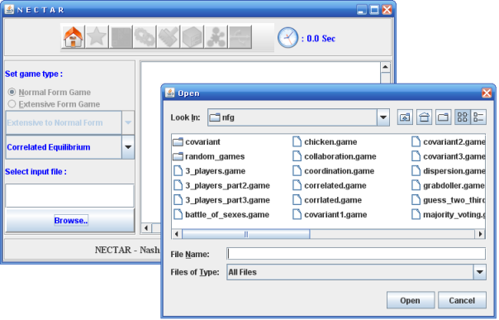

Slide 10
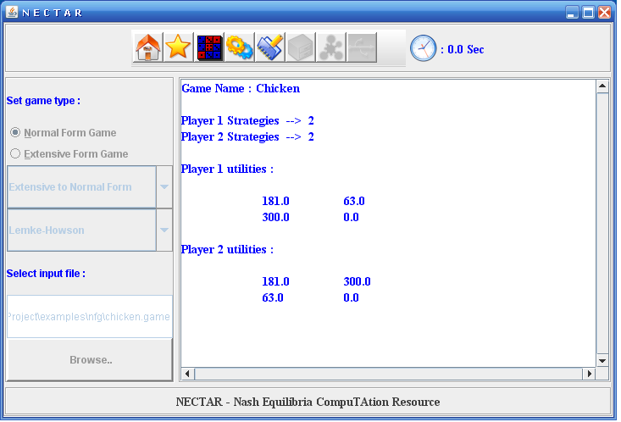

Slide 11
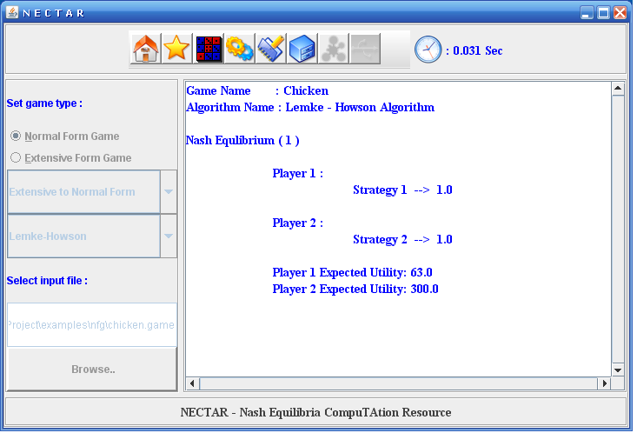

Slide 12
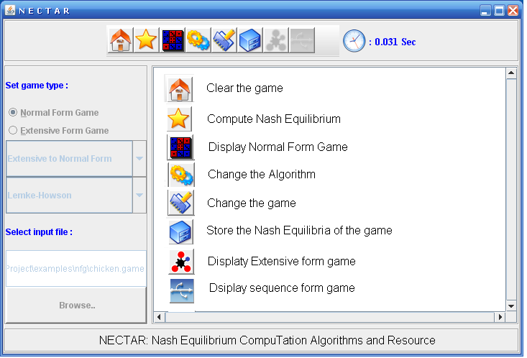

Slide 13
Lemke-Howson Algorithm
Notes:
The dots mark points with a maximum number of labels.

Slide 14
Lemke-Howson: Example
G₁:
a₃
G₂:
a₅
(0,0,1)
(0,1)
1
2
(0,1/3,2/3)
4
4
(1/3,2/3)
2
1
a₁
(2/3,1/3)
3
(1,0,0)
5
(2/3,1/3,0)
a₄
3
5
(1,0)
(0,1,0)
a₂
 | a₄ | a₅
a₁ | 0 | 6
a₂ | 2 | 5
a₃ | 3 | 3
 | a₄ | a₅
a₁ | 1 | 0
a₂ | 0 | 2
a₃ | 4 | 3
U₁=
U₂=
Notes:
The dots mark points with a maximum number of labels.

Slide 15
Lemke-Howson: Example
G₁:
a₃
G₂:
a₅
(0,0,1)
(0,1)
1
2
(0,1/3,2/3)
4
4
(1/3,2/3)
2
1
a₁
(2/3,1/3)
3
(1,0,0)
5
(2/3,1/3,0)
a₄
3
5
(1,0)
(0,1,0)
a₂
 | a₄ | a₅
a₁ | 0 | 6
a₂ | 2 | 5
a₃ | 3 | 3
 | a₄ | a₅
a₁ | 1 | 0
a₂ | 0 | 2
a₃ | 4 | 3
U₁=
U₂=

Slide 16
Lemke-Howson: Algorithm
a₃
a₅
G₁:
(0,0,1)
G₂:
(0,1)
1
2
(0,1/3,2/3)
4
4
(1/3,2/3)
2
1
a₁
(2/3,1/3)
3
(1,0,0)
5
(2/3,1/3,0)
a₄
3
5
(1,0)
(0,1,0)
a₂
In G₁ and G₂, consider points with the maximal #labels, plus the origin.
Points are connected if they share all but one label.
We are searching the space of G₁ X G₂
A point (p₁,p₂) is k-almost completely labeled if for any label in the set {1,…,m+n} – {k}, either p₁ or p₂ has that label.

Slide 17
Lemke-Howson: Algorithm
a₃
G₂:
a₅
G₁:
(0,0,1)
(0,1)
1
2
(0,1/3,2/3)
4
4
(1/3,2/3)
2
1
a₁
(2/3,1/3)
3
(1,0,0)
5
(2/3,1/3,0)
a₄
3
5
(1,0)
(0,1,0)
a₂
INITIALIZE: Start at (0,0) and move to an adjacent point.
LOOP:
  Alternating between G₁ and G₂, move to an adjacent point such that the pair is k-almost completely labeled.
  UNTIL we reach a point that is completely labeled.
Notes:
Equilibrium 1: (0,0,1) and (1,0)

Slide 18
Lemke-Howson: Algorithm
a₃
a₅
G₁:
(0,0,1)
G₂:
(0,1)
1
2
(0,1/3,2/3)
4
4
2
1
(1/3,2/3)
a₁
(2/3,1/3)
3
(1,0,0)
5
(2/3,1/3,0)
a₄
3
5
(1,0)
(0,1,0)
a₂
INITIALIZE: Start at (0,0) and move to an adjacent point.
LOOP:
  Alternating between G₁ and G₂, move to an adjacent point such that the pair is k-almost completely labeled.
  UNTIL we reach a point that is completely labeled.
Notes:
Equilibrium 2:

Slide 19
Lemke-Howson: Other Equilibria
a₃
G₁:
a₅
(0,0,1)
G₂:
(0,1)
1
2
(0,1/3,2/3)
4
4
2
1
(1/3,2/3)
a₁
3
(1,0,0)
5
(2/3,1/3)
(2/3,1/3,0)
a₄
3
5
(1,0)
(0,1,0)
a₂
INITIALIZE: Start at an equilibrium point and move to an adjacent point.
LOOP:
  Alternating between G₁ and G₂, move to an adjacent point such that the pair is k-almost completely labeled.
  UNTIL we reach a point that is completely labeled.
Notes:
Equilibrium 2:

Slide 20
Govindan Wilson’s GNP Method
Govindan and Wilson ‘03:
Continuation method for normal-form games
  Perturb game by a vector of bonuses
    Pay each player an additional bonus for each one of their actions independently
  If the perturbation is large, the game is easily solvable
    Unique pure equilibrium in which each player chooses the action with the highest bonus
Notes:
The dots mark points with a maximum number of labels.

Slide 21



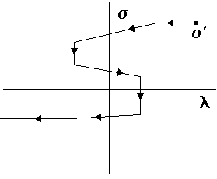

Big Idea: The Picture
Choose a random bonus vector b, perturb game g by , λ a scale factor. Follow the path back from to
Finds equilibria of
Solutions at vertical axis
  Multiple equilibria found with a single ray b

