Slide 1

NECTAR
Nash Equilibrium CompuTation Algorithms and Resource
N Rama Suri, Sujit
Supervisor: Prof Y Narahari

Slide 2
Nash Equilibrium
Strategic Form Game: G=(N,(S_{i})_{iЄN},(u_{i})_{iЄN}), where N = {1,2,…,n} is set of players, S_{i} is strategy set for player i and u_{i} is utility function for player i.
Strategy profile
  Assigns a strategy to every player
  A pure strategy chooses one action
  A mixed strategy(ς_{i}) is a distribution over pure strategies, S_{i}. i.e. ς_{i} ∈ Σ_{i}
A Nash equilibrium is a “solution” to the game
  A strategy profile where no player can improve his payoff by unilaterally deviating from his strategy

Slide 3
Nash Equilibrium Contd…
The strategy profile s∗ = (s₁∗, s₂∗ , . . . , s_{n}∗) is said to be a Pure Strategy Nash equilibrium of G if,
u_{i}(s_{i}∗,s_{-i}∗) ≥ u_{i}(s_{i},s_{-i}∗), ∀s_{i}∈S_{i}, ∀i = 1, 2, . . . , n
The strategy profile ς∗ = (ς₁∗, ς₂∗ , . . . , ς_{n}∗) is said to be a Mixed Strategy Nash equilibrium of G if,
u_{i}(ς_{i}∗, ς_{-i}∗) ≥ u_{i}(ς_{i}, ς_{-i}∗), ∀ ς_{i}∈ Σ_{i}, ∀i = 1, 2, . . . , n

Slide 4
Dominant Strategies
Dominated Strategy: A strategy a is said to be weakly dominated by b for player i,
if u_{i}(b ,s_{-i}) ≥ u_{i}(a,s_{-i}), ∀s_{-i}∈S_{-i} and
u_{i}(b ,s_{-i}) > u_{i}(a,s_{-i}), for some s_{-i}∈S_{-i}.
A strategy a is said to be weakly dominant for player i,
if u_{i}(a ,s_{-i}) ≥ u_{i}(b,s_{-i}), ∀s_{-i}∈S_{-i} , ∀b∈S_{i} and
u_{i}(a ,s_{-i}) > u_{i}(b,s_{-i}), for some s_{-i}∈S_{-i} and for some b∈S_{i} .

Slide 5
Dominant Strategy Equilibrium
The strategy profile s∗ = (s₁∗, s₂∗ , . . . , s_{n}∗) is said to be a dominant strategy equilibrium of G, if s_{i}∗ is weakly dominant strategy for each player i.

Slide 6
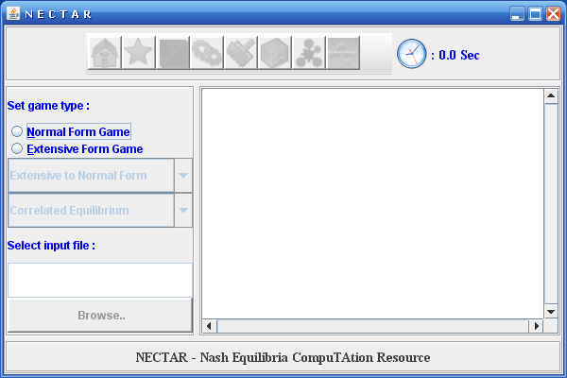

Slide 7
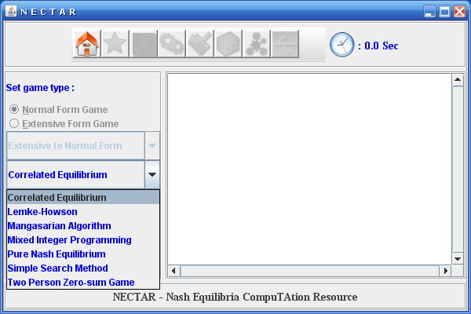

Slide 8
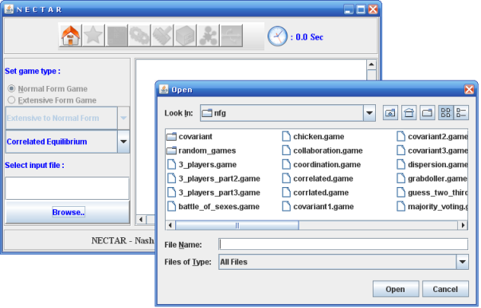

Slide 9
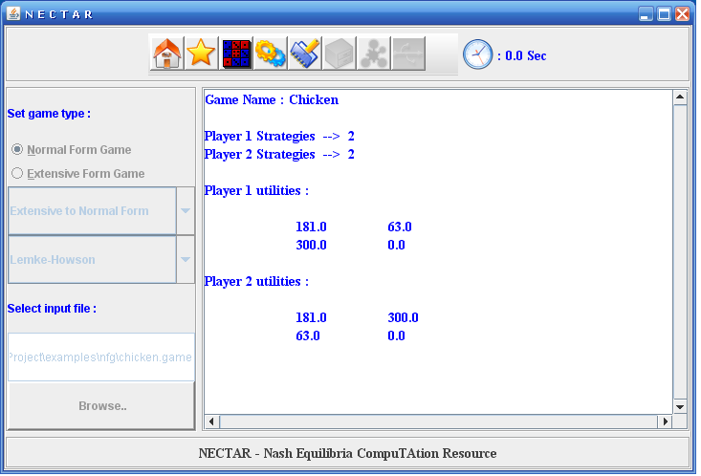

Slide 10
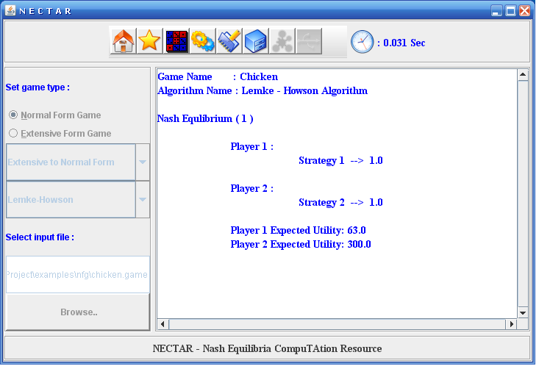

Slide 11
