Slide 1



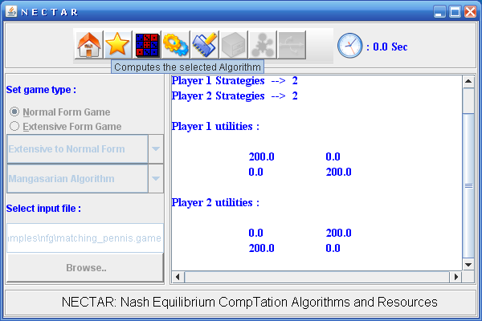



NECTAR
Nash Equilibriam CompuTation Algorithms and Resources
Game Theory provides a rich mathematical
framework for analyzing strategic interactions of
rational and intelligent players.
Analysis of strategic form games involves
computing certain equilibrium points.
These equilibrium points, notably Nash equilibria,
are fixed points of certain correspondence
mappings derived from the payoff matrices.
NECTAR (Nash Equilibriam CompuTation
Algorithms and Resources), is a software
environment for computing Nash equilibria and
other equilibrium points in games.
Value Proposition
NECTAR is designed to serve the computational
needs of game theory researchers and
practitioners who apply game theory and
mechanism design to solve their design problems.
Currently game theoretic modeling and analysis is
key to numerous applications in e-Commerce,
network economics, internet auctions, grid
computing, network computing, supply chain
management, multi agent systems, etc.
Features of NECTAR:
NECTAR includes implementation of all well
known algorithms such as mini-max algorithm,
Lemke-Howson algorithm, Mangasarian
algorithm, Govindan and Wilson algorithm,
and algorithms based on search methods, mixed
integer programming, sequence forms, correlated
equilibrium, etc.
Use of Design Patterns: Best practices DPs such
as Factory method, Singleton, Command,
Facade, Mediator, and Adapter etc., are used for
NECTAR.
NECTAR uses ingenious data structures and
employs highly optimized code.
Strategic Form Game: G=(N,(S_{i})_{iЄN},(u_{i})_{iЄN}),
where N = {1,2,…,n} is set of players, S_{i} is strategy set for player i
and u_{i} is utility function for player i.
Dominant Strategy Equilibrium: It is a strategy profile, consisting
of one strategy per each player, in which it is the best response
for each player to play according to the prescribed strategy
irrespective of the strategies played by the other players.
Formally, the strategy profile s∗ = (s₁∗, s₂∗ , . . . , s_{n}∗) is said to be a
dominant strategy equilibrium of G if,
u_{i}(s_{i}∗,s_{-i}∗) ≥ u_{i}(s_{i},s_{-i}), ∀s_{i}∈S_{i}, ∀s_{-i}∈S_{-i} , ∀i = 1, 2, . . . , n
Nash Equilibrium: It is a strategy profile, consisting of one
strategy per each player, in which it is the best response for each
player to play according to the prescribed strategy while others
are playing according to the given strategy profile. In short, any
player is not better off by unilateral deviation. Formally, the
strategy profile s∗ = (s₁∗, s₂∗ , . . . , s_{n}∗) is said to be a Nash
equilibrium of G if,
u_{i}(s_{i}∗,s_{-i}∗) ≥ u_{i}(s_{i},s_{-i}∗), ∀s_{i}∈S_{i}, ∀i = 1, 2, . . . , n
Game
Generators
Optimization
Solver
(CPLEX)
Complexity of Computing Nash Equilibria
Two Person Games
    Zero sum games: Nash equilibrium (called saddle points) computation is polynomial time.
    General sum normal form games: Determining whether there exists a Nash equilibrium with certain properties is NP-hard.
n-Person Games
    It is polynomial to compute pure strategy Nash equilibrium in symmetric congestion games.
    Counting number of Nash equilibria is #P-hard.
    Determining whether pure strategy Nash equilibrium exists is NP-hard.
    It is NP-hard to determine whether there are more than one Nash equilibria.
    In general, computing Nash equilibrium is Polynomial Parity Argument (Directed), PPAD.
NECTAR
N
E
C
T
A
R
I
N
T
E
R
F
A
C
E
Algorithms
Graphical
User
Interface
Games
NECTAR
Preprocessing
Some Milestones in Nash Equilibrium Computation
John von Neumann and Oskar Morgenstern (1928): Proved mini-max theorem, useful for the computation of equilibrium points in 2-person zero sum games.
2. J. Nash (1950): Showed the existence of a strategic equilibrium for non-cooperative games.
3. C.E. Lemke and J.T. Howson (1964): Developed an efficient scheme for computing a Nash equilibrium point for bi-matrix games.
4. L. Mangasarian (1964): Designed an algorithm for computing all Nash equilibria of two-person games.
5. R.J. Aumann (1974): Correlated equilibrium of games.
6. S. Govindan and R. Wilson (2003): Global Newton Method to compute Nash equilibria in n-person games.
7. R. Porter, E. Nudelman, and Y. Shoham (2004): Simple search methods for computing a sample Nash equilibrium in 2-player and n-player normal form games.
8. T. Sandholm, A. Gilpin, and V. Conitzer (2005): Mixed integer programming method to find Nash equilibrium.
Architecture Diagram of NECTAR
Comparison with Gambit and other Tools
NECTAR is implemented in Java, which provides
platform independence. Most other tools including
Gambit are implemented in C++.
NECTAR’s design is highly extensible due to solid use of
design patterns and this enables new algorithms and
variations to be included in flexible way.
NECTAR: Current Status and Future Evolution
NECTAR is continuously evolving with inclusion of
new algorithms and enhancement of existing code.
We are currently implementing computation of
cooperative game solution concepts such as core,
Shapley value, bargaining set, kernel, nucleolus, etc.
NECTAR will be enhanced with a mechanism
design suite to aid the design of auctions and market
protocols.
Tool Snapshot
REFEENCES:
1. J.F. Nash, Non-Cooperative Games, Annals of Mathematics 54, pages 286-295, 1951.
2. C.E. Lemke and J.T. Howson, Jr. Equilibrium points of bi-matrix games. Journal of the
Society for Industrial and Applied Mathematics, 12(2):413–423, 1964.
3. O.L. Mangasarian. Equilibrium points of bi-matrix games. Journal of the Society for
Industrial and Applied Mathematics, 12(4):778–780, December 1964.
4. S. Govindan and R. Wilson. A global Newton method to compute Nash equilibria. Journal
of Economic Theory, 110(1):65–86, 2003.
5. R. McKelvey and A. McLennan, "Computation of equilibria in finite games", In Handbook of
Computational Economics. 1996
6. R. Porter, E. Nudelman, and Y. Shoham. Simple search methods for finding a Nash equilibrium.
In Proceedings of the Nineteenth National Conference on Artificial Intelligence, pages 664–669, 2004.
7. T. Sandholm, A. Gilpin, and V. Conitzer. Mixed-integer programming methods for finding Nash equilibria. In Proceedings of the
Twentieth National Conference on Artificial Intelligence, pages 495–501, 2005.
8. R.J. Aumann, Subjectivity and correlation in randomized strategies. Journal of Mathematical Economics,
Volume 1, pages 67-96, 1974.
9. B. Von Stengel. Computing equilibria for two-person games. Technical report, London School of
Economics, ETH Zentrum, CH-8092, Zurich, Switzerland, 1999.
10. M Kalyan Chakarvarthy. NECTAR: Nash Equilibrium Computation Algorithms and Resources. ME Thesis, Dept. of Computer
Science and Automation, Indian Institute of Science, Bangalore, India, 2006.
Students Involved : Sujit Gujar and Rama Suri Narayanam
Institute : Indian Institute of Science, Bangalore
Department : Computer Science and Automation
Professor : Y Narahari
http://lcm.csa.iisc.ernet.in

