Slide 1






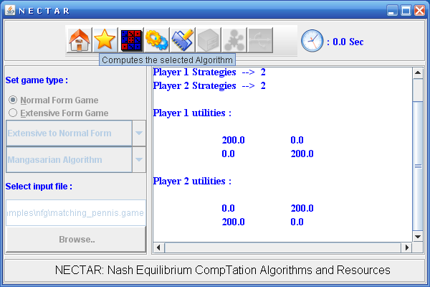



NECTAR
Nash Equilibriam CompuTation Algorithms and Resources
Game Theory provides a rich mathematical framework for analyzing strategic interactions of rational and intelligent players.
Analysis of strategic form games involves computing certain equilibrium points.
These equilibrium points, notably Nash equilibria, are fixed points of certain correspondence mappings derived from the payoff matrices.
NECTAR (Nash Equilibriam CompuTation Algorithms and Resources), is a software environment for computing Nash equilibria and other equilibrium points in games.
Value Proposition
NECTAR is designed to serve the computational needs of game theory researchers and practitioners who apply game theory and mechanism design to solve their design problems.
Currently game theoretic modeling and analysis is key to numerous applications in e-Commerce, network economics, internet auctions, grid computing, network computing, supply chain management, multi agent systems, etc.
Features of NECTAR:
NECTAR includes implementation of all well
known algorithms such as mini-max algorithm,
Lemke-Howson algorithm, Mangasarian
algorithm, Govindan and Wilson algorithm,
and algorithms based on search methods, mixed
integer programming, sequence forms, correlated
equilibrium, etc.
Use of Design Patterns: Best practices DPs such
as Factory method, Singleton, Command,
Facade, Mediator, and Adapter etc., are used for
NECTAR.
NECTAR uses ingenious data structures and
employs highly optimized code.
Strategic Form Game: A strategic form game G=(N,(S_{i})_{iЄN},(u_{i})_{iЄN}), where N is set of players, S_{i} is strategy set for player i and u_{i} is utility function for player i.
Dominant Strategy Equilibrium: It is a strategy profile, consisting of one strategy per each player, in which it is the best response for each player to play according to the prescribed strategy irrespective of the strategies played by other players. Formally, the strategy profile s∗ = (s₁∗, s₂∗ , . . . , s_{n}∗) is said to be a Dominant strategy equilibrium of G if,
u_{i}(s_{i}∗ , s_{-i}∗) ≥ u_{i}(s_{i} , s_{-i}), ∀s_{i} ∈ S_{i}, ∀s_{-i} ∈ S_{-i} , ∀i = 1, 2, . . . , n
Nash Equilibrium: It is a strategy profile, consisting of one strategy per each player, in which it is the best response for each player to play according to the prescribed strategy while others are playing according the strategy profile. In short, unilateral deviation by any player is not better off. Formally, the strategy profile s∗ = (s₁∗, s₂∗ , . . . , s_{n}∗) is said to be a Nash equilibrium of G if,
u_{i}(s_{i}∗ , s_{-i}∗) ≥ u_{i}(s_{i} , s_{-i}∗) ∀s_{i} ∈ S_{i}, ∀i = 1, 2, . . . , n
Game
Generators
Optimization
Solver
(CPLEX)
NECTAR
Complexity of computing Nash equilibria
Two Person Games:
  Nash equilibrium (called saddle points in this case) computation is polynomial.
In two person general sum normal form games, determining whether there exists a Nash equilibrium with certain properties is NP-hard
Determining whether pure strategy Nash equilibrium exists is NP-hard.
Counting the number of Nash equilibria is #P-hard.
It is polynomial to compute pure strategy Nash equilibrium in symmetric congestion games.
It Is NP-hard to determine whether there are more than one Nash equilibria in an arbitrary player game.
In general, computing Nash equilibrium is Polynomial Parity Argument (Directed), PPAD.
N
E
C
T
A
R
I
N
T
E
R
F
A
C
E
Algorithms
Graphical
User
Interface
Games
NECTAR
Preprocessing
Some Milestones in Nash Equilibrium Computation
John von Neumann and Oskar Morgenstern (1928): proved mini-max theorem, useful for the computation of equilibrium points in 2-person zero-sum games.
2. J. Nash (1950): proved the existence of a strategic equilibrium for non-cooperative games.
3. C.E. Lemke and J.T. Howson (1964): developed an efficient scheme for computing a Nash equilibrium point for bi-matrix game.
4. L. Mangasarian (1964): designed an algorithm for computing all Nash equilibria of two-person games.
5. R.J. Aumann (1974): correlated equilibrium of games.
6. S. Govindan and R. Wilson (2003): Global Newton Method to compute Nash equilibria in N-person games.
7. R. Porter, E. Nudelman, and Y. Shoham (2004): simple search methods for computing a sample Nash equilibrium in 2-player and n-player normal form games.
8. T. Sandholm, A. Gilpin, and V. Conitzer (2005): mixed integer programming method to find the Nash equilibrium.
Architecture Diagram of NECTAR
Comparison with Gambit and other Tools
NECTAR is implemented in Java, which provides platform independence. Most other tools including Gambit are implemented in C++.
NECTAR’s design is highly extensible due to solid use of design patterns and this enables new algorithms and variations to be included in flexible way.
NECTAR: Current Status and Future Evolution
NECTAR is continuously evolving with inclusion of new algorithms and enhancement of existing code.
We are currently implementing computation of cooperative game solution concepts such as core, Shapley value, bargaining set, kernel, nucleolus, etc.
NECTAR will be enhanced with a mechanism design suite to aid design of auctions and market protocols.
REFEENCES:
1. J.F. Nash, Non-Cooperative Games, Annals of Mathematics 54, pages 286-295, 1951.
2. C.E. Lemke and J.T. Howson, Jr. Equilibrium points of bimatrix games. Journal of the
Society for Industrial and Applied Mathematics, 12(2):413–423, 1964.
3. O.L. Mangasarian. Equilibrium points of bimatrix games. Journal of the Society for In-
dustrial and Applied Mathematics, 12(4):778–780, December 1964.
4. S. Govindan and R. Wilson. A global Newton method to compute Nash equilibria. Journal
of Economic Theory, 110(1):65–86, 2003.
5. R. McKelvey and A. McLennan, "Computation of equilibria in finite games", In Handbook of
Computational Economics. 1996
6. R. Porter, E. Nudelman, and Y. Shoham. Simple search methods for finding a Nash equilibrium.
In Proceedings of the Nineteenth National Conference on Artificial Intelligence, pages 664–669, 2004.
7. T. Sandholm, A. Gilpin, and V. Conitzer. Mixed-integer programming methods for finding Nash equilibria. In Proceedings of the Twentieth National Conference on Artificial Intelligence, pages 495–501, 2005.
8. R.J. Aumann, Subjectivity and correlation in randomized strategies. Journal of Mathematical Economics,
Volume 1, pages 67-96, 1974.
9. B. Von Stengel. Computing equilibria for two-person games. Technical report, London School of
Economics, ETH Zentrum, CH-8092, Zurich, Switzerland, 1999.
10. M Kalyan Chakarvarthy. NECTAR: Nash Equilibrium Computation Algorithms and Resources. ME Thesis, Dept. of Computer
Science and Automation, Indian Institute of Science, Bangalore, India, 2006.
Students Involved: Sujit Gujar and Rama Suri Narayanam
Institute : Indian Institute of Science, Bangalore
Department : Computer Science and Automation
Professor : Y Narahari
http://lcm.csa.iisc.ernet.in

