Slide 1



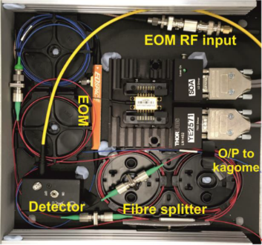
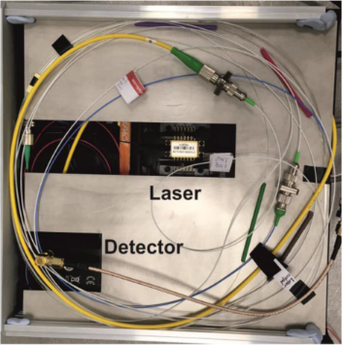
VERSATILE HIGH-FIDELITY REFERENCE GAS CELL AS LASER WAVELENGTH STABILISATION UNIT FOR DIAL MEASUREMENTS OF ATMOSPHERIC TRACE GASES
Contractors: NPL (GB), ORC (GB), Eblana Photonics (IRL)
ESA Budget:
300 k€
TRP T117-307MM
YoC: 2017
TO: Michael Jost (TEC-MME)
TRL
Initial: 2
Achieved: 4
Target TRL: 6 Date: 2020
Background and justification:
ESA is pursuing the development of technologies enabling space-borne atmospheric sensing of trace gases, in particular greenhouse gases such as carbon dioxide. A promising measurement technique is differential absorption lidar (DIAL) relying on linear molecular absorption in the 1.5 µm to 2.5 µm NIR band. Previous work has made use of conventional bulk cells for wavelength referencing. Gas-filled hollow core fibre cells offer advantages in terms of scalability, mass, compactness and robustness.
EBB lower layer, with the laser in a butterfly package; the 50/50 fibre splitter, fibre isolator and detector
Objective(s):
Exploration of feasibility, limitations and conceptual design of a generic, versatile, hollow-core fibre based wavelength reference architecture that can be used for specific applications with only moderate modifications. Build and characterise an elegant breadboard of an all-fibre system stabilising a laser diode on the HITRAN P(30) ¹²CO₂ absorption feature at 2.05 µm with a 100kHz @10s (Allan deviation) frequency stability requirement. Demonstrate locking on a feature with 20dB reduced line strength as compared to the P(30). Investigate offset-locking up to 3 GHz from line centre.
Achievements and status:
A compact and robust architecture of a versatile wavelength referencing system based on wavelength modulation spectroscopy and PDH spectroscopy in a kagome fibre has been developed and characterised in various respects. The elegant breadboard has demonstrated a performance meeting the most challenging requirements as defined for the ¹²CO₂ P(30) feature, the most likely candidate absorption line for a DIAL CO₂ monitoring mission. Locking to a 20dB weaker line as well as the feasibility of offset locking at 3 GHz have been shown. A high-power DFB laser diode at 2.05 µm with excellent stability, suitable to be used in a high-performance frequency reference system, has been developed.
Fibre mounting shield in place, with a 2-kPa fibre shown mounted
Benefits:
The demonstrated frequency reference system is an enabling element for a DIAL mission to monitor various atmospheric trace gases. Due to its versatility it can benefit a large number of applications, both space-borne and terrestrial.
Next steps:
It is intended to continue the development with the aim to further improve certain performance features, e.g. increasing the frequency stability when locking to weak lines and widening the continuous tuning range in offset locking. Another key objective is to raise the TRL of the breadboard to 6. A follow-on activity in the frame of the GSTP is under consideration.

