Slide 1


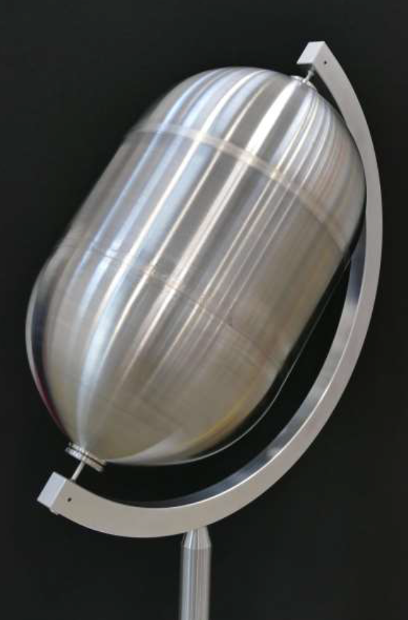
Friction Stir Welded Low Cost Propellant Tank
Contractor(s): TWI (GB), Airbus D&S (GB)
ESA Budget:
1,500 k€
GSTP G617-125QT
YoC: 2016
TO: Andrew Norman (TEC-MSP)
TRL
Initial: 3
Current: 6
Target TRL: 9 Date: Q1 2020
Background and justification:
Titanium propellant tanks are one of the most costly items in the rocket/spacecraft propulsion system. This is due to a combination of the high cost of titanium forgings, long lead time, and the extensive amount of machining that is required during manufacturing. Furthermore, the evolution of larger motor systems is demanding even larger tanks, which threatens to become prohibitively costly if manufactured by traditional methods.
Objective(s):
To perform a series of trade studies aimed at reducing the overall manufacturing cost of propellant tanks. The activity will study an alternative method of manufacturing the tank hemispheres, together with the adoption of the solid state joining technique of Friction Stir Welding (FSW).
Achievements and status:
The manufacturing method of thin wall casting was selected for the production of the tank hemispheres. The project has focused on the development, characterisation and validation of the FSW process and tooling system to weld Ti-6Al-4V Titanium alloys, starting from sheets up to formed shells. Finally the validated processes was up-scaled and 4 full size tanks have been successfully manufactured. This has raised the TRL of the FSW of titanium from 3 to 6.
Benefits:
The new manufacturing process compares favourably with equivalent titanium tanks welded by conventional techniques including cost, reliability, industrial efficiency and environmental friendliness aspects. Production costs are expected to be halved and the manufacturing time reduced from many months to a few weeks.
Next steps:
Airbus D&S (GB) are now considering how to take this technology to the next logical step. This includes the identification of alternative methods for the manufacturing of the tank hemispheres. This will be performed in the GSTP activity G61A-011QT, Advanced Forming of Complex Shape.
Full Size Tank demonstrator

