Slide 1

Pure Focus
Considering stressful habits

Slide 2
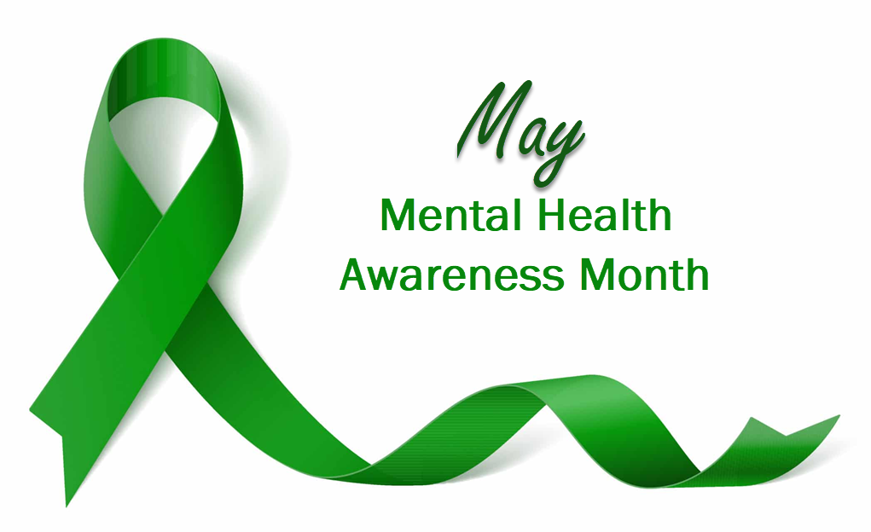
Notes:
Focused Attention versus Multi-tasking
My Story: So a little bit at me, is that I’m constantly looking to improve efficiencies and my mental awareness of how things are going (I’m very committed to Continuous Improvement : Progress over Perfection)
And based on some feedback from others, the fact that I noticed that myself that I might be stressing, AND the fact that May is mental awareness month: I did some researching on the topic of focus and multitasking and one’s ability to be as efficient as possible – hopefully leading to my being more calm, productive, and “happier”

Slide 3
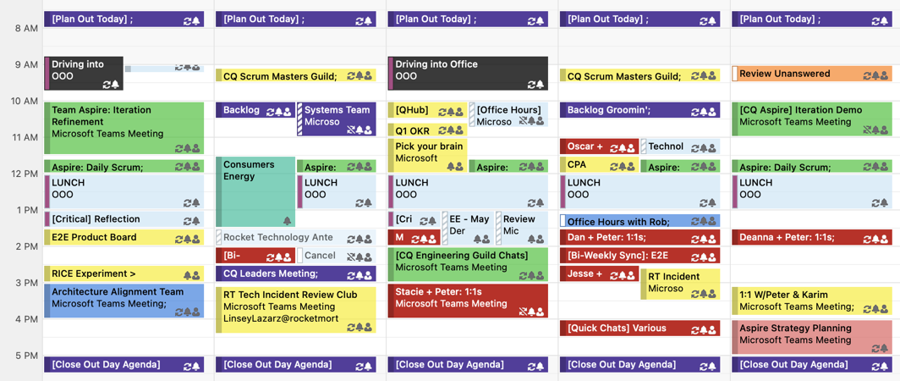
Next Week’s Calendar
Notes:
So I picked one of the things that I thought was causing me stress, and tried focusing on making improvements
Insert obvious joke here:: I started taking a look at my calendar, and where my time and energy was being spent
Really seeing where my priorities lay, where I could potentially remove things that didn’t need my immediate attention – (especially reoccurring meetings), -- and where I could improve efficiency

Slide 4
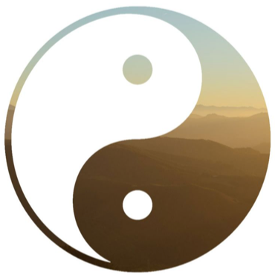
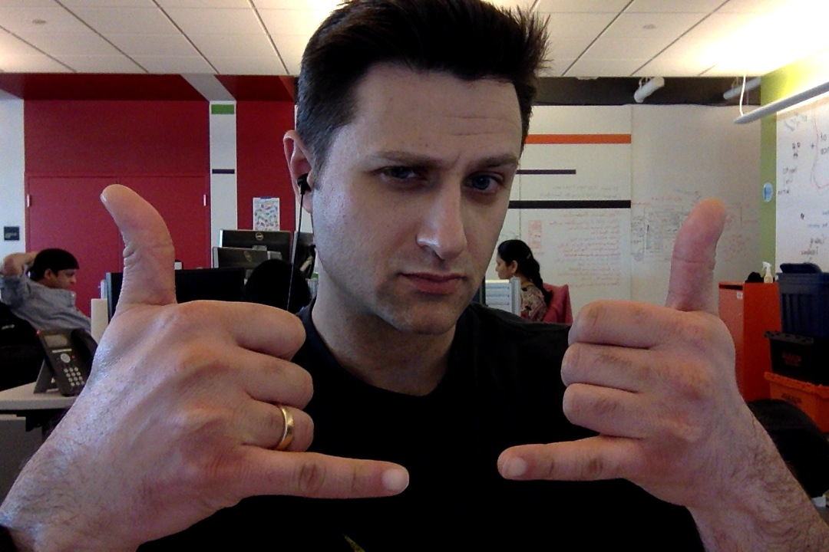
Balance/Harmony
Notes:
I’d like to find balance and harmony in all that I do and making sure that I’m doing the right things at the right times
This desired state of being is often in direct conflict with time management and the things that are competing for my immediate attention

Slide 5

Multi-tasking
… is the concept that one can split their attention across multiple tasks or activities at the same time
Multi-tasking can result in time wasted due to human context switching, and becoming prone to errors due to insufficient attention
Notes:
So I started considering multi-tasking and the fact that I do it a lot
… is the concept that one can split their attention across multiple tasks or activities at the same time
… such as speaking on the phone while driving a car
Multi-tasking can result in time wasted due to human context switching, and becoming prone to errors due to insufficient attention
Not just at work – but on the weekends, with a busy/packed schedule
While I can humble brag that I’m “pretty good” at multi-tasking – I asked myself honestly : Am I being as effective / the best I can be – in this manner?
While ’m pretty good at context switching quickly (from lots of practice throughout my life) – is this a really good thing for me?

Slide 6
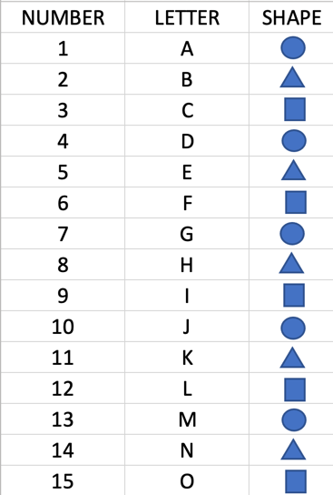
Quick Activity:
How quickly can you fill out this chart?
First start by writing out information by columns – we’ll time the process
Next, we’ll fill out the grid, by rows – and time this too
Compare your times (columns vs rows)
Notes:
Multi-tasking Activity (timed/efficiency)
3 columns:
Numbers (1-10) | Letters (A-J) | Shapes (Square, Triangle, Circle)
Start with "ACROSS COLUMNS" and time it takes to complete: (1, A, Square > 2, B, Triangle)
Next with "HORIZONTAL COLUMNS" and time it takes to complete: (1, 2, 3 > A, B, C > Shapes)
Determine which was more efficient/easier --> And why multi-tasking is harder/worse (context switching / parasitic drag)

Slide 7
Some Techniques To Consider
Tips:
Know Your Triggers
Focus Time
One Task ONLY
Pomodoro
Remove distractions/blockers
Acceptance
Ask for help
Benefits:
More “In the Flow” (live in the moment)
Better focus
More efficiency
More happiness!
Notes:
Identify your triggers (what causes you to want to multi-task?)
Why am I multi-tasking now?
How’d I get into this situation?
How can I identify/prevent this in the future?
Make a calendar appointment for “Focus Time” to accomplish a task
Commit to yourself, the task, and the time necessary to complete it
Try not to let it your time block get stomped on/rescheduled – Ask: Which task is the highest priority for me, right now?
Then: Just START the task, and focus on that ONE task ONLY
Google Pomodoro (time-boxing & “tomato timers”)
Take breaks! Humans are complex – Breaking often on difficult tasks DOES HELP
Stay “in-the-flow” for as long as possible
Revisit tasks if necessary, later. (your subconscious mind will still be processing it probably)
Remove distractions: clear up a cluttered work-space, “toast pop-up” notifications > OFF, Your mind-set > Get ready mentally!
Acceptance: Find/make time to prioritize your tasks and knock ‘em out > Feels good to achieve results
You can’t do everything all at once – but if you make time for things, in priority order, and DO them – you’ll actually GAIN time/efficiency > And be happier in the long run
HELP! Leverage other’s knowledge, experience, and support – You’ll be surprised at how willing others are to share their experience, knowledge, and their time/effort

Slide 8
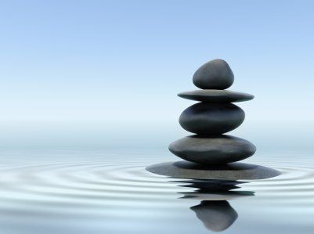
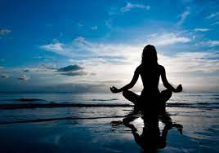
Focus = Serenity

