Slide 1


OpenClaw

Slide 2



What OpenClaw does
Conversation
Execution
Discord
Browsers
↻
Web UI
Plugins
Natural prompts
Automation

Slide 3


Capabilities
Chat
Web
CLI
Files
Plugins
Automation

Slide 4


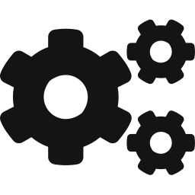
How the workflow runs
→
→
A message or task arrives
answer
artifact
status
1. Receive
2. Plan
3. Deliver

Slide 5
Demo and test server
Web UI
Safe testing
Responsive layout
Validation
↻
Visual workflow
Automation checks
Clean presentation
Repeatable demos

Slide 6

Built for action.

