Slide 1
Group 7 Topic name
File management
Write or modify functions related to file management
Programming the execution process

Slide 2
member
Phạm Thanh Trường
20IT461
Phan Văn Bằng
20IT490
Phan Văn Lai
20IT1028
Hồ Thăng Trình
20IT511

Slide 3

topic introduction
1. Linux File Management
2. Linux File Ownership
3. Linux File Permissions
4. Write or modify functions related to file management

Slide 4

Linux Preview
Linux is a clone of UNIX, the multi-user operating system which can be accessed by many users simultaneously. Linux can also be used in mainframes and servers without any modifications. But this raises security concerns as an unsolicited or malign user can corrupt, change or remove crucial data. For effective security, Linux divides authorization into 2 levels:
Ownership
Permission

Slide 5
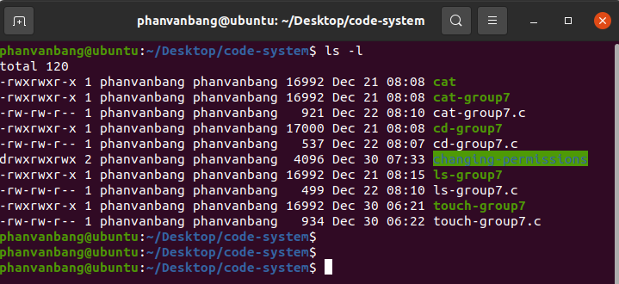
Linux Shell

Slide 6
Linux FilE MANAGEMENT

Slide 7
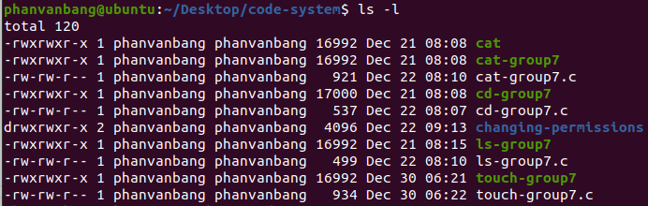
File Listing
To perform Files listings or to list files and directories ls command is used
All your files and directories in the current directory would be listed and each type of file would be displayed with a different color. Like in the output directories are displayed with dark blue color.

Slide 8
Creating Files
touch command can be used to create a new file. It will create and open a new blank file if the file with a filename does not exist. And in case the file already exists then the file will not be affected.

Slide 9
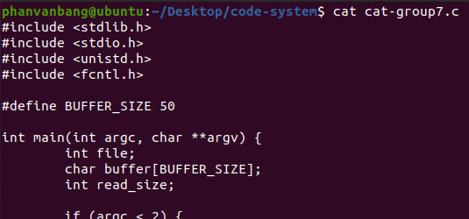
Displaying File Contents
cat command can be used to display the contents of a file. This command will display the contents of the ‘filename’ file. And if the output is very large then we could use more or less to fit the output on the terminal screen otherwise the content of the whole file is displayed at once

Slide 10

Copying a File
cp command could be used to create the copy of a file. It will create the new file in destination with the same name and content as that of the file ‘filename’.

Slide 11

Moving a File
mv command could be used to move a file from source to destination. It will remove the file filename from the source folder and would be creating a file with the same name and content in the destination folder.

Slide 12
Renaming a File
mv command could be used to rename a file. It will rename the filename to new_filename or in other words, it will remove the filename file and would be creating a new file with the new_filename with the same content and name as that of the filename file.

Slide 13

Deleting a File
rm command could be used to delete a file. It will remove the filename file from the directory.

Slide 14
Linux File Ownership

Slide 15
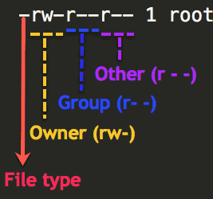
User By default, the person who created a file becomes its owner Group All users belonging to a group will have the same Linux group permissions access to the file. Other Any other user who has access to a file. This person has neither created the file, nor he belongs to a user group who could own the file.
Every file and directory on your Unix/Linux system is assigned 3 types of owner, given below.

Slide 16
Example
r – Read
w – Write
X – Execute
rwx
Group
r – Read
Other
r – Read
User
- – No Write
X – Execute
r-x
- – No Write
X – Execute
r-x

Slide 17
Linux File Permissions

Slide 18
Linux File Permissions
Read
Write
Execute
This permission give you the authority to open and read a file.
Read permission on a directory gives you the ability to lists its content.
The write permission gives you the authority to modify the contents of a file.
The write permission on a directory gives you the authority to add, remove and rename files stored in the directory.
In Windows, an executable program usually has an extension “.exe” and which you can easily run.
In Unix/Linux, you cannot run a program unless the execute permission is set.

Slide 19
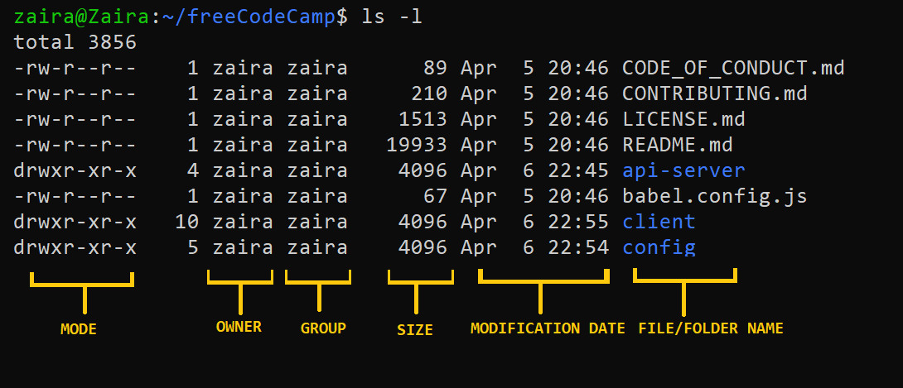
Syntax show file permissions in Linux
ls –l
Here, we have highlighted ‘-rw-rw-r–‘and this weird looking code is the one that tells us about the Unix permissions given to the owner, user group and the world.

Slide 20
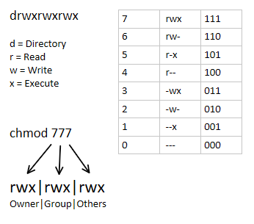
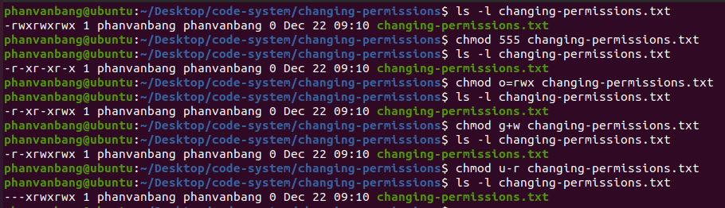
Changing file/directory permissions in Linux
There are 2 ways to use the command:
- Absolute mode
- Symbolic mode
Syntax: chmod permissions file_name
Example

Slide 21
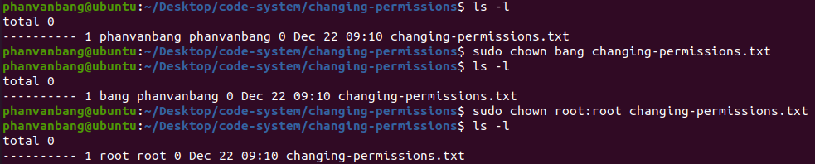
Changing Ownership and Group in Linux
For changing the ownership of a file/directory, you can use the following command:
In case you want to change the user as well as group for a file or directory use the command:
chown user file_name
chown user:group file_name

Slide 22
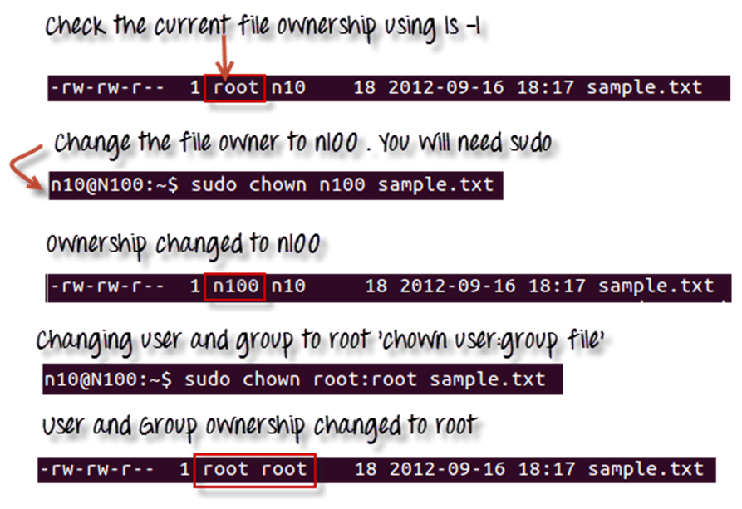
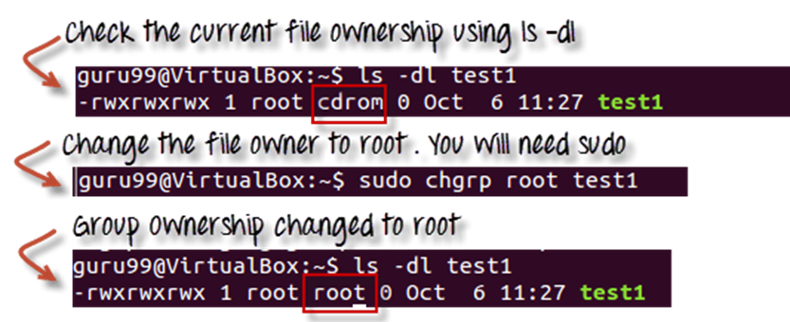
Changing Ownership and Group in Linux
Let’s see this in action:
In case you want to change group-owner only, use the command:
chgrp group_name filename

Slide 23
Write or modify functions related to file management

Slide 24
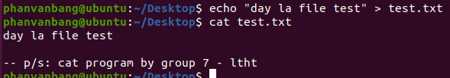
Modify function “cat” in Linux
Our team changed the "cat" command in the Linux system file. After calling the "cat" command, the terminal still displays the contents of the file, but the bottom also writes the words "-- p/s: cat program by group 7 - ltht"

Slide 25
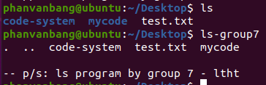
Write function “ls-group7” same as “ls” command
Our team wrote the command "ls-group7" which has the same effect as the command "ls" in the Linux operating system. After calling the command "ls-group7", the terminal still displays files and folders, but the bottom also says "-- p/s: ls program by group 7 - ltht"

Slide 26
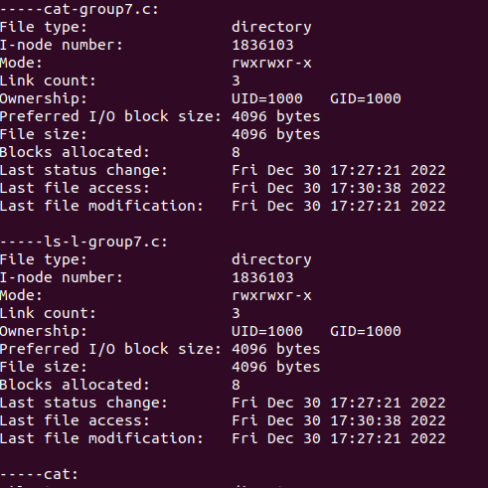
Write function “ls-l-group7” same as “ls -l” command
Our team wrote the command "ls-l-group7" which has the same effect as the command "ls-l" in the Linux operating system. After calling the command "ls-l-group7", the terminal still displays files and folders, but the bottom also says "-- p/s: ls -l program by group 7 - ltht"

Slide 27

Write function “cd-group7” same as “cd” command
Our team wrote the command "cd-group7" which has the same effect as the command "cd" in the Linux operating system. After calling the command "cd-group7", the terminal displays the path after moving in, but the bottom also says "-- p/s: cd program by group 7 - ltht"

Slide 28
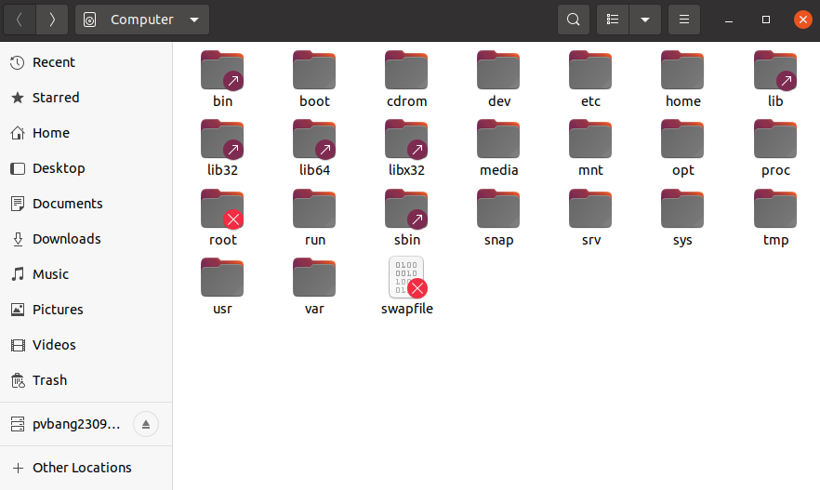
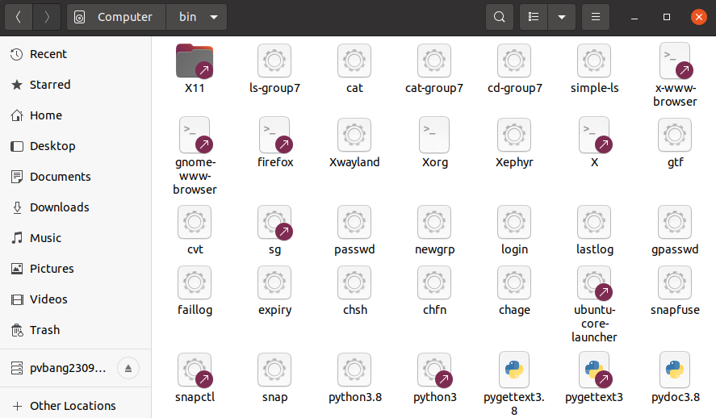
Address of Linux system commands

Slide 29

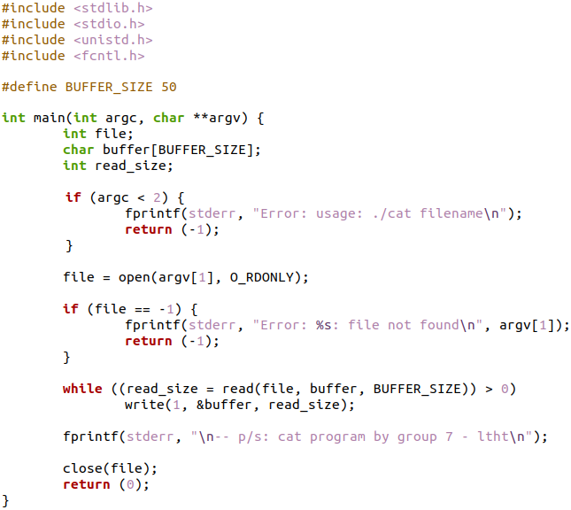
Source code

Slide 30

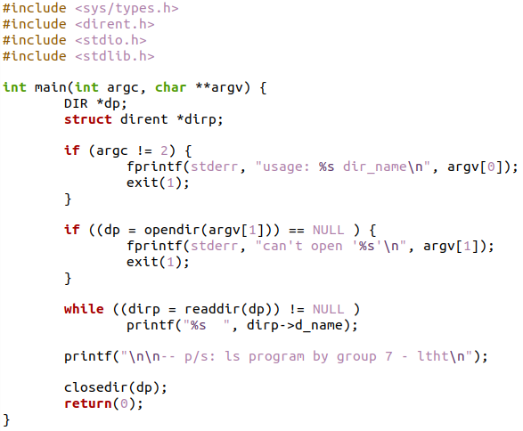
Source code

Slide 31

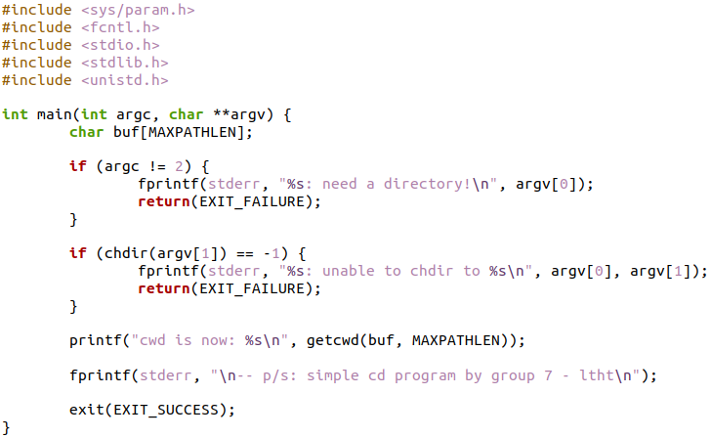
Source code

Slide 32




Thank you

