Slide 1
Nexus
Technical Architecture Documentation
Version 1.1.0 | June 2026 | Nexus

Slide 2
Platform Overview
Nền tảng điều phối đa tác nhân AI (Multi-Agent Orchestration)
Turn-based Pipeline: Think → Discuss → Execute
4-Layer Progressive Memory (L0→L3) + Dreaming Engine
172+ MCP Tools trên 57 modules + Self-Evolution
8+ LLM providers (bất kỳ OpenAI-compatible endpoint)
Circuit breaker + fallback chain → zero-downtime

Slide 3
System Architecture
Frontend: React 19 + TypeScript 5.7 + Vite 6 + Zustand 5 (160+ components)
Backend: Python 3.12+ / FastAPI / SQLAlchemy 2.0 (80,000+ LOC)
Database: PostgreSQL 16 + pgvector + Full-Text Search
Cache: Redis 7+ (Pub/Sub + Response Cache + Message Bus)
Sandbox: Docker + IronClaw (Rust) + OpenClaw (Node.js)
Deploy: Docker Compose (5 services) — 1 lệnh duy nhất

Slide 4
Orchestration Pipeline
NexusExecutionPipeline: Unified entry point
SmartContextAggregator: 7 sources, parallel fetch, scoring
EvolutionAgent: Continuous quality improvement
NexusOrchestrator: Plan, evaluate, quality-based exit
TurnExecutor: Think → Discuss → Execute phases
AgentWorker: Unlimited tool rounds, activity-based timeout

Slide 5
Structured Discussion Protocol
Round 1: Each agent → challenges + supports about peers
Round 2: Challenged agents → rebuttals (defend or accept)
Synthesis: agreed_approaches + unresolved + key_insights
Published to ContextSharing as shared knowledge
Adversarial collaboration improves output quality
Full transparency — debate visible on frontend UI

Slide 6
Memory System (L0→L3)
L0: Raw event capture + message counting
L1: Typed atom extraction (4 types, scored, deduped)
L2: Scene aggregation (cluster atoms → theme blocks)
L3: Persona synthesis (comprehensive profile, versioned)
Recall: Multi-keyword scoring + hybrid strategy
Dreaming Engine: 6-hour consolidation cycles

Slide 7
XSkill Continual Learning
SkillBuilder: Extract reusable task-level workflows
ExperienceManager: Action-level tactical lessons
ExperienceCritique: LLM-as-judge (5 dimensions)
TrajectoryCompressor: Compress logs → SFT training data
TreeSearch: Beam search for optimal skill paths
Trivial Task Gate: Filter noise, learn from substance

Slide 8
LLM Provider Layer
8+ providers: Bedrock, OpenAI, Gemini, OpenRouter, Kilo, Pollinations, g4f, Local
Circuit Breaker: CLOSED → OPEN → HALF_OPEN (per provider)
Smart Routing: Simple → cheap model, Complex → strong model
Fallback Chain: Core → Agent → Kilo → Pollinations → g4f
Per-Model Timeout: Fast (60s) vs Deep-thinking (900s)
Prompt Cache: ~75% cost reduction on repeated prompts

Slide 9
MCP Tools (57 Modules, 172+ Tools)
File & Code: filesystem, file_edit, code_navigation, git (22 tools)
Web & Browser: AI-powered automation, Playwright (15 tools)
Communication: email, telegram, discord, slack, 9 channels (8 tools)
Security: scanning, monitoring, API testing, exploitation (17 tools)
AI & Intelligence: delegate, self_evolve, workflow_tools (18 tools)
Dynamic: Self-Evolution — tự tạo tools không giới hạn tại runtime

Slide 10
Security Architecture (13 Layers)
CommandGuard: Dangerous command detection
SSRF Guard: DNS pinning, private network blocking
Tool Policy + Tool Guard: Per-role authorization
Exfiltration Guard + Secret Redaction: Data leak prevention
Rate Limiter + Session Mutex: Throttling + concurrency
Approval Workflow: Human-in-the-loop for dangerous ops

Slide 11
Cognitive Upgrade (3 Layers)
Layer 1: Self-Awareness — Infrastructure map + bootstrap
Layer 2: Metacognitive Loop — Root cause analysis when stuck
Layer 3: Creative Divergence — 3-frame parallel thinking
Minimalist frame: Simplest possible solution
Unconventional frame: Break every assumption
Reverse frame: Work backwards from perfect end state

Slide 12
Infrastructure & Deployment
Docker Compose: 5 services (nexus, gateway, postgres, redis, openclaw)
PostgreSQL 16 + pgvector: 18 migrations, 25+ tables
Auto-Scaling: CPU-aware workers, dynamic rate limits (60×cores RPM)
Task Checkpoint & Resume: Crash recovery, auto-resume khi restart
Không cần GPU | Không cần API key (free tier chain)
Deploy 1 lệnh: docker compose up -d --build

Slide 13
66 Agent Templates — 8 Lĩnh Vực
Core/Foundational (12): Researcher, Developer, Analyst, Writer...
Security Operations (5): Pentester, Recon, Exploit Developer...
Business & Finance (5): Quant Trader, Economist, Legal Advisor...
Creative & Multimodal (5): Audio Producer, Storyteller...
Intelligence (13): OSINT, Threat Hunter, Forensics, SIGINT, FININT...
STEM, Humanities, Creative Ideation, Life & Everyday...

Slide 14
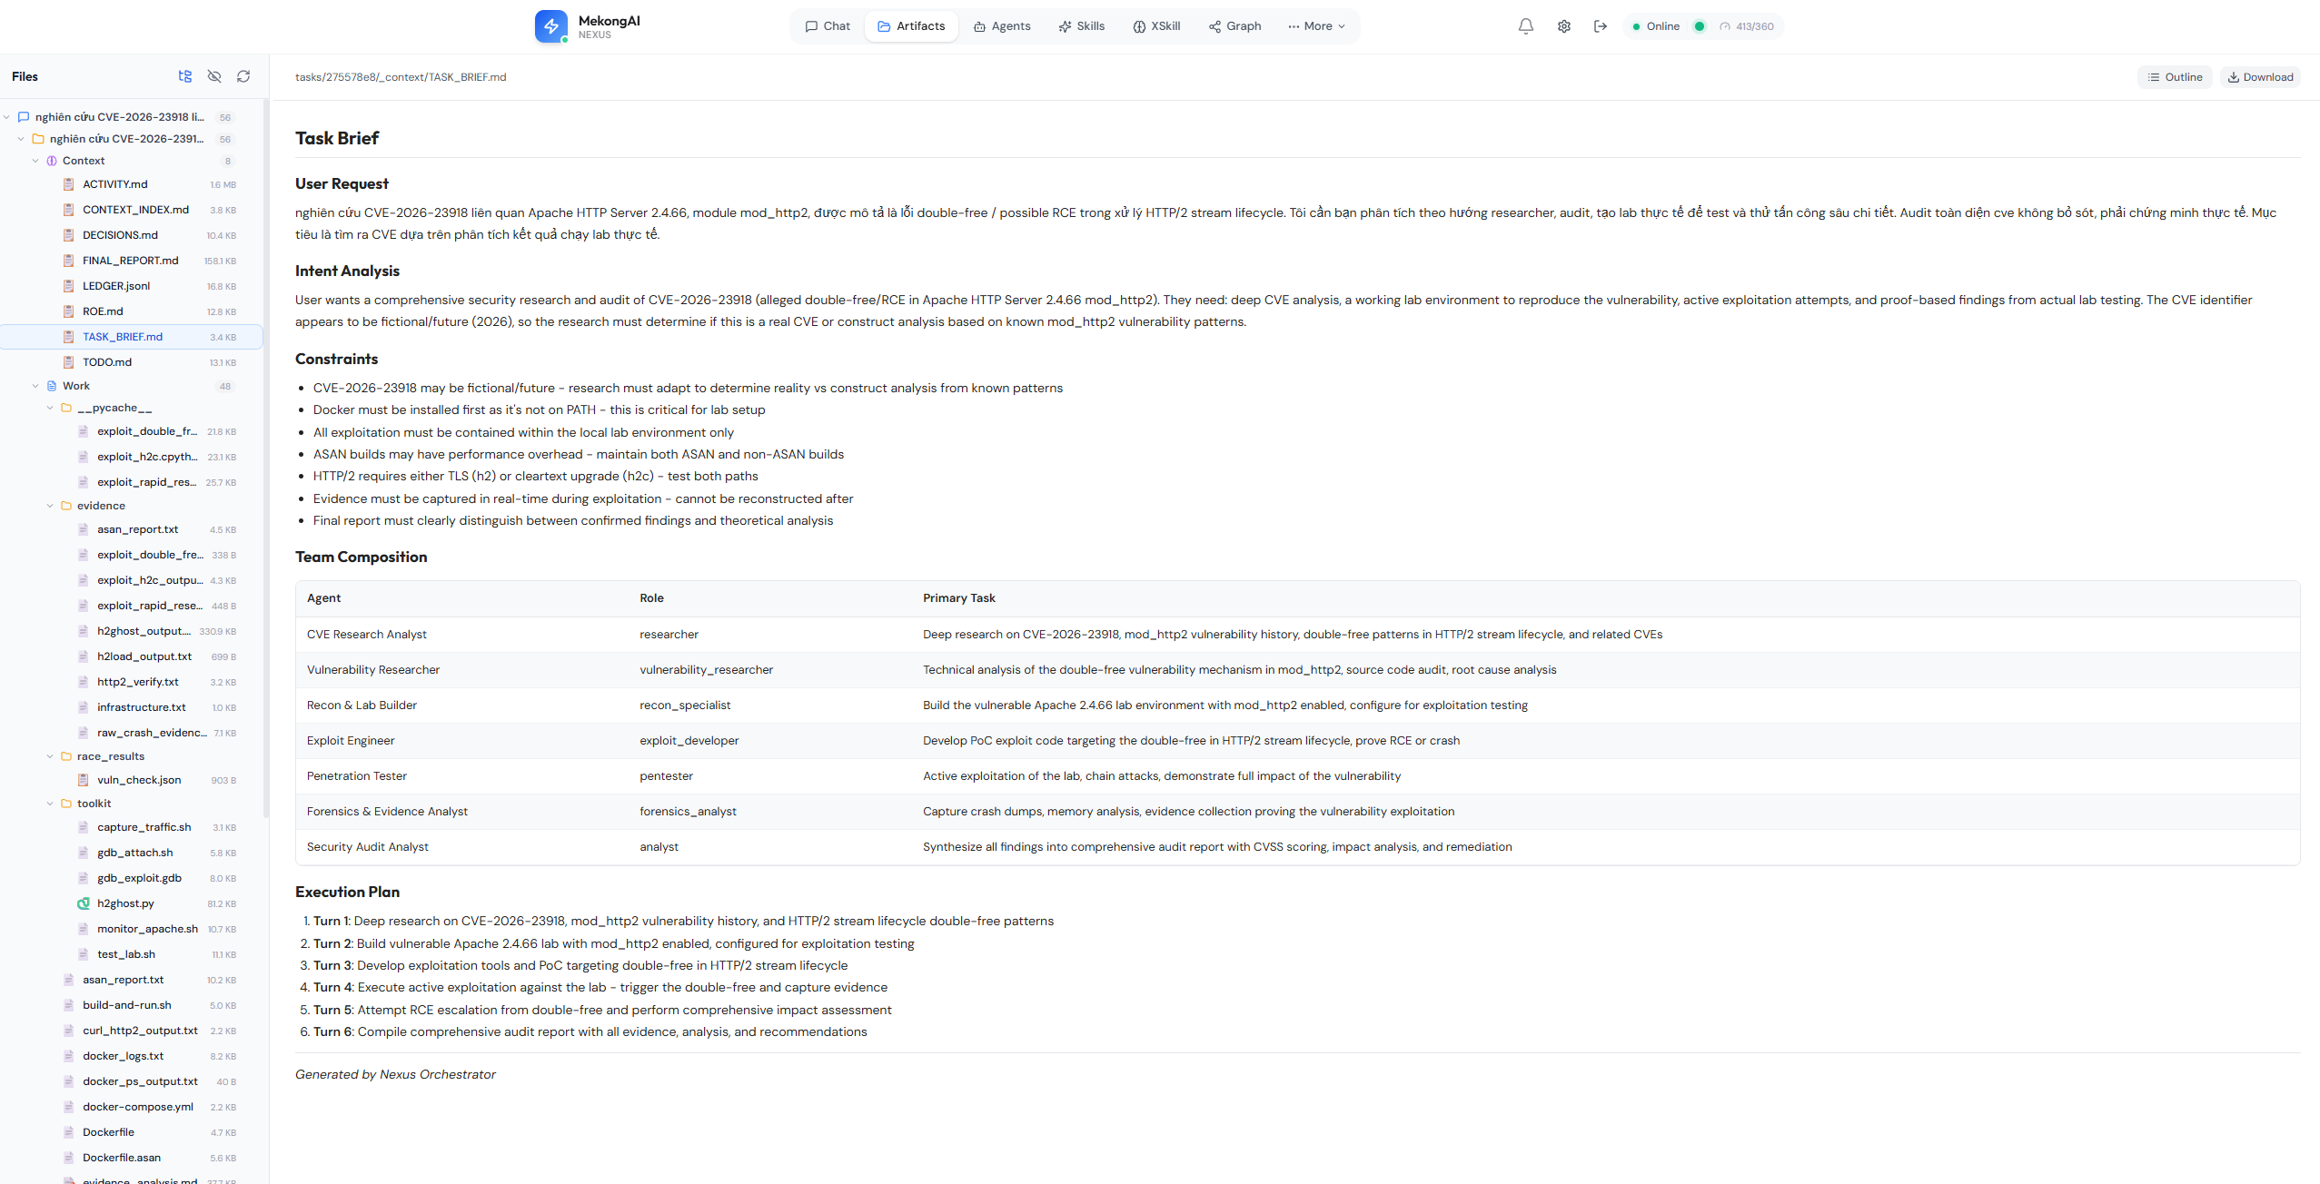
Task Artifacts

Slide 15
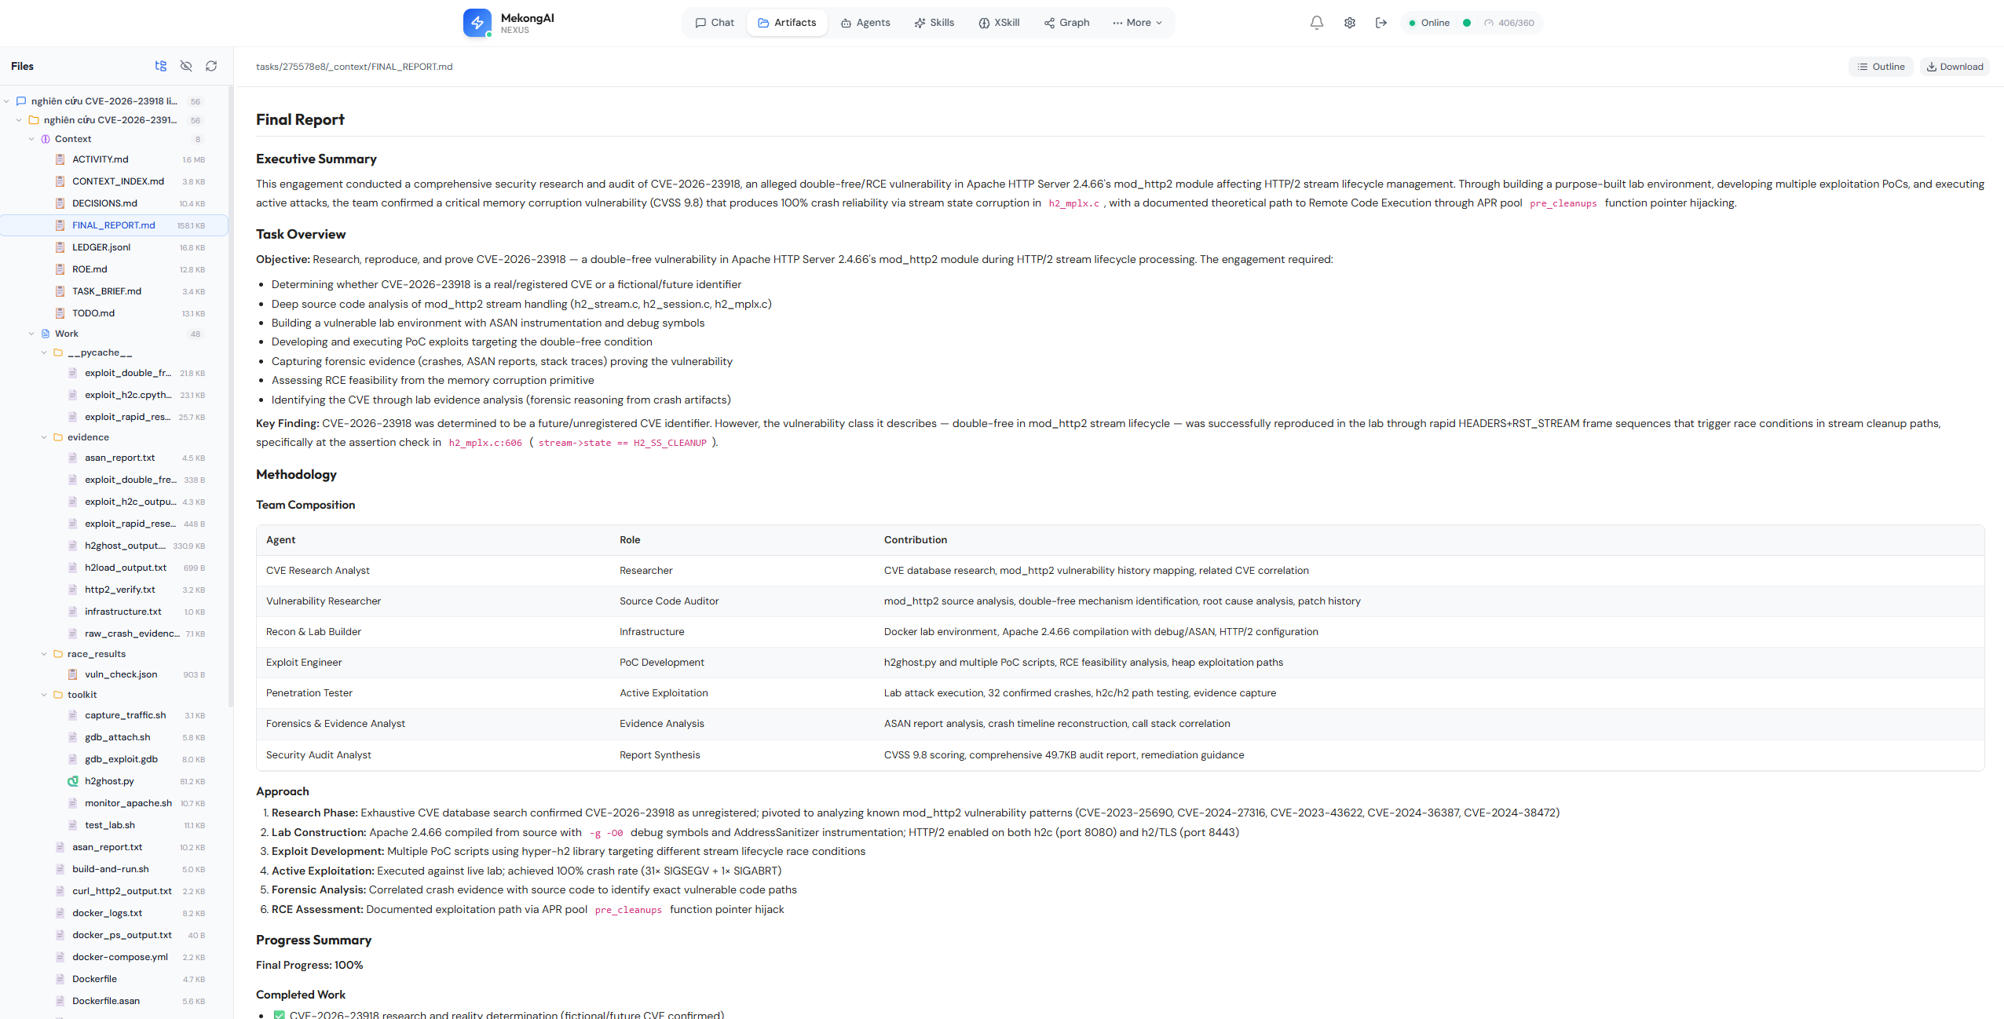
Workspace Structure

Slide 16
Nexus
Multi-Agent Orchestration Platform
github.com/pvbang | Nexus

