Slide 1

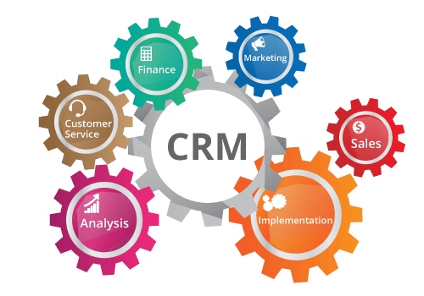
CRM
ANALYSIS
PROJECT

Slide 2

CRM Project Group Members (GROUP 2)
MEET THE TEAM
MR. PRAFUL BHAGWATKAR
MRS. SUVARNA GHOGALLU
MRS. RAMESHAWARI PAWAR
MRS. SHROTIKA GHADAGE
MRS. DIKSHA SUKALKAR
MRS. PURVI SOMVANSHI

Slide 3

DATA AT A GLANCE
Domain : CRM
Project Name: CRM ANALAYSIS PROJECT
Dataset Name: CRM Data
Dataset Type: CSV and Excel Files

Slide 4
CHALLENGES FACED
Data Integration: Integrating data from various sources can be complex. So Maintaining data quality and ensuring that data is synchronized across the platform is a significant challenge.
We have faced the issue during importing an entire data in MySQL
Similarly we have faced the hurdle of importing years (dates) in tableau. So, we have converted the string into a date format.

Slide 5
Report Analytics & Dashboard
OPPORTUNITY KPI’S
Expected Amount
Active Opportunities
Conversion Rate
Win Rate
Loss
Trend Analysis
Running Total Expected Vs Commit Forecast Amount over Time
Running Total Active Vs Total Opportunities over Time
Closed Won Vs Total Opportunities over Time
Closed Won vs Total Closed over Time
Expected Amount by Opportunity Type
Opportunities by Industry

Slide 6

Report Analytics & Dashboard
LEAD KPI’S
Total Lead
Expected Amount from Converted Leads
Conversion Rate
Converted Accounts
Converted Opportunities
Lead By Source
Lead By industry

Slide 7
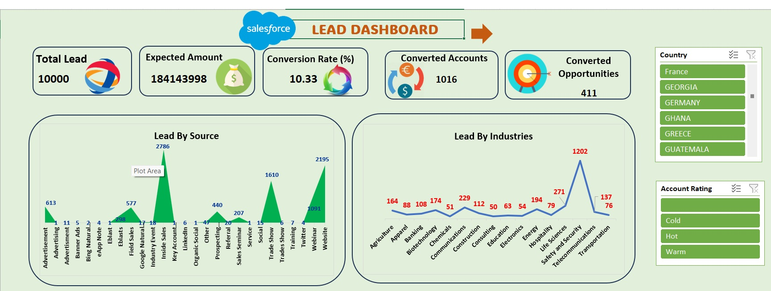
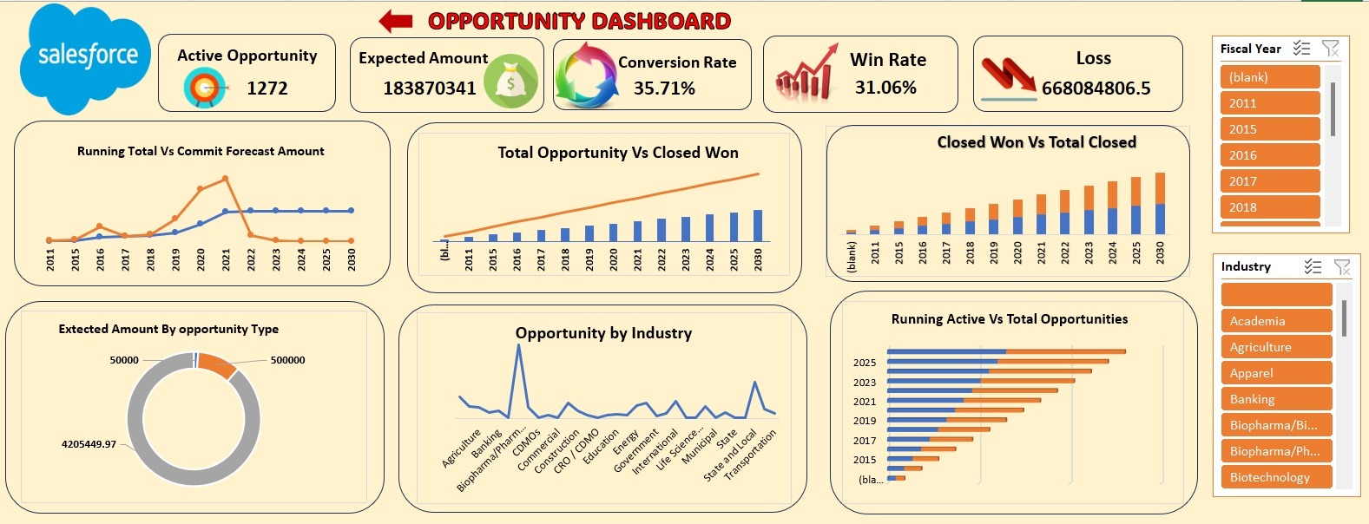
EXCEL LEAD & OPPORTUNITY DASHBOARD

Slide 8
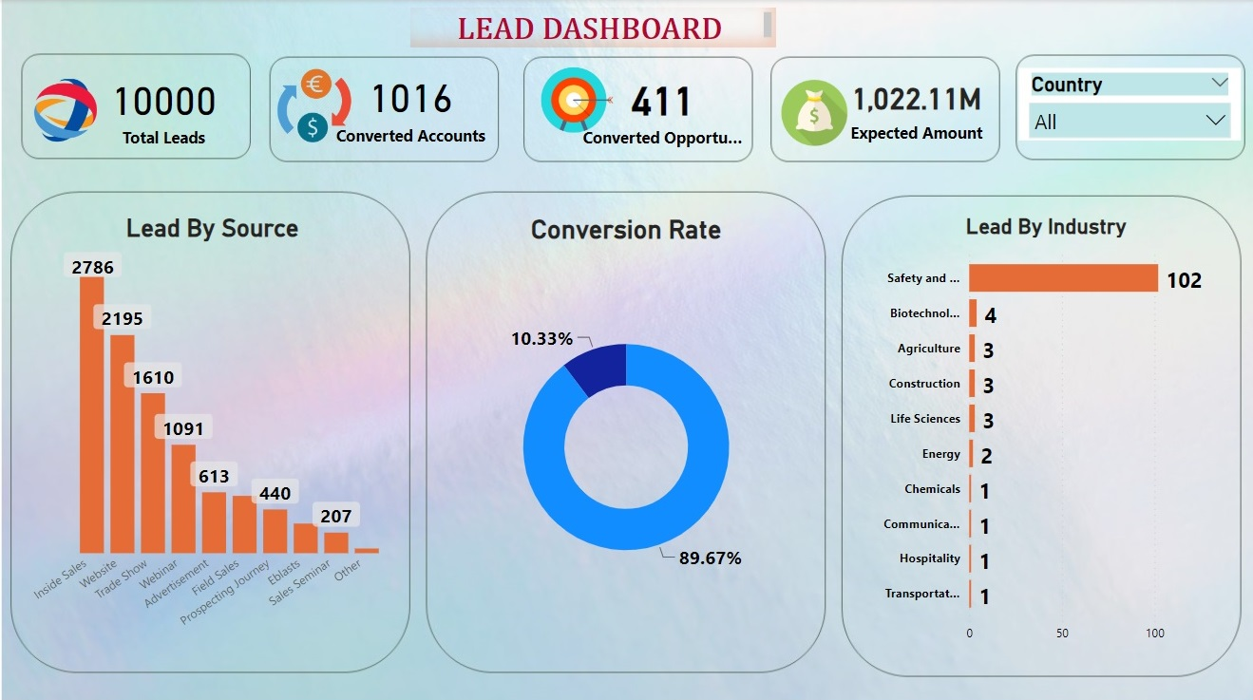
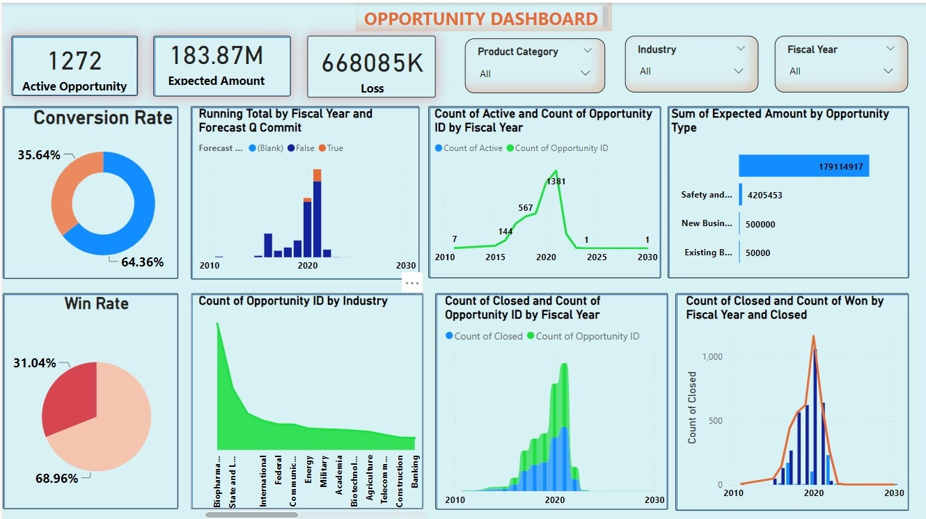
POWER BI LEAD & OPPORTUNITY DASHBOARD

Slide 9
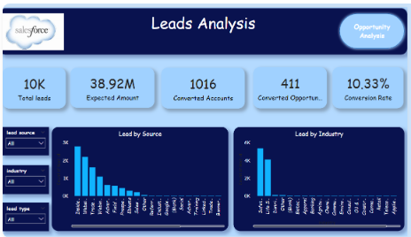
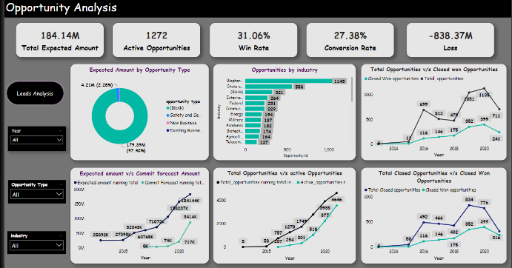
TABLEAU LEAD & OPPORTUNITY DASHBOARD

Slide 10
SUGGESTION
Improve customer Satisfaction- CRM helps in customer satisfaction as the satisfied customers remain loyal to the business and spread good word-of-mouth. This can be accomplished by raising customer engagement via social networking sites, surveys, interactive blogs, and various mobile platforms.
Expand the customer Base – CRM not only manages the existing customers but also creates knowledge for prospective customers who are yet to convert. It helps creating and managing a huge customer base that raise profits continuity, even for a seasonal business.
Enhance Business Sales – CRM methods can be used to close more deals, increase sales, improve forecast accuracy, and suggestion selling. CRM helps to create new sales opportunities and thus helps in increasing business revenue.

Slide 11





Conclusion
By intelligently storing and managing the customers' information, a CRM system increases the number of leads coming in, helping our marketing team find new customers faster. It supports our sales teams in closing more deals faster.
Improve employee engagement by reducing workload: Having customer data consolidated using CRM tools also means employees will have an easier time getting to the information they need regarding specific customers, so they can be more productive in related work tasks.
Address workload issues: Ensure employees have manageable workloads by regularly monitoring and adjusting workloads to prevent burnout and overwhelm.
The project has provided valuable insights into lead sources, industry trends, and opportunity performance.
The CRM project has demonstrated the value of CRM software in increasing business sales through analysis and data-driven decision-making. It has not only streamlined lead and opportunity management but also provided a foundation for continuous improvement and growth.

Slide 12


